Slide 1
DELAC LCAP Annual Update
April 26, 2018
5:30 – 7:30 p.m.
Serna Center Community Rooms
Cathy Morrison, LCAP/SPSA Coordinator
cathy-Morrison@scusd.edu

Slide 2
Local Control & Accountability Plan Goals

Slide 3
Background
The district is expected to produce an update to the LCAP on an annual basis (Education Code 52061)
Review LCAP goals
Review progress toward goals
List and describe expenditures implementing the actions
The district should reflect, and consider necessary changes to be taken as a result of the review

Slide 4
“Equal Treatment for Children in Unequal Situations is Not Justice.” – Gov. Brown
Equity

Slide 5
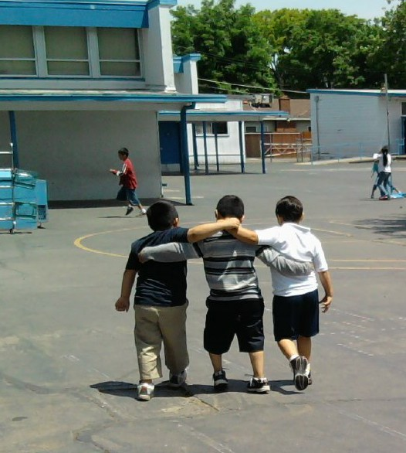
Local Control
District decision-making is flexible

Slide 6
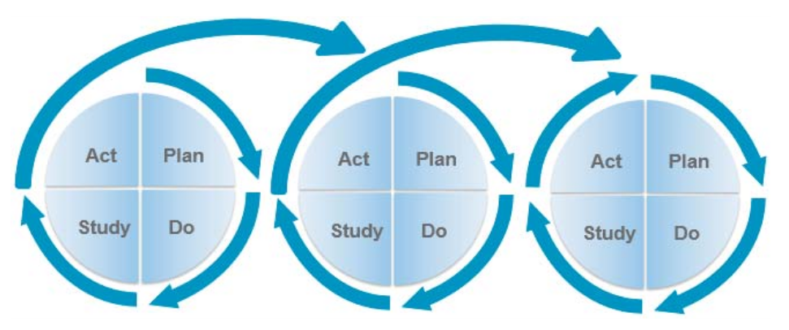
Continuous Improvement
Doesn’t start and stop
Requires commitment from everyone to continually assess, plan, act, and learn from one’s actions

Slide 7
Local Control Funding Formula (LCFF)
California’s funds for districts and schools
LCFF is not restricted, but LCFF funds are targeted
Are the funds “principally directed toward, and effective in” meeting goals for low income, English learner, and foster youth?

Slide 8
LCFF Fidelity Indicators
To ensure the appropriate use of LCFF funds, two indicators are being developed:
Percentage of LCFF resources used to fund services to English learner, foster youth, and low income students
Percentage of LCFF resources used to fund other district services

Slide 9
LCFF Fidelity Indicator Tracking
Beginning in the 2018-19 fiscal year, the district will add budget codes to report on the new indicators:
Resource 0007: Low Income
Resource 0009: English Learners
Resource 0011: Foster Youth

Slide 10
Understanding LCAP Metrics
California requires districts to measure progress in the LCAP
On the next slides, we will compare selected metrics:
Baseline (starting place)
Target (the goal)
Actual

Slide 11
LCAP Goal 1 – College/Career Ready
Selected Metrics:
Teachers appropriately assigned and credentialed Targets: 97% credentialed correctly Misassignment rate less than 1% | Baseline 2016: 95% credentialed correctly; 1.2% misassigned 2017: 94.8% 1.2% teaching outside of subject area; 4 misassignments in classes of EL students (previously not reported)
Academic Achievement on CAASPP ELA (Grades 3-8) Target: Increase to -21.4 | Average Distance from 3/Met: Baseline 2016: -28.4 2017: All students -31.4
Academic Achievement on CAASPP Math (Grades 3-8) Target: Increase to -40.4 | Average Distance from 3/Met: Baseline 2016: -45.4 2017: All students -46.3

Slide 12
LCAP Goal 1 – College/Career Ready
Selected Metrics:
A-G Completion Target: 44.0% | Baseline 43.0% Class of 2016 43.9%
11th Grade College Readiness (Exceeded on CAASPP ELA) Target: 21% | Percent Exceeded/Level 4 Baseline 19.0% 2017: All students 22.6%
11th Grade College Readiness (Exceeded on CAASPP ELA) Target: 9% | Percent Exceeded/Level 4 Baseline 8.0% 2017: All students – 9.1%
Reclassification Rate Target: 12.7% | Reclassification Rate Baseline 11.2% 2017-18: 12.3%

Slide 13
LCAP Goal 2 – Student Engagement
Selected Metrics:
Attendance Target: 95.5% | Midyear attendance rate: Baseline 2017: 95.3% 2018: 95.2%
Chronic Absence Target: 9.4% | Midyear chronic absence rate: Baseline 2017: 11.9% 2018: 10.4%
Graduation rate Target: 83.9% | Graduation rate: Baseline Class of 2016: 81.4% Class of 2017: Not available yet
Suspension rate: Target: 2.5% | Midyear suspension rate: Baseline 2017: 6.3% 2018: Not available yet

Slide 14
LCAP Goal 3 – Family Empowerment
Selected Metrics:
School Site Council (SSC) Training Target: 38 schools | Number of SSCs receiving training Baseline 2017: 17 schools 2018 midyear: 10 schools
DELAC attendance Target: 65% of schools with an ELAC send a representative to DELAC | Schools with an ELAC sending a rep to DELAC Baseline 2017: 54% 2018 midyear: 41%
Parent-Teacher Home Visits Target: 5,000 annually | Baseline 2017: 3,791 home visits Midyear 2018: 1,200 home visits
Parent Leadership Pathway participation: Target: 2,500 annually Target EL participation: 75% | Baseline participation 2017: 2,500 67.1% non-English speakers Midyear 2018: 2,872 Non-English speakers: 58.2%

Slide 15
LCAP Goal 4 – Operational Excellence
Selected Metrics:
Data Dashboard usage Target: Increase page views by 10% annually | Dashboard page views Baseline 2017: 3,226 page views Midyear 2018: 1,340 page views
Maintain on-time submission to CalPADS and Civil Rights Data Collection Target: maintain on-time status | Baseline 2016-17: On time submission 2017-18: On time submission is maintained
Infinite Campus usage: increase number of families with accounts Target: Increase accounts by 10% annually | Baseline 2016-17: 5,761 accounts Midyear 2018: 5,398 accounts
Develop customer service measurement tool | In progress

Slide 17
Local Control & Accountability Plan Goals

Slide 18
Estimated Actual Expenditures
In the Annual Update, we must explain “material differences” between what was budgeted and what has been spent
LCAP spending is shown in two different views:
Planned vs. Actual by LCAP goal
Planned vs. Actual by LCAP goal and Funding Source
All Goals
Goal 1
Goal 2
Goal 3
Goal 4

Slide 19
2017-18 LCAP Expenditure Summary
LCAP Goal | Planned | Estimated Actual
College, Career, and Life-Ready Graduates (Goal 1) | $353,723,669 | $352,893,335
Safe, Emotionally Healthy and Engaged Students (Goal 2) | $42,559,371 | $43,170,014
Family and Community Empowerment (Goal 3) | $2,568,880 | $2,642,091
Operational Excellence (First Year Included) (Goal 4) | $211,280 | $384,985
TOTALS | $399,063,230 | $399,090,425

Slide 20
2017-18 LCAP GOAL 1
College/Career | Planned | Estimated Actual
Base (General) Funds | $277,902,426 | $278,073,353
Supplemental/Concentration | $52,097,628 | $52,445,983
Title I, II, III | $5,417,681 | $4,024,166
Grant/Other | $18,305,964 | $18,349,833
TOTALS | $353,723,699 | $352,893,335

Slide 21
2017-18 LCAP GOAL 2
Student Engagement | Planned | Estimated Actual
Base (General) Funds | $21,582,061 | $21,648,864
Supplemental/Concentration | $8,741,096 | $8,175,256
Title I | $1,722,555 | $1,553,674
Grant/Other | $10,513,659 | $11,792,220
TOTALS | $42,559,371 | $43,170,014

Slide 22
2017-18 LCAP GOAL 3
Family & Community Empowerment | Planned | Estimated Actual
Base (General) Funds | $179,683 | $179,683
Supplemental/Concentration | $1,830,113 | $1,830,113
Title I | $559,084 | $632,295
TOTALS | $2,568,880 | $2,642,091

Slide 23
2017-18 LCAP GOAL 4
Operational Excellence | Planned | Estimated Actual
Base (General) Funds | $211,280 | $155,380
Title I* | 0 | $229,605
TOTALS | $211,280 | $384,985
*Note: This is the first time Goal 4 was included in the LCAP. The Planned Title I expenditure for Illuminate Education (assessment system) was not originally included in the 2017-18 LCAP; for complete information it is provided here.

