Slide 1


2014 California Assessment of Student Performance and Progress (CAASPP)
Pre-Test Workshop for Paper-Pencil Tests
Elementary, k-8, middle schools
February 24-27, 2014
Presenter: Melody Hartman

Slide 2
Objectives
Site CAASPP coordinators will:
Follow current procedures properly.
Ensure all materials are handled securely and appropriately.
Train site examiners to conduct testing consistently.

Slide 3
Agenda
New for 2014
Site CAASPP Coordinator responsibilities
NEW Accessibility Support Request Form
Multiple-choice tests
California Standards Tests (CSTs) for Science
California Modified Assessment (CMA) for Science
Standards-based Tests in Spanish (STS) for RLA
California Alternate Performance Assessment (CAPA)
After testing

Slide 4
New for 2014
Most paper testing has been eliminated, except:
  Grade-level science tests (CST, CMA, CAPA)
    Grades 5, 8
    CAPA ELA and Math
    Grades 2-8
  STS RLA – Bilingual, Immersion grades 2-6
Changes in terminology and titles
  STAR Coordinator is now CAASPP Coordinator
Revised Security Agreement and Affidavit
Universal Tools, Designated Supports, and Accommodations
  Accessibility Support Request Form

Slide 5
Site CAASPP Coordinator Responsibilities
#1 Responsibility—Security
  No unauthorized electronic devices used in classroom during testing
    For testing purposes, any electronic device that is not specifically designated in the student’s IEP or Section 504 plan is unauthorized.
  Security audits to occur (They always pick us)

Slide 6
Security Audits
At randomly selected schools and LEA offices
Before, during, or after testing
Are materials secure, accounted for, and
locked up when not in use?
Are correct administrative procedures being followed? For example:
  Instructional materials have been removed or covered.
  Students are not being coached through the exams.
  Only appropriate Universal Tools, Designated Supports, and Accommodations are being provided.
  No unauthorized electronic devices are being used.

Slide 7
CAASPP Coordinators’ Responsibilities
#2 Responsibility—Train your Examiners
  New and updated videos
  Room sign with reminder of no electronic devices
    To be posted in clear view of students
    Included in coordinator kit
    Available on californiatac.org
    Can be photocopied
Notes:
Make sure your teachers’ walk around and are observant of what students are doing, especially those finished

Slide 8
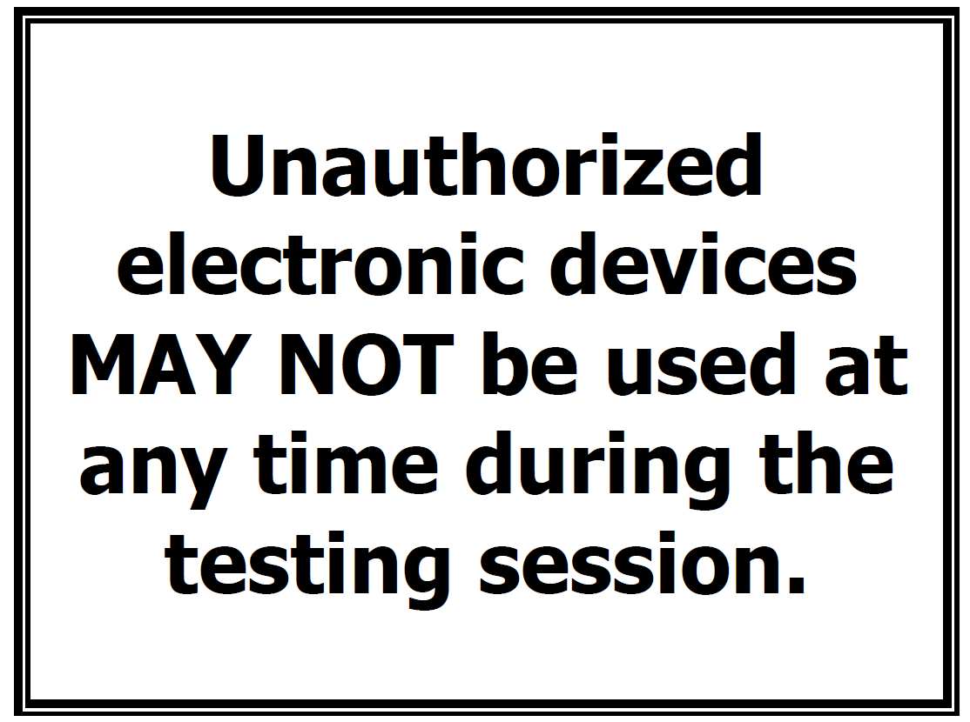

Slide 9
Other CAASPP Coordinator Responsibilities
Receive, count, store, distribute, track, collect, count and return materials.
Coordinate testing schedule.
Coordinate collection of demographic data.
  Pre-ID
  Or hand-mark answer documents if no late pre-id
Assist your Examiners
NEW Complete Accessibility Support Request Form, as necessary

Slide 10
Accessibility Support Request Form
New for 2014
Request new universal tool, designated support, or accommodation that is not yet listed as approved
Approved tools/supports/accommodations will be added to list
Request form will be online and available on the CDE Web site

Slide 11
Site Coordinator Responsibilities
Train examiners
Ensure examiners READ and sign security affidavits that you retain at the school site
Prevent errors
Secure test materials
Verify materials are marked correctly to ensure correct student scores
Guarantee correct enrollment counts
Complete Accessibility Support Request Form, as necessary
Return materials promptly to AR&E

Slide 12
Site Coordinators: Train Examiners
READ and sign security affidavits.
Emphasize NO unauthorized electronic devices.
MAKE SURE CORRECT TESTS ARE GIVEN.
Students who are not testing may not stay in the classroom where a test is being administered.
If students need to be taken to another room to finish testing, BE SURE THEY ARE ESCORTED BY LEA STAFF. Do not allow students to walk to another room with test materials by themselves.

Slide 13
Site Coordinators: Train Examiners (cont.)
Examiners CANNOT:
  Review test questions before, during, or after testing.
  Check students’ answers including (but not limited to):
    Advising students of wrong answer or to check an answer; or
    Withholding answer docs until students demonstrate they have the right answers.
    CANNOT erase bubble markings on students’ tests.

Slide 14
Site Coordinators: Train Examiners (cont.)
Examiners shall monitor students throughout testing to make sure students are:
  On correct part
  Not going on to other parts or back to a previously completed part
  Not skipping a question on their answer document (so that they are off by one or more)
  Not using unauthorized electronic devices during the testing session
  Examiners must ensure there is enough time to complete a part before beginning the part.

Slide 15
Before Multiple-choice Testing
Receive boxes:
  Before signing receipt, check number of boxes.
Prepare answer documents:
  Use only the 2014 scorable answer documents received in the shipment from the testing contractor.
  NON PUBLICS - Ensure correct NPS code.

Slide 16
Before Multiple-choice Testing (cont.)
Confirm which test(s) each student takes.
Confirm any Universal Tools, Designated Supports, and Accommodations students will use and where they will be tested.
Prepare materials:
  Test booklets
  No. 2 pencils
  Signs

Slide 17
Before Multiple-choice Testing (cont.)
Plan your testing schedule
SBAC Field Test = 3.5 hours
  25 questions ELA and Math + Performance Task
CST Science = 2 parts = 2 hours total
  66 questions
CMA Science = 3 parts = 2.5 hours total
  66 questions
  CMA Science = 3 parts = 2.5 hours total
CAPA
    ELA 12 questions = 45 minutes
    Math 12 questions = 45 minutes
    Science 12 questions = 45 minutes (5th, 8th & 10th)

Slide 18
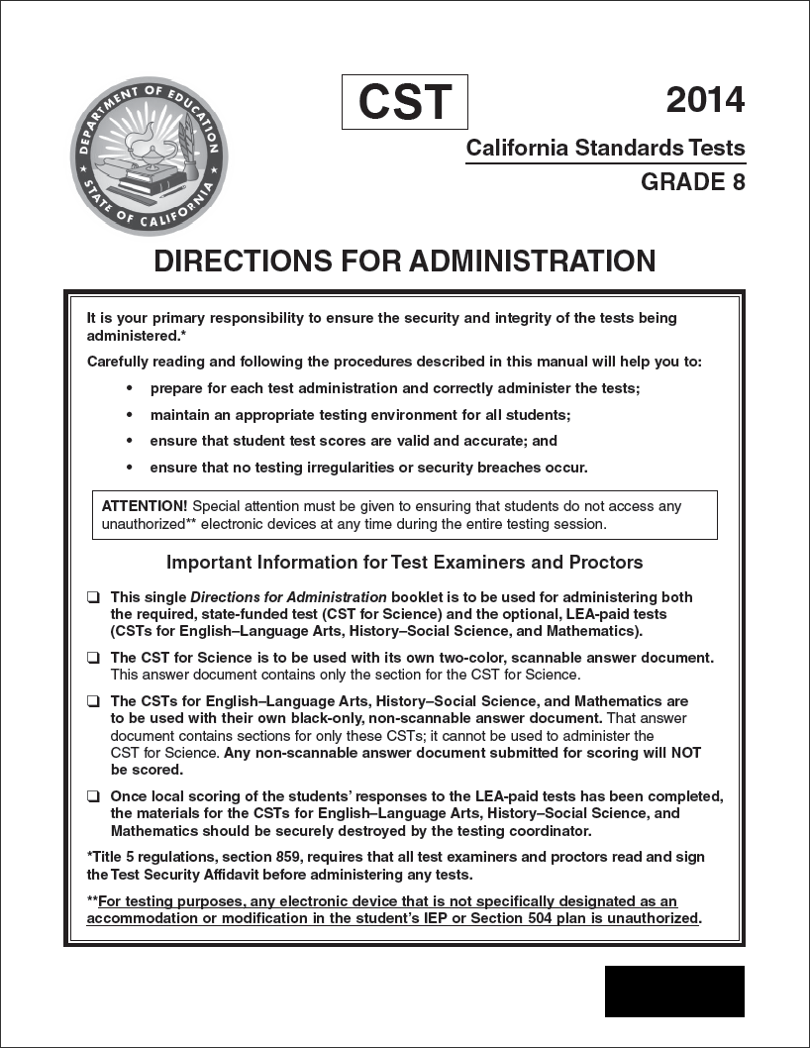
During Multiple-choice Testing
Use Directions for Administration
(DFAs) correctly.
  Read ALL “SAY” boxes
  exactly as written.
  Be sure to read and complete
  “First Day of Testing” section
  with students.
  ONLY translate boxes
  with “T” (NO CST/CMA/STS
  questions, prompts, or
  passages may be translated).

Slide 19
During Multiple-choice Testing (cont.)
Check names on test booklets and answer documents before distributing to make sure students receive correct documents.

Slide 20

During: Answer Documents (cont.)
Avoid teaching students to mark through answer circles to eliminate answers. Such marks MAY NOT be erased by adults

Slide 21
During Multiple-choice Testing (cont.)
Monitor for use of unauthorized electronic devices.
Make sure students are taking the correct test and marking answers in the correct section of the answer document.
Ensure students complete all parts of each test.

Slide 22

During Multiple-choice Testing (cont.)
Breaks
  Give breaks only at end of a part as indicated by stop sign.
  Individual students may use restroom during test:
    Collect materials
    Monitor student
  Some students may be allowed supervised breaks (IEP, 504, ELs)
  See DFA for more information on breaks.

Slide 23
California Standards Tests (CSTs) for Science and EAP
CST for Science in grades 5 and 8
Take unless IEP designates CMA or CAPA

Slide 24
California Modified Assessment (CMA) for Science
Student must have an IEP that designates that he/she takes the CMA for Science.
Examiners should check the student’s IEP to see whether the student should take the CMA instead of CST.
CMA for Science in grades 5 and 8

Slide 25
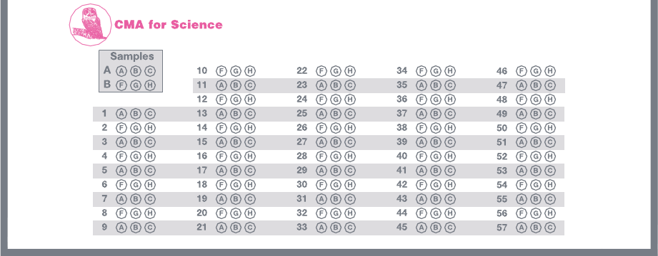
CST/CMA Combined Answer Document for Grade 5
Right side of inside of grade 5 answer document
CMA section has:
Different subject icon from CST
Alternate row shading for the response bubbles
Three options
Fewer number of questions

Slide 26
Standards-based Tests in Spanish (STS)
STS for Reading/Language Arts (RLA) is optional for Spanish-speaking English learners (ELs), grades 2–6.
  Receive instruction in Spanish regardless of the length of time they have been.
Students taking the STS must also take CSTs or the CMA for Science.
Students who take CAPA do NOT take STS.

Slide 27
California Alternate Performance Assessment (CAPA)
Performance-based, one-on-one test
For students with significant cognitive disabilities unable to take the CSTs even with Universal Tools, Designated Supports, and Accommodations
Student must have an IEP
IEP specifies CAPA and level
Do not take STS

Slide 28
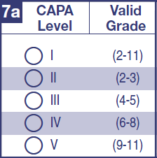
CAPA Answer Document
Use only 2014 answer document.
Ensure correct CAPA Level is marked in 7a.
Only Level I can have “5” as a score. The highest possible score for Levels II through IV is “4.”

Slide 29
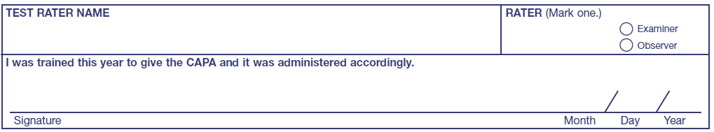
CAPA Observers
Districts must double-rate a minimum of ten percent (10%) of the CAPA students per level, per site (including NPS).
Students to be double-rated are randomly selected.
Observers must mark Observer and BOTH examiners and observers must sign their separate answer documents.

Slide 30
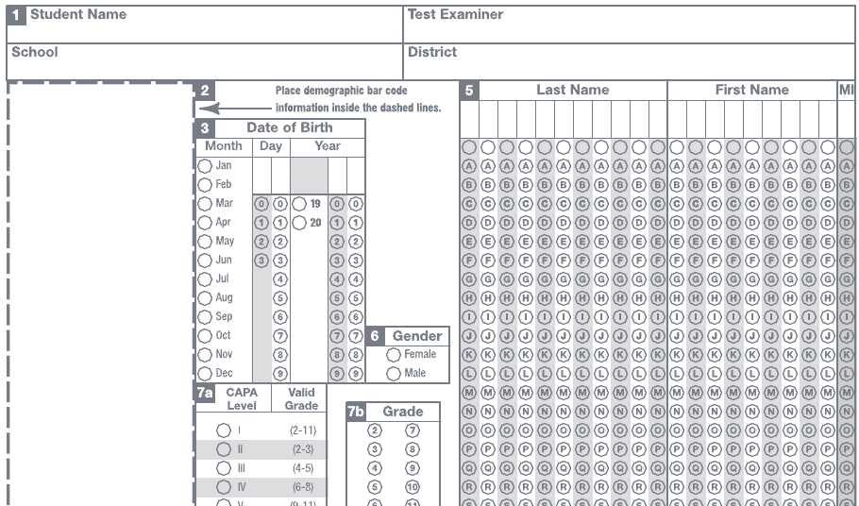
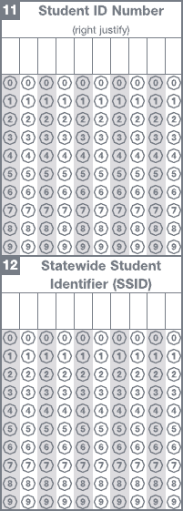
Preparing to Administer the CAPA Observer’s Answer Document
Use blank from overage.
Observers must mark sections.
1 – Name, etc.
3 – Date of Birth
5 – Name
6 – Gender
7a – CAPA Level
7b – Grade
11 – Student ID
12a – SSID

Slide 31
After Testing
Paperwork
  Complete back of answer document.
  Transcribe voided answer documents.
  Complete SGID.
  Complete Master File Sheet.
Pack: scorables vs. nonscorables
  Attach correct shipping labels.

Slide 32

After Testing: Answer Documents
Train examiners to:
  Erase NOTHING in answer circles

Slide 33
After Testing: Complete Back of Answer Documents
A1 DO NOT complete without CDE notification
A2 Special Conditions
A3 Accommodations and Modifications
  Part a: mark “IEP” and/or “Section 504 plan” to indicate which program/plan student has, whether used Universal Tools, Designated Supports, and Accommodations or not.
    Note: IEP is required to take CMA, CAPA.
  Part b, mark codes for all Universal Tools, Designated Supports, and Accommodations student used as specified in IEP and/or 504 plan.

Slide 34
After Testing: Complete Back of Answer Documents (cont.)
  Part b, mark codes for all Universal Tools, Designated Supports, and Accommodations student used as specified in IEP and/or 504 plan.
A4 English Learner Test Variations
  For each test, what was actually used

Slide 35
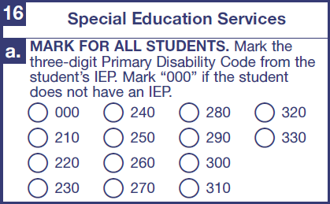
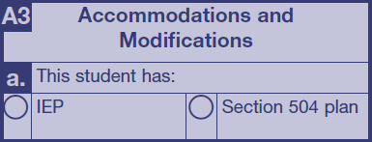
16a—Disability Code
If not in Pre-ID, mark after testing.
For CST and STS:
  Mark “000” if no IEP; or
  Disability Code from IEP.
For CMA and CAPA:
  Disability code is REQUIRED.
  “000” not valid for CMA or CAPA.
  Also, be sure to mark the “IEP” or “504 Plan” circle in section A3a even if the student does not use any accommodations or modifications.

Slide 36
CAUTION
If no disability is marked, but CMA answer circles have marks or CAPA answer document is completed:
  Disability defaults to “unknown.”
  Must be corrected in CALPADS or not counted as participating in API/AYP.

Slide 37
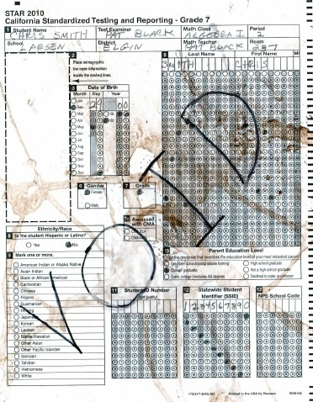
After Testing
Transcribe
  Braille and large print (or not processed)
    In Section A3 on the back of the answer document mark “G” or “H.”
  Damaged answer documents
    Write VOID on
    front of answer document(s)
    and return with nonscorables.

Slide 38
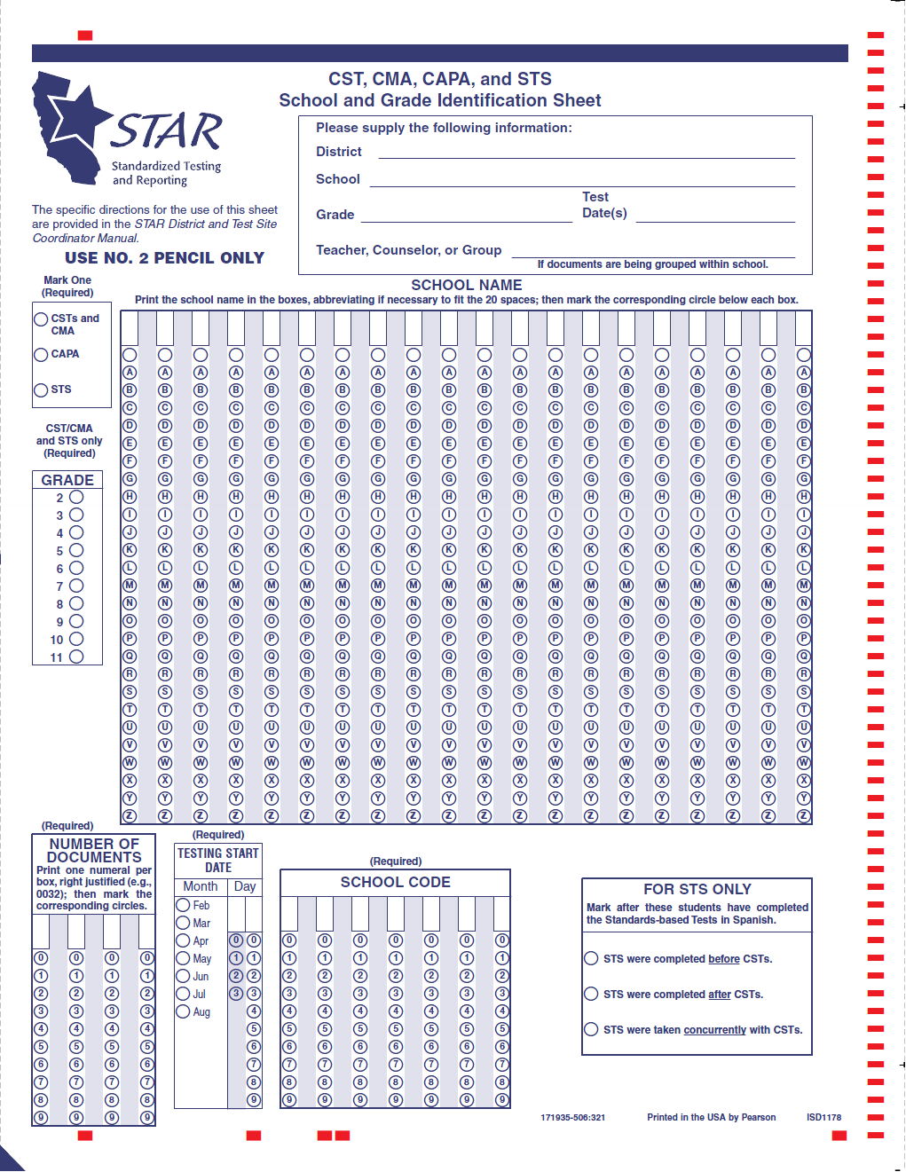
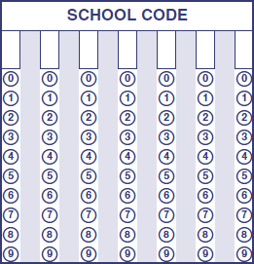
School and Grade Identification Sheet (SGID)
Complete for each set of answer documents or test booklets.
Check counts to be accurate; include docs of students not tested with reason why in A2.
Place on answer documents for correct:
  Grade
  School
  Processing stops
  if not correct.
Notes:
School code must be entered, not pre-printed.

Slide 39
SGID (cont.)
Make sure the REQUIRED fields are completed to ensure accurate processing.
  Test
  Grade
    Mark only one
    For CST/CMA, STS only
  Number of documents
  Test start date = first day of testing within window
    Used by CDE accountability office
  School code
    NOT pre-slugged
    For home/hospital or independent study, enter 7-digit district code

Slide 40
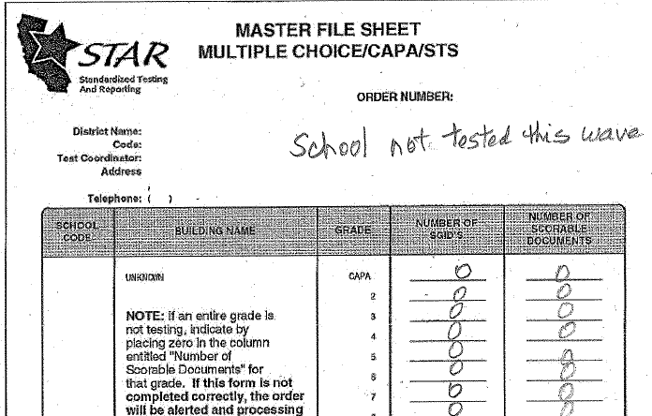
After Testing Master File Sheets
Return for each school and LEA.
Check counts of answer docs and SGIDs to make sure they are accurate.
Required with scorables if materials were ordered:
  Write “0” (zero), no
  blanks, for each item
  ordered.
  If not tested, note that
  school did not test.

Slide 41
Home/Hospital/Independent Study
On answer document, A3, mark as accommodation “M” if home/hospital.
On SGID, enter correct home hospital/independent study school code = same as 7-digit county district code.
If test booklets/answer documents ordered, but those with that school code did not test, must return Master File Sheet with zeros next to each unused, ordered item.

Slide 42
Nonpublic School Answer Documents
Put on answer doc each NPS unique school code.
Put under SGID with 0000001 school code.
Return with LEA materials.

Slide 43
After Testing: Which Answer Documents to Return
An answer document must be returned for students enrolled on the first day of testing and designated to take one of the following tests (even if not tested):
  CST for Science (grades 5, 8)
  CMA for Science (grades 5, 8)
  CAPA (any level)
Return answer documents for students with special conditions identified in Section A2.
Must return STS answer document only if test taken

Slide 44
After Testing: What to Return
Must return all CAPA Examiner’s Manuals with nonscorables
Must return all test booklets. If only cover or part returned, considered a security breach.

Slide 45
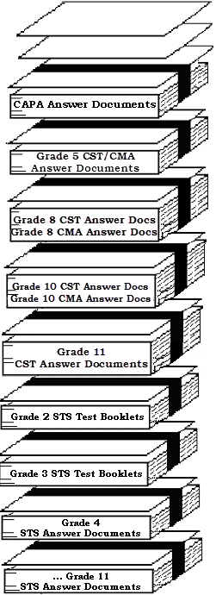
After Testing: Pack and Return
Return all documents within an administration in same shipment.
Separate scorables (with SGID) from
nonscorables: make sure grade on answer
documents matches grade on SGID.

