Slide 1
SCUSD Title IX Training for Student-Related Complaints and Investigations
November 2, 2021
November 9, 2021
November 17, 2021
3:30pm-4:30pm

Slide 2
Title IX Contacts
Student Hearing and Placement Department
  Stephan Brown (Title IX Coordinator)
  Jessica Wharton (Lead Investigator)
Legal Services Department
  Raoul Bozio (In-House Counsel)
  Alexa Hankard (Legal Analyst I)

Slide 3
What is Title IX?
Title IX of the Education Amendments Act of 1972
“No person in the United States shall, on the basis of sex, be excluded from participation in, be denied the benefits of, or be subjected to discrimination under any education program or activity receiving Federal financial assistance.”
District policies cover nondiscrimination/harassment and sexual harassment (BP and AR 5145.3 and 5145.7); recently updated AR 5145.7

Slide 4
New Title IX Regulations
2011 vs. 2020
Reasonably prompt timeframe
  Process now needs to be completed in a “reasonably prompt” timeframe
Procedural requirements for due process
  Increased due process for respondent, including multiple opportunities to respond to allegations and finding
  Either the complainant or respondent can appeal the District’s decision, but only the respondent can appeal the District’s sanction

Slide 5
New Title IX Regulations
2011 vs. 2020
The definition of “sexual harassment”
  Unwelcome conduct determined by a reasonable person to be so severe, pervasive, and objectively offensive that it effectively denies a person equal access to the District’s education program or activity
  Also includes sexual assault, dating violence, domestic violence, and stalking
Actual knowledge for notice
  When any employee has notice of sexual harassment or allegations of sexual harassment
“Deliberate indifference standard”

Slide 6
New Title IX Regulations
2011 vs. 2020
“Sexual Harassment” Definition Continued
Sexual assault
Dating violence
Domestic violence
Stalking

Slide 7
Examples of “Sexual Harassment”
Unwelcome propositions
Derogatory comments
Sexual jokes or gestures
Spreading sexual rumors
Grabbing or touching
Comments on an employee or student’s body
Sexual acts without consent or based on coercion

Slide 8
Title IX Jurisdiction
2020 Rule
Allegations of sexual harassment fall under Title IX when:
  The conduct occurs against a person in the United States;
  The conduct occurs in an education program or activity over which the District exercised substantial control over both the respondent and the context in which the sexual harassment occurs; and
  The complainant was participating/attempting to participate in the educational program or activity at the time the complaint was filed.

Slide 9
Mahoney Area School District v. B.L.
A freshman student who, while outside of school and using her own personal device, expressed in a Snapchat post her displeasure (using profanity) in not making the varsity cheer team
The post was sent to only her private friends on Snapchat, and per that social media platform’s functions, was deleted within 24 hours.
Other students who saw the post turned over the screenshot to school officials, who then suspended the student from the junior varsity cheerleading team for the upcoming year.
The student brought a lawsuit challenging her suspension from cheer as a violation of her First Amendment free speech rights.

Slide 10
Mahoney Principles
Certain types of student expression occurring outside of the school environment may be regulated subject to the following principles:
  1. When compared to on-campus speech, off-campus speech “will normally fall within the zone of parental, rather than school-related, responsibility.”
  2. Schools’ off-campus speech regulation, together with on-campus speech regulation, would functionally permit schools to regulate a student’s speech 24-hours a day, seven days a week—a concept the court found constitutionally untenable.
  3. Schools have a duty to protect expression, even unpopular expression, as a way to transmit the ideals necessary for “our representative democracy.”

Slide 11
Mahoney Conclusion – Case By Case Basis
The court concluded that the student’s off-campus expression was beyond the school’s authority to discipline for or otherwise regulate.
  The student made the offending posts outside of school hours, on a non-school device, at a non-school location;
  There was no reason to think the student’s parents had delegated the school control over the student’s behavior;
  The posts did not identify the school or any school staff; and
  The off-campus expression did not cause a substantial disruption to the educational environment or the extracurricular activity of the cheerleading squad.

Slide 12
Social Media
How does Mahoney play a role?
  Are the texts made outside of school hours, on a non-school device, at a non-school location?
  Is there a reason to think the student’s parents had delegated the school control over the student’s behavior?
  Do the texts identify the school or any school staff?
  Do the texts cause a substantial disruption to the educational environment or the extracurricular activity?
If the texts are made outside of school hours, on personal devices, and off-campus and there is no substantial impact on students’ education, extracurricular activities, or mental health, then the District most likely should not apply consequences. Nonetheless, the District may have an obligation to further investigate.

Slide 13
Key People and Terms
Complainant
Respondent
Coordinator
Investigator
Decision-maker
Appeals Officer
Informal Resolution Officer
Advisor

Slide 14
Title IX Specialist Responsibilities
Know the Process/ Explain Process
  Formal Written Complaint vs. Report
  Keep Excellent Records
  Preliminary Investigation (Keep Notes)
  Likely Assist Actual Investigation
Offer Supportive Measures

Slide 15
Informal Resolution
Informal resolution is a process that does not involve a full investigation and adjudication and can only be offered when:
  A formal complaint is filed;
  The District has sent a notice about the allegations and the informal resolution process;
  A written informed that a determination has not yet been made;
  Both parties have provided voluntary, written consent to the process (and have been notified they can withdraw from the process as any time).
Informal resolution cannot be used for allegations where an employee is alleged to have sexually harassed a student.

Slide 16
Complaint
Formal Complaint v. Informal Report
Formal Complaint: A document filed by a complainant (i.e., the student or the student’s parent/guardian) or signed by the Title IX Coordinator alleging sexual harassment against a respondent and requesting that the District investigate the allegation.
Informal Report: If no formal complaint is filed by the complainant, the Title IX Coordinator should assess whether to independently initiate a complaint based on a threat to safety.

Slide 17
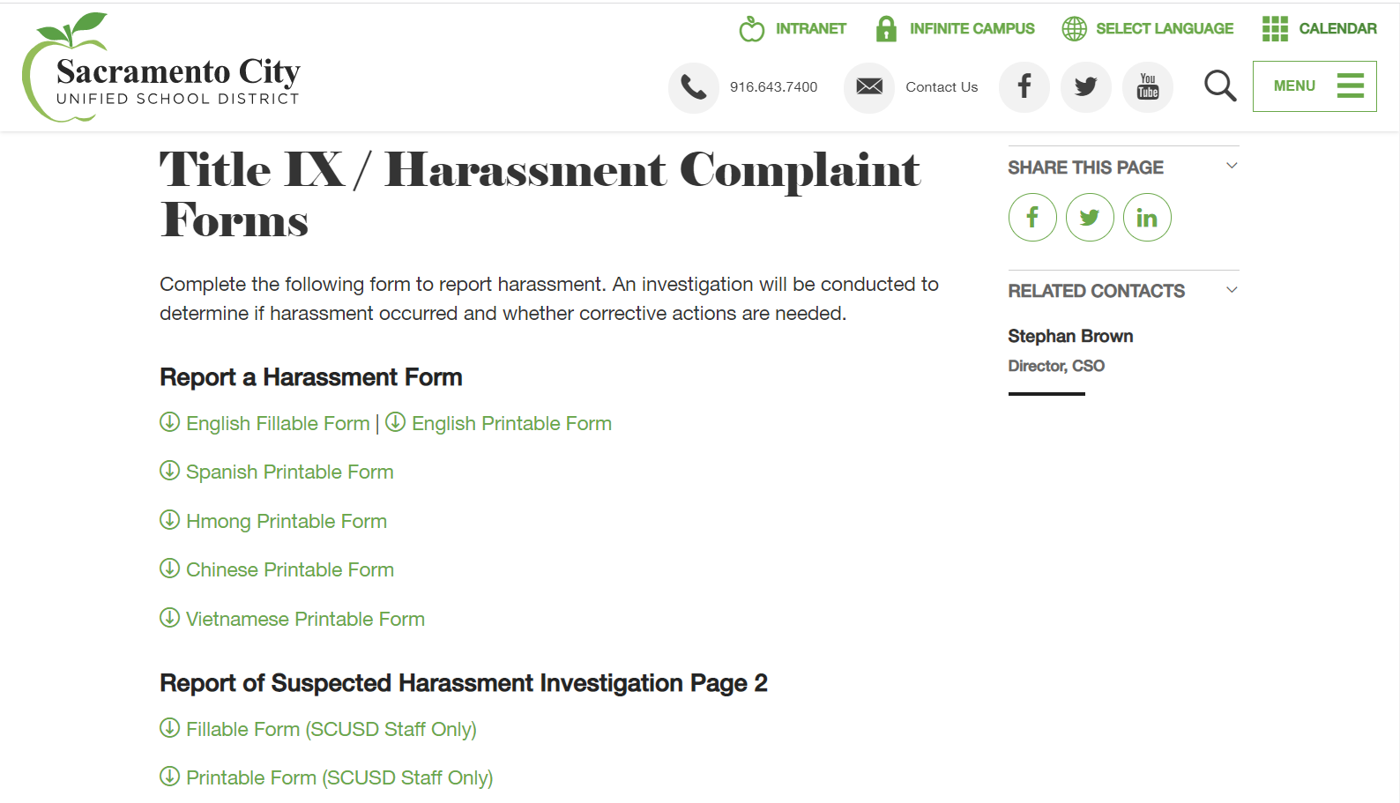
Report of Suspected Harassment https://www.scusd.edu/post/title-ix-harassment-complaint-forms

Slide 18
Whenever In Doubt, Report
Verbal report to CPS agent
Complete written report
Keep copy of written report
We are all mandated reporters

Slide 19
Supportive Measures
Supportive measures should be offered to the complainant or respondent before and after the filing of a formal complaint or where no formal complaint has been followed.
  Escort to class
  Change to class schedule
  Refer to counseling
  Safety plan
  No Contact Order
  Emergency Removal
Use trauma-informed approach
Non punitive

Slide 20
Investigation
Send notice of investigation letters to both the complainant and the respondent.
Investigation process includes interviewing witnesses and reviewing evidence.
Investigation report should be prepared by the investigator and must summarize relevant evidence.
  Parties must be offered the opportunity to provide a written response to the investigation report.

Slide 21
Decision-Maker
The decision-maker must allow parties the opportunity to submit written relevant questions for the other party/witnesses and ask those questions they deem relevant.
  The decision-maker must provide an explanation as to why a question was deemed irrelevant.
The decision-maker must prepare the written determination.

Slide 22
Appeal
Parties may appeal the written determination on the following bases:
  Procedural irregularity
  New evidence that was not reasonably available earlier
  Title IX personnel had a conflict of interest or bias
Appeal Officer – Doug Huscher, Assistant Superintendent Student Support Services

Slide 23
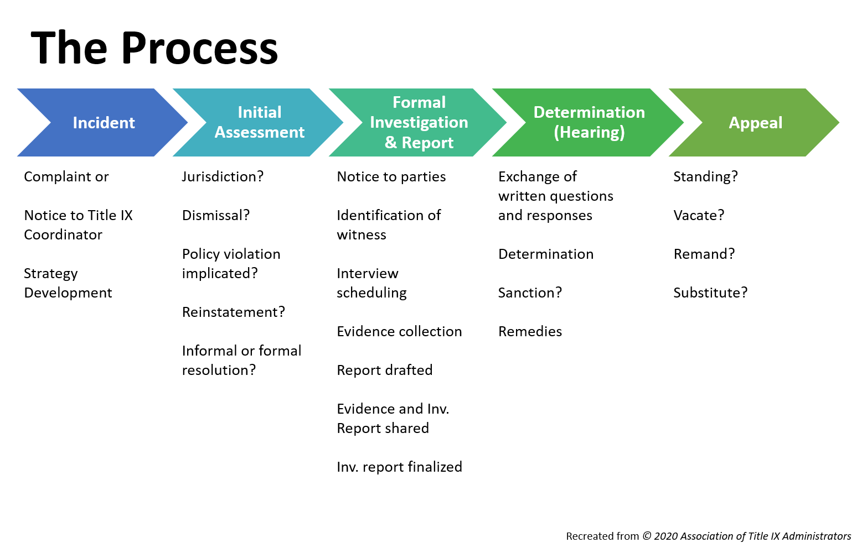

Slide 24
Questions?

