Slide 1
SCUSD Title IX Training for Student-Related Complaints and Investigations
May 2023

Slide 2
Title IX Contacts
Title IX Office
  Stephan Brown (Title IX Coordinator)
  Kyle Allen (Investigator)
  Sharon Barnes (Investigator)
  Appeals Officer (Dr. Olga Simms)
  Decision Maker (Stan Echols)
Legal Services
  Lozano Smith, Attorney at Law
  Raoul Bozio, Attorney
  Equal Rights Advocates, Attorney’s at Law

Slide 3
What is Title IX?
Title IX of the Education Amendments Act of 1972
“No person in the United States shall, on the basis of sex, be excluded from participation in, be denied the benefits of, or be subjected to discrimination under any education program or activity receiving Federal financial assistance.” (facilities, athletics, access, scholarships etc..)
District policies cover nondiscrimination/harassment and sexual harassment (BP and AR 5145.3 and 5145.7); recently updated AR 5145.7

Slide 4
Title IX Specialist Responsibilities
Know the Process / Explain Process
  Formal Written Complaint vs. Report
  Keep Excellent Records
  Preliminary Investigation (Keep Notes)
  Likely Assist Actual Investigation
  Offer Supportive Measures

Slide 5
History of Title IX
Very little change from 1972 - 2011
  Nixon, Ford, Carter, Reagan, Bush, Clinton, Bush,
Major changes since 2011
  Obama: 2011 (Dear Colleague Letter)
  Trump: 2020 (New Rule, Period of Public Comment)
  Biden: 2023 (New Rule, Period of Public Comment)

Slide 6
New Regulations 2023
  Formal Announcement any day
  LGBTQ (increased protections)
    Limited impact in California
  Increased rights for Pregnant and Parenting (Reasonable Accommodations)
    Limited impact in California
  Victims of sexual assault or harassment (Safeguards and protections)
    Limited impact in California
  New standard Sufficiently Severe or Pervasive (and)

Slide 7
New Regulations 2023
Expected
Written complaints no longer required by complainant
New rules for investigations
  (coordinator has more discretion for investigations and dismissals)
Possible new rules for appeals (CDE vs. OCR)
Minimal changes in California
Exchange of information still required
  SCUSD Model: SCIF (Sensitive Compartmented Information Facility)

Slide 8
Title IX Jurisdiction
Allegations of sexual harassment fall under Title IX when:
  The conduct occurs against a person in the United States;
  The conduct occurs in an education program or activity over which the District exercised substantial control over both the respondent and the context in which the sexual harassment occurs;
  The complainant was participating/attempting to participate in the educational program or activity at the time the complaint was filed.

Slide 9
Examples of Sexual Harassment
Unwelcome propositions
Derogatory comments
Sexual jokes or gestures
Spreading sexual rumors
Grabbing or touching
Comments about looks or appearance that are unwelcome
Sexual acts without consent or based on coercion

Slide 10
Key People and Terms
Complainant
Respondent
Coordinator
Investigator
Decision-maker
Appeals Officer
Informal Resolution Officer (Coordinator)
Advisor

Slide 11
Supportive Measures
Supportive measures should be offered to the Complainant or Respondent before and after the filing of a formal complaint.
  Escort to class
  Change to class schedule
  Refer to counseling
  Safety plan
  No Contact Order
  Emergency removal
Use trauma-informed approach
Non punitive

Slide 12
Investigator
Send notice of investigation letters to both the Complainant and the Respondent.
Investigation process includes interviewing witnesses and reviewing evidence.
Investigation report should be prepared by the investigator and must summarize relevant evidence.
  (likely changes in 2023..no report required)

Slide 13
Decision-Maker
The decision-maker must allow parties the opportunity to submit written relevant questions for the other party/witnesses and ask those questions they deem relevant.
  The decision-maker must provide an explanation as to why a question was deemed irrelevant.
The decision-maker must prepare the written determination.

Slide 14
Appeals Officer
Parties may appeal the written determination on the following bases:
  Procedural irregularity
  New evidence that was not reasonably available earlier
  Title IX personnel had a conflict of interest or bias
Appeals Officer – Olga Simms

Slide 15
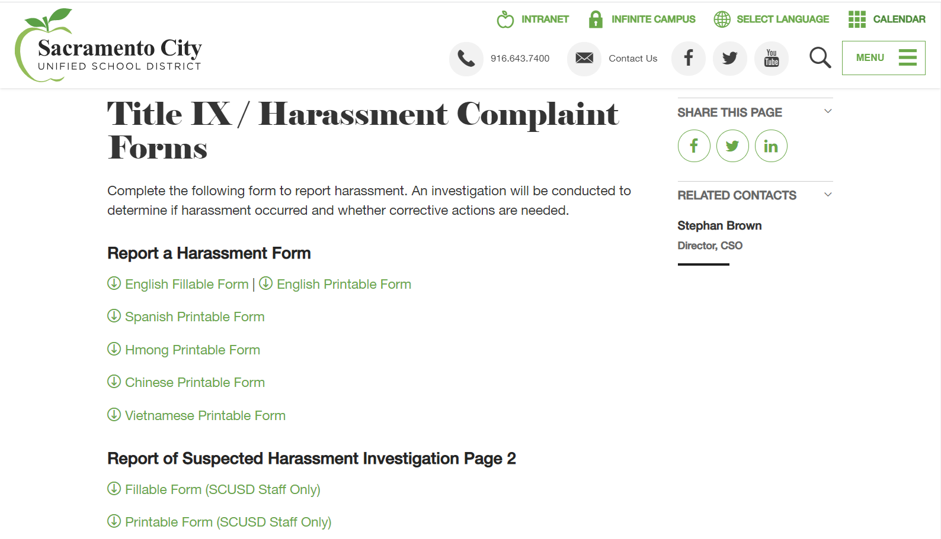
Report of Suspected Harassment https://www.scusd.edu/post/title-ix-harassment-complaint-forms

Slide 16
Questions?

