Slide 1
Federal Time Accounting
Office Managers’ Meeting
August 8, 2018 REVISED 11-6-2018
Presenter: Lisa Hayes, Director, State & Federal Programs
Lisa-Hayes@scusd.edu 916-643-9051

Slide 2
Federally funded employee time and effort documentation
Documentation is required to ensure that the district is properly charging salaries and wages that are reasonable, necessary and allowable in accordance with applicable federal program requirements

Slide 3
Federal Program Monitoring
The CDE can review a district every two years looking at documentation from the previous or current year.
Missing documents may mean that the district is required to move charges, possibly losing general funds.

Slide 4
Program/Site Managers’ Responsibilities
The program/site manager must ensure that all federally funded employees and their supervisors are familiar with the time documentation guidelines and are complying with these requirements. Program/site manager should ensure that employees understand the duties associated with the federal program and must sign the documents to certify.

Slide 5
Three Types of Time Accounting Reports
Semi-Annual Certification
Semi-Annual Certification with schedule
Personnel Activity Report (PAR)
The type of time accounting document submitted depends on the funding and work duties of the employee

Slide 6
Semi-Annual Certification
Employee works 100% in one funding source
Signed two times a year:
in January after the July – December period;
in July after the January – June period (or after the last day of work for the school year)
Always signed and dated AFTER the pay period.
Must be signed by the employee or supervisor having
first hand knowledge of the work performed.

Slide 7
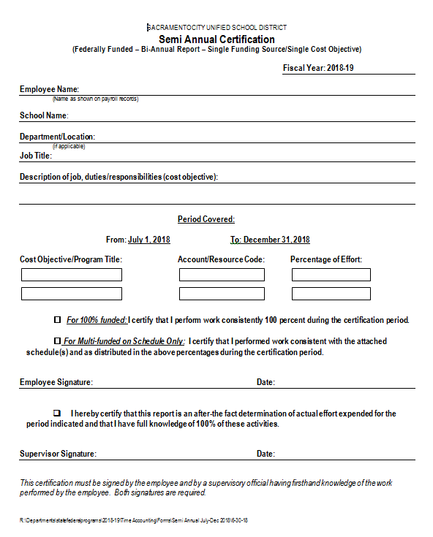

Slide 8
Semi-Annual Certification with Sample Work Schedule forMulti-funded Site-based Personnel (called Substitute System of Time Accounting)
An employee may complete the Semi-Annual Certification with a sample work schedule if the employee:
1. Works with students
2. Works at one site on a schedule
In order to use this form, the employee MUST submit one accurate sample monthly schedule with each semi-annual certification.
The sample work schedule must include time periods, grades or student groups and subject or description of work.

Slide 9
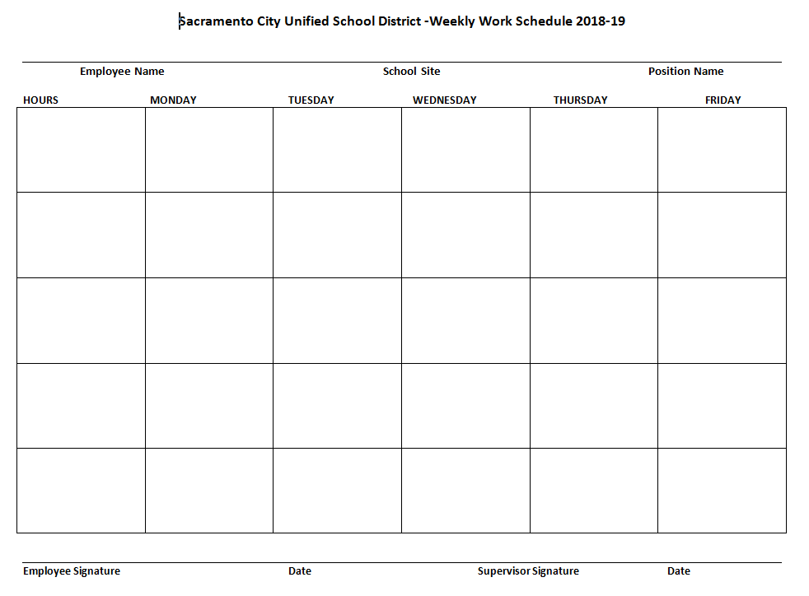

Slide 10
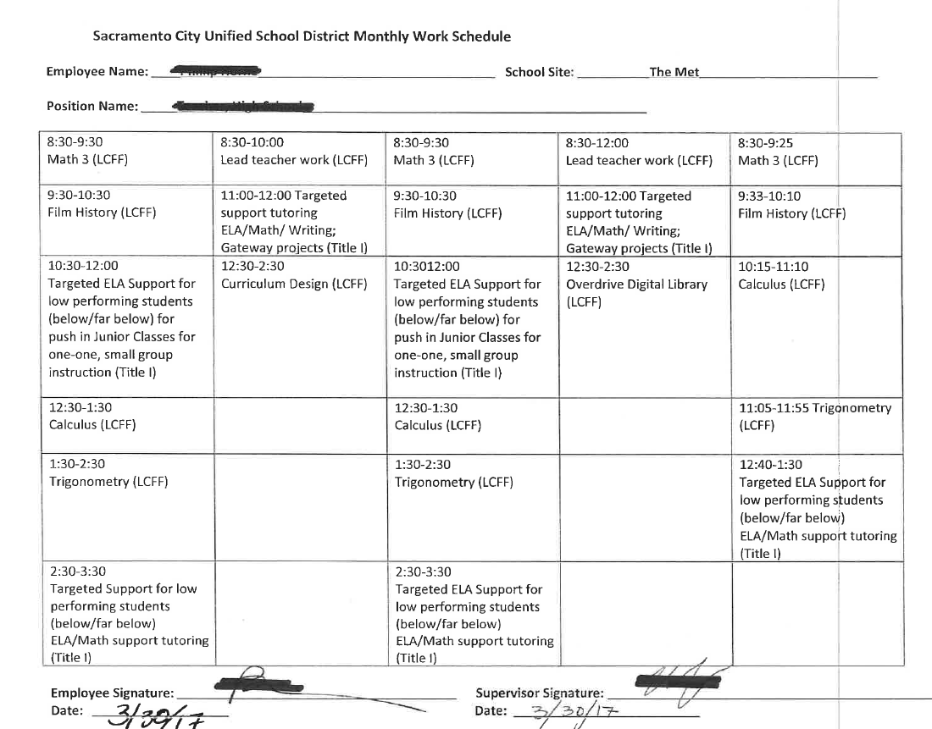

Slide 11
Personnel Activity Report (PAR)
Used when an employee’s salary is funded by multiple federal programs or partially with federal programs & other sources
It is a monthly calendar that shows the amount of time the employee has worked daily in each funding source
Employees document actual time worked in each activity so daily recording ensures more accuracy.

Slide 13
Which Employees Complete PARs?
Personnel who provide a variety of services and/or move to various sites.
Site based: SICs, training specialists, counselors, social workers, case workers. parent advisors, learning support coordinators, community liaisons, nurses
District based: administrators, nurses, social workers

Slide 14
What are the Responsibilities of Office Managers?
Use Position Control to find employees with federal funds (full or partial) and their percentages
Help principal to determine which documentation each employee must submit.
Help employees to obtain the proper forms. Direct them to ask for training or help when needed.
Collect forms and submit to the principal for signatures
If funding is changed for a position, inform the employee.
Send documentation by email to time-accounting@scusd.edu or to State & Federal Programs, Box 0725.

Slide 15
How to Access POSITION CONTROL in Escape
HR/Payroll Module
Reports/Admin
Choose Report Name: POS 03
Enter the following information in your search:
Location Code (4 dig)
Resource code (3010 Title I), (6500 Spec. Ed)
Select-Sort Option c
Press GO

Slide 16
QUESTIONS?

