Slide 1
School Site Council Composition

Slide 2
SSC Composition – Elementary Model
Laws govern how SSCs are composed and there must be parity (equality) between staff and parents/community.
Principal of the school or a designee
No less than 3 classroom teachers (teachers are always a majority of the staff)
One “other staff” – classified or certificated
No less than 5 parents
There can be more members as long as there is “parity” between the staff group & parent group
Notes:
Sean

Slide 3
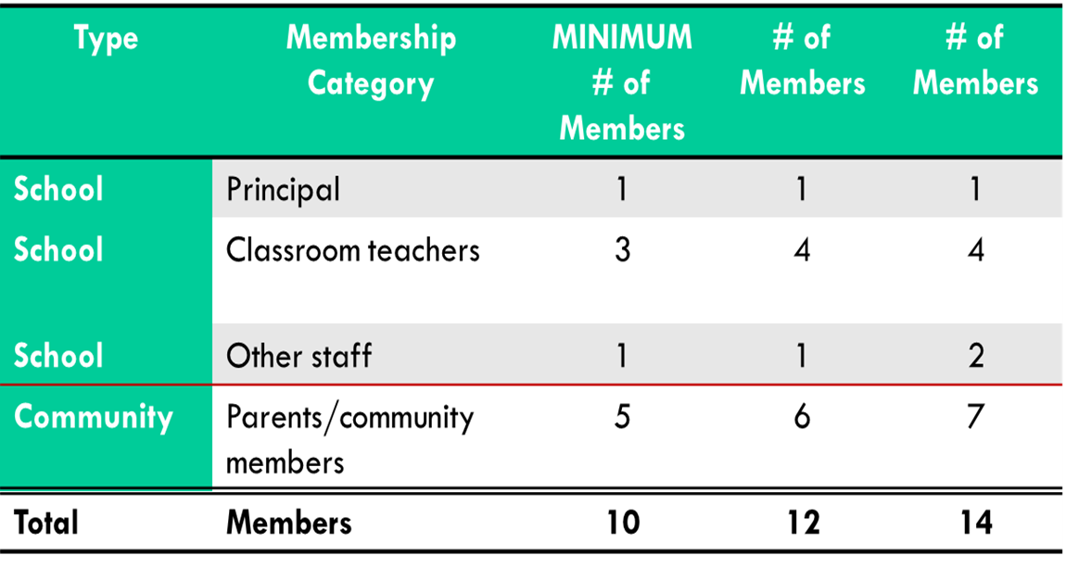
SSC Composition for Elementary Schools
The SSC shall be constituted to ensure parity between school and community.
Notes:
Sean

Slide 4
SSC Composition – Secondary Model
Laws govern how SSCs are composed and there must be parity (equality) between staff & parents/community/students.
Principal of the school or a designee
No less than 3 classroom teachers (teachers are always a majority of staff)
One ‘other staff” – classified or certificated
Parents/community & students
There can be more members as long as there is “parity” between the staff group & parent group
Notes:
Sean

Slide 5
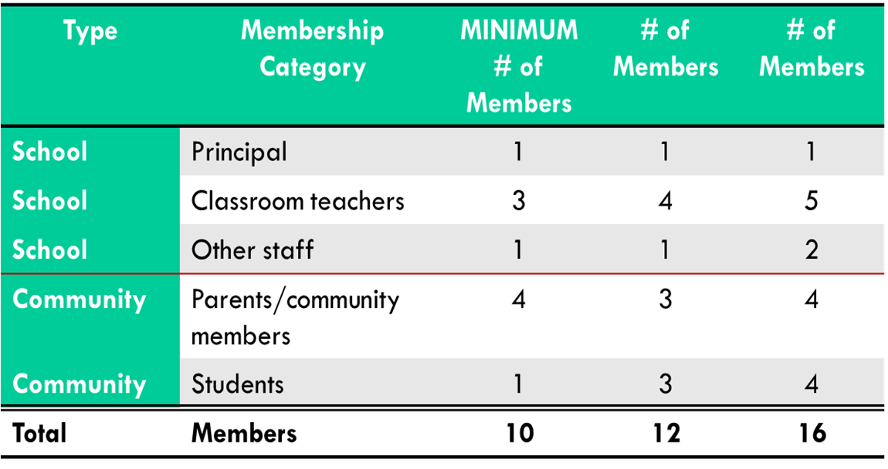
SSC Composition for Secondary Schools
The SSC shall be constituted to ensure parity between school and community
Notes:
Sean

