Slide 1



UDL: Innovating for Access and Equity
April 2020
Module #2
UTILIZING THE UDL FRAMEWORK TO DEVELOP EXPERT LEARNERS
In Collaboration

Slide 2
UDL: Innovating for Access and Equity
April 2020
Module #3
MITIGATING BARRIERS TO ACCESS AND EQUITY
THROUGH LESSON DESIGN
In Collaboration

Slide 3
UDL: Innovating for Access and Equity
Module #2
UTILIZING THE UDL FRAMEWORK TO DEVELOP EXPERT LEARNERS
Educators will:
…deepen their understanding of the UDL framework and vocabulary.
…explore the components of the UDL framework.
…define the characteristics of an expert learner.

Slide 4

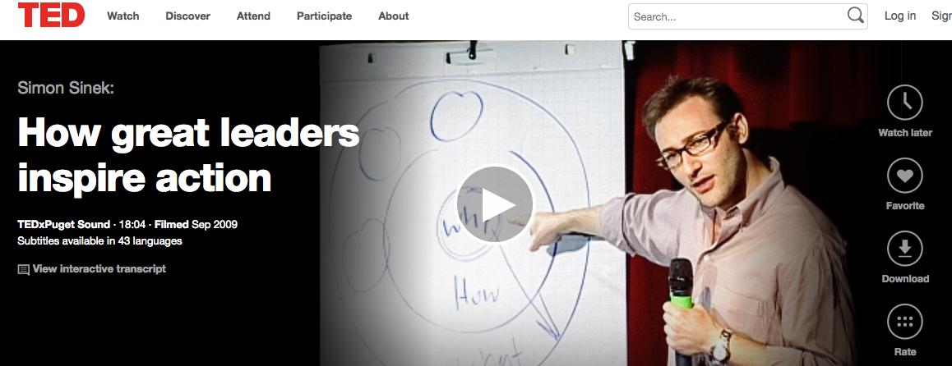
“Why”?
“Imagine a world in which trust and loyalty are the rule rather than the exception.”
www.startwithwhy.com
Funded by the California Department of Education, Special Education Division

Slide 5

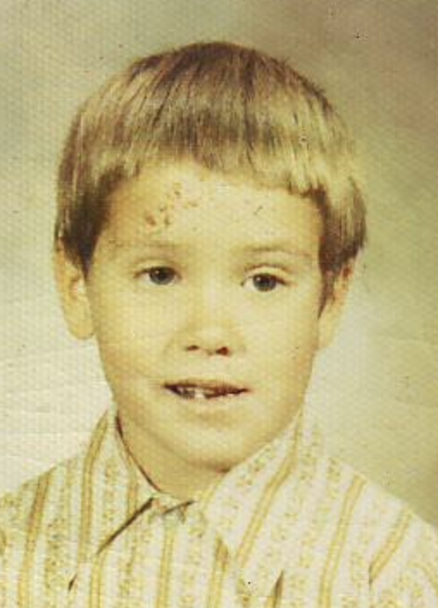
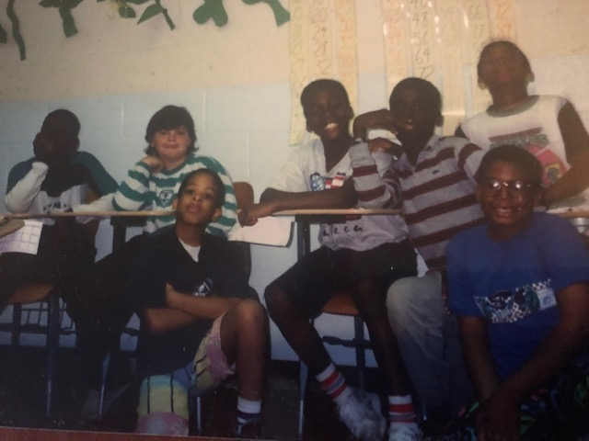
IT’S PERSONAL
MY WHY…
Processing Guide
What is your ”Why”?
Funded by the California Department of Education, Special Education Division

Slide 6
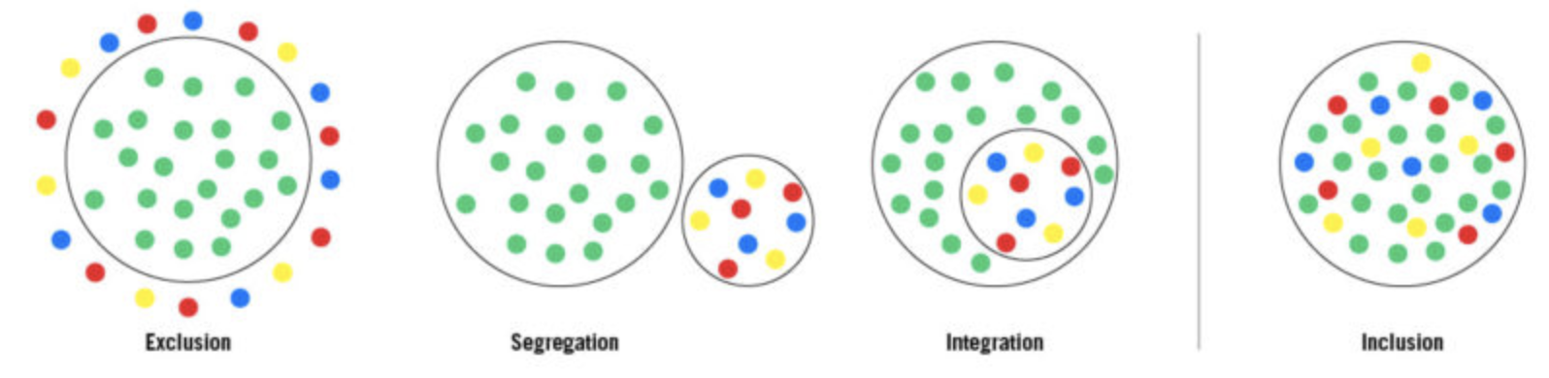
Inclusion is a mindset.
It is a way of thinking.
It is not a program that we run or a classroom in our school
or a favor we do for someone.
Inclusion is who we are.
It is who we must strive to be.
-Lisa Friedman: Removing the Stumbling Block
How do you define inclusion?
Funded by the California Department of Education, Special Education Division

Slide 7
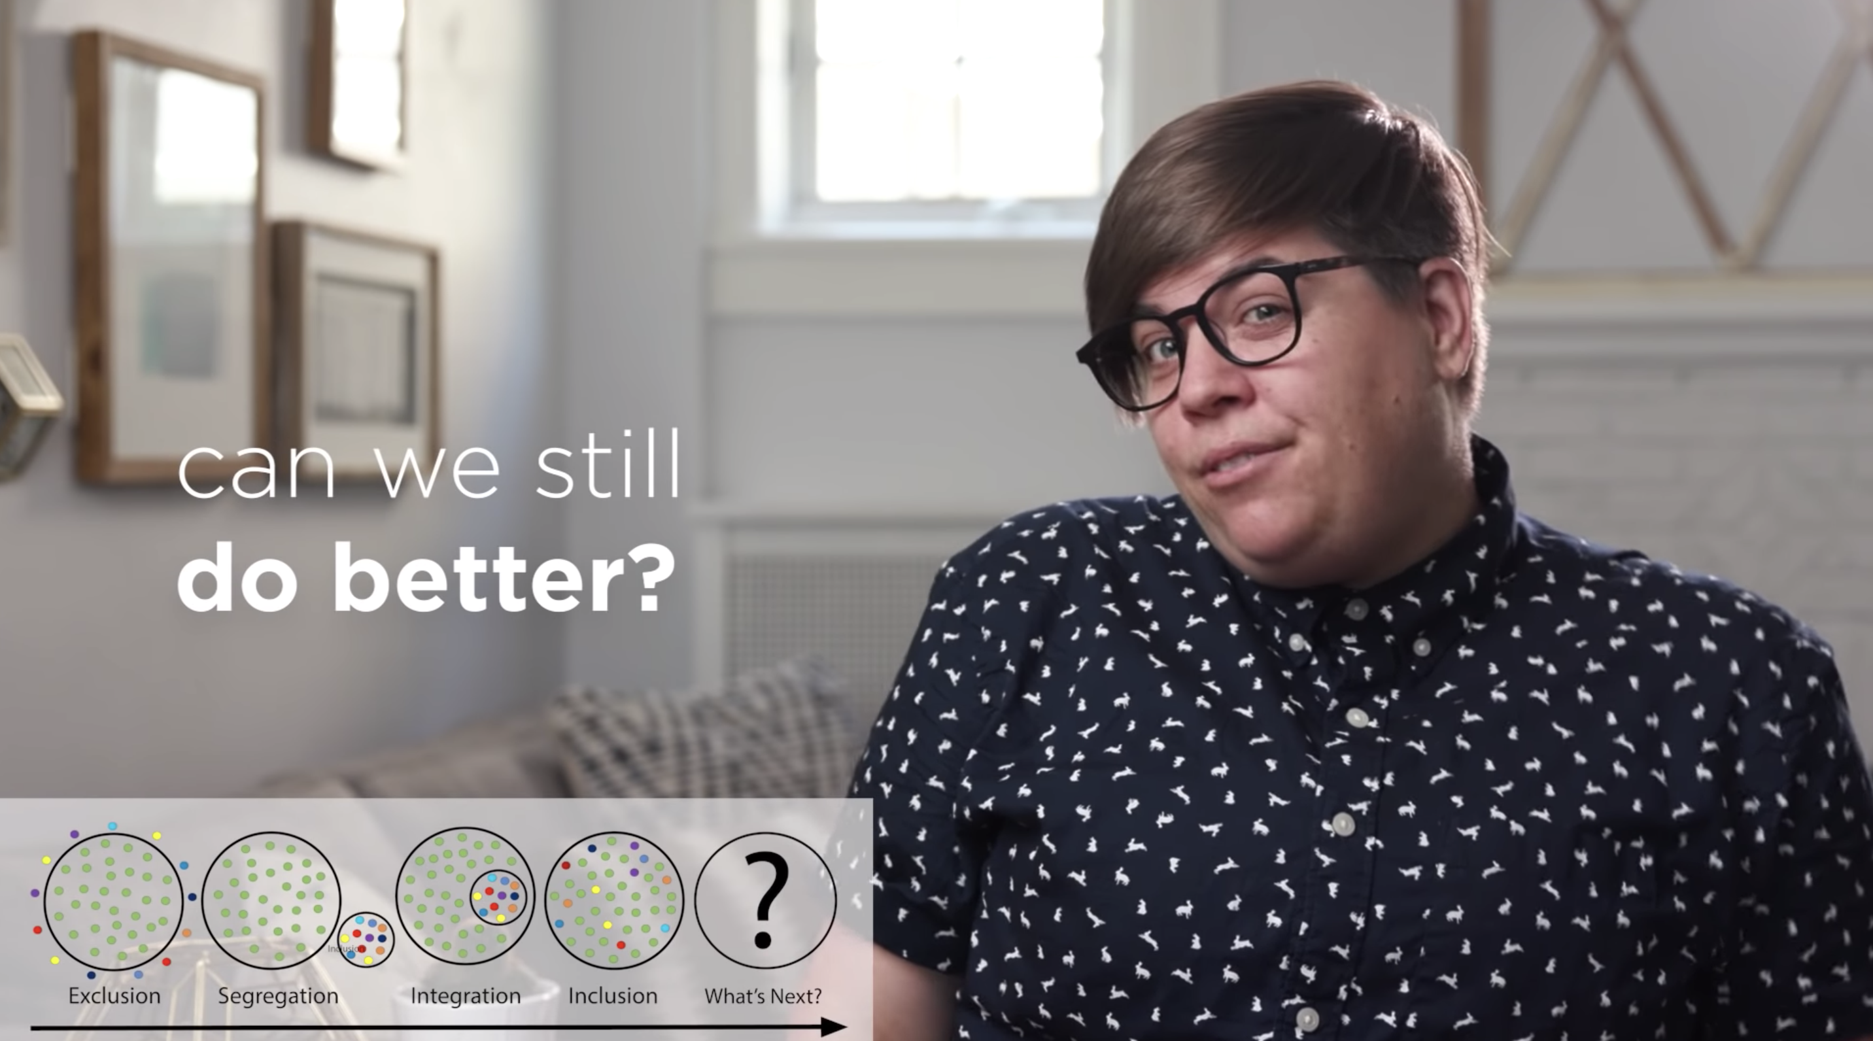
The Evolution of Inclusion
Shelley Moore
https://www.youtube.com/watch?v=PQgXBhPh5Zo
Funded by the California Department of Education, Special Education Division

Slide 8

How is inclusion defined in SCUSD?
What would “doing better” look like?
Funded by the California Department of Education, Special Education Division

Slide 9

Inclusion IS… Inclusion IS NOT…
What Inclusion Is (Not)
Educational Equity and Access Dump and Hope
Sense of Community and Belonging GenEd with a 1:1 Untrained Aide
Educational Benefit Just Mainstreaming
Independence and Interdependence Line of Sight Inclusion
Philosophy That ALL Students Can Learn For Compliance
Breaking Down Silos
Funded by the California Department of Education, Special Education Division

Slide 10
Grounding Us in Language
Across scholars’ many definitions of inclusion, a common theme appears to be that students with a range of abilities and disabilities should be educated in the general education setting with appropriate supports to reach their full potential (Mitchell, 2004; Smith, 2006; Taylor, 2006).
Villa and Thousand (2003) further describe inclusion as “the principles and practice of considering general education as the placement of first choice for all learners” (p. 20).
Funded by the California Department of Education, Special Education Division

Slide 11
Grounding Us in Language
Variability of Learners/Identity
Bitters (1997) defines equitable education as:
The educational policies, practices, and programs necessary to: (a) eliminate educational barriers based on gender, race/ethnicity, national origin, color, disability, age, or other protected group status; and (b) provide equal educational opportunities and ensure that historically underserved or underrepresented populations meet the same rigorous standards for academic performance expected of all children and youth. (p. 1)
Funded by the California Department of Education, Special Education Division

Slide 12
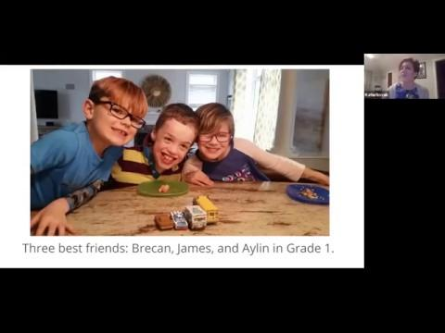
Who Do We Value?
“The world’s problems begin with the belief that some human lives are more valuable than others”
Nelson Mandela
Entire video can be found at: https://youtu.be/fA1NYWmo20I
Presented by Katie Novak for Supporting Inclusive Practices (SIP)
Notes:
3 Min.
Context to the video:
Katie Novak: presenter in video
Education consultant and author, that focuses on research and professional learning on the implementation of Universal Design for Learning and Universally Designed Leadership.
Helped author the MTSS & Special Education Resource
Purpose of the video: webinar for CA county offices, school leaders and teachers to introduce how to build a strategic system of support, focusing on Universal Design for learning as the foundation, for all learners.
Video in its entirety can be found at https://youtu.be/fA1NYWmo20I
Prompt for participants watching video:
Based on the objectives, notice how Katie’s introduction of the children in the video align with the objectives for today’s presentation.

Slide 13

Universal Design for Learning
Access/Equity-based Lesson Planning
Funded by the California Department of Education, Special Education Division

Slide 14
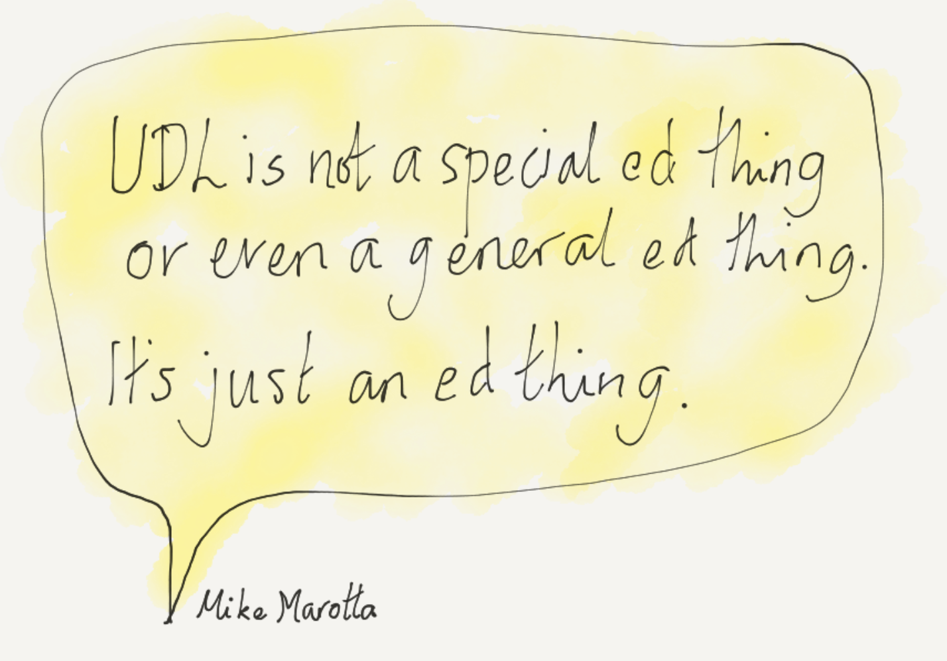
Why UDL Now?
Funded by the California Department of Education, Special Education Division
Notes:
10:45
Objective/Purpose: Participants will strengthen their understanding of current CA inequities, using data resources, in order to connect why UDL is a strategy to make learning accessible for all learners

Slide 15
College, Career and Civic Life Readiness
The Whole Child; Every Child
In my opinion, the #1 quality of a student who is college, career and civic life ready is_____________ because __________________.
Expert Learner
Funded by the California Department of Education, Special Education Division
Notes:
This activity is fairly self explanatory. It is the lead in to the Expert Learner conversation on slide 45.
Participants reflect for a moment on the sentence frame, then find someone they don’t work with to share. They choose who is “Awesome” and who is “Terrific”. Give 3-5 min for pairs to share and have them stay in their place. Have all “Awesome partners” call out, then change. Note no one says academically proficient. Share the importance of learners knowing themselves in the learning environment across all contexts. The ability to self-advocate is critical.

Slide 16
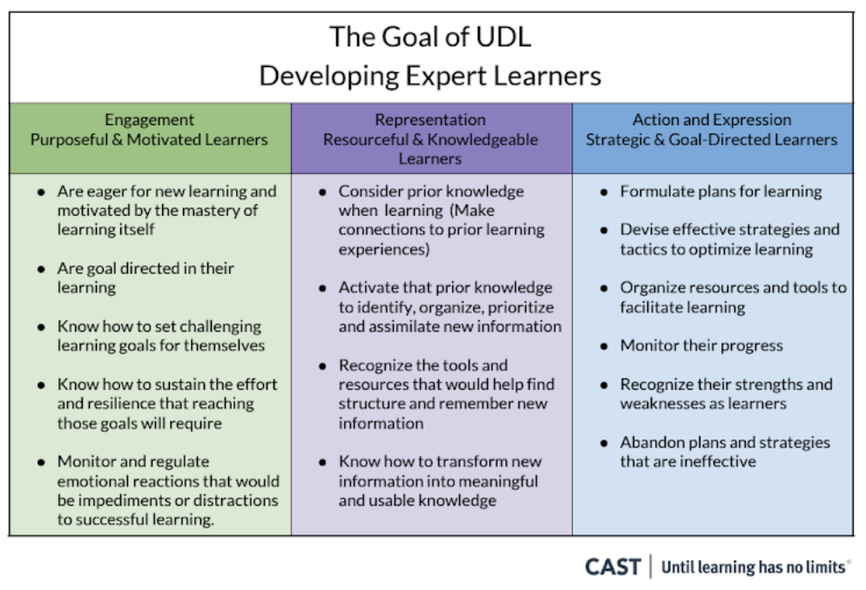
Funded by the California Department of Education, Special Education Division

Slide 17
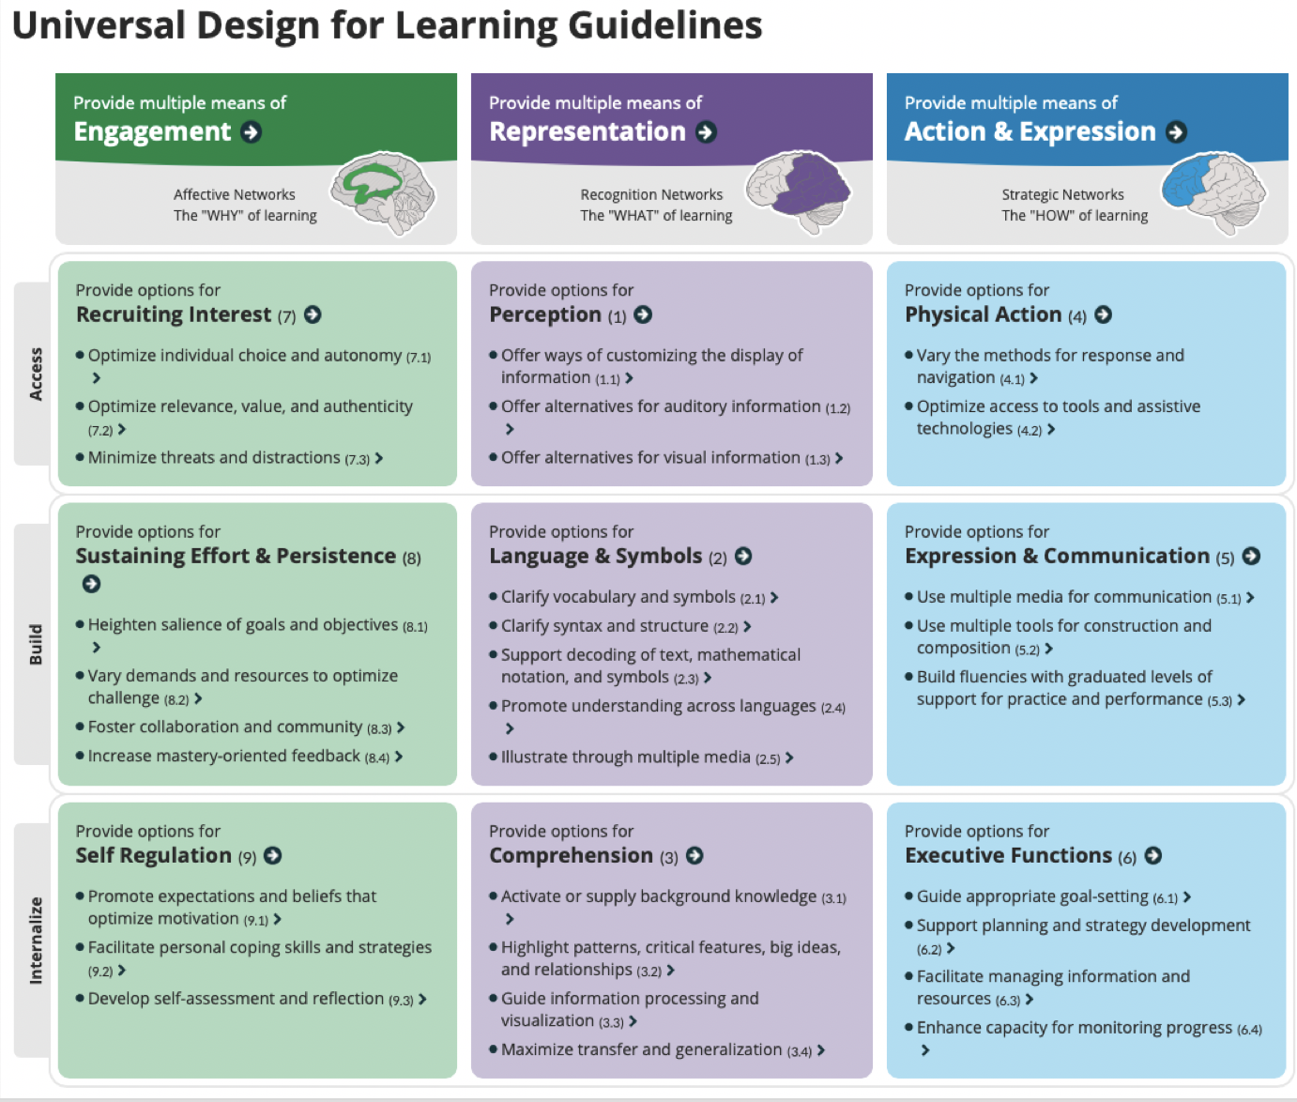
Universal Design for Learning (UDL)
Universally designed structures are indeed more usable by individuals with disabilities, but in addition they offer unforeseen benefits for all users. Similar to DI, but uniquely, UDL calls for the design of curricula with the needs of all students in mind, so that objectives (goals), assessments, methods, and materials are usable by all.
Funded by the California Department of Education, Special Education Division

Slide 18
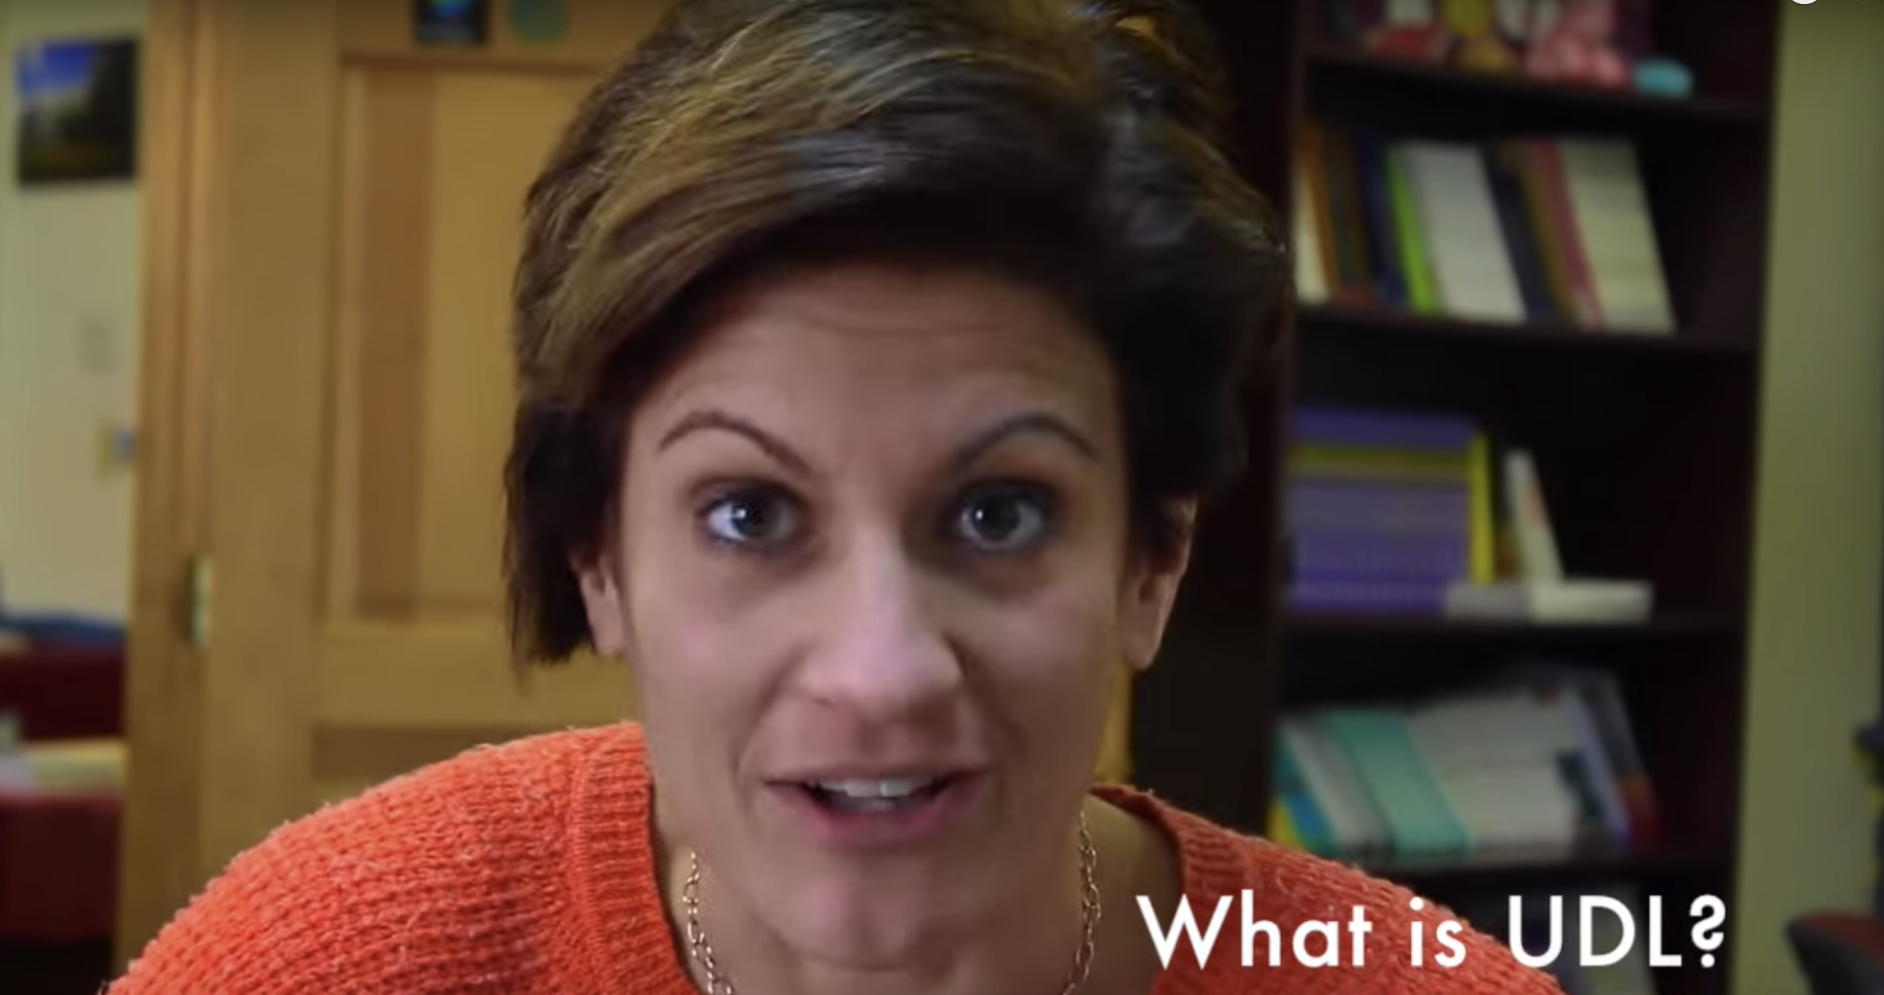
UDL at a Glance
https://www.youtube.com/watch?v=iY9PecIWcWE
Funded by the California Department of Education, Special Education Division

Slide 19

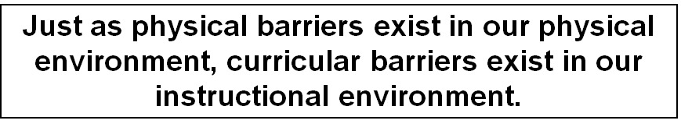
Is Our Learning Environment Welcoming?
UDL is the proactive design of curriculum and instruction to ensure they are educationally accessible regardless of modality preference, physical or sensory abilities.

Slide 20
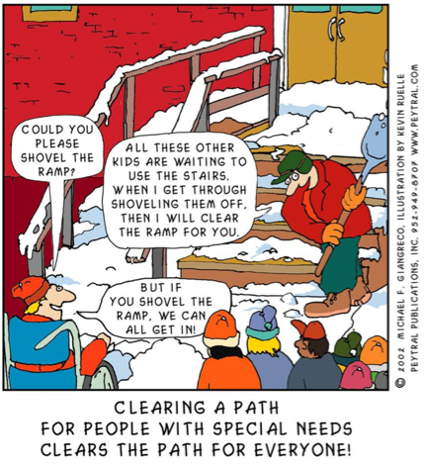
Universal Design for Learning
Funded by the California Department of Education, Special Education Division

Slide 21
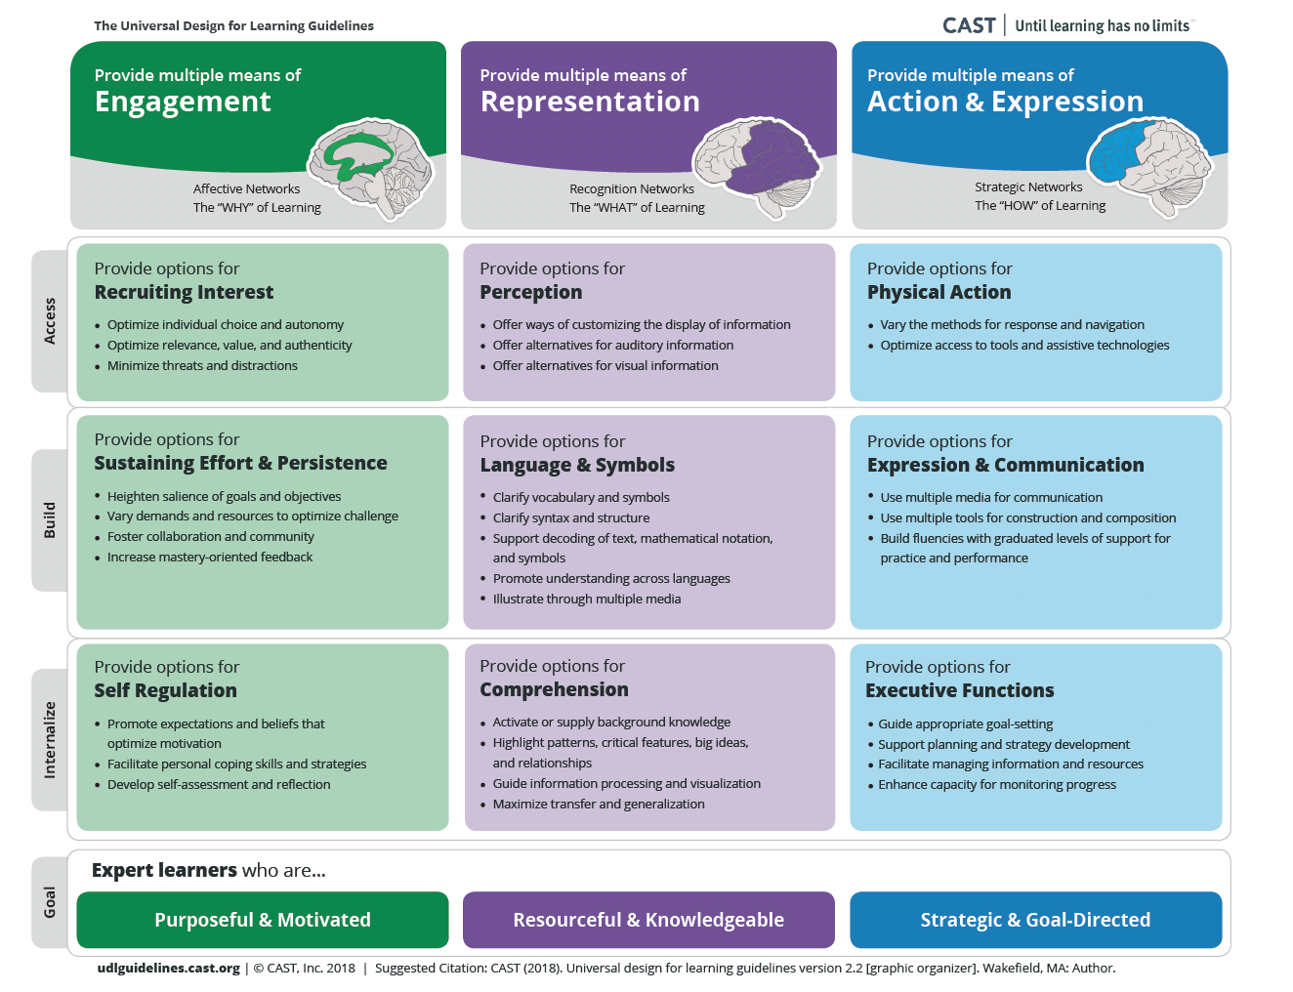
Principles
Guidelines
Checkpoints
http://udlguidelines.cast.org/
Funded by the California Department of Education, Special Education Division

Slide 22
Access
Build
Internalize
http://udlguidelines.cast.org/
Funded by the California Department of Education, Special Education Division

Slide 23
Access
Build
Internalize
http://udlguidelines.cast.org/
Funded by the California Department of Education, Special Education Division

Slide 24
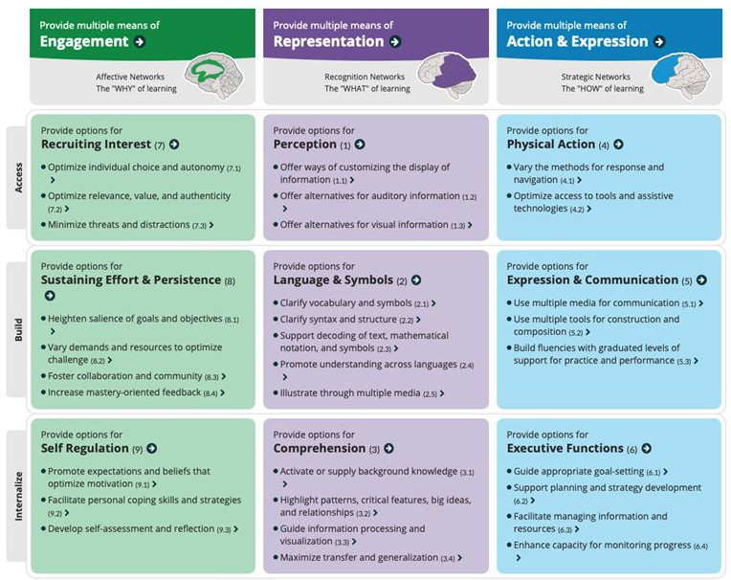
http://udlguidelines.cast.org
Funded by the Californi/a Department of Education, Special Education Division

Slide 25
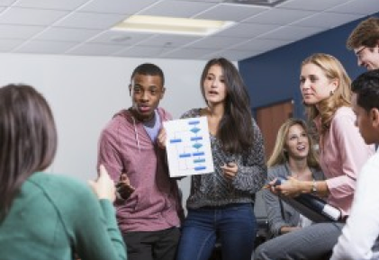
Multiple Means of Engagement
Funded by the California Department of Education, Special Education Division

Slide 26
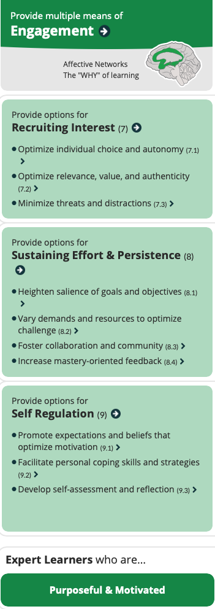
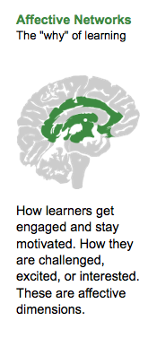
The Limbic System is a group of brain structures including the amygdala, hippocampus, and hypothalamus that are involved in processing and regulating emotions as well as memory. This is where our “flight our fight” responses come from.
Funded by the California Department of Education, Special Education Division

Slide 27
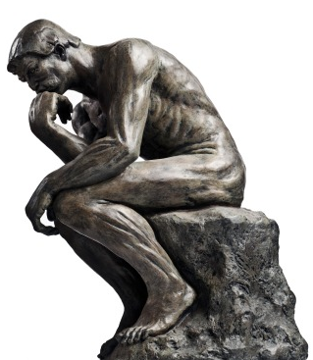
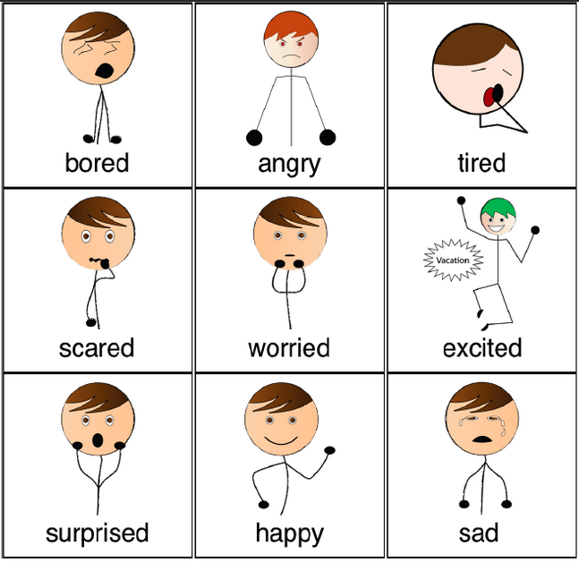
Integration of Cognition and Emotion
They (the UDL guidelines) explicitly call for the integration of emotion and cognition. We know that students continuously appraise their environment as good for them or bad for them—beneficial or threatening.
- Universal Design for Leaning: Theory and Practice, 2014
Funded by the California Department of Education, Special Education Division

Slide 28
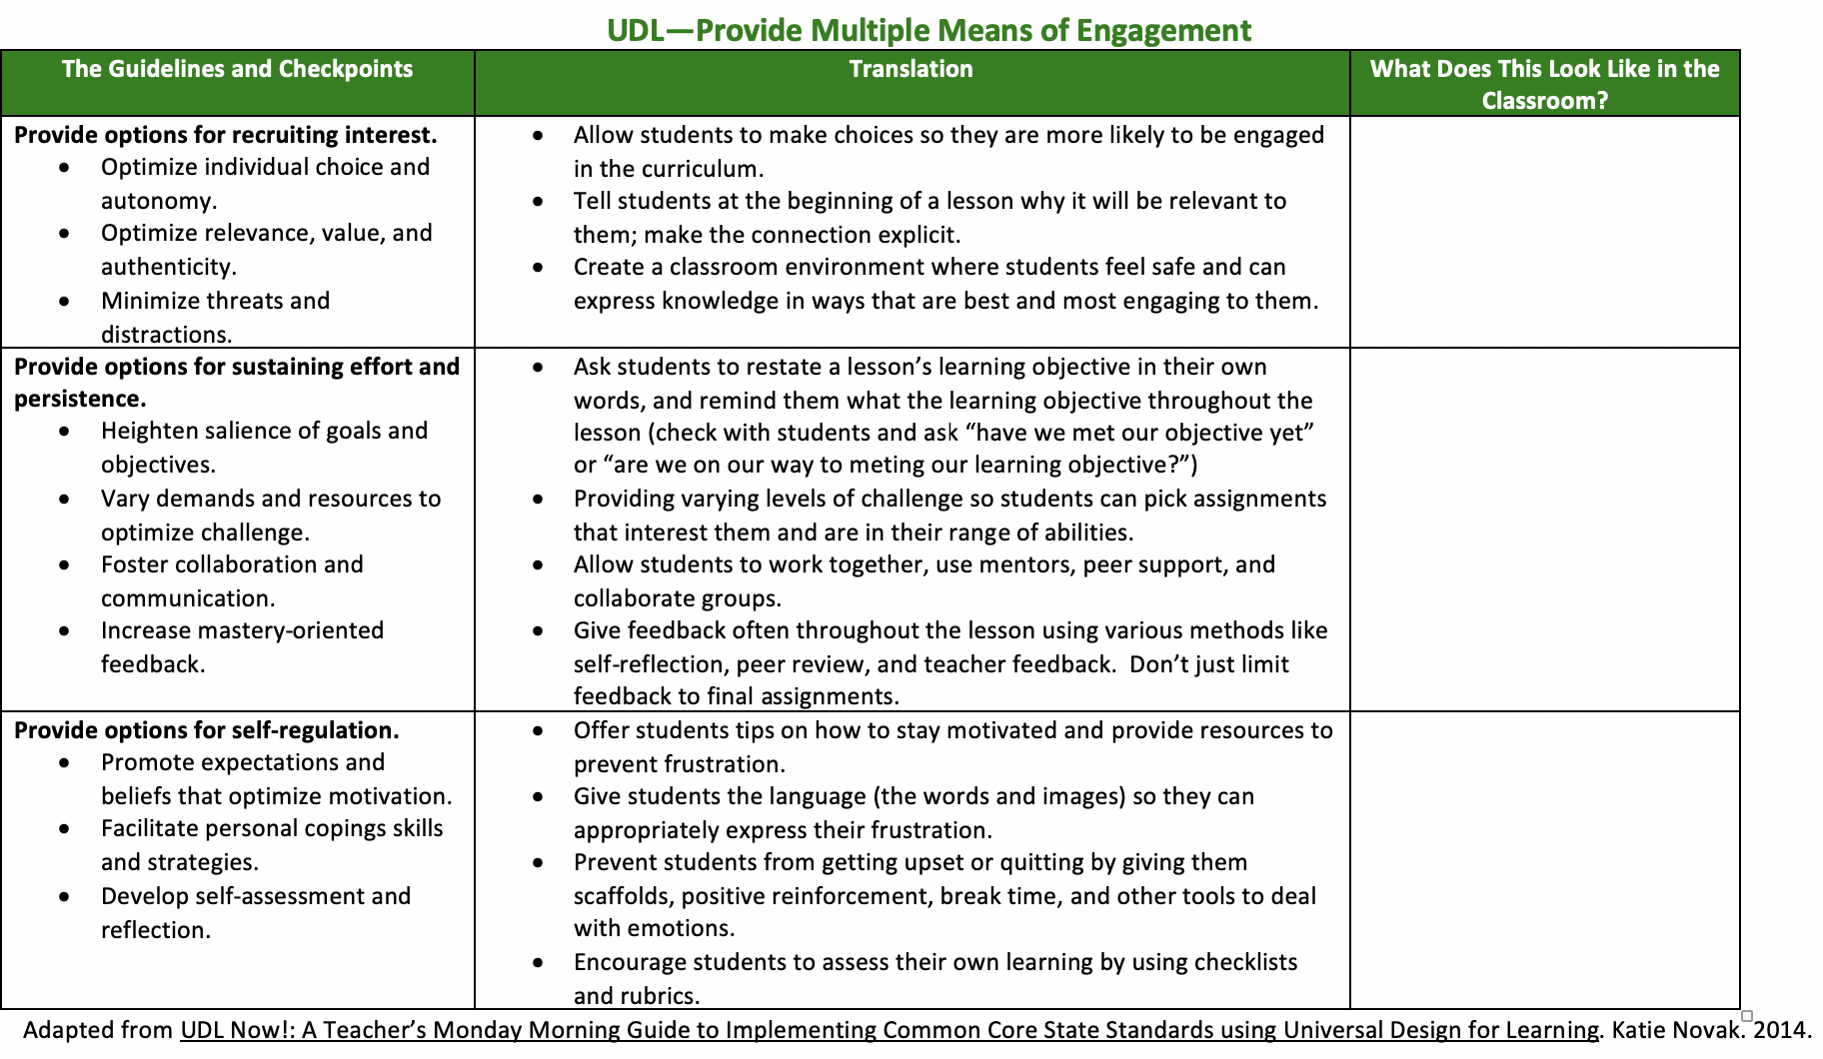
”Translating” Engagement to the Classroom
Access
Build
Internalize
Notes:
Make sure you are logged into the teacher channel to access this video
https://learn.teachingchannel.com/video/graphing-linear-equations-lesson
Discussion Questions:
How does Ms. Davis keep all students engaged while each team graphs?
Notice how Ms. Davis pushes the first team by modifying their equation.
How do the students react to this activity that's not just pencil and paper?

Slide 29
http://udlguidelines.cast.org
Funded by the Californi/a Department of Education, Special Education Division

Slide 30

Multiple Means of Representation
Worksheets
Funded by the California Department of Education, Special Education Division

Slide 31
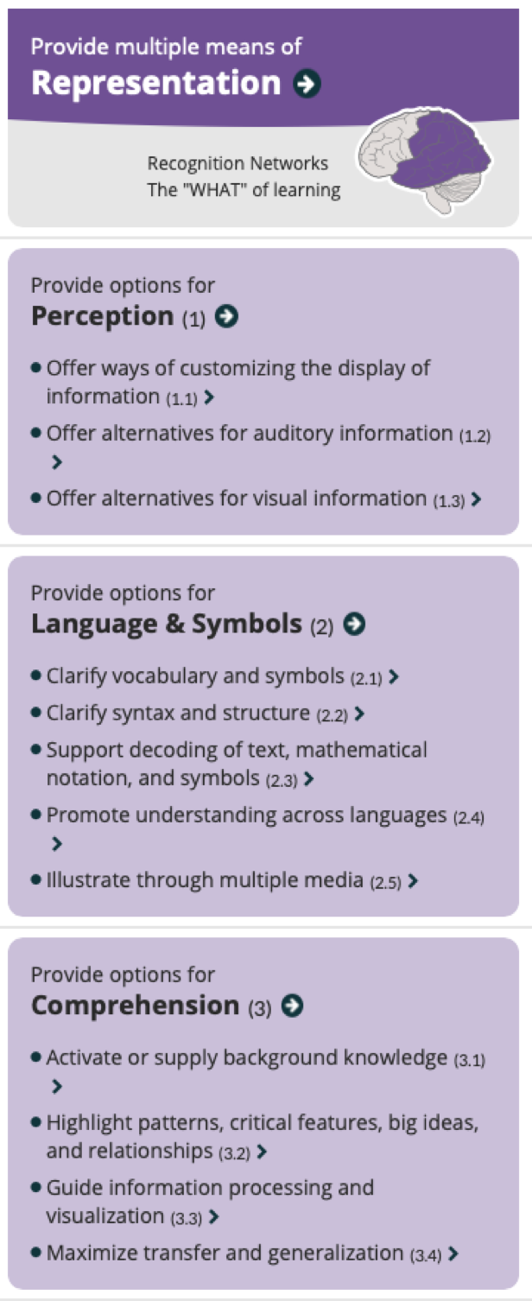
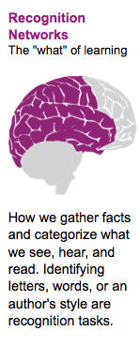
The Temporal Lobe contains a large number of substructures whose functions include perception, recognition, memory acquisition, understanding language, and emotional reactions. Associated functions to the temporal lobe include perception (auditory, visual, and smell) and long and short term memory.
Funded by the California Department of Education, Special Education Division

Slide 32
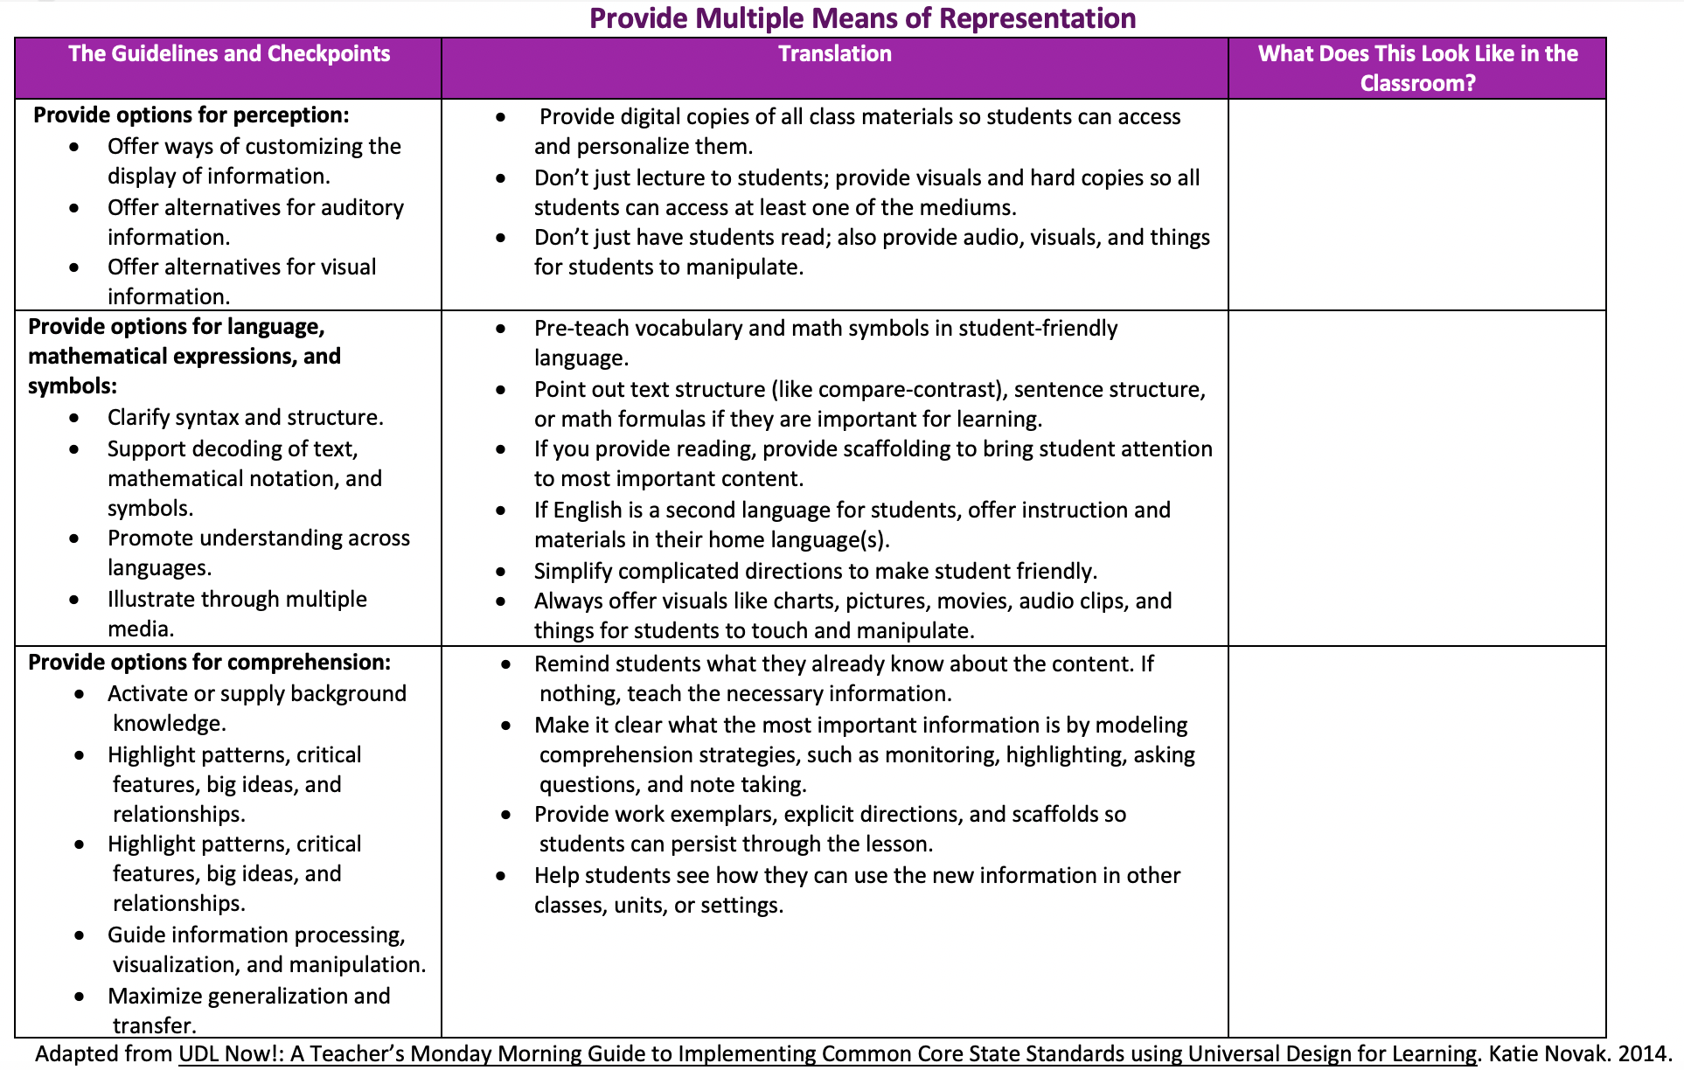
”Translating” Representation to the Classroom
Access
Build
Internalize
Notes:
Make sure you are logged into the teacher channel to access this video
https://learn.teachingchannel.com/video/graphing-linear-equations-lesson
Discussion Questions:
How does Ms. Davis keep all students engaged while each team graphs?
Notice how Ms. Davis pushes the first team by modifying their equation.
How do the students react to this activity that's not just pencil and paper?

Slide 33
http://udlguidelines.cast.org
Funded by the Californi/a Department of Education, Special Education Division

Slide 34

Multiple Means of Action and Expression
Funded by the California Department of Education, Special Education Division

Slide 35
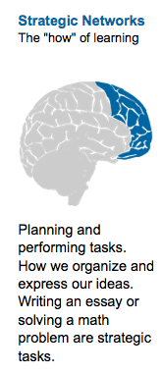
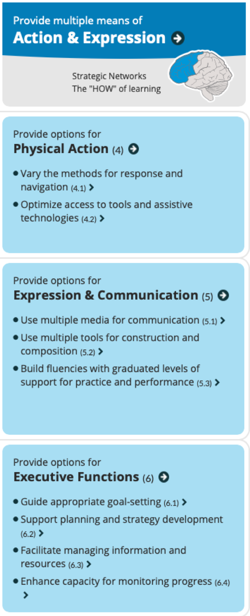
The Frontal Lobes are part of the cerebral cortex and are the largest of the brain’s structures. They are the main site of the so-called “higher” cognitive functions. Associated functions of the frontal lobes include Executive processes (voluntary behavior such as decision making, planning, problem–solving, and thinking), voluntary motor control, cognition, intelligence, attention, language processing and comprehension, and many others.
Funded by the California Department of Education, Special Education Division

Slide 36
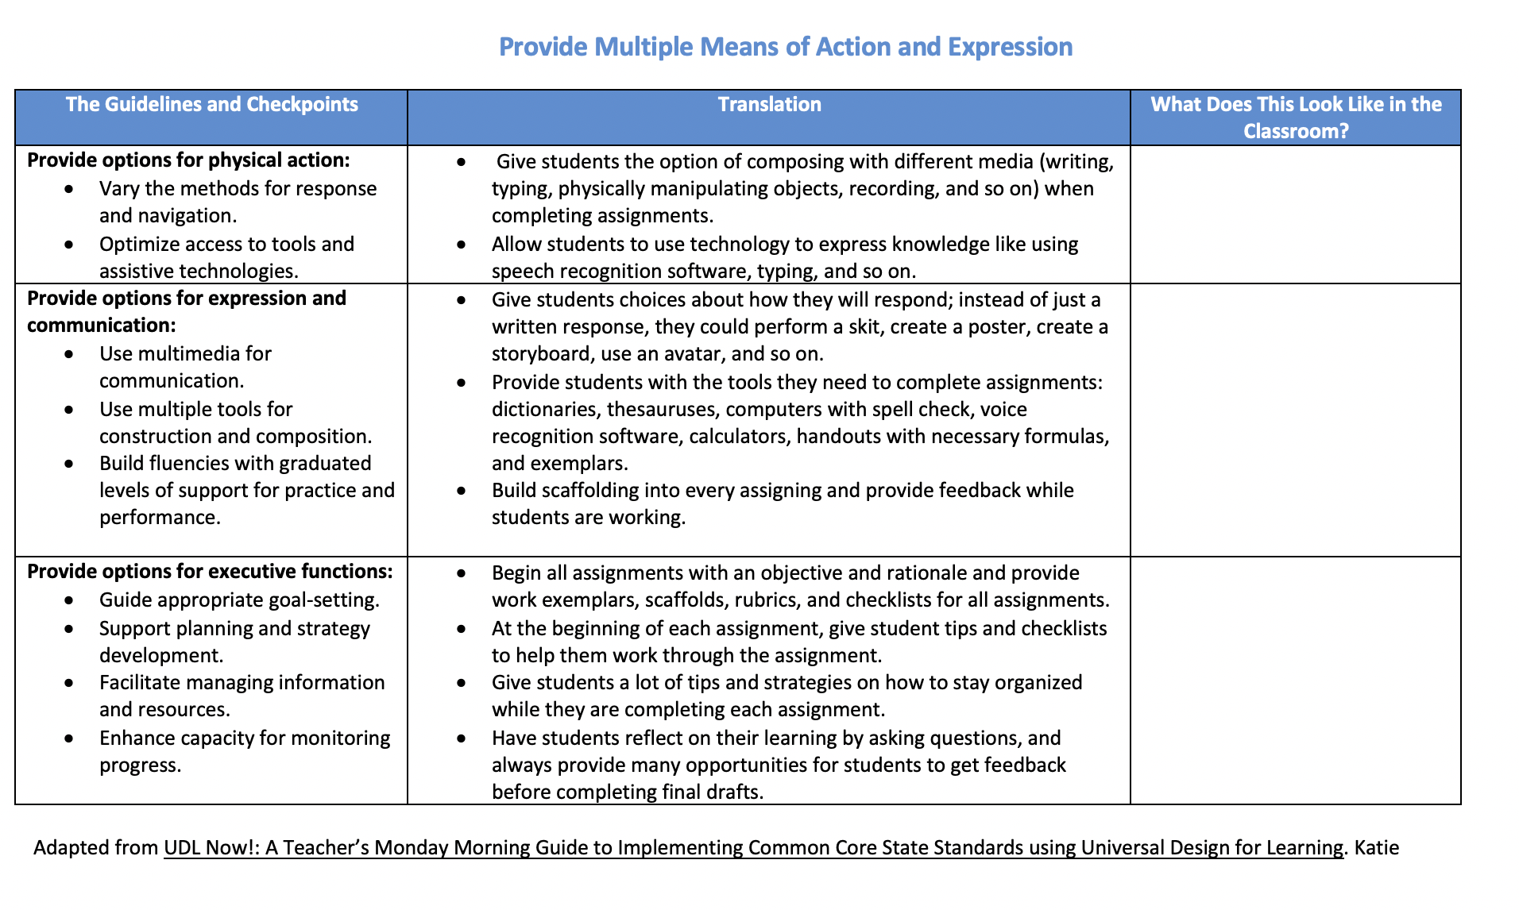
”Translating” Action/Expression to the Classroom
Access
Build
Internalize
Notes:
Make sure you are logged into the teacher channel to access this video
https://learn.teachingchannel.com/video/graphing-linear-equations-lesson
Discussion Questions:
How does Ms. Davis keep all students engaged while each team graphs?
Notice how Ms. Davis pushes the first team by modifying their equation.
How do the students react to this activity that's not just pencil and paper?

Slide 37


“Though we cannot think alike, may we not love alike? May we not be of one heart, though we are not of one opinion? Without all doubt, we may.”
― from a letter in the Works of John Wesley
https://www.youtube.com/watch?v=2bgfLiZWam0

