Slide 1
Safety, Supervision & Zoning

Slide 2
Agenda
Objective: To understand the importance of proper supervision to support safe transitions and classrooms and identify potential barriers to appropriate SUPERvision practices and problem solve ahead of time
OHS/CCL Expectations
Monitoring Trends
SUPER-vision: Steps for Transitions
Communication
Zoning
Use of tools/resources
Classroom Safety Plans
Reporting/ RAN
Notes:
Introduction
Review objective with participants

Slide 3

Supervision Expectations
Office of Head Start:
The Head Start Program Performance Standards require that programs "ensure no child is left alone or unsupervised by staff, consultants, contractors, or volunteers while under their care" (45 CFR §1302.90).
Community Care Licensing:
(1) No child(ren) shall be left without the supervision of a teacher at any time, Supervision shall include visual observation.
“But the child was only out of supervision for a minute.”
Notes:
Note that during lapses in supervision the amount of time can be downplayed, but even one minute is a huge amount of time
Have everyone sit for a minute of silence. When the minute is over, ask folks to pair up with someone (or two people) at their table and reflect on the experience and its relation to supervision.

Slide 4
Unannounced Safety and Supervision Trends
Safety Supervision protocols are not consistently followed for visual bathroom supervision.
  Staff at times are unaware of children in the bathroom.
Ratio was not maintained
Staff provided inaccurate head count.
  Number of children enrolled was given instead of actual children present.
General observation is that not all steps of SUPERvision were performed. Specifically:
  No visual or verbal sweep of classroom during transitions.
  Roll Call, and Recount.

Slide 5
RAN Reviews
Head Start Risk Assessment Notification (RAN) review will be conducted as needed, when the Office of Head Start (OHS) requires more information about a significant incident affecting the health and safety of program participants.
The RAN review will:
· Document serious health and safety incidents and ensure that recipients are following requirements for timely, accurate reporting.
· Identify if there are contributing program or management factors that may have enabled the incident.
· Communicate any required corrective action steps to the recipient.
· Provide feedback and inform support to strengthen program management approaches and prevent similar incidents from occurring in the future.
Notes:
Keeping children safe is the most important reason behind effective Supervision! That is why it is a high stakes topic for the Office of Head Start.
Go over a RAN review. Sacramento is currently on a RAN Corrective Action Plan due to a couple supervision lapses in the county.
Explain the need to let supervisors know if there is ever an incident.

Slide 6
SUPERvision
A guide to safe transitions

Slide 7

What are the 5 Steps to SUPERvision?
Stop
Unite & Gather
Perform Sweep
Exact Count
Roll call & Recount

Slide 8



Stop
We are stopping whatever activity is happening.
Best practices include:
Creating routine
Practicing
Adaptive to the changing needs of children
Clear attention getter
  Audio, visual

Slide 9
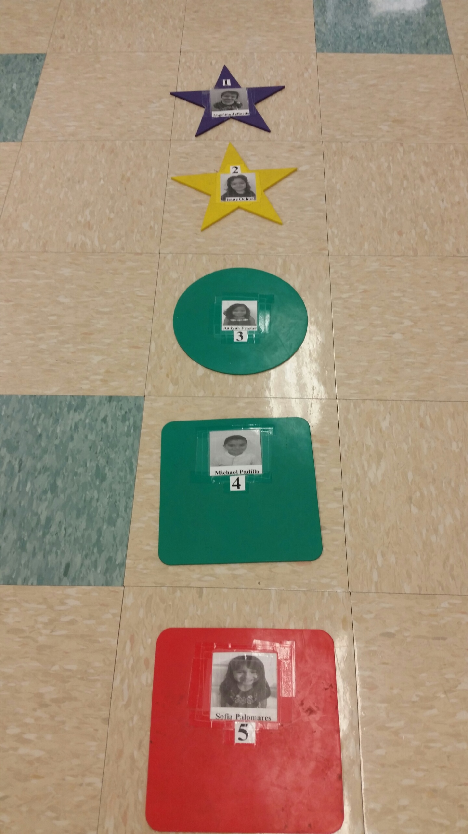
Unite & Gather
The group is coming back from individual activities to join as a singular group
Best practices include:
  Creating routine
  Practicing
  Visual cues
  Location away from high traffic/activity areas

Slide 10
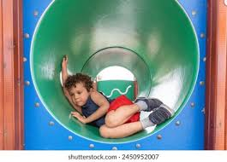
Perform a
Sweep
Staff are double (and triple) checking the space to ensure all children are accounted for, and nobody will be left behind
Best practices include:
  Creating routine
  Practice
  Staff saying out loud “I’m performing a sweep!”
  Checking hot spots and cold spots

Slide 11
Exact Count
All children are identified and accounted for.
Best practices include:
  Creating routine
  Practicing
  Count out loud
  Make sure all staff are counting and in agreement
  Staff are aware of the count and changes throughout the day
  Compare with transition sheet

Slide 12
Roll Call &
Re-count
Children are identified by name, and their presence is confirmed before transitioning
Best practices include:
  Creating routine
  Practicing
  Use the transition sheet
  Make visual contact with each child as their name is called
  Once in a new area, perform another recount of children to finish the transition

Slide 13
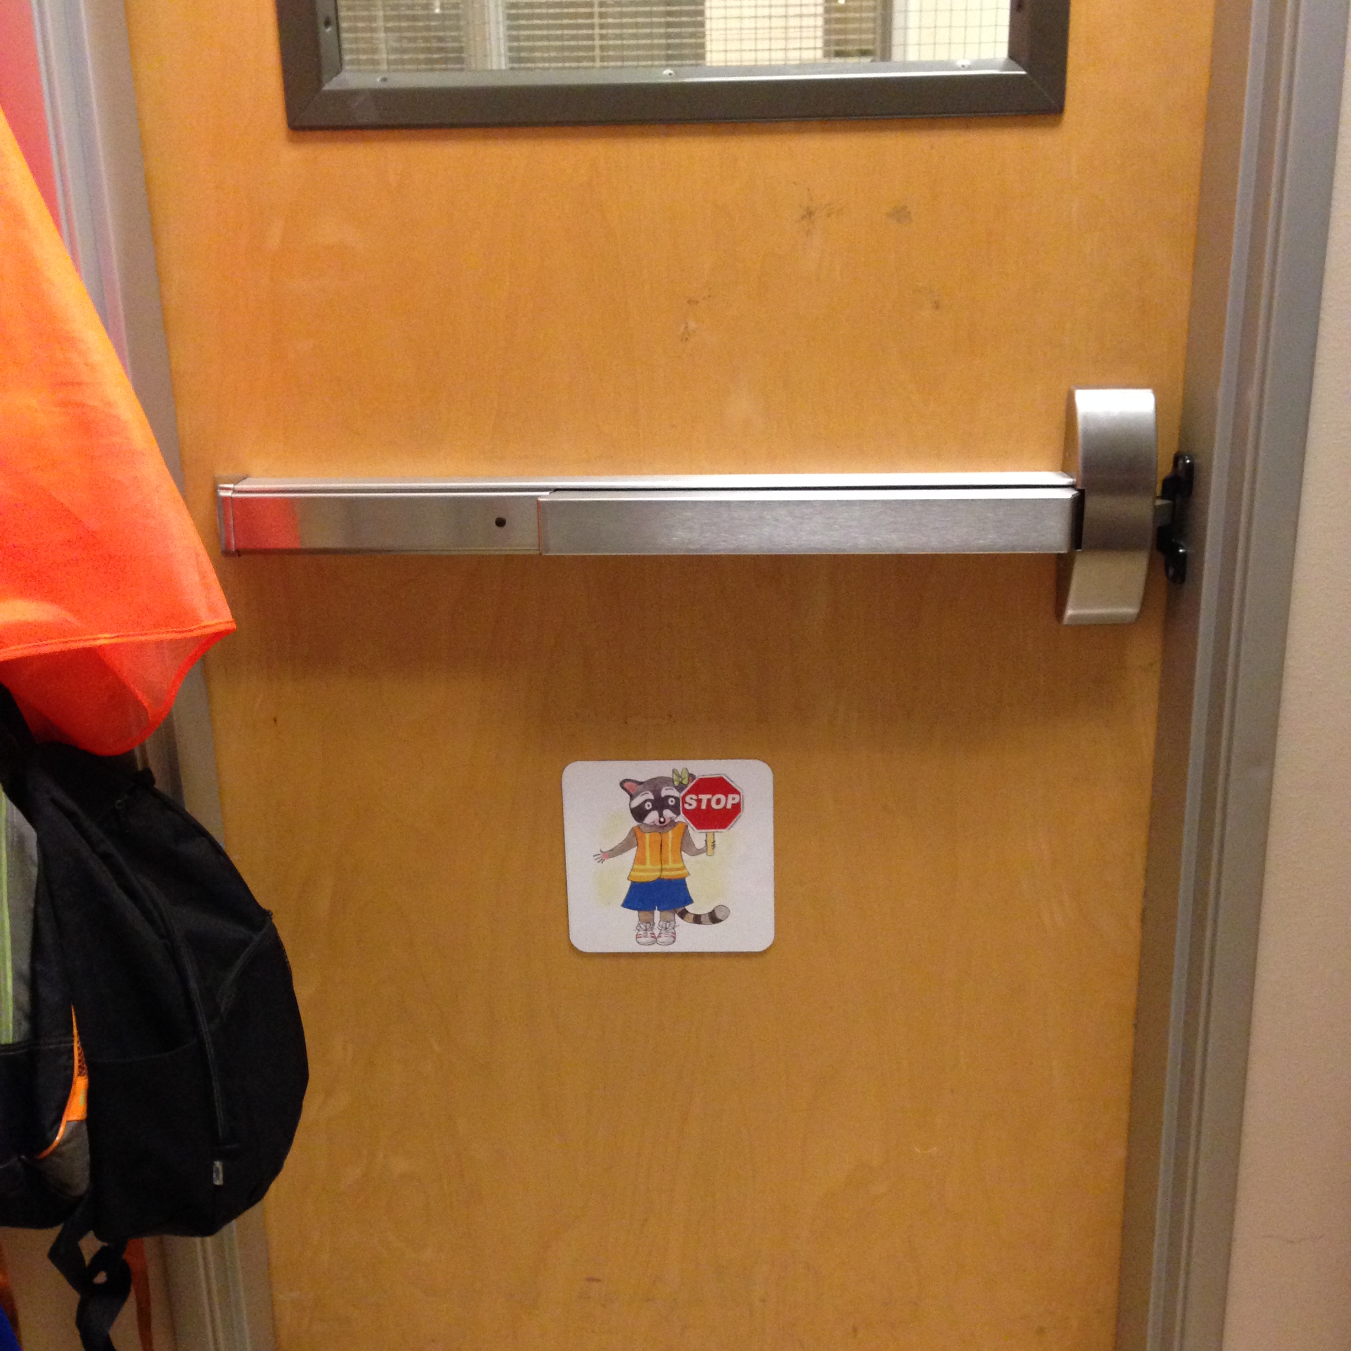
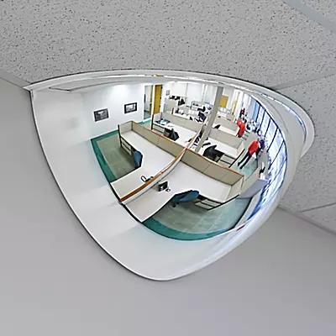


Using Tools and Resources
Notes:
Identify some tools that can assist in Supervision such as door signs, chimes, mirrors, markers on the ground, etc.

Slide 14
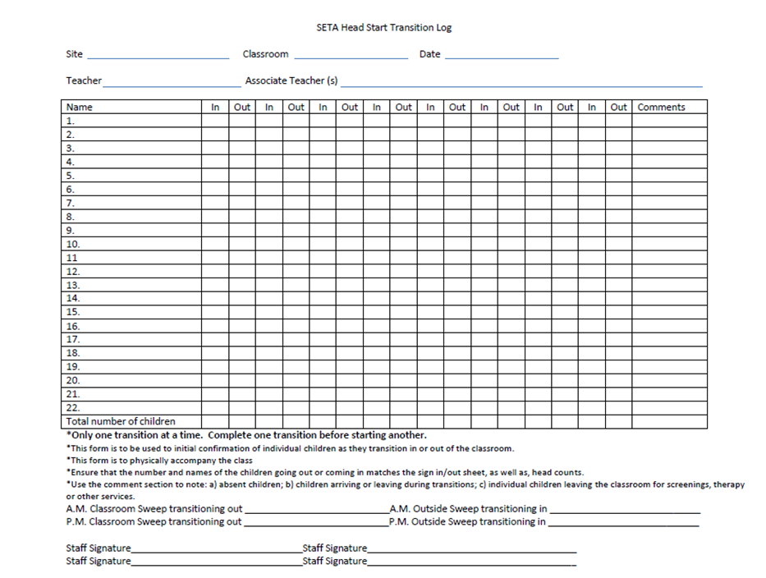
Transition Sheets
Identify who takes the lead to fill out
Only one transition at a time
Notes:
Emphasize that the form is like an insurance policy. If used correctly during transitions, it can prevent a lapse

Slide 15
Activity – Gallery Walk
Let’s look at the 5 SUPERvision steps
and identify the challenges and the successful strategies
Notes:
Have people stand up and join one of the five posted papers in the room. Share that a gallery walk will take place, and each group will take turns cycling around the room, stopping at each word to write down their ideas about what is a challenge and a success for each part of SUPERvision. When the groups are back to their original paper, a spokesperson for the group will read out what was written

Slide 16
Communication

Slide 17
Communication is key
Communication only works if all members are participating
Ensures fail safes are incorporated into routines
Builds relationships and trust in team

Slide 18

I’m taking three friends to the bathroom; you have eight friends.”
I’m back with our three friends. Now all eleven friends are together!”
Got it! You are taking three friends to the bathroom; I have eight friends.”
Got it! You are back with three and we now have eleven.
Call & Response
Make sure the communication loop is closed
Our friend Melanie is leaving for the day. We are down to ten friends.
Noted! I will change the board to ten and mark it on the transition form.
Notes:
We need to close the loop and make sure we not only say what we need to say but that we were actually heard and acknowledged

Slide 19
Practice Accountability
It is always okay to say “hold on”
Practice, practice, practice
Review plans and update regularly
Build trust
Give grace, assume positive intent
Follow up and debrief
Communicate when things aren’t going safely. Do not proceed if you are ever unsure about:
  Having all children
  Accurate count
  All staff on the same page
“Did you mark that child on the transition sheet?”
“Let’s do one more sweep”
“Can you step in ratio?”
“I didn’t hear how many kids you are taking to the bathroom”
Notes:
Practice helps us master these steps. Everyone has the power to put on the brakes if something doesn’t feel safe or secure. If this happens, give each other grace that all have the best intentions. If something does go wrong, debrief to find out why so it can be prevented from happening again.

Slide 20
Zoning
Planning for Effective Supervision
Notes:
What is zoning? When teams share out, note similarities between what they say (redirect understandings as needed)

Slide 21
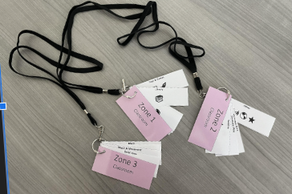
What is Zoning?
  Dividing a space (classroom, yard, etc) into multiple areas or “zones” and assigning a staff person as the primary monitor for that area
The objective is to develop a strong understanding of how to properly monitor and modify a classroom and outdoor space to ensure effective safety and supervision of children
Essential to Identify
Active Supervision Strategies
Hot Spot vs. Cold Spot
Primary Zone vs. Secondary Zone
Notes:
Review objective, encourage people to write down any questions that come up onto sticky notes to review at end
Introduce key terms (ask for volunteers to share their thoughts on each key term)
Active supervision
Hot spot vs. Cold spot
Primary zone vs. Secondary zone

Slide 22
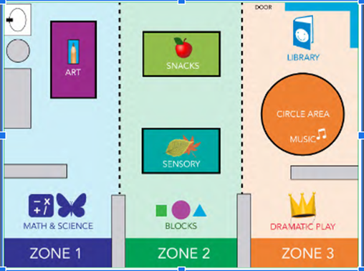
Create a Zoning Plan for your classroom
Using materials provided, make a model of your classroom, and divide into three zones
Questions to consider
  What are Hot Spots vs Cold Spots?
  What times of day are children most engaged? What times are most challenging?
  How do you currently communicate with each other when concerns come up, and how will that change with the Zoning plan?
Notes:
Activity - Classroom set up
Hand out blank pages, and let participants know they will be recreating their classrooms using the materials in the paper bags; the end goal will be to then divide the classrooms into three zones
Each team gets lanyards with zoning areas to create zone assignments

Slide 23
Create a Zoning Plan for your classroom-
continued
 | Interest Areas/Classroom Features | Hot/Cold Spots | Additional Notes
Zone 1
Zone 2
Zone 3
Notes:
As classroom teams, complete the zoning plan handout – classroom
Facilitators walk around and help troubleshoot as needed
Site Supervisors work on the zoning plan handout – outdoor area
Facilitators walk around and help troubleshoot as needed

Slide 24
The Zoning Plan- Ongoing Support
This zoning plan should not a “one and done,” but an ongoing plan that is revisited and updated regularly
Established team
  Rotating between zones and responsibilities
  Frequency of updating Zoning Plan
  Adaptive vs. Reactive zoning
New staff
  Who will review the Zoning Plan with new teaching staff?
Short-term staffing
  Who will review with substitutes?
Notes:
Teams discuss plan for rotating staff between zones, frequency of updating the plan, and how to be adaptive rather than reactive with setup of spaces
Site Supervisors work with staff to determine who will review the plan with new long term staff and short term (substitutes)

Slide 25
Putting it All Together and Creating a Plan
Using all the information discussed during this session, you will work with your classroom team to develop the overall Classroom Safety Plan.
Notes:
Pass out the Classroom Safety Plans- 2024 version. Teachers will complete as a team.

Slide 26

Have a wonderful safe new program year!
Notes:
Thank everyone for participating, remind them to give their plan to the facilitators so copies can be made before they leave; ask for people to share a highlight from the training they are looking forward to implementing at their sites

