Slide 1
Small Group Discussions
Literature Circles
In Your Classroom

Slide 2
Session Outcomes
Experience the value and pitfalls of discussion as a central classroom tool
Acquire multiple strategies for implementing small group discussion (lit circles/book clubs)

Slide 3
Three weird but true things about me…
I was a Classics Major.
I have 19-year-old triplet boys. In college.
It is my first time presenting to teachers. Please share some feedback about what I should do less of and what I should do more of. Thank you!

Slide 4
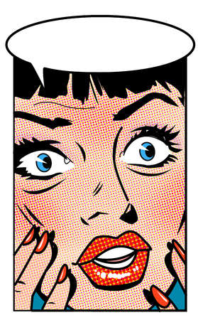
The last thing
I need is…
more student talk!

Slide 5
Why use discussion?
Engage Students
Increase Rigor
Common Core
Share the Stage

Slide 6
Building Academic Conversations
Establishing expectations for all classroom talk
Implementing discussion protocols
Increasing depth of conversations
Setting up physical environment that promotes conversation
Rare Occasional Frequent
Notes:
Talking points:

Slide 7
Yes…
more student talk!

Slide 8
Let’s Try on the Work!
Learner Hat
Small group activity
Fully experience your own learning
Work together to unlock the meaning of a short text
Teacher Hat
Debrief after
Pick a partner to share out
How would you use this in your classroom?

Slide 9
4 Essential Components of Small Group/Lit Circle Discussions
Accountability (forms)
Discussion Protocol Supports
Thinking Tools
Output/Product (backwards planning)

Slide 10
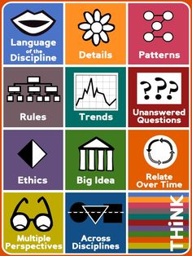
Icons of Depth and Complexity
“Thinking tools”
from Sandra
Kaplan’s
work

Slide 11
“Handlebars” by the Flobots
Use Depth and Complexity thinking tools
All listen for Details that stand out
Next, groups talk for 5 minutes, using your assigned tool as a lens to approach the text
Share out; work as whole group to articulate the Big Idea/theme

Slide 12
https://www.youtube.com/watch?v=8tFFdO2UZCU

Slide 13
Teacher Talk (partners)
What might this look like in your classroom?

Slide 14
OK, that’s what small group discussion looks and feels like.
Let’s talk about what it takes to make it happen in your classroom.

Slide 15
Accountability
Before discussion:
Role Sheets (grade for completion)
Quick reading check: quiz/attribute quotes/passage commentary
After discussion:
Evaluate self and group
Corroborate quiz, role sheet, participation
Culminating reflection: What did we do well? What could we do better? Why use Lit Circles?

Slide 16
Teacher Talk (partners)
What might this look like in your classroom?

Slide 17
Discussion Protocols
Poster on wall
Table-top supports (flat or folded)
Ask students to set goals for participation
Problem-solve around inducing quiet students to join the conversation (shy, or lack of preparation?)
“Two cents” – limit talk until all have spoken twice
“Fishbowl” to present strong model
Reflect, reflect, reflect!

Slide 18
Increasing Depth of Conversations with Conversation Skills
Another way to increase the depth of academic conversations is to teach students to facilitate conversations in teacher-like ways.
Academic Conversations,
Jeff Zwiers and Marie Crawford
Stenhouse (2011)
Notes:
This is the Constructive Conversation Skills Poster. It is a tool for helping teach students to facilitate their own conversations is teacher-like ways. Each conversation skill should be explicitly taught including some ways the skill might sound in conversation. Read the passage from Jeff Zwiers BOOK TITLE explaining each of the skills. Think time (2 minute plan) how would you teach this in your classroom? Now you will have 5 minutes to come up with the steps you would take in your classroom to teach one of these skills.
Note to presenter: Be sure modeling the skills, practicing with student-friendly content, and developing an anchor chart are among strategies discussed as a group.

Slide 19
Teacher Talk (partners)
What might this look like in your classroom?

Slide 20
Wrap up
Q & A

