Slide 1

CCSS-Aligned K-6 Report Card Training
for SCUSD Parents/Guardians
Notes:
Welcome SCUSD parents and guardians of students in Kindergarten through grade 6. We are excited to share with you changes to the elementary report card that are occurring as a result of state-wide implementation of the Common Core State Standards. These changes will impact what you see on your child’s report card beginning with the 2014-15 school year. We believe the changes will provide you with more detailed information about your child’s progress towards meeting the standards and will allow you to support your child’s academic growth and development.

Slide 2
Outcomes
  Examine the similarities and differences between the old and new report cards
  Understand the key features of standards-based grading
  Provide ways parents can use the new report card to support their child
Notes:
In this video, we will cover three areas
First, we will introduce you to the new report card by highlighting some of the similarities and differences between the old and the new report card.
We will then share with you some of the key features of standards based grading
We will end with some ways you can use the new report card to support your child with meeting the standards

Slide 3
CCSS-Aligned K-6 Report Card
What’s New/What’s The Same
Notes:
Now lets take a look at the new report card and discuss what is new and what remains the same.

Slide 4
CCSS-Aligned Report Card: What’s New?
Different Grading Scales (2)
Notes:
Time: 1-2 minutes
Take a look at the far left side of the report card where you see the grading scales. The first major difference you will see on the report card is that there are different grading scales on the new report card. The first scale “Academic Performance Level for Standards Achievement” is numerical and based on the four levels of the new state assessment, the California Assessment of Student Progress and Performance or CAASPP. Students will receive a number mark of 4 for exceeding the standard. 3 for meeting the standards, 2 for progressing towards the standards, or 1 for minimal progress. This replaces the old scale of A for Advanced, P for Proficient, B for Basic, BB for Below Basic, and FBB for Far Below Basic. The headers, exceeds standards, meets standards, approaching standards, and minimal progress etc., will be used to report on your child’s achievement on the major areas for each subject such as Reading Literature, Writing, Mathematics, Science, Physical Education, etc.
The second scale, Academic Performance Level for Learning Expectations, is an alpha scale and is used to show how students are progressing on specific sub-skills and standards that fall under or describe each of the major areas that receive a numeric grade. Students will receive an O for Outstanding, a S for Satisfactory, a P for Progressing, or a N for Needs Improvement. For example, the specific clusters under mathematics, or sub strands under Reading Literature. This detail is provided to help you understand your child’s areas of strength and challenge for each subject area
You will see this illustrated more closely shortly
The Academic Performance Level for English learner Proficiency is the same as that on the previous report card and indicates English Learner performance on the California English Language Development Test or CELDT
The last scale “Academic Performance Level for Service Notifications” is the same as on the previous report card and indicates that a student is receiving certain services such as those for students identified as English Learners, Gifted and Talented or Students with disabilities.

Slide 5
CCSS-Aligned Report Card: What’s New?
Different Grading Scales
Academic Performance Level for Standards Achievement
Name
Score
Explanation of Scores
Exceeds
Standards
Meets
Standards
Approaching
Standards
Minimal Progress
Towards Standards
4
3
2
1
Exceeds grade level expectations; demonstrates strong independence
Meets grade level expectations; requires minimal support
Approaching grade level expectations; requires moderate support
Minimal progress on grade level
expectations; requires significant support
Notes:
This document provides more detailed information about the meaning of the score points on the grading scale. This scale will appear as a separate document and will be attached to your child’s report card. Remember, the standards reflect end of the grade level expectations or what the student should know and be able to do at the end of the year. The work the student will engage in over the year is designed to help them meet the standards by the end of the year. It is expected that most students will be working at the level of “2” for most of the year as they will be learning and therefore approaching the standards. This indicates normal progress.
Note that a four (4) means that the student is consistently working above the grade level standards or is working in the next grade level’s standards and is doing so with independence which means that he or she does not require a great deal of support. A score of 3 means that the student is meeting the grade level expectations consistently and requires minimal support. A score of 2 means that the students is approaching the grade level expectations and requires moderate support. A score of one means that the student is making minimal progress towards grade level expectations and requires significant support. NA means that the content area is not addressed in the trimester or is not applicable at the grade level.

Slide 6
CCSS-Aligned Report Card: What’s New?
Does not negatively impact grade/mark for Standards Achievement
Different Grading Scales
Academic Performance Level for Learning Expectations
Name
Score
Explanation of Scores
Outstanding
Satisfactory
Progressing
Needs Improvement
Not Addressed
O
S
P
N
NA
Exceeds grade level expectations
Meets grade level expectations
Student is near to meeting grade level expectations
Does not meet grade level expectations
Standards were not addressed in the marking period
Notes:
This scale, Academic Performance Level for Learning Expectations, is to used to show how students are progressing on specific sub-skills and standards for each area receiving a numeric mark strands. These marks provide greater detail on the areas of strength and challenge.
We are advising teachers to provide 3-5 pieces of evidence to determine a mark of O, S, P, N.
Note that the mark NA is used to indicate that certain areas were not addressed in that trimester or are not applicable to the grade level. These marks should not impact a students overall mark in the area.

Slide 7
Should I be alarmed if my child receives a “2” in the first two trimesters?
NO!
Can my child earn a “3” or “4” in the first two trimesters?
YES!
Notes:
The question is sometimes asked “Should I be alarmed if my child is receiving a 2 in the first and second semester. The answer is no. You should not be surprised if your child is receiving 2’s during the first and second semester because the standards are end of year expectations and your child should be approaching the standards or scoring a 2 in the first and second trimesters. This indicates that he or she is making expected progress. A score of 2 may also indicate that the standard has not yet been taught to it’s full level of depth and complexity during the marking period, so the student is making progress.
Another questioned that is asked is “Can my child receive a 3 or 4 in the first two trimesters. While this should be a rare occurrence, it is possible for a student to score a 3 or 4 in the first trimester. The student can earn 3 if their work consistently demonstrates that they have fully mastered the grade level standards. A student earns a mark of “4” if he or she is consistently working at the level of expectation of the next grade level standards. Again, these marks are not expected in the first or second trimester, but may occur.

Slide 8
CCSS-Aligned Report Card: What’s New?
English Language Arts
2
2
O
P
S
P
P
N
2
2
P
NA
S
2
P
P
P
P
P
P
2
NA
S
NA
NA
P
NA
NA
Notes:
Now lets take a look at where the items from the ELA standards document appear on the report card. The sample on this slide is for Kindergarten, but is very similar to the other grade levels.
The numeric mark is always recorded for the areas with the the word“ ACHIEVEMENT” in the title and is always in Capital letters. For example, on this sample report card, you see Reading literature Achievement, Reading Informational text achievement, Writing Achievement, Language Achievement, Speaking and Listening Achievement, and Foundations Achievement. These lines all receive a numeric grade or a 4, 3, 2, 1.
Under each numeric mark you see a title with the word “EXPECTATIONS”. For example. Under Reading Literature Achievement, you see “Reading Literature Expectations” Below this, you will see a list of sub skills or expectations that students will meet to demonstrate meeting the grade level standards for Reading Literature Achievement. These include, Key Ideas and Details, Craft and Structure, Integration of Knowledge and Ideas, and Range of Reading and Text Complexity. Each of these would receive an “Alpha mark of O for Outstanding, S for Satisfactory, P for Progressing, N for needs improvement, or NA if the areas has not been addressed in the trimester.
Wherever you see the word “Expectations” in the title, the skills underneath will be marked with alpha marks as indicated here.

Slide 9
CCSS-Aligned Report Card: What’s New?
Mathematics
2
P
P
S
S
P
NA
NA
NA
NA
2
S
NA
P
P
P
P
NA
NA
Notes:
Now lets take a look at where the items from the Math standards appear on the report card. The sample on this slide is also for Kindergarten, but is very similar to the other grade levels.
Look on the slide for “Mathematics Achievement. Overall Mathematics Achievement indicates how the student is doing in all of the areas for mathematics and is marked with a Numeric grade (4, 3, 2, 1). The other area for math that receives a numeric mark are the standards for mathematical practice. These are the habits of mind and the practices of a mathematical thinker.
Lets take a look at the other areas on the report card. Similar to English Language Arts, you see areas with the word “Expectations in the title. These include Counting and Cardinality Expectations, Operations and Algebraic Thinking Expectations, Numbers and Operations in Base ten Expectations, Measurement and data Expectations, Geometry Expectations, Standards for Mathematical Practice Expectations.
Under this title, you will see the sub-skills and standards for each area. These are what students are expected know and be able to do at the end of the year. These areas are always marked with an Alpha mark or an O for Outstanding, S for Satisfactory, P for Progressing, N for Needs Improvement or NA if the area is not addressed. Here is a sample of how the report card should be marked.

Slide 10
CCSS-Aligned Report Card: What’s New?
Social Studies, Science, and Physical Education
2
NA
S
NA
2
P
P
P
P
NA
S
NA
NA
NA
2
P
NA
NA
Notes:
Similar to English Language Arts and Math, Social studies, science, and PE are graded at the Achievement Level with a numeric grade (4, 3, 2, 1)
Standards or content has been added under Social Studies Expectations, Science Expectations, Physical education Expectations, and is graded with an Alpha grade (O for Outstanding, S for Satisfactory, P for Progressing, N for Needs Improvement or NA if the area has not been addressed.

Slide 11
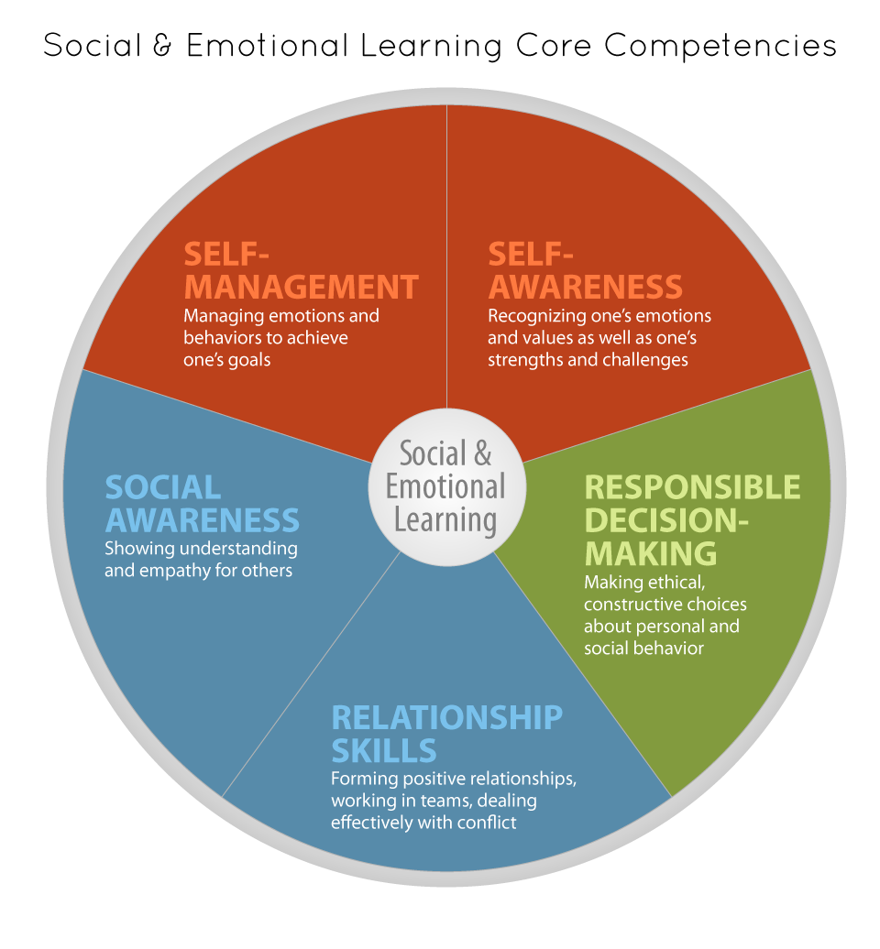
CCSS-Aligned Report Card: What’s New?
Behaviors that Support Learning
S
S
S
S
S
S
Notes:
Similar to the previous report card, this report card also provides feedback on student’s progress with Behaviors that Support Learning which are work habits and behavior marks. These have been revised to reflect the social emotional learning competencies or skills. They are marked with an Alpha grade of O for outstanding, S for satisfactory, P for progressing, or N for needs improvement.

Slide 12
CCSS-Aligned Report Card: What’s New?
Student Status & Approaches to Intervention
New Headers
And
Information Organized Differently
X
X
Notes:
Student Status and Approaches to Intervention is re-organized and renamed. These are marked with an “X” to indicate the status of the student or the approach being utilized. In the example on the screen, this student is working below grade level which is marked with an X under the section titled “Student Status” and is receiving small group instruction as indicated under the section “Approaches to Intervention”

Slide 13
CCSS-Aligned Report Card: What’s New?
X
X
X
I
Notes:
The Special Programs section is marked with an X if the students is in one of the program. In the example, the student is in the English Learner Program and is receiving “Primary Language Support”
The English Learner Proficiency section is marked with an “X” if the student Redesignates as Fluent English Proficient or RFEP in the trimester or is left blank. The CELDT section is marked with the students most recent scores on the CELDT or the CA English Language Proficiency Test. In the example on this slide the student’s CELDT score is marked “I” for Intermediate

Slide 14
Standards-Based Grading with the Common Core State Standards
Notes:
The district has been engaged in standards based grading for several years even with the CA State Standards. We will now share with you some of the major differences between standards-based grading and traditional grading.

Slide 15
Standards-Based Grading
DEFINITION: “Grades are feedback to the learner on the degree to which he/she has the knowledge in standards (benchmarks, indicators, learning goals…etc.) at a particular point in time.”
Dr. Robert J. Marzano & Dr. Tammy Heflebower
http://www.ywp.esd112.org/assets/articles/docs/WA_ESD_May_2010.pdf
Notes:
The focus of standards based grading is to provide feedback on where students are in relationship to the standards at a particular point in time. This feedback helps the student, the teacher, and parents or guardians understand the areas of strength and the areas were the student may need additional support.

Slide 16
Determining Marks for Trimester Grades
Some assignments will be graded and some will not
  First attempts and beginning practice should be corrected but no mark given
    Only after a concept/skill has been taught and practiced should grades be kept in a grade book
Multiple opportunities should be given for each student to master a standard
  3-5 pieces of successful, recent evidence should be collected to determine final reporting grades (i.e. evidence of student learning through daily work, observations, quizzes, tests, and projects)
Student should be able to consistently show proficiency
    If the student is all over the place with marks-- teachers ask themselves---does this student consistently demonstrate mastery?
Notes:
With standards-based grading, not all assignments will be graded and count towards report card marks. Early attempts and practice should provide feedback. After a skills and concepts have been taught and practiced, more recent work should be used for marks
Students should have multiple opportunities to master the standards and show what they know.
Three to five pieces of recent evidence should be used to determine report card marks.
Finally, students need to be able to consistently show that they are able to meet the standards, otherwise there mark in that area should be a “2” for approaching the standards or a “P” for progressing.

Slide 17
Looking at Student Performance Over Time
 | Task 1 Key Ideas and Details | Task 2 Key Ideas and Details | Task 3 Key Ideas and Details | Task 4 Key Ideas and Details | Task 5 Key Ideas and Details | Task 6 Key Ideas and Details | Task 7 Key Ideas and Details | Average
Cinderella | 4 | 1 | 3 | 2 | 4 | 1 | 2 | 2.4
Snow White | 1 | 2 | 1 | 2 | 3 | 4 | 4 | 2.4
Belle | 4 | 3 | 4 | 2 | 1 | 2 | 1 | 2.4
Mastery (Score that indicates meeting the standards) | 3 | 3 | 3 | 3 | 3 | 3 | 3
Notes:
Time: 10 minutes
To illustrate how standards based grading work, we will show you an example of 3 students. Cinderella, Snow White, and Belle
These student have completed seven assignments that reflect their performance on one of the areas graded for Reading Literature “Key Ideas and Details. All of the assignments are graded on a 4-point scale with a 4 meaning that the student is exceeding the standards . Note that a 3 is mastery or the score that indicates a student has met the standards.
Remember, in standards based grading, we are paying closer attention to the most recent evidence or work. Take a look at the three students. Cinderella, who is represented by the blue line has scores that have been up and down from a 4 to 1 and 3 to a 2. Her last three scores indicate a downward trend. Snow white who is represented by the orange line, started off weak but has progressed upward. Her most recent scores shows mastery and she is beginning to exceed the standards. The last student, Belle, whose scores are represented by the grey line, started off strong, but her most recent work indicates that she is not meeting the standards.
In traditional grading, teachers would take the average of the scores to determine a students marks. Take a look at the averages for each student. Which students would pass and which would fail if these were traditional grades. If this were a traditional classroom, all of the students would receiving a failing mark. In standards based grading, teachers do not average scores to determine grades, but look at trends over time with closer attention paid to the most recent evidence. In this example, Snow White is the only student who has consistently demonstrated that she has met the standards.

Slide 18
How Can You Use the New Report Card System to Support Your Child?
During Parent Conferences:
Ask to see samples of your child’s work
Discuss the work samples to see if they are satisfactory
Request specific feedback on areas needing improvement
Inquire about resources to support your child
Notes:
HOW CAN YOU USE THE NEW REPORTING SYSTEM TO HELP YOUR CHILD?
Standards-based report cards provide detailed information about how a child is doing in each subject. Parents will be able to see whether students need extra assistance in certain areas or when they need to be challenged even more. By using these clearly defined standards, teachers and parents can work together to ensure that students succeed
During parent-teacher conferences, ask to see samples of your child’s work. Talk to his or her teacher about whether the work samples are satisfactory, or how your child could have done a better job on the assignments. Ask how you can help your child improve or excel in various subjects and what resources are available to use outside the classroom to encourage his or her progress.

Slide 19
For more information go to
www.scusd.edu/common-core
Notes:
We are excited to bring you this new report card system and believe that the information it provides will keep you better informed about your child’s progress towards meeting the standards in all subject areas. We look forward to implementing it this year school year. We encourage you to have conversations with your child’s teacher about their performance an learn as much as you can about the new Common Core State Standards. More information can be found at the SCUSD website www.scusd.edu/common-core

