Slide 1

Maintenance & Operations
Mandated Training
2024-2025
Presented by
Keyshun Marshall, Risk Management Director
Amber Pena, Risk Management Manager
Martine Kruger, Risk Management Specialist
BraJona Rashada, Benefit Analyst
Notes:
Keyshun

Slide 2

What We Will Cover Today
Injury Reporting
Employee Assistance Program
Risk Management Folder
Site/Property Inspection Requirement
Mandated Safety Compliance
Notes:
Keyshun

Slide 3
Injury Reporting - What you need to do……
District Bulletin WORKERS’ COMPENSATION CLAIMS REPORTING PROCEDURES, STRUCTURED TRANSITIONAL WORK PROGRAM, INJURY REPORTING
Claims Reporting Procedure:
If the injury or illness is life-threatening or requires medical transport, call 911
Employees must report all work-related injuries/illnesses directly to their supervisor, site administrator, or designee as soon as possible
Employees must contact the SIA Injury Reporting Line as soon as possible at (916) 643-9299 to report a work injury or illness and obtain further instructions from the Early Intervention Nurse (EIN)
EIN will conduct a telephonic medical triage (if needed) and if formal medical care is needed or requested, the EIN will coordinate medical treatment for the employee
Employee must complete an Incident report. Report can be found online or with the School Office Manager. Report must be signed by Supervisor and sent to Riskm@scusd.edu. An incident report can be completed for you by colleague or Supervisor. The intent of this report is to notify Risk Management of the incident immediately
Appointments are to be scheduled before or after work whenever possible to prevent sick leave dock or wage loss. This applies to follow-up appointments and physical therapy as well. Please note: For work-related injuries/illnesses, workers’ compensation will not pick up benefits for lost time or wages due to medical or therapy appointments.
Notes:
Moderator - BraJona
Panelist - Amber

Slide 4
Injury Reporting - What you need to do……
District Bulletin - WORKERS’ COMPENSATION CLAIMS REPORTING PROCEDURES, STRUCTURED TRANSITIONAL WORK PROGRAM, INJURY REPORTING
Temporary Transitional Work Program:
To assist injured employees in their recovery for both work and non-work related injuries/illnesses, the District provides temporary transitional work in the form of modified or alternate work whenever possible. This includes placement at an alternate site if your permanent site cannot accommodate
Permanent Restrictions:
The District will comply with all federal, state and local laws and regulations requiring the accommodation of disabled employees. Contact the Benefits Analyst at (916) 643-7895 if you have a permanent disability that will affect your performance at work.
Doctor’s Statement/Medical Appointment:
The injured worker must provide the original medical slip to their Supervisor and Benefits Analyst immediately following his/her medical appointment.
Medical documents can be emailed to leaves@scusd.edu, or faxed to a secured fax number at (916) 399-2071.
Notes:
Moderator - BraJona
Panelist - Amber

Slide 5
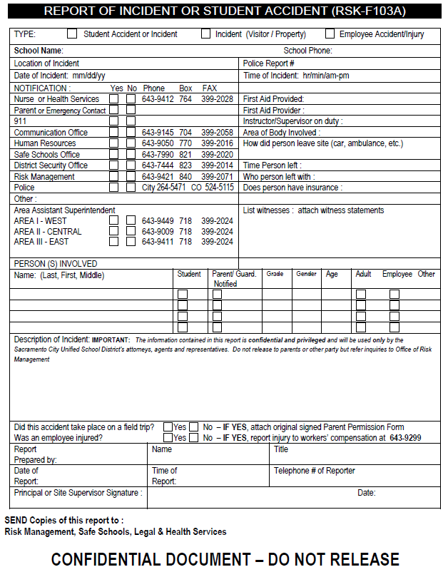
Notes:
BraJona

Slide 6
EAP - Employee Assistance Program OPTUM
EAP is a service designed to help you manage life’s challenges. With Optum, they customize EAP solutions by understanding your unique needs and then offering the appropriate assistance or referrals. The following services, paid for by SCUSD, are available to all employees including members within the household. Services are available 24/7 and kept completely confidential
Clinical Counseling
Marriage, relationship and family counseling
Domestic Violence
Alcohol and drug dependency
Stress, anxiety, and depression
Grief of loss
Work and Life Services
Childcare and eldercare assistance
Financial services
Legal services
Identity theft recovery services
2 Steps to access:
Visit www.liveandworkwell.com to register and use company code: SIA
2. Call 866-248-4096
Notes:
Moderator - BraJona
Panelist - Amber

Slide 7
Risk Management Folder - Safety at your site…
Waste Removal - Hazardous, Universal, E-waste, surplus equipment, recycling
Bulletins - Fireworks, Injury Reporting, Vehicle Restrictions, IPM Healthy Schools Act, Pull Notice Program
Report of Incident/ Accident
Heat Illness Prevention
Slips, Trips and Falls / Lift and Carry
PPE ordering
Vandalism Prevention Tips
Accident Exposure
Hazardous Conditions Reporting/Hazard Alert Form
Inspection checklist - IIPP (Safety Inspection), Playground, Property, Bleachers
Safety Data Sheet (SDS)
Auto Accident
Notes:
Keyshun
Use your risk management folder as a resources
This folder of information contains all the needed documents and forms required to have a safe and healthy school site
Throughout the school year there is a lot of movement with staff, students, community

Slide 8
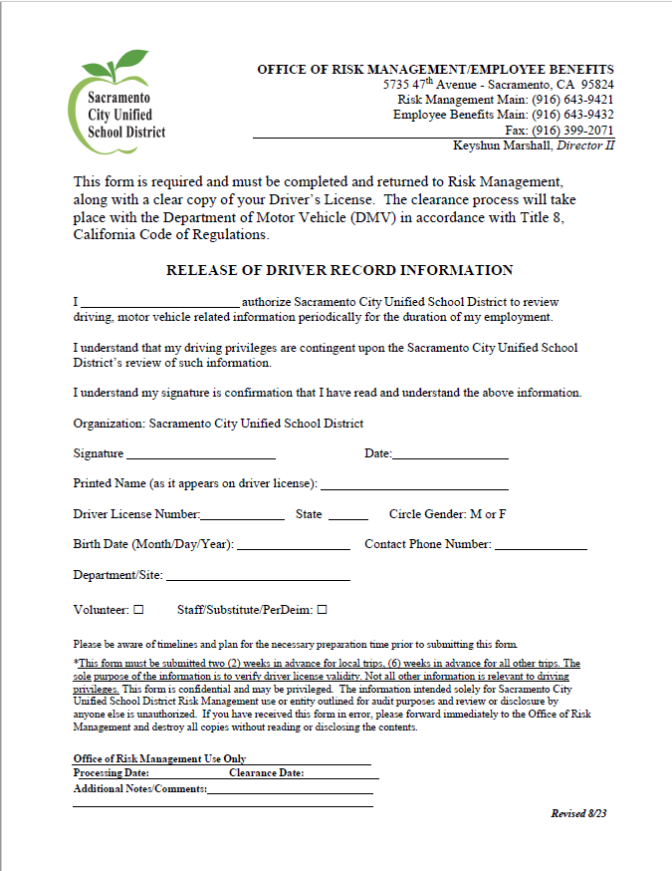
Employee Pull Notice Program
Notes:
Moderator - Keyshun
Panelist - Martine
If you are volunteering for your child at a site, make sure to write the site on the release form. If you are driving for District and volunteering, please enter both, your department and the site of your child. This will ensure you are on both lists are approved drivers.

Slide 9
Site/Property Inspections
IIPP - safety inspection checklist covering floors/walkways, ladders/fall protection, fire safety, electrical safety, machine, chemical hazards, ergonomic and PPE
Playground - inspections frequency should be a daily visual, weekly to check fall material, monthly to check equipment and annually to fill fall material.
Property - monthly checklist covering fire/intrusion alarms, doors and fences, fire extinguishers, indoor air quality, elevators/lifts
Bleachers - covers general and specific structural areas, guardrails, openings. Other specific areas for operational use (trained staff), warning signs affixed and visible, clearly marked isles, regular documented inspections
Document all Inspections. “If it isn’t written down, it didn’t happen”. Take credit for the work you are doing!
Notes:
Moderator - Keyshun
Panel Martine - See handout in folder for more detailed information
Property Damages - fill out the property damage form and turn in to RM - Notify Facilities and place work orders. Same for playgrounds.

Slide 10
Waste Removal
Hazardous waste - generated with custodial staff, science labs, robotics, auto shop,
Universal waste - 5 types; batteries, pesticides, mercury, lamps, aerosol cans
Batteries / Vape Pens - use battery container for both items. Never put pens or batteries in boxes, drawers or other areas.
Notes:
Moderator - Keyshun
Panelist Martini -
Haz Waste Removal requests - Prep forms and obtain Science Teacher assistance for list of chemicals. Send to Scott Holton and include Riskm@scusd.edu in cc
Universal Waste - send form to Scott Holton and Riskm@scusd.edu
Keyshun - Vape Pens

Slide 11
Mandated Safety Compliance
IIPP - Injury Illness Prevention Plan Heat Illness, Respiratory, Hazard Reporting
CPP - COVID Prevention Plan, Non-Emergency regulations effective 8/2022 - February 3, 2026 - District shall provide face coverings which includes respirators for voluntary use. District shall provide means for employees to test at no cost
WVPP - Workplace Violence Prevention Plan effective 7/1/2024 - California Occupational Safety and Health. Employers are required to establish and maintain an effective workplace violence prevention plan
CSSP - Comprehensive Safe Schools Plan - plan includes maintenance of a safe and orderly environment, procedures for safe ingress and egress, school building disaster response, fire drills, earthquake emergency procedures, etc.
For a more detailed outline and training for staff please refer to Public School Works (PSW).
Notes:
Moderator - Martine
Panelist - Keyshun

Slide 12
Mandated Safety Compliance - IIPP
IIPP (Injury Illness Prevention Plan) - District commitment to safety. The plan must be in writing, identify the person or persons with authority, provide a means for identifying job safety and health hazards, establish routine documented inspections, document training, provide method of assuring of
Hazard Identification, Evaluation and Control - Inspections, Employee Hazard Reporting Procedures, Hazard Evaluation and Control, Imminent Hazards
Safety and Health Training - when training will occur, areas of training to be covered such as Heat Illness and respiratory
Communication with employees on safety and health - safety meetings, anonymous reporting, department safety committee meetings
Accident Investigation
District Safety Rules
Emergencies
Enforcement of safety program
Notes:
Moderator - Martine
Panelist -Keyshun

Slide 13
Environmental/OSHA Visits
Documents/Training
HMBP Hazardous Materials Business Plan - Site Plan (All High Schools)
Proof of Inspection
DOT - Manifest
Staff Training - IIPP, Heat Illness, HMBP,
Frequent Violations
Vape pens
Waste labeling
Proof or lack of training
Notes:
Moderator - Martine
Panelist - Keyshun

Slide 14
Content Review
Injury Reporting
Employee Assistance Program
Risk Management Folder
Site/Property Inspection Requirement
Mandated Safety Compliance
Notes:
Moderator - BraJona
Panelist - all Injury Reporting/EAP (AMBER), Site (MARTINE), RM/Mand (Keyshun)

Slide 15
Knowledge Check Quiz
Where can you find the Injury Illness Prevention Plan?
  In a teacher’s classroom
  In the SPOM/Tradesmen office
  Risk Management webpage
Name two documents required for environmental inspections:
  Manifest/HMBP
  Heat Illness/ICPC
  Mechanical Safety/Incident Report
What does HMBP stand for?
  Hazardous Materials Base Plan
  Hazardous Materials Business Plan
  Hazardous Materials Ballpark Plan
Notes:
BraJona

Slide 16
Knowledge Check Quiz
4. When do you need to report your work injury?
  When you get home
  When I see my Supervisor
  Immediately after it occurs
5. Where can you find the Incident Report?
At the Office Managers desk
Ask the Principal
Ask your Director
  Bonus question: What other location can you find the Incident report?
6. Name one mandated compliance discussed today?

Slide 17
Knowledge Check Quiz
7. How often are playground inspections conducted?
daily, weekly, monthly, annually
Monthly
Never
8. Who can use EAP services?
9. How often are you going to submit a valid driver's license to risk management?
Every 3 years
Every 6 months
Every school year

Slide 18
Risk Management / Employee Benefits Contact Information
Keyshun Marshall, Director II Keyshun-Marshall@scusd.edu 916-643-9421 916-752-3324 cell | Amber Pena, Manager II amber-pena@scusd.edu 916-643-7895 916-417-8931 cell
BraJona Rashada, Benefits Analyst BraJona-Rashada@scusd.edu 916-643-7895 | Martine Kruger, RM Specialist Krugerm@scusd.edu 916-643-9421
Maria Colmenares, Benefit Technician (A-L) MariaCo@scusd.edu 916-643-7908 | Nicole Macias, Benefit Technician (M-Z) Nicole-Macias@scusd.edu 916-643-7906
Scott Holton, Haz Materials Compliance Lead Scott-Holton@scusd.edu 916-643-7905 916-752-3304 cell | Gerald Ayers, Serna Security Officer Gerald-Ayers@scusd.edu 916-730-9597
Risk Management main line 916-643-9421 * Workers’ Compensation reporting line 916-643-9299 Employee Benefits main line 916-643-9432 *Fax 916-399-2071
Notes:
Keyshun

