Slide 1
Tools for Success: Application of UDL and Accommodations to Support ALL Students in the CCSS
Presented By:
Linda Mangum, Courtney Coffin, Melissa Ferrante
SCUSD Inclusive Practices Coaches

Slide 2
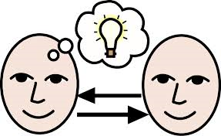
Share one strategy you are using to reach ALL learners.
Notes:
Introduce yourself. Discuss question, then ask for a few responses. Share partner’s response.

Slide 3
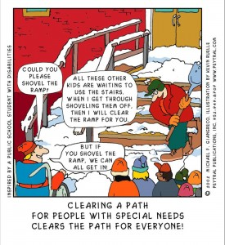
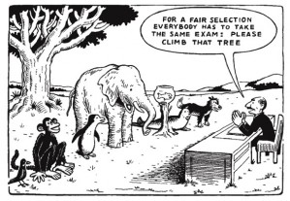
Universal Design for Learning Benefits Everyone!

Slide 4
What is UDL?
UDL gives all individuals equal opportunities to learn.
UDL provides a blueprint for creating instructional goals, methods, materials, and assessments.
It’s not a single, one-size-fits-all solution, but rather flexible approaches that can be customized and adjusted for individual needs.
Notes:
NEED TO LOOK AT THE LESSON BEFORE HAND
Need to know your students (accomm checklist or other tools)
Need to understand UDL and accomm on IEP

Slide 5
Why is UDL Necessary?
Individuals bring a huge variety of skills, needs, and interests to learning.
Neuroscience reveals that these differences are as varied and unique as our DNA or fingerprints.
Notes:
12-22% of students have some sort of cognitive, behavioral, or emotional difference. These are students with AND without IEPs

Slide 6
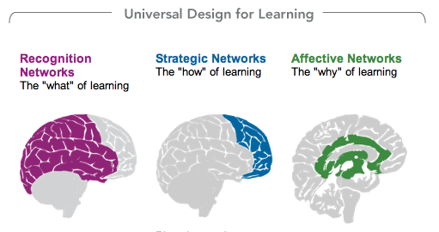
How we gather facts and categorize what we see, hear, and read. Identifying letters, words, or an author's style are recognition tasks.
Planning and performing tasks. How we organize and express our ideas. Writing an essay or solving a math problem are strategic tasks.
How learners get engaged and stay motivated. How they are challenged, excited, or interested. These are affective dimensions.
Notes:
Introduce the WHEELS, UDL handout

Slide 7
Using a curriculum that is rooted in the 3 UDL principles:
Teachers Provide: | Students Have:
Flexible ways of presenting lesson content. (WHAT) | Options for how they learn.
Flexible methods of expression and assessment. (HOW) | Choices for how they demonstrate their knowledge and learning.
Flexible options for student engagement. (WHY) | Choices which will engage student interest.
Notes:
Providing thoughtful choices based on student need and differences. Set the parameters.

Slide 8
UDL is for ALL Students
Strategy # 8
UDL is a framework to support the variability of learners that exist in all classrooms.
This includes gifted students, disengaged students, students with disabilities, students who are English learners, and even the mythical average student.
Notes:
Todd Rose Learner Variability 10:13 minutes TED TALK

Slide 9
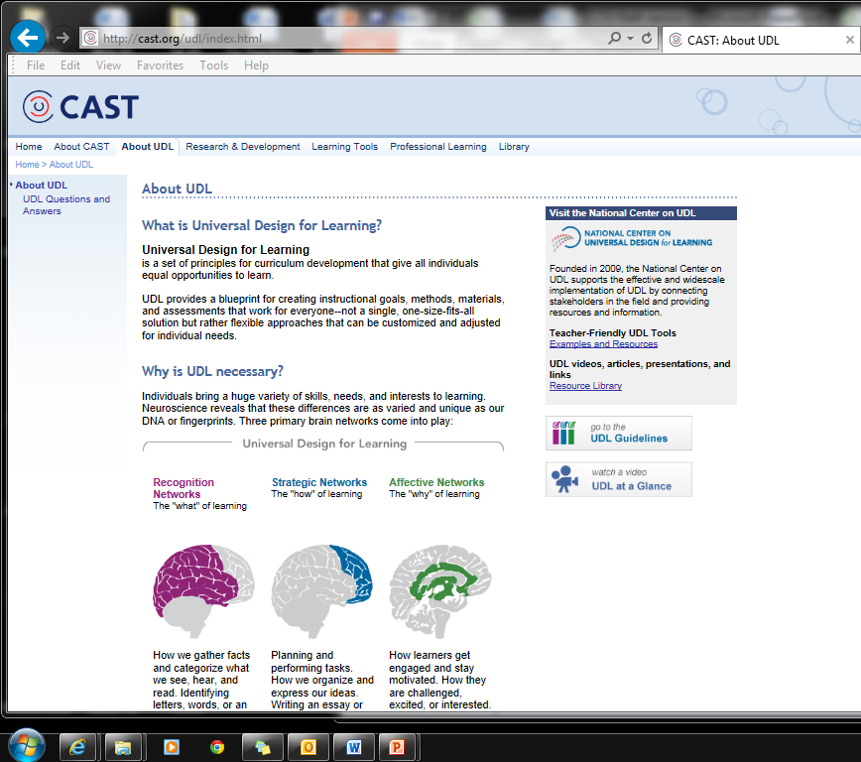
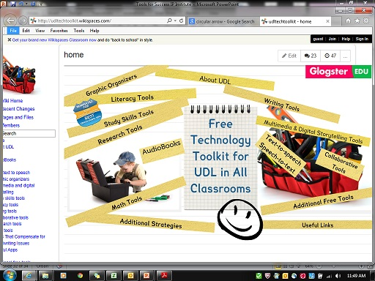
http://udltechtoolkit.wikispaces.com/
http://cast.org/index.html

Slide 10
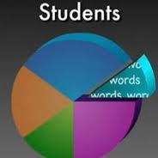
Strategy # 6
California’s Learning Population
http://www.youtube.com/watch?v=7odhYT8yzUM
Notes:
Stop after 1:47 after Einstein quote WOW!
Feedback?

Slide 11
But what about those students who need more???
Accommodations:
A change in what or how something is being presented or represented
Does not alter or change the outcome or expectation
Does not require an IEP
Grading is the same
Looks a lot like UDL…
Notes:
Its just good teaching… cannot be used interchangeably with the word MODIFICATION

Slide 12
Common Deficits
Fine motor/writing skills
Comprehension, reasoning, and processing
Reading skills
Basic math skills
Organization, executive functioning skills
Short attention span (ADHD), sensory needs
Notes:
support sheet

Slide 13
2nd Grade Common Core Math Standard
2.NBT.1-4
Understand place value
https://www.pearsonrealize.com/community/program/58e50286-d716-4390-a92f-a02ae1d49382/6/tier/986e2fc9-9328-48c2-adcb-800a85deebeb/5/lesson/0ac2b731-4401-4296-bdc1-81a74626f074/6/content/f5525465-2a31-33ed-b75d-91d3680e48a8/5

Slide 14
3rd Grade Common Core Math Standard
3.NBT.1-2
Use place value understanding and properties of operations to perform multi-digit arithmetic.
https://www.pearsonrealize.com/community/program/164bc745-2f2e-4050-95e3-a4d0fcb7bac4/10/tier/f8f5abe6-2874-49a2-b1d2-3f8c1a2087ea/11/lesson/94601ea1-143b-4589-bc6c-6bf1c4668855/11/content/678c7648-ee97-40f9-8af9-62b29ace0c2d/16

Slide 15
Academic Conversation about Supports to Assist Struggling Learners
Answer the following questions citing supporting evidence from your own teaching and the information learned today.
What supports and strategies are embedded in the framework and Envision materials to support struggling learners?
What skill barriers or deficits do your students most often demonstrate that may inhibit their attainment of the standard?
What supports can you provide students to achieve access to and mastery of the standard?
At what point in a student’s academic career should we put more emphasis on providing access to and teaching use of tools rather than direct remediation of skills (e.g. a student has not memorized their basic math facts)?
Notes:
Break into groups of 3-4. Discuss and report out.
Academic conversation: Think about prerequisite skills that a learner may need to access the particular standard.

Slide 16
Academic Conversation about Supports to Assist Struggling Learners DEBRIEF
Were all the participants involved in the conversation? To what degree?
Did participants ask for clarification or evidence?
How did the prompt support sustained academic discourse? Could it have done more?
Notes:
Only if time…….

Slide 17
References:
UNIVERSAL DESIGN FOR LEARNING:
http://cast.org//
http://www.udlcenter.org/
Hall, Tracey, Meyer, Ann, and Rose, David. Universal Design for Learning in the Classroom. New York, New York: Guillford Press, 2012
http://www.youtube.com/watch?v=7odhYT8yzUM
http://www.youtube.com/watch?v=8WClnVjCEVM
ACCOMMODATIONS
http://www.cehd.umn.edu/nceo/TopicAreas/Accommodations/Accomtopic.htm
http://www.ncld.org/students-disabilities/accommodations-education/accommodations-include-iep-504-students-ld
https://www.teachervision.com/special-education/printable/5596.html

Slide 18
Kindergarten Common Core Math Standard
K.CC.4-5
Count to tell the number of objects
https://www.pearsonrealize.com/community/program/a4e8187a-8b54-4334-96ed-2629f5b60dc7/8/tier/ec95c2de-a89d-4c78-a94e-099b94d3c3bb/7/lesson/08d89469-63b0-4556-8650-a729db654a85/8/content/f340b1d0-46ca-3feb-987c-7b4a0fee245b/8

Slide 19
1st Grade Common Core Math Standard
1.OA.3-4
Understand and apply properties of operations and the relationship between addition and subtraction
https://www.pearsonrealize.com/community/program/59e7e4ef-b1d3-4f28-a687-6cdc92ecddf9/11/tier/f5d77e8f-7ac9-49c5-81b6-e50d24f40991/11/lesson/9fedcf7b-51a2-49d4-9a36-5fd9b23f3b6b/11/content/3a6b54ca-6db4-327d-a859-1ba82d762452/9

Slide 20
5th Grade Common Core Math Standard
5.NBT.5-7
Perform operations with multi-digit whole numbers and with decimals to hundredths
https://www.pearsonrealize.com/community/program/7e6d77d1-5da0-4f04-aa02-d158a091f7d6/9/tier/c9f863af-c430-4a97-a5bb-a8b6f4511fd0/9/lesson/81de8b4f-7b3c-4af4-a15c-d7c753d49f29/9/content/97768d80-cfd7-4aec-8b25-5b4a351644fe/14
Notes:
Lesson 2-4 Modeling addition and subtraction of decimals

Slide 21
6th Grade Common Core Math Standard
6.EE.5-8
Reason about and solve one-variable equations and inequalities
https://www.pearsonrealize.com/community/program/735325a4-cbec-4650-b7b9-20c408d0ed51/9/tier/4cf5f122-dc0f-4841-8bd2-b592a8753a83/8/lesson/a3847d72-f23f-4291-9da1-032d8da05ed4/8/content/a0754cd7-c29b-387e-a349-7bf9af3648a9/8
Notes:
Use problem solving worksheet, process card and other supports per the IEP (or just needed).

Slide 22
4th Grade Common Core Math Standard
4.NBT.4-6
Use place value understanding and properties of operations to perform multi-digit arithmetic
https://www.pearsonrealize.com/community/program/15c08662-5fba-4f76-bea7-c93586562573/12/tier/e89d617d-e6cd-4cc2-afcf-c95c8d727ebe/12/lesson/18257b3b-c8df-46d3-9b2d-f95210213fcd/13/content/4bce4ab5-d83c-4a77-bf3c-738a6aa2ca5c/17

Slide 23
7th Grade Common Core Math Standard
7.NS.3
Solve real-world and mathematical problems involving the four operations with rational numbers.
Notes:
Support demo lesson:
“formulating a plan” #2: Decrease writing demands: A student who struggles with writing may be able to verbalize their answer more effectively. Teacher may want to scribe their response for them.
“Doing the task” #2: Provide access to definitions, formulas, task cards, etc for averages, mean and other vocab; Some students may need a calculator to do the math so long as they understand the concept.
“Closure/Independent work”: provide a template or sentence frames for students with language deficits.
Worksheet (all work on separate paper). Some students may need to work on the actual worksheet for reference points. Some students may need a template to organize work.

Slide 24
8th Grade Common Core Math Standard
8.EE.5-6
5. Graph proportional relationships, interpreting the unit rate as the slope of the graph. Compare two different proportional relationships represented in different ways.
6. Use similar triangles to explain why the slope m is the same between any two distinct points on a non-vertical line in the coordinate plane.
Notes:
4. Vocab support with definitions: congruent, similar, ratio
What can you conclude…… provide support for constructing argument: group/partner work, templates, sentence frames, oral responses.
Fine motor support: provide graphs

