Slide 1

Math CCSS Sessions
October 2014
Using the Math Word Problem Genre and Academic Conversations to Help Students Solve Word Problems

Slide 2
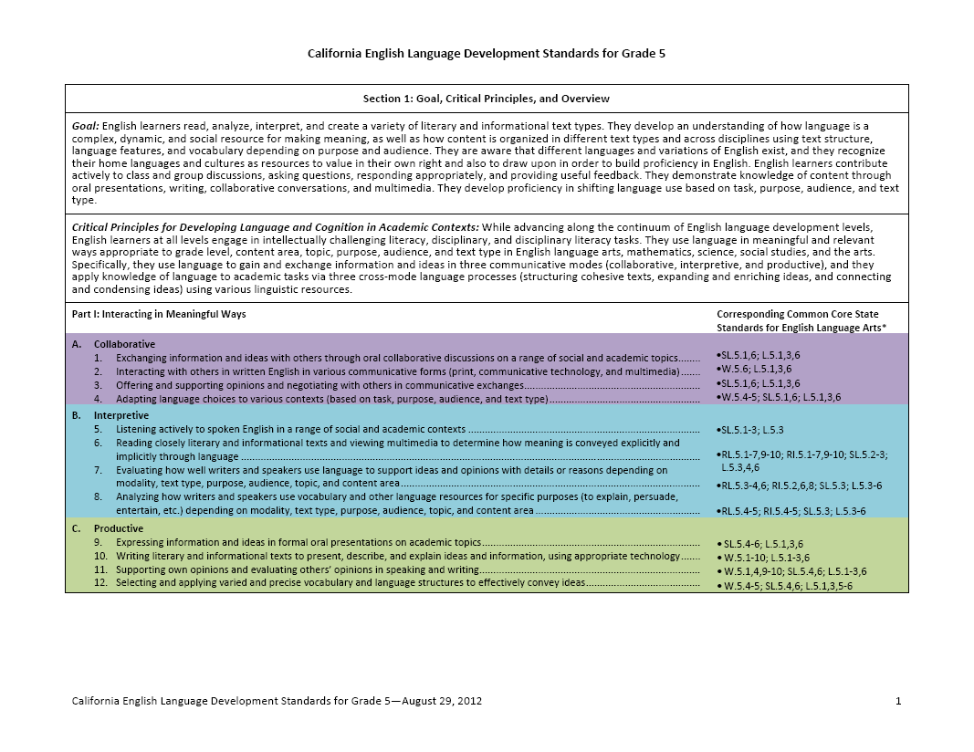
The California ELD Standards
Part I: Interacting in Meaningful Ways
Part II: Learning About How English Works
II A. 1 Structuring Cohesive Texts: Apply understanding of how text types are organized to comprehending and composing texts.
I A. 1 Collaborative: Exchanging information and ideas with others through oral collaborative conversations on a range of social and academic topics.

Slide 3
Building Academic Conversations
Establishing expectations for all classroom talk
Implementing discussion protocols
Increasing depth of conversations
Setting up physical environment that promotes conversation
Rare Occasional Frequent

Slide 4
Math Word Problems as a Genre
4. Cara and her father are at the grocery store…
Math word problems are their own genre.
A genre is a category of texts that shares a particular social purpose, structure, and set of language features.

Slide 5
Math Word Problems as a Genre
4. Cara and her father are at the grocery store…
What is the purpose of math word problems? In other words, why do textbook publishers and others include math word problems in their curricula?
Jot down your ideas.

Slide 6
Math Word Problems as a Genre
Academic Conversation
Share your ideas with your partner.
Create a new statement of purpose based on both your ideas.
Be prepared to share your purpose in the event that you are called upon.
The purpose for having students solve math word problems is …
Having students solve math word problem serves to …

Slide 7
Math Word Problems as a Genre
4. Cara and her father are at the grocery store…
Word problems are their own genre.
A genre is a category of texts that shares particular social purpose, structure, and set of language features.

Slide 8
Jan and Fran are twins. They have the same number of toys. If they each have two toys, how many do they have in all?
There are three carrots in the pot. The cook adds one. How many carrots are in the pot?
There are three rabbits resting under a bush. There are two other rabbits eating grass. How many rabbits are there in all?
Danny sees three fish in one bowl and one fish in another bowl. How many fish does Danny see altogether?
Danny is sitting on a bench. Three friend join him. How many children are sitting on the bench in all?
Molly is at her school carnival. She sees four game booths . She sees one prize booth. How many booths does Molly see in all?

Slide 9
Word Problems as a genre- inquiry approach
Word problems are their own genre.
Review the samples of word problems provided.
What do you notice about the structure, context, and language features that they share or mostly share?
 | STRUCTURE |  |  | Language Features
 | Beginning | Middle | End
Sample 1
Sample 2
Sample 3
Sample 4
Sample 5
Sample 6

Slide 10
Word Problems as a genre- inquiry approach
Word problems are their own genre
Review the samples of word problems provided
What do you notice about the structure, context, and language features that they share or mostly share?
 | STRUCTURE |  |  | Language Features (vocab, verb tenses, POV, etc.)
 | Beginning | Middle | End
Sample 1 | Scenario | Vital math info | Question to be solved
Sample 2 | Scenario | Vital math info | Question to be solved
Sample 3 | Scenario | Vital math info | Question to be solved

Slide 11
Scaffolding Word Problems in Math for the Early Primary Grades
Teacher models telling the “story” and manipulating objects
Teacher tells the story while students manipulate objects
Students tell the story and manipulate objects, along with the teacher
Students work with partners to tell the story and manipulate objects, along with the teacher

Slide 12
Scaffolding Word Problems in Math for the Early Primary Grades (continued)
Students and teachers work to create a word problem chart with sentence frame, objects and settings
Students work with partners to use the frames and manipulate objects
Students work with partners to create their own stories
Students are able to independently create stories and manipulate objects

Slide 13
Scaffolding Word Problems in Math for the Early Primary Grades
Stick to one operation and one type of problem in the beginning.
Change the operation first
Change the type of problem next.

Slide 14

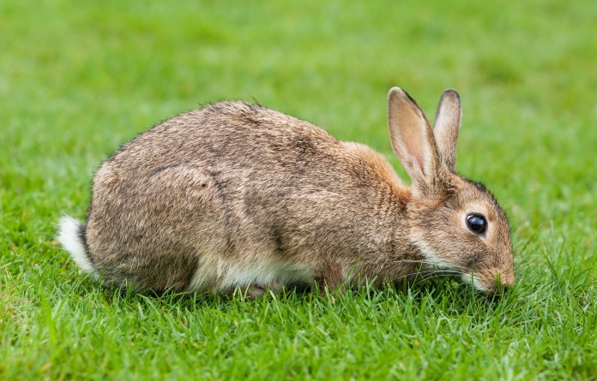
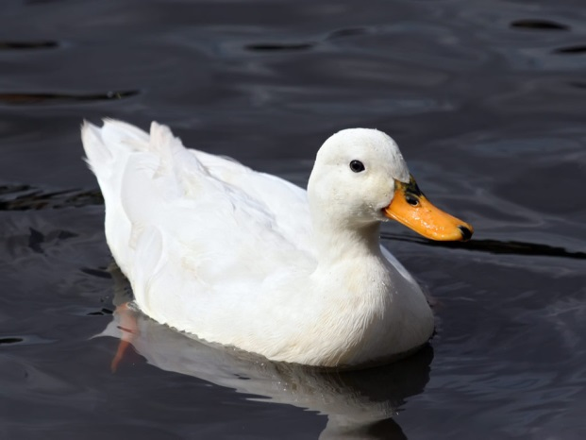
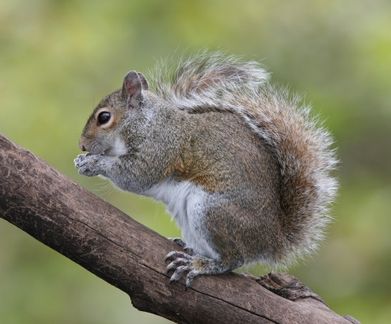

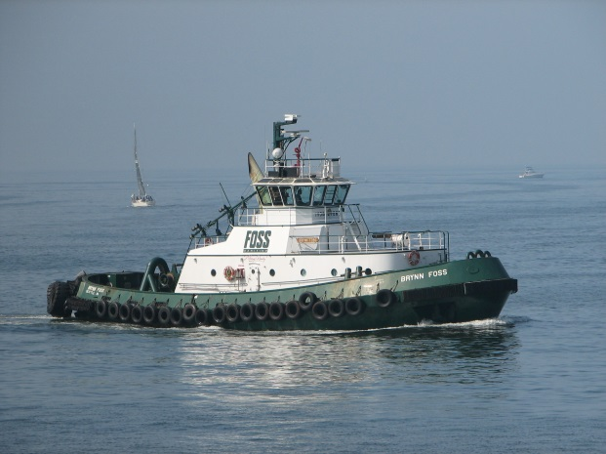

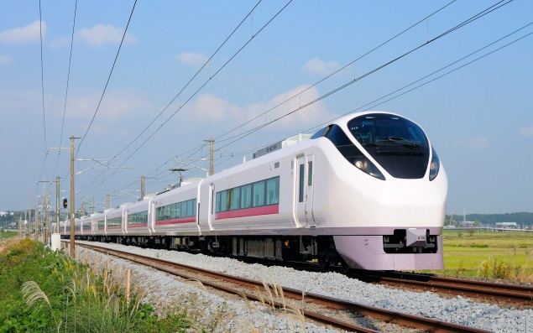

Slide 15
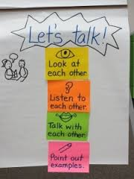
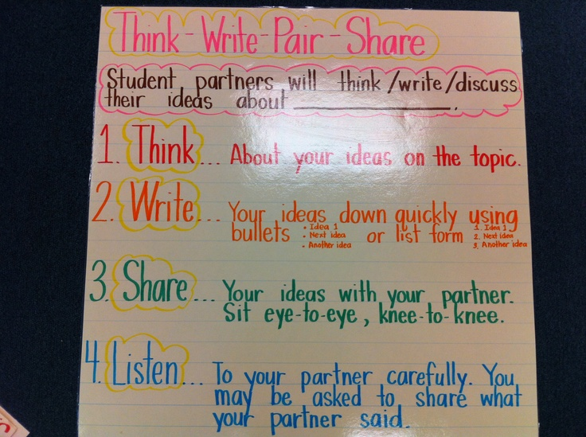
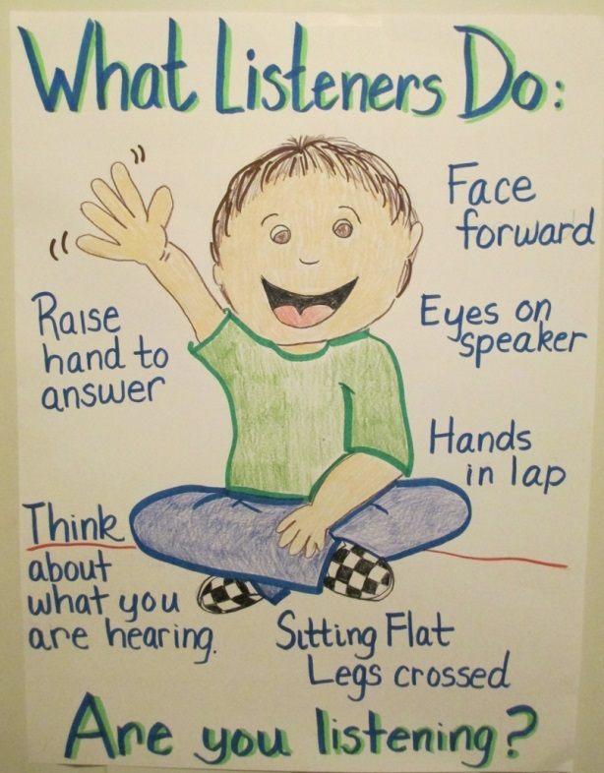
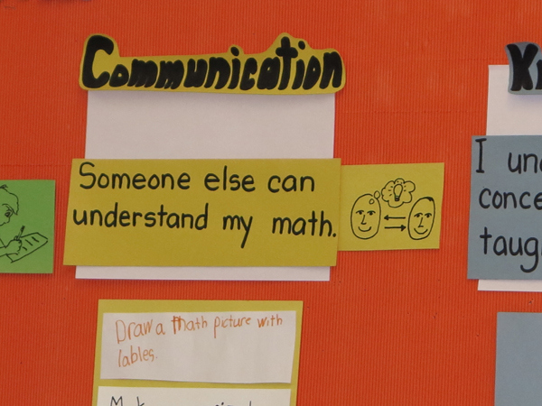
Expectations for Academic Conversations

Slide 16
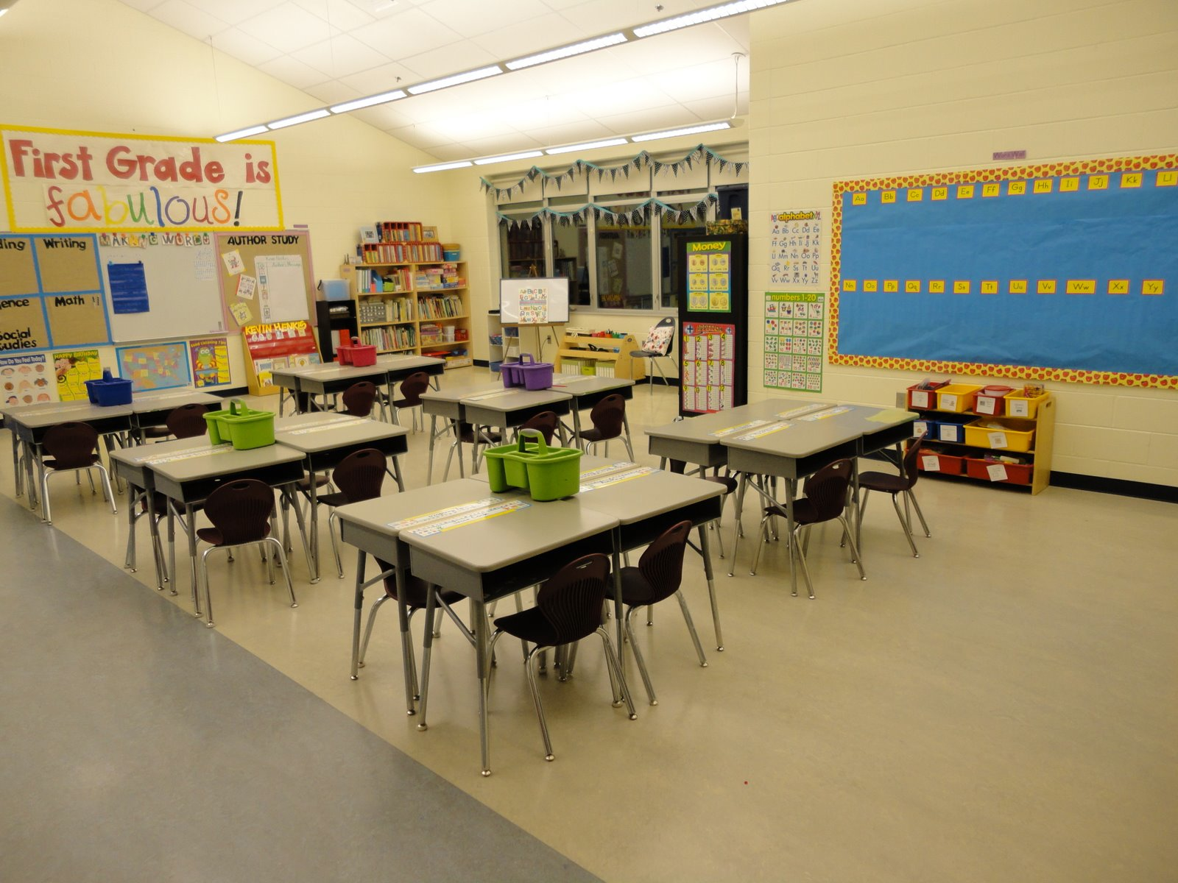
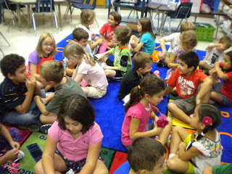
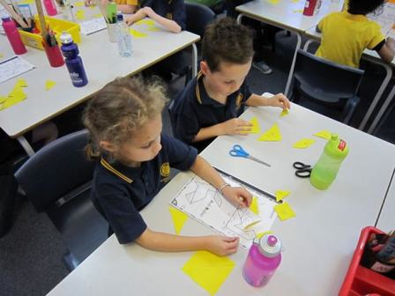
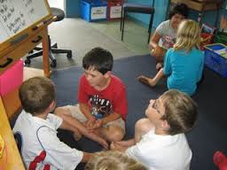
Structuring Academic Conversations
Create a physical environment that supports student interaction
Establish partners and small groups
Provide role or jobs
Require preparedness
Chunk the activity so that you’re touching bases with the students during the conversation

Slide 17
Partners Solve Word Problems– An Example
Academic Conversation
Partner A: Picks an animal and chooses the setting.
Partner B: Chooses how many more animals come and uses the appropriate verb.
Together decide how many animals there are in all. Be ready to share.
Notes:
Talking points: In Core Ready materials partner work is often referred to as turn and talk. Many of you are probably familiar with Think, Pair, Share. I recommend calling it Think, Pair, Share or Think, Turn, and Talk because it is easy to forget the think time that is so critical to the success of the discussion. When introducing a new discussion protocol, it is important to address each of these areas in order to set your students up for success. For (Think) Turn and Talk, these areas might be addressed like this.
What it is, why we use it – partner discussion will be our most commonly used form of discussion because talking with partners means EVERYBODY gets a chance to talk and process their ideas, we also can get nervous when sharing our ideas with larger groups and we get comfortable working with our partner regularly
Establish partnerships – We can increase the success of this protocol through strategic partnering. This can mean heterogeneous or homogeneous pairs based on ability in content area, pairs of students with the same primary language, pairs based on interest, etc. Having assigned partners allows you to scaffold in the moment depending on tasks. For example, I could have eyeball partners and elbow partners (or A/B partners) predetermined. One is a heterogeneous pairing and one is homogeneous by ability. If I think my struggling students will need additional scaffolding for a task I ask them to work with their elbow partner (higher achieving peer), If I want each pairing to struggle through something at their level, they can work with they eyeball partner. I would seat students accordingly when planning my physical environment. Some teachers, especially at older grades prefer to have students choose their own partners in order to promote agency. I personally have concerns about this strategy because I have seen many classrooms in which the same student never gets chosen and must be assigned a partner by the teacher. It also removes the ability of the teacher to take advantage of strategic partnering. If you choose to use this strategy, just be sure you have addressed those two issues in some other way. You also want to be sure you have a procedure in place for what to do if your partner is absent. You know it’s going to happen so you might as well have a plan in place so it doesn’t take away from the student work-time.
Model – Modeling of this protocol can take many forms. The teacher can model with a student; two students can model for the rest of the class in a fish bowl; you can take the class to visit an older class using the protocol.
Practice with student-friendly topics – In order to provide students a chance to be meta-cognitive about the structure of the protocol, they can practice with a topic that is comfortable and engaging. Even though the topic is student-friendly, the task should require the same type of conversation you expect students to engage in. For example, “With a partner, design a robot that can do your three least-favorite household chores.” will elicit more complex conversation than “Tell your partner your three least-favorite household chores.”
Debrief – SUPER IMPORTANT!!! The debrief can be general, such as “what worked/didn’t work” or focused on a particular area, such as “how did we do with staying on topic?”. Younger children especially will need to debrief their product before process. This may mean sharing the content of your conversation with another partnership, having additional think time around the process, and then sharing that as a large group.
Chart – You may not need a chart for this protocol since it is relatively simple and you will use it so often, but more complex protocols (jigsaw, or numbered heads together) or those that are less frequently used will benefit from an anchor chart for students to refer to during the protocol.
Multiple opportunities – Once your students seem to have a protocol mastered, it is easy to forget that they’ll need opportunities to practice and debrief over time. But don’t worry, they have ways of letting you know when they need them.
This process for introducing discussion protocols can be used for any new protocol for partner talk, small group or whole class. And is included in your handouts.

Slide 18

We discussed two ways to help students solve math word problems:
Have them explore and name the features of the math word problem genre and practice creating problems of their own.
Have them engage in academic conversations in order to work out problems in an active way and use the ideas of others’ to help build and consolidate their understanding
Notes:
Talking points: Co-creating anchor charts, AS A CLASS, is an effective way of setting classroom expectations. Here you see pictures of some classroom anchor charts around the basics of academic conversations. These are expectations that apply to all classroom talk regardless of size of group or specific discussion protocol. Some of the basics include: eye contact, face your partner, speak audibly. You may also use this opportunity to introduce stems or frames for basic conversation skills, such as sharing ideas, agreeing, disagreeing, requesting clarification, inviting participation of others, etc. How many skills you introduce will be grade-level dependent. For example, in the beginning of kindergarten we are excited if students exhibit turn taking and clearly state their own idea. In sixth grade, we would expect students to request clarification and stick with one idea for an extended time elaborating and clarifying throughout the conversation.

