Slide 1
Senior Assessment Fellows
Kathy Caric
Gina Koency
Mary Tribbey
Interim Assessments and the Digital Library

Slide 2
A Balanced Assessment System
Summative:
Tests used for end-of-year accountability and evaluation
Teachers and schools have information and tools they need to improve teaching and learning
Common Core State Standards specify
K-12 expectations for college and career readiness
All students leave
high school college
and career ready
Formative resources:
Educator resources that support measuring student learning in real-time during instruction
Interim Assessments:
Tests used for timely and periodic information based on local needs/goals

Slide 3
Purpose of the Interim Assessments
Designed to support teaching and learning throughout the year.
  Feedback to inform instruction including:
    Global measures of early and midyear progress
    Identify specific areas of strength and weakness
    Assess skills of incoming students
Local use

Slide 4
Interim Assessments: Two Types
Interim Comprehensive Assessments (ICAs)
  Assess the same claims and standards
Interim Assessment Blocks (IABs)
  Assess smaller sets of assessment targets
  Address specific content areas
  More flexible

Slide 5
Interim Assessment Items
Same as summative items
  assess Common Core State Standards
  same accessibility resources
  provide evidence to support claims in mathematics and English language arts/literacy
Different from summative items
  Separate, non-secure pool

Slide 6
IABs for ELA, Grades 3 to 5
Grades 3–5
Read Literary Texts
Read Informational Texts
Edit/Revise
Brief Writes
Listen/Interpret
Research
*Narrative Performance Task (Grades 4–5 only in 2014–15)
*Informational Performance Task
*Opinion Performance Task (Grade 3 only in 2014–15)
*Will be available in 2015–16

Slide 7
IABs for ELA, Grades 6 to 8
Grade 6-8
Read Literary Texts
Read Informational Texts
Edit/Revise
Brief Writes
Listen/Interpret
Research
*Narrative Performance Task
*Explanatory Performance Task
Argument Performance Task
*Will be available in 2015–16

Slide 8
IABs for ELA, High School
High School
Read Literary Texts
Read Informational Texts
Edit/Revise
Brief Writes
Listen/Interpret
Research
*Explanatory Performance Task
Argument Performance Task
*Will be available in 2015–16

Slide 9
IABs for Mathematics
Grades 3 to 5
IAB Name | Grade
 | 3 | 4 | 5
Operations and Algebraic Thinking | a | a | a
Numbers and Operations in Base 10 | * | a | a
Fractions | a | a | a
Geometry |  | * | *
Measurement and Data | a | * | *
Mathematics Performance Task | a | a | a
*Will be available in 2015–16

Slide 10
IABs for Mathematics
Grades 6 to 7
IAB Name | Grade
 | 6 | 7
Ratio and Proportional Relationships | a | a
Number System | a | a
Expressions and Equations | a | a
Geometry | a | *
Statistics and Probability | * | *
Mathematics Performance Task | a | a
*Will be available in 2015–16

Slide 11
IABs for Mathematics
Grade 8
Grade 8
*Expressions & Equations I (and Proportionality)
*Expressions & Equations II
Functions
Geometry
Mathematics Performance Task
*Will be available in 2015–16 (available as a single Expressions & Equations Block in 2014–15)

Slide 12
IABs for Mathematics for High School
High School
Algebra and Functions – Linear Functions
Algebra and Functions – Quadratic Functions
*Algebra and Functions – Exponential Functions
*Algebra and Functions – Polynomials Functions
*Algebra and Functions – Radicals Functions
*Algebra and Functions – Rational Functions
*Algebra and Functions – Trigonometric Functions
*Geometry – Transformations in Geometry
Geometry – Right Triangle Ratios in Geometry
*Geometry – Three-Dimensional Geometry
*Geometry – Proofs
*Geometry – Circles
*Geometry – Applications
*Interpreting Categorical and Quantitative Data
*Probability
*Making Inferences and Justifying Conclusions
Mathematics Performance Task
*Will be available in 2015–16

Slide 13
Administration of ICAs and IABs
Administered online (no paper/pencil administration)
Same teacher registration process and test delivery interface as the summative assessment
Fixed length test format for 2014−15
Computer adaptive tests (CATs) for 2015-16

Slide 14
Grades Supported by Interim Assessments for 2014–15

Slide 15
Scoring of the Interim Assessments
Most items are scored by the Smarter Balanced test delivery engine
Scoring of constructed-response items and performance tasks is a local responsibility
Reports are generated after the constructed-response item scores and performance task scores are input into the system
Scoring is supported by rubrics and anchor papers
Notes:
This year only two opportunities to take interim assessments
Hand scoring module available Wednesday

Slide 16
Interim Blocks That Do Not Require Local Scoring in 2014–15
ELA, all grade levels:
  Edit/Revise
  Listen/Interpret
  Research
Mathematics, all grade levels
  All blocks
(Performance task blocks in both ELA and math require local scoring)

Slide 17
Results from the Smarter Balanced Interim Assessments
The ICAs and the IABs provide individual student results that teachers can examine in order to adjust instruction.
  ICA: Overall scale score and
  Score of “Below” “At/Near” or
  “Above” Standard for each Claim
  IAB: Score of “Below” “At/Near” or
  “Above” Standard for each Block

Slide 18
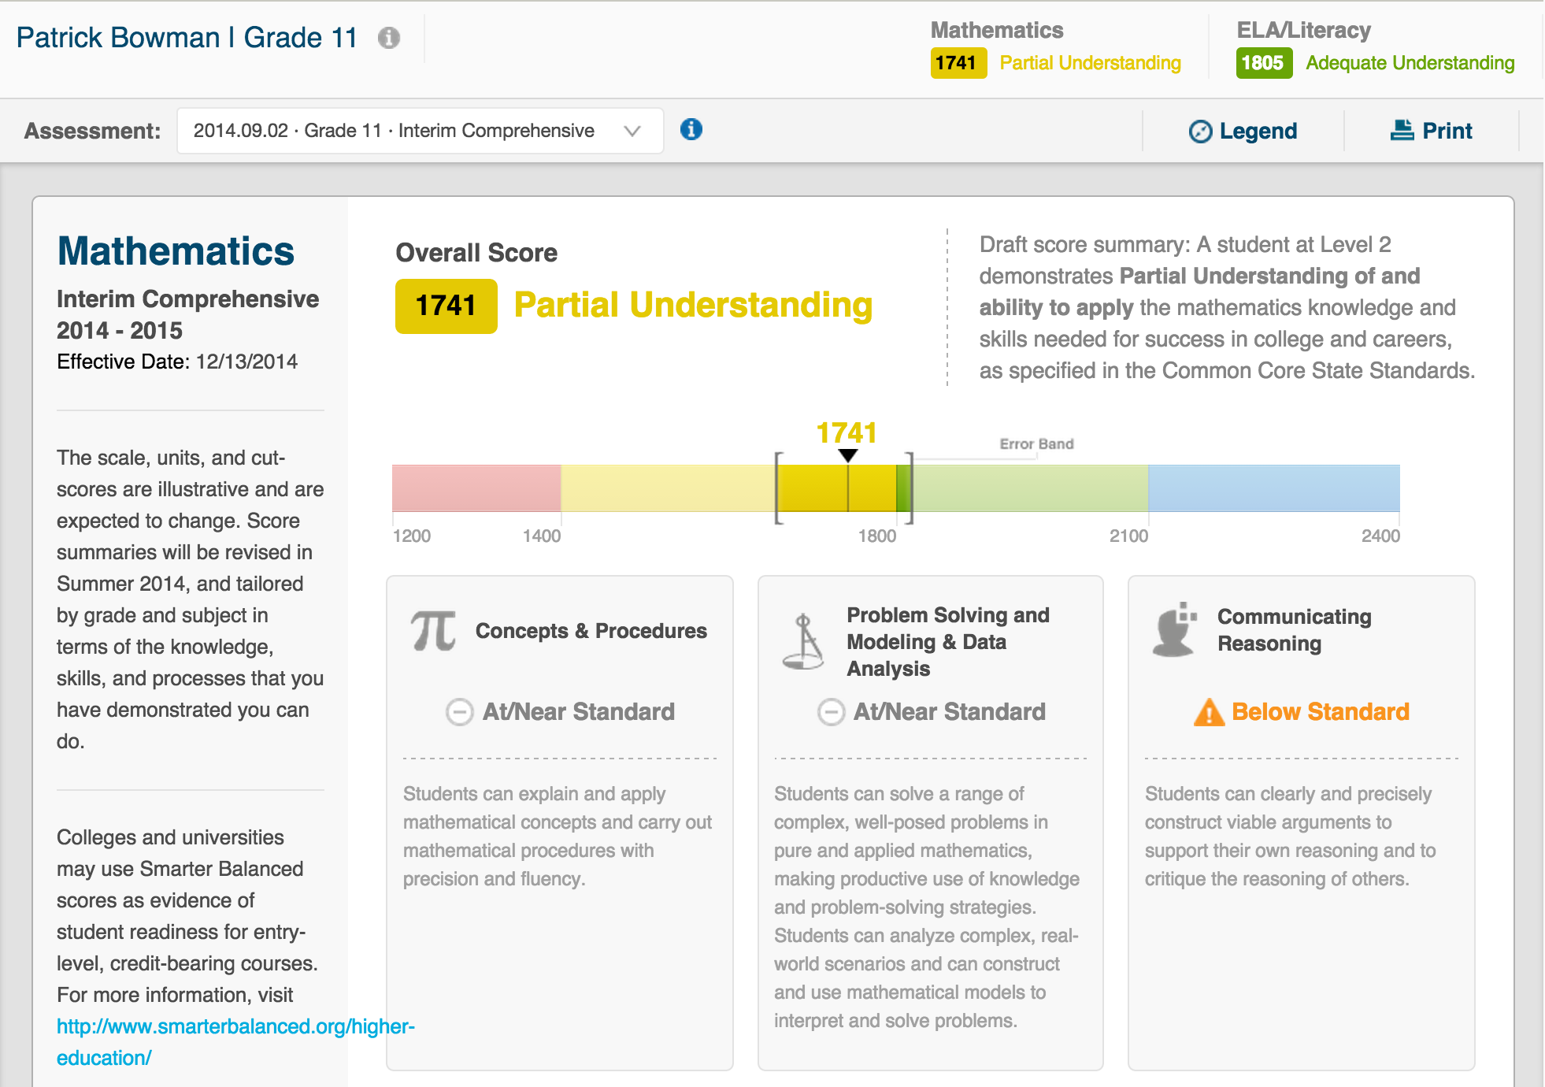
Smarter Balanced Mockup:
Individual Student Report

Slide 19
Suggested Uses of the Interim Assessments in 2014−15

Slide 20
Inform Teaching and Learning
  Administer IAB(s) that align with current curriculum and pacing
  Use IAB results with other sources of evidence to identify student strengths and weaknesses
  Use ICAs or IABs to evaluate progress and plan adjustments to increase student learning

Slide 21
Authentic Experience
  Create test sessions, pause the test, experience the interface, experience the technology
  Experience content and items reflective of the summative
  Use ICAs to gauge time needed for students to complete the summative

Slide 22
Accessibility Supports
  Universal tools, designated supports, and accommodations are modifiable on the TA Interface for the interim assessments
      Provides an excellent opportunity to try out accessibility supports with students and actual test items
  Note: Only universal tools will be modifiable on the TA Interface for the summative assessments.

Slide 23
Local Scoring
  Builds content knowledge
  Supports collaboration
  Provides a sense of the student’s strengths and weaknesses
  Builds teacher comfort with the process of online scoring
  Helps LEAs estimate the time required to conduct local scoring of ICAs and IABs.

Slide 24
Sample Implementation Plan for LEAs for 2015–16
Become familiar with the ICAs and IABs
Consider the district’s available technology
Plan how to use the Interim Assessments next year:
  Locus of control/roles and responsibilities
  Student registration
  Accessibility supports
  Teacher log-ins and security agreements
  Scoring (training and time to score)
  Technology
  Scheduling
  Troubleshooting

Slide 25
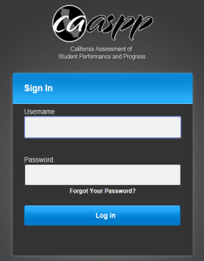


Log-ins required to support Interims
TOMS
Verify student demographic data
Requires same logon credentials used for the Digital Library:
User Name: LEA e-mail
Password: ****** (6 characters)
1
Test Administrator Interface
Administer assessments
2
Data Warehouse
Receive and view student reports
4
Interim Handscoring System
Handscore students’
constructed responses
3
Requires TOMS logon credentials:
User Name: First Name.Last Name
Password: ********* (9 characters)

Slide 26
A Balanced Assessment System
Summative:
Tests used for end-of-year accountability and evaluation
Teachers and schools have information and tools they need to improve teaching and learning
Common Core State Standards specify
K-12 expectations for college and career readiness
All students leave
high school college
and career ready
Formative resources:
Educator resources that support measuring student learning in real-time during instruction
Interim Assessments:
Tests used for timely and periodic information based on local needs/goals

Slide 27
Digital Library
On-line collection of resources:
  Aligned with the intent of the Common Core State Standards
  Contributed by educators for educators
  Vetted against a set of quality criteria
Supports implementation of the formative assessment process
Incorporates collaboration features
Supports diverse groups of learners

Slide 28
Definition of the Formative Assessment Process
Formative assessment is a deliberate process used by teachers and students during instruction that provides actionable feedback that is used to adjust ongoing teaching and learning strategies to improve students’ attainment of curricular learning targets/goals.

Slide 29
Four Attributes of the
Formative Assessment Process
Clarify
intended
learning
Elicit
evidence
Act on
evidence
Interpret
evidence

Slide 30
Digital Library Resources
Assessment Literacy Modules
Interactive Professional Learning Modules
Resources for educators, students, and families
Frame Formative Assessment within a Balanced Assessment System
Articulate the Formative Assessment Process
Highlight Formative Assessment Practices and Tools
Instructional Modules
Interactive Professional Learning Modules
Instructional coaching for educators
Instructional materials for students
Demonstrate/support effective implementation of the formative assessment process
Focus on key content and practice from the Common Core State Standards for Mathematics and English Language Arts
Education Resources
High-quality vetted instructional resources and tools for educators
High-quality vetted resources and tools for students and families
Reflect and support the formative assessment process
Reflect and support the Common Core State Standards for Mathematics and English Language Arts
Create Professional Learning Communities

Slide 31
Assessment Literacy Modules
Interactive Professional Learning Modules
Resources for educators, students, and families
Frame Formative Assessment within a Balanced Assessment System
Articulate the Formative Assessment Process
Highlight Formative Assessment Practices and Tools

Slide 32
Instructional Modules
Interactive Professional Learning Modules
Instructional coaching for educators
Instructional materials for students
Demonstrate/support effective implementation of the formative assessment process
Focus on key content and practice from the Common Core State Standards for Mathematics and English Language Arts Literacy

Slide 33
Education Resources
High-quality vetted instructional resources and tools for educators
High-quality vetted resources and tools for students and families
Reflect and support the formative assessment process
Reflect and support the Common Core State Standards for Mathematics and English Language Arts Literacy
Create Professional Learning Communities

Slide 34
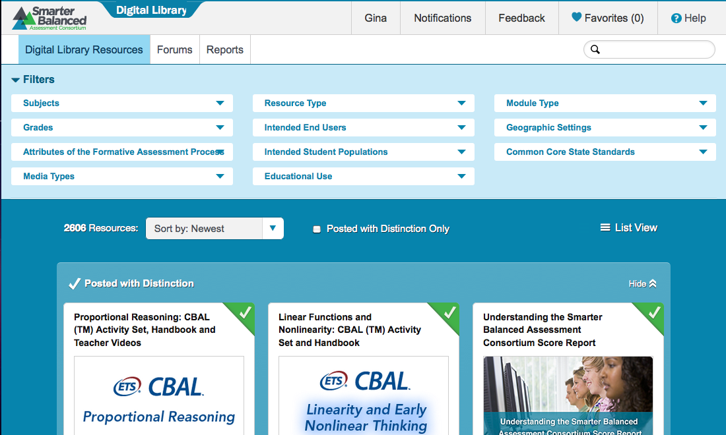
Digital Library Features

Slide 35
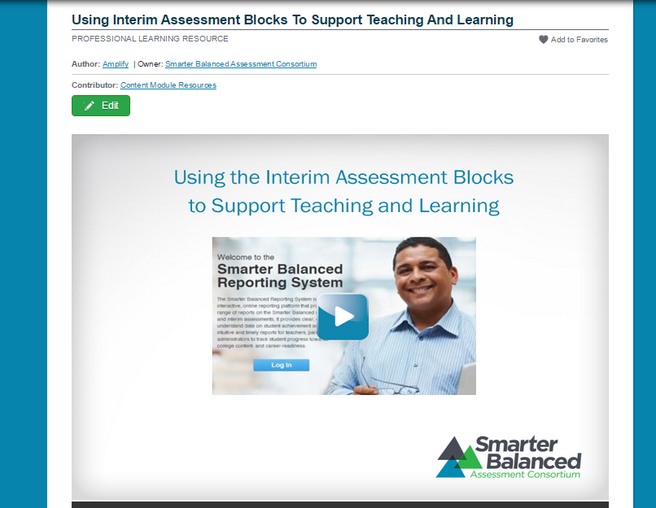
Interim Assessment Blocks
Interactive Module

Slide 36
Using Interim Assessment Blocks
Elicit Baseline Evidence Using an Interim Assessment Block
Digital Library
Clarify
Intended
Learning
Elicit
Evidence
Act on
Evidence
Interpret
Evidence
Clarify
Intended
Learning
Elicit
Evidence
Digital Library
Check Progress Using an Interim Assessment Block
Act on
Evidence
Interpret
Evidence

Slide 37
Log-in Credentials for Teachers
Each LEA must:
Register Schools (Institutions)
Register Teachers
Important to complete forms Accurately
Help: CalTAC at 855-631-1510

Slide 38
Digital Library Implementation
Think through what the teachers might need
Provide hands-on training and support
Embed into existing meetings
Encourage collaborative exploration
Build the knowledge base around formative assessment practice

Slide 39
Questions?

Slide 40
For Further Information
California Department of Education
CAASPP Office
caaspp@cde.ca.gov
916-445-8765
http://www.cde.ca.gov/ta/tg/sa/sbacinterimassess.asp
http://www.cde.ca.gov/ta/tg/sa/diglib.asp
Smarter Balanced Web Page
http://www.smarterbalanced.org/interim-assessments/
CalTAC
http://caaspp.org/
1-800-955-2954
(for Digital Library: 1-855-631-1510)

