Slide 1
The Fair Education Act (SB 48) Senator Mark Leno
Resources for Classroom Use
Angela F. Luna, M.Ed., National Board Certified Teacher
Melissa E. Bryden
Mathematics Teacher – Del Campo High School
Trainer, Committee Member of SJTA LGBT Task Force
MA, Education - Gender Studies
“Whatever satisfies the soul is truth.” –Walt Whitman

Slide 2
The Fair Ed Act: What does it say?
California Education Code Section: 51204.5:
Additions to the code:
“…a study of the role and contributions...of Mexican-Americans, Asian-Americans, European Americans, lesbian, gay, bisexual, transgender Americans, persons with disabilities…and members of other cultural groups, to the economic, political, and social development of California & the U.S. with particular emphasis on portraying the role of these groups in contemporary society.” –California Education Code

Slide 3
…with regard to instructional materials:
The Fair Ed Act prohibits inclusion of discriminatory matter “reflecting adversely upon persons because of race, sex, color, creed, handicap, national origin, or ancestry.” The Fair Ed Act added “sexual orientation” to the list.
Governing boards must adopt materials that “accurately portray the cultural and racial diversity of our society.”
The law took effect January 1, 2012

Slide 4
How will you implement the Fair Ed Act?
“It is up to local districts to determine how the instructional content is included. That section applies to the course of study in grades 1 through 12, but again it falls to the teacher and the local school and district administration to determine how the content is covered and at which grade levels.” –California Dept. of Ed

Slide 5
Textbooks/Teaching Materials are a significant component of students lives
Students make judgments based on experiences and knowledge
Textbooks are often used to fill in gaps, when students lack experience or knowledge
When LGBT people are not represented students assume they do not belong in that academic world
(Wirtenberg, Murez, & Alspektor, 1980)
Notes:
Story about gsa bulletin apparently I ‘pass’

Slide 6
The Academic Consequences
Increased Drop Out Rate – 28% of LGBT youth are likely to drop out of high school (Suicide Prevention Resource Center, 2008)
Less Engaged (Gilligan, 1982)
Lower achievement (Petrovic, 2000)
Denied scholarships more frequently (Mays & Cochran, 2001)
Course choice (Grayson, 1988)
Career study (Dornbusch, 1974)
Don’t feel supported by teachers as much as their non-LGBT counterparts (Petrovic, 2002)
Notes:
(one recent report claims that it may be as high as 40%

Slide 7
The Personal/Emotional Influences of Invisibility in Textbooks/Curriculum
Isolation (Zimet, 1976)
Low self-esteem (Beautrais, 2003)
Sense of inferiority, even shame (Rofes, 1983)
Not taking into consideration other harmful factors in the environment (here, I am strictly speaking of absence in curriculum)

Slide 8
The Personal/Emotional Consequences
Isolation is among risk factors that play a role in LGBT teen suicide (U.S. Department of Health and Human Services, 2001)
Teens who experience isolation are less likely to seek help when feeling suicidal (Berman et al, 2006)
While all students may experience isolation, such Psycho-Social Stressors are more prevalent in the LGBT student than in their heterosexual counterpart (Kitts, 2005)

Slide 9
Role Models
We know, and the research has found, that role models in books and other educational materials can significantly affect a student’s social well-being as well as their academic well-being. Role models can influence a student’s self-esteem and aid in a student’s ability to establish a social niche (Campbell, 1996).
Additional research confirms that positive role models are a protective factor in the well-being of the LGBT student (Fenaughty & Harre, 2003).

Slide 10
Before we embark…a few things to be mindful about:
Study the law: (read it, review it, keep a copy accessible when talking w/ interested parties)
All lessons MUST be age and grade level appropriate: The Supreme Court is very clear on this point…AGE and GRADE level appropriate
Plan lessons that “fit” with your current group of students: ( examples: if your students use homophobic language, plan lessons accordingly. If your students think they’ve never met an LGBTQ person, plan lessons accordingly. If students think LGBTQ people are strictly contemporary, plan accordingly with some deeper historical figures such as Walt Whitman or Sappho)
Transparency: (communicate with partner teachers, administrators, parents/guardians, union rep…if you’re not sure-ASK! Transparency pays dividends because it builds trust and lowers anxiety)
Check your comfort level: (it’s okay if you’re nervous and it’s okay if you don’t know something…this is new to many, many people. Start with where you’re comfortable and grow from there. Practice & share what you learn with others)

Slide 11
Lessons w/LGBTQ Focus modify/adjust lessons to fit other groups in Fair Ed Act as needed
LGBTQ Research Project (Contemporary and/or deeply historical focus):
Students work in pairs
Strategically assign preselected LGBTQ people to partnerships based on your knowledge of students’ needs
Assign areas of relevance for research such as early life, education, career/job, family configuration
Students conduct research and inquiry based on the structure/format set by the teacher (laptops/internet or printed materials provided by teacher, student, parent/guardian volunteer)
Students identify contributions/impact of LGBTQ person on society and make inferences, draw conclusions, identify cause & effect relationships that go beyond basic knowledge questions

Slide 12
LGBTQ Research Project continued…
6. Students create a visual artifact (poster board) about their LGBTQ person w/ hand drawn pictures, recent printed pictures and other artifacts that are salient (ex: Suze Orman- student created dollar bills with construction paper, Cat Cora- student created pizza with play-doh)
7. Students identify contributions and positive impacts of their LGBTQ person and include those contributions on the visual artifact for display (“contributions” proved difficult for my students to grasp. Try: How did this person make the world a better place? You may also ask students to submit a written response sheet to accompany the visual artifact)
8. Students present their findings to the class via oral presentations to share their knowledge of the LGBTQ person (listening, viewing, reading, writing, speaking-literacy, National Board for Professional Teaching)

Slide 13
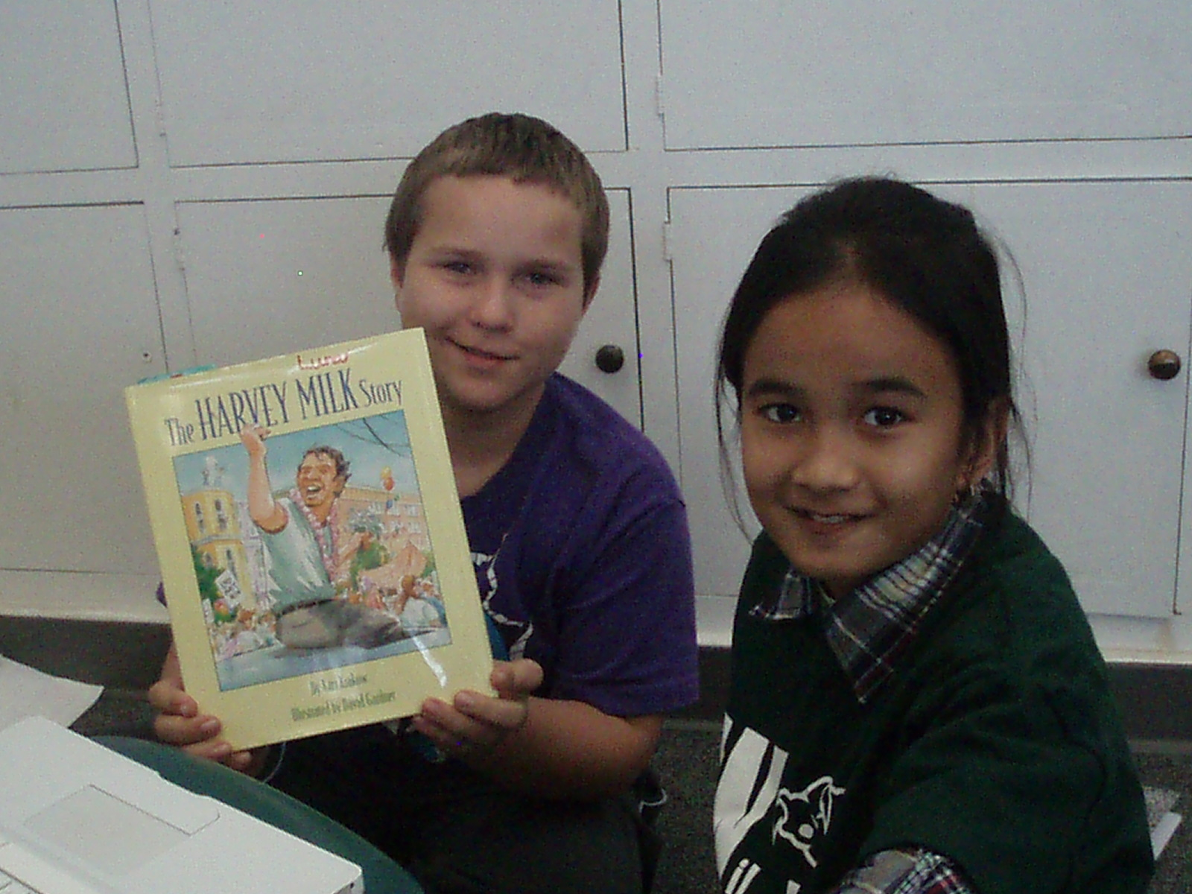
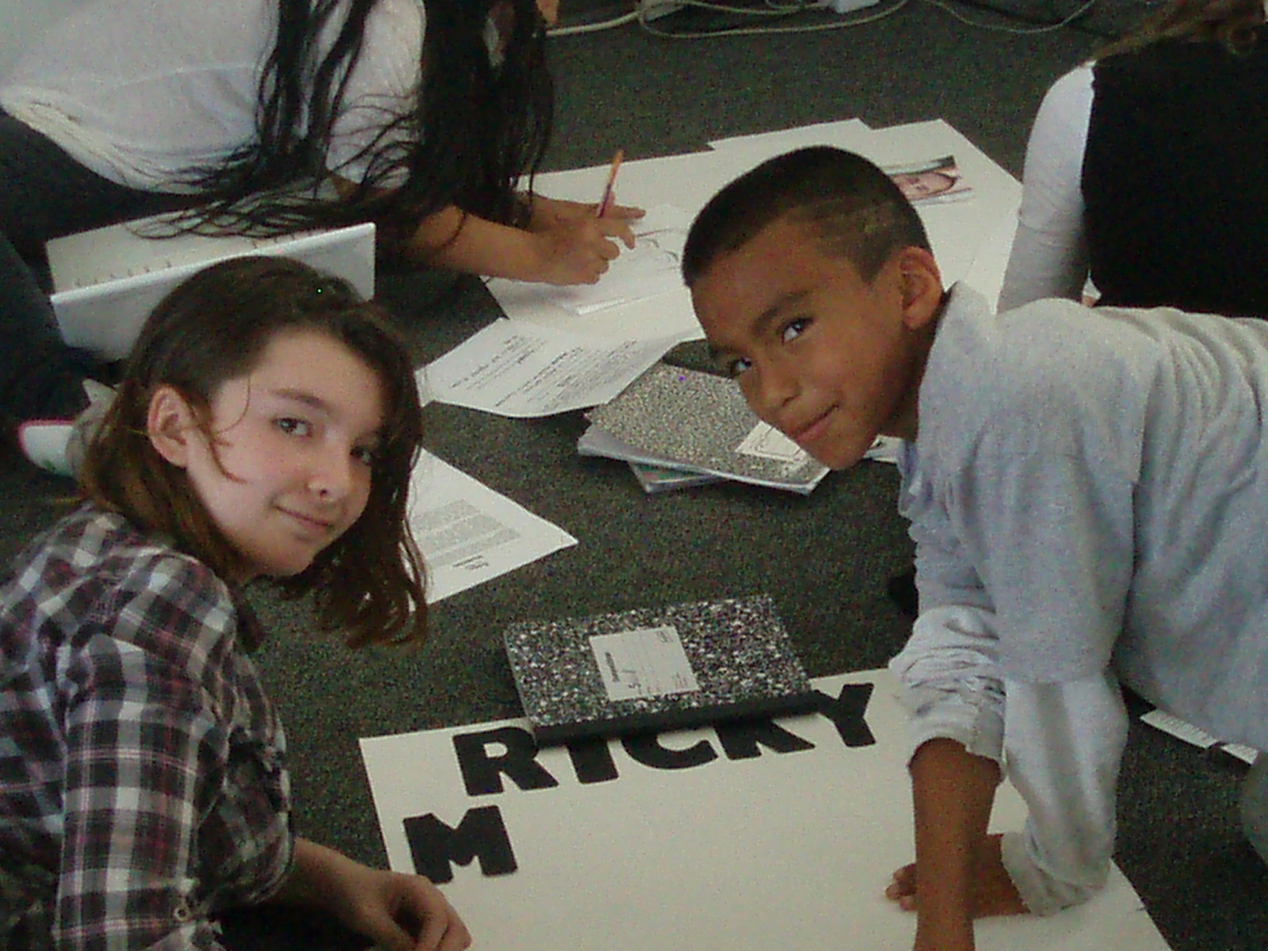

Slide 14
LGBTQ people for research project (this list is not exhaustive…keep researching):
Jeffrey Fehr, Cat Cora, Barney Frank, Eleanor Roosevelt, Suze Orman, Sheila Kuehl, Christopher Cabaldon, Alice Walker, Ricky Martin, Rachel Maddow, Greg Louganis, Gertrude Stein, Mark Bingham, Walt Whitman, Harvey Milk, David Geffen, Mark Leno, John Perez, Gertrude Stein, Oscar Wilde, Matthew Shephard, Rock Hudson, Sir Ian McKellan, Michelangelo, Leonardo DaVinci, Sappho, Alexander the Great, Frida Kahlo, Rudolph Valentino, Gore Vidal, Hans Christian Anderson, Elton John, Ellen DeGeneres, Tennessee Williams, Lawrence of Arabia, Johnny Mathis, Wanda Sykes, Tchaikovsky, Malcolm Forbes, Rita Mae Brown, Martina Navratilova, Ranjit Singh, Billy Bean, Lady Gaga, Melissa Etheridge, Tammy Baldwin, Billie Joe Armstrong, Leonard Bernstein, Truman Capote, Sir Laurence Olivier, Benny Medina, Jane Lynch, Lorraine Hansbury, Tom Ammiano, William Shakespeare, Rosie O’Donnell, Brandon Teena,
What impact have these people made? How have they contributed to our communities, our society? How have they made the world a better place? Cite evidence for your assertions. Be prepared to defend your claims with examples, evidence, & identify causes & effects.

Slide 15
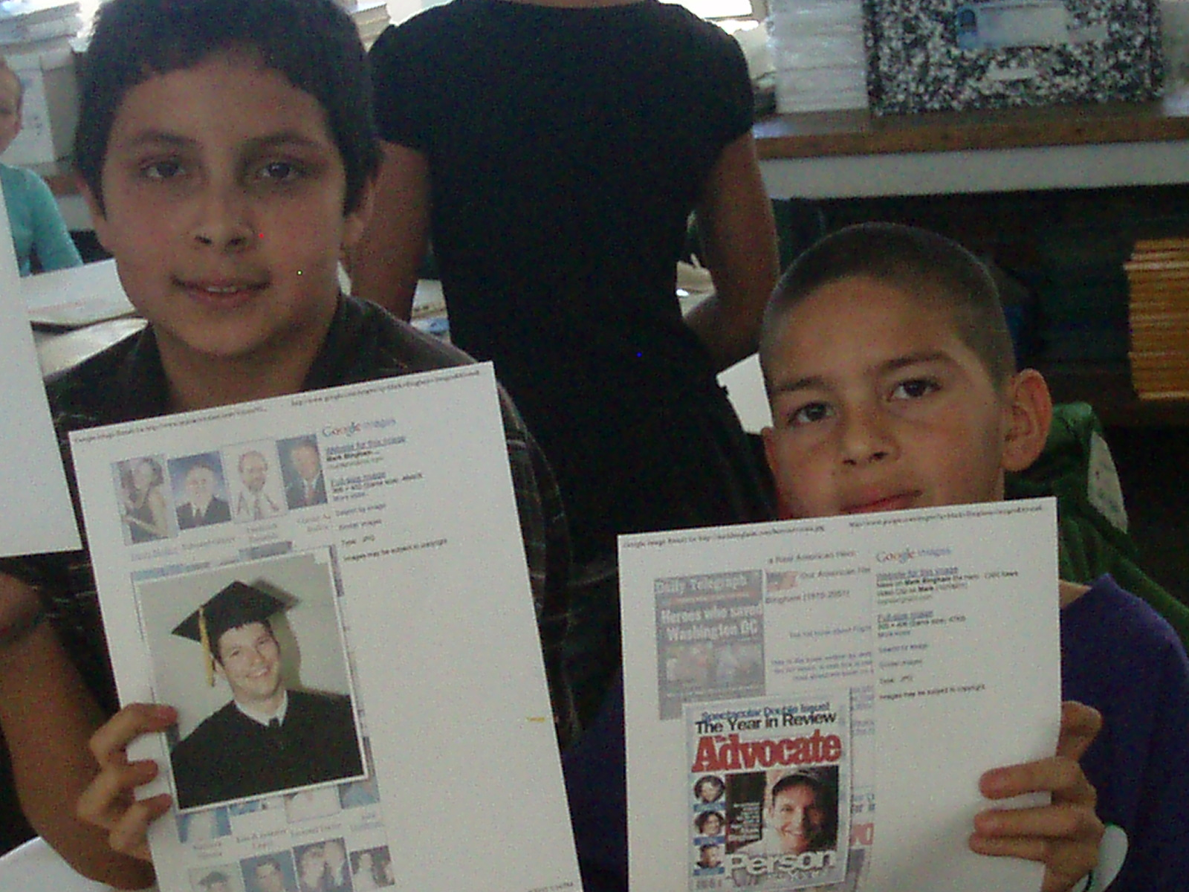

Slide 16
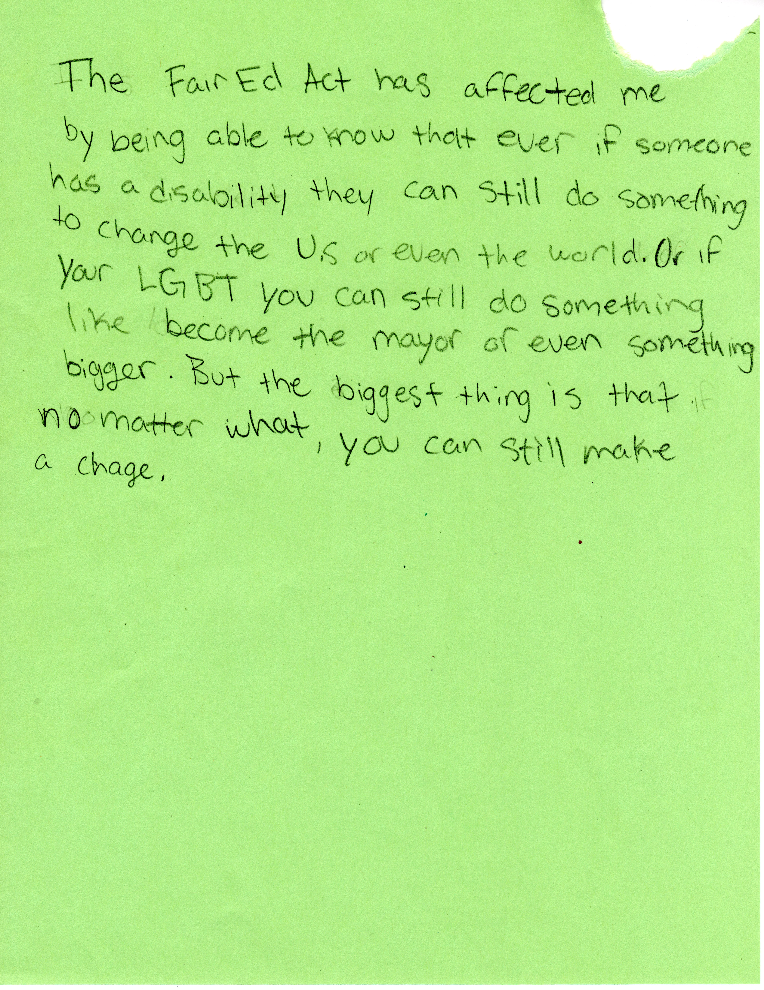

Slide 17
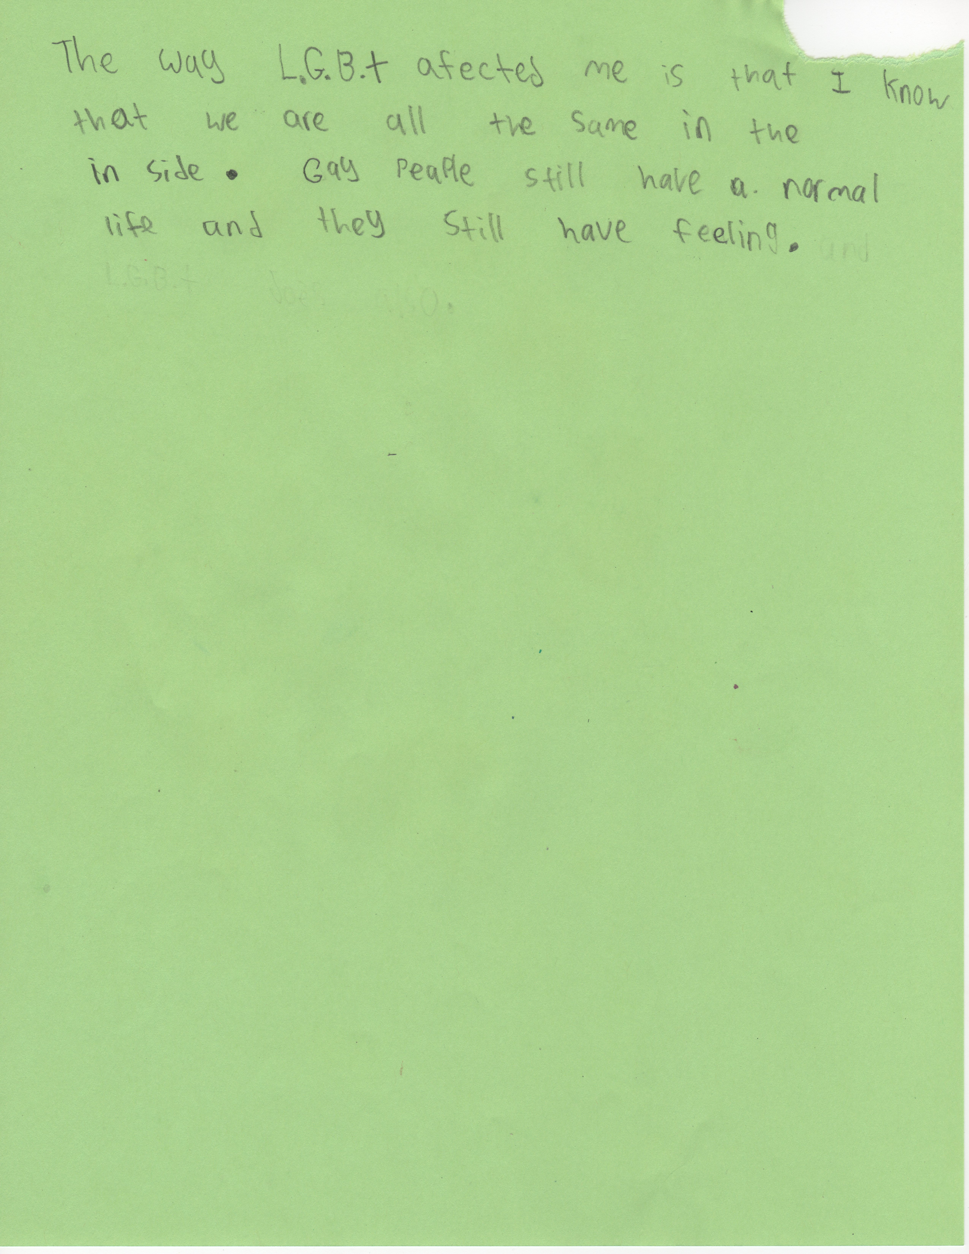

Slide 19
Additional Fair Education Act Lessons:
Lesson: “What’s a Family?” grades 1, 2, 3, 4 (or beyond…think: What do my students need?)
(free lesson plan on SCUSD website)
-The National Board for Professional Teaching states that the accomplished teacher honors diversity within the classroom and views diversity as a strength, including all family configurations. Examining the diversity of family configurations is a powerful way to build respect and acceptance for all. Go to www.nbpts.org and read the standards to learn more.
-Video: “That’s a Family!” go to http://groundspark.org for the video and other MUST HAVE teacher resources!

Slide 20
Lesson: “Word” grades: 5 through 12
(free lesson plan on SCUSD website)
-The use of homophobic language in elementary, middle and high schools is a national crisis and must be proactively addressed. Homophobic language contributes to a psychologically and physically unsafe learning environment for our LGBTQ youth and educators. Students must be directly taught how to use words correctly and allowed practice if we expect change. –A. Luna

Slide 21
Lesson: “Uncommonly Good Community Contributions” grades: K through 12
(free lesson/ideas on SCUSD website)
-The Fair Ed Act (SB 48) requires that groups (LGBTQ, people w/ disabilities, revised names of other groups and additional groups) be included within social studies instruction. The Fair Ed Act explicitly states that an emphasis should be made to contemporary people. With this in mind, students benefit from learning about and learning from members of our local communities.
-It is quite powerful for students to meet and talk with contributing members of their community to see firsthand the contributions and positive impacts that are made.

Slide 22
Sacramento LGBTQ people making a difference each day:
Ken Pierce, Public Relations Consultant, President EqualityActionNOW, Activist
Jennie Reiken, Youth Outreach Worker for the Children’s Receiving Home of Sacramento, works with LGBT & homeless youth ages 12-25, Suicide Prevention
Rachel Pearman, Grants & Contracts Specialist for WEAVE, Inc.
Kim Zeltvay, Vice Principal, San Juan Unified School District
Lieutenant Jennifer Ikemoto, California Department of Fish & Game
Diana Luiz, Portuguese American activist for equality
Melissa E. Bryden, Mathematics Teacher, MA Education, Gender Studies
Patricia M. Ianni, Database Administrator, Upstream Engineering

Slide 23
Sacramento LGBTQ Locals continued…
Jovi Radtke, Writer & Activist
Tina Reynolds, Owner Uptown Studios & Founder EqualityActionNOW
Paul Curtis, Director of Development Food Bank of Yolo County, Co-Founder Capital City AIDS Fund
Stevie Long, Fire Captain, CAL FIRE-Amador, El Dorado Unit
Nicola Simmersbach, PsyD Licensed Marriage & Family Therapist (fighting for ALL marriages!)
Ben Hudson, Executive Director Gender Health Center, Community Activist
Melissa Murhpy, Police Officer
Lori Vine, Special Education Teacher, MA Special Education
Ms. Vihil H. Vigil, MBA Business Womyn Extraordinaire, Photographer, Equal Rights Activist, Native American Two Spirit

Slide 24
Local Sacramento LGBTQ continued…
Chris Packey, HIV Education & Prevention, Activist, H.E.R.O. (Human & Equal Rights Organizer)
Ted Lindstrom, local attorney
Toni Curtis, CA State employee, aspiring author and entrepreneur
Robin Gunning, SDC/ED Teacher, QSA Advisor, activist for the Vagina Monologues & Women Take Back the Night
Carrie Jett, Asst. Deputy Secretary of State, Voter Outreach and Education
Nichole DeVore, Educator SCUSD, female co-chair NEA/GLBT Caucus, Activist
Joe Wood, Instructional Technology Integration Specialist

Slide 25
Fair Ed Act Role Plays
(free talking points/rebuttals on SCUSD website)
“Concerned” parties have somewhat predictable stances…Be prepared & proactive.
Example:
“Concerned Party”: “Teachers aren’t supposed to create lessons! You’re supposed to use only the textbook and our state can’t afford those now!”
Response: “Actually, the Fair Education Act (SB 48) requires that discriminatory content be excluded from textbooks and other instructional materials regarding all groups, including LGBTQ people. AND, teachers are free to not only teach their own lessons, but author, create and execute them within their classrooms in age and grade level appropriate ways.”

Slide 26
LGBT Relations – not exactly a modern development…
7th century BCE: Sappho of Lesbos
5th century BCE: Aristophanes comic playwright
356-323 BCE: Alexander the Great
1st century BCE: 1st same sex marriages recorded in the Roman Empire
76 AD – 138 AD: Hadrian – Roman Emperor
1685 – 1759: George Frederic Handel
1886: “The Bostonians” by Henry James
1825 – 1895: Karl Heinrich Ulrichs
1930 – 1978: Harvey Milk
(Fordham University, People with a History, 1997;
LGBThistorymonth.com, 2010)
Notes:
Erastothanes… comic playwright…will and grace
(source of the word ‘lesbian’ ) – known for her ‘beautiful and passionate’ poetry, which had at one time filled 9 volumes.
Aristophanes comic playwright who ridiculed effeminate men.
gives rise to the term “Boston Marriage” where two women set up household. Some were official legal arrangements, where 2 wwI widows set up household.
who was the first to speak out publicly for gay rights
Milk – fought to keep our jobs! and so much more…
Add Hadrian
(January 24, 76 AD - July 10, 138 AD) Roman emperor, who was born in Italica, Spain. His full name was Publius Aelius Hadrianus. In 100 AD he married Sabina. He met his lover Antinioüs of Bithynia in 123 AD. In 130 AD they were sailing down the Nile when Antinioüs drowned.

Slide 27
Imagine the world without just some of these LGBT people…
http://www.youtube.com/watch?v=teau7ubQTNM
Great for providing a list of people for research projects!
Notes:
Find a shorter version, or use the photos

Slide 28
In Literature
We may discuss and analyze the works of Oscar Wilde.
But, when we talk about the author’s life do we include his literary suffering after Wilde was sentenced to two years’ prison and hard labor for being convicted of homosexual relationships, described as "gross indecency" with other men?
(Pettinger, 2006)
CA Content Standards:
Grade 8, 9, 10 & 11 – Language Arts, Reading 3.0 & Writing 2.0
Notes:
Read “Ballad of Reading Gaol “ and compare to one of his poems before he was imprisoned. Discuss how he might have been affected by the trial and imprisonment.

Slide 29
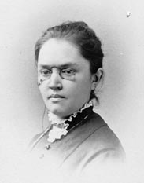
In Our US History Books
We may find Betsy Ross…
What about Katharine Lee Bates (1859-1929), author of America the Beautiful…
She attended Wellesley college and later returned to join the faculty. While on staff she met Katharine Coman and began a relationship that lasted for 25 years and sometimes referred to as a Boston Marriage, denying the romantic involvement. Her volumes of poems reveal the love she had for her friend and roommate. (Schwarz, 1979)
CA Content Standards: 5th Grade Social Science 5.7
Notes:
Raise your hand if… rosa parks or Martin Luther King – stonewall riots or Harvey Milk. Poems are a wonderful way to show that it was about “love.” Coman, professor of economics, both women were very political.

Slide 30
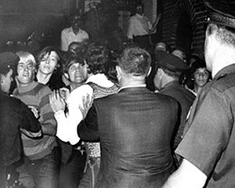
The Stonewall Riots
On June 28th 1969 at the Stonewall Inn located…
After years of harassment, police raids and arrests for simply haunting an establishment that was known for catering to gay men and drag queens...
This time the patrons decided to fight back…
A riot broke out and the word got out…
Supporters came in from all around New York City!
Leading up to the Stonewall Riots:
http://www.youtube.com/watch?v=9piUkiMKHro&feature=related
CA Content Standards:
Grade 11 Social Science – 11.0, 11.11, 12.5
Notes:
Review, in order to tell more

Slide 31
Resources
Colby Quarterly, Volume 26 no.4, December 1990 p.205-212
(Gay Straight Alliance) Network, retrieved fromhttp://gsanetwork.org/news/fair-education-act-introduced-sponsored-gsa-network/121310 on January 7, 2011
People with a History (1997). Ongoing research project at Fordham University.
Pettinger, T. “Biography of Oscar Wilde:, Oxford, UK www.biographyonline.net 22nd Nov. 2006.
Schwarz, J., "Yellow Clover: Katharine Lee Bates and Katharine Coman," Frontiers: A Journal of Women's Studies, 4:1 (Spring 1979), 59–67. Quote p. 59: "Katharine Lee Bates and Katharine Coman were a devoted lesbian couple."

Slide 32
Resources
Campbell, D. (2004). Choosing democracy (3rd ed.). Upper Saddle River, NJ: Prentice-Hall.
Feinleib, M. R. Report of the Secretary's Task Force on Youth Suicide. Volume 3: Prevention and Interventions in Youth Suicide. Washington D.C.
Gilligan, C. (1982). In a Different Voice, Harvard University Press
Grayson, D. (1988). Emerging equity issues related to homosexuality in education. Peabody Journal of Education, 64(4), 132-145.
Howe, K. R. (1997). Understanding Equal Educational Opportunity: social justice, democracy and schooling (New York, Teachers College Press).
Laub, C. GSA (Gay Straight Alliance) Network, retrieved fromhttp://gsanetwork.org/news/fair-education-act-introduced-sponsored-gsa-network/121310 on January 7, 2011.
Mays, V., Cochran, S. (2001). Mental health correlates of perceived discrimination among lesbian, gay and bisexual adults in the United States. American Journal of Public Health,91(11), 1869-1876.

Slide 33
Petrovic. J. E. (2000). Caring without justice: How we deaden the spirits of gay and lesbian youth in schools. International Journal of Children’s Spirituality, 5, pp.49-59
Petrovic. J. E. (2002). Promoting democracy and overcoming heterosexism in schools: And never the twain shall meet
Rofes, E. (1989). Opening up the clasroom closet: Responding to the educational needs of gay and lesbian youth. Harvard Educational Review, 59(4). 444-453
Russell, S.T., Kostroski, O., McGuire, J.K., Laub, C., & Manke, E. (2006)
Suicide Prevention Resource Center. (2008). Suicide risk and prevention for lesbian, gay, bisexual, and transgender youth. Newton, MA: Education Development Center, Inc.
Unks, G. (1995). The Gay Teen: Education Practice and Theory for Lesbian, Gay and Bisexual Adolescents. Routledge, New York, NY.
U.S. Department of Health and Human Services, (2001).
California Department of Education, Ed Code

