Slide 1

Reclassifying English Learners in SCUSD
Presented by
Academic Office
Multilingual Literacy Department

Slide 2
Four Legal Requirements for Reclassification and How SCUSD Complies
LEGAL | SCUSD
Assessment of English language proficiency, using an objective assessment instrument, including but not limited to, the state test of English language development | CELDT Overall score Early Advanced or Advanced, with no
Assessment of basic skills in English–language arts, using an objective assessment instrument, and compared to peer students’ performance | CAASPP or District Benchmark Test or CAHSEE
Teacher evaluation | Teacher gives OK
Parent consultation and opinion | Parent gives OK
1
2
3
4

Slide 3
Reclassification Process in SCUSD
Strategy and Innovation Office downloads list of students who are eligible for reclassification based on Requirement 1 and 2 Multilingual Literacy notifies schools that their lists are ready
EL site representatives begin reclassification process in Illuminate
  EL site representatives ask teachers for recommendation
    If teachers recommends “yes,” either the teacher or the EL site representative marks the recommendation in Illuminate
    If the teacher recommends “no,” they must provide evidence, like test scores, to demonstrate the student is not ready. Multilingual Director looks these cases over, student by student, and makes decisions
  EL site representatives ask parents/guardians for recommendation
    If parent recommends “yes,” the EL site representative marks the recommendation and date in Illuminate
    If the parent recommends “no,” Multilingual Director contacts parent to discuss
Notes:
Explain the four points.
Activity:
Find a neighbor and ask him or her to tell you the four things that makes ELAC and ELAC. You have two minutes each person. When you hear, clap, clap….clap, clap, clap, I want you to stop talking and look at me. Ensure understanding and repeat directions:
1. Tell your neighbor the four things that make ELAC and ELAC. 2. Each person has 2 minutes. 3. Ready… go!

Slide 4
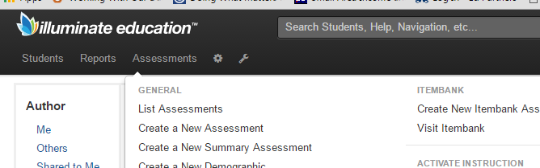
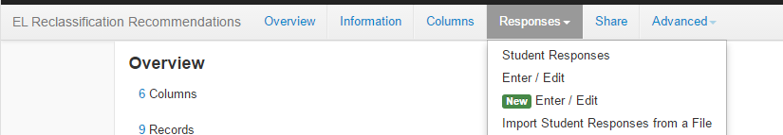
Online in Illuminate
1
2
Notes:
Explain the four points.
Activity:
Find a neighbor and ask him or her to tell you the four things that makes ELAC and ELAC. You have two minutes each person. When you hear, clap, clap….clap, clap, clap, I want you to stop talking and look at me. Ensure understanding and repeat directions:
1. Tell your neighbor the four things that make ELAC and ELAC. 2. Each person has 2 minutes. 3. Ready… go!

Slide 5
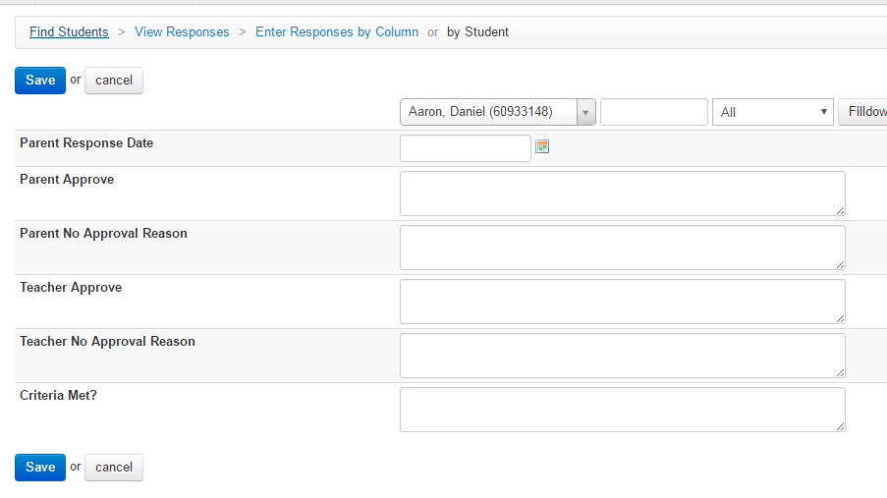
Online in Illuminate
3
EL Coordinator only
Notes:
Explain the four points.
Activity:
Find a neighbor and ask him or her to tell you the four things that makes ELAC and ELAC. You have two minutes each person. When you hear, clap, clap….clap, clap, clap, I want you to stop talking and look at me. Ensure understanding and repeat directions:
1. Tell your neighbor the four things that make ELAC and ELAC. 2. Each person has 2 minutes. 3. Ready… go!

Slide 6
Reclassification Process in SCUSD
Once a school has completed reclassifying all their eligible students, Multilingual Literacy changes the students’ status from “EL” to “Reclassified” in Infinite Campus, our student information system
The next time we provide student information to CA’s student information system, the students are reclassified and no longer need to take the CELDT
Multilingual Literacy provides annual lists of reclassified students to schools for follow up; each student is monitored for two years
Notes:
Explain the four points.
Activity:
Find a neighbor and ask him or her to tell you the four things that makes ELAC and ELAC. You have two minutes each person. When you hear, clap, clap….clap, clap, clap, I want you to stop talking and look at me. Ensure understanding and repeat directions:
1. Tell your neighbor the four things that make ELAC and ELAC. 2. Each person has 2 minutes. 3. Ready… go!

