Slide 1
Overview of the new
State Accountability System
Information for Parents and Community Members
March 2017

Slide 2
Learning Goals for Today
Participants will:
Understand the new accountability system that replaced the Academic Performance Index (API)
Review the different measures used in the California School Dashboard
Compare the state Dashboard to the district’s Data Dashboard
Receive resources for additional learning

Slide 3
Changes with the new system
BEFORE | NOW
Performance represented by a single performance indicator (API) | Performance represented by multiple performance indicators
Performance measured by achievement OR growth | Performance measured by both achievement AND growth
Performance measured by student test scores | Multiple measures that go beyond test scores

Slide 4
What is a Dashboard? An Indicator?
Multiple Measures? Student Group?
Discuss with someone next to you.
Notes:
This new system provides us an opportunity to introduce some new terms to the community.
Give the attendees a moment to think about and discuss new terminology.
Define Dashboard: something that gathers/reports information and groups it in a visual way (like a car dashboard)
Indicators: a measure, a guide, a way to report
May use health analogy for multiple measures
Contrast with API single measure
Student group: new way to describe demographic groups (formerly subgroup)

Slide 5
Elements of the California School Dashboard
State Indicators Spring 2017 | Local Indicators Spring 2017
Graduation Rate (HS only) Suspension Rate English Learner progress indicator Student Achievement (ELA/Math) (Grades 3-8 and 11) | Basic Services Implementation of State Standards Parent Engagement School Climate
State Indicators Fall 2017
College-Career Readiness, Chronic Absenteeism
Notes:
On the left are the indicators, or measures, that are part of the Spring rollout. All schools will receive an indicator on Suspension rate, Student Achievement and English Learner progress. High schools only will receive an indicator on graduation rate.
On the right, are the local indicators that only will reported at the district level.
At the bottom are two more indicators that will be ready in the next state Dashboard version in the fall.
All of these measures are aligned with the eight state priorities outlined by the state, and reported on in the LCAP.

Slide 6
Key Concepts: State Indicators
Performance levels are calculated using percentiles that combine Status and Change.
Districts and schools across the state will be rated on this scale.
 | Blue | Highest
 | Green
 | Yellow
 | Orange
 | Red | Lowest
Notes:
So what does the system look like? The rating is determined using a combination of Status (a performance level – which varies by indicator) and Change.
This system represents a big change.
Previously schools only had to reach a level of proficiency, but this system is more nuanced.
Schools that might have a lower performance level, but experienced positive growth will receive credit for moving in the right direction.

Slide 7
Data Sources for State Indicators Spring 2017
Indicator | Status Year(s) | Change Year(s)
Suspension | 2014-15 | 2013-14
English Learner Progress | 2013-14 and 2014-15 English Learner testing and Reclassification | 2012-13 and 2013-14 English Learner testing and Reclassification
Graduation Rate | 2014-15 | Average of the previous three years
Academic Achievement | 2015-16 Standardized testing in English Language Arts and Math | 2014-15 Standardized testing in English Language Arts and Math
Notes:
Briefly, this is where the data in the Spring 2017 Dashboard comes from.
The data comes from several different years at this point.

Slide 8
District-only reporting: Local Indicators
The district will self-reflect and self-report on these state priorities:
Basic Services
Implementation of State Standards
Parent Involvement
School Climate
Rating: Met - Not Met - Not Met for Two Years
Notes:
The state does not collect any data on these measures, but it believes these are critical to supporting positive outcomes for students.
So every district is asked to review the criteria for each of these indicators, and rate on this scale: met – not met – or not met for two years
There is no color indicator for these priorities.

Slide 9
The Fine Print
The California State Dashboard will be available regularly every fall.
Data will be provided at the district and school level only (no grade level, or student level data)
Data will be reported for all students, and also by student group, including:
- Low income students | - Students with disabilities
- English learners | - Ethnic identification
- Foster Youth (in the future) | - Homeless (in the future)
Notes:
Data will be reported for every student group with an N size greater than 30 in the current and prior year
Status and change for student groups between 11 and 29 will be reported but will not receive a color rating.
Student groups of less than 11 will not receive any rating.

Slide 10
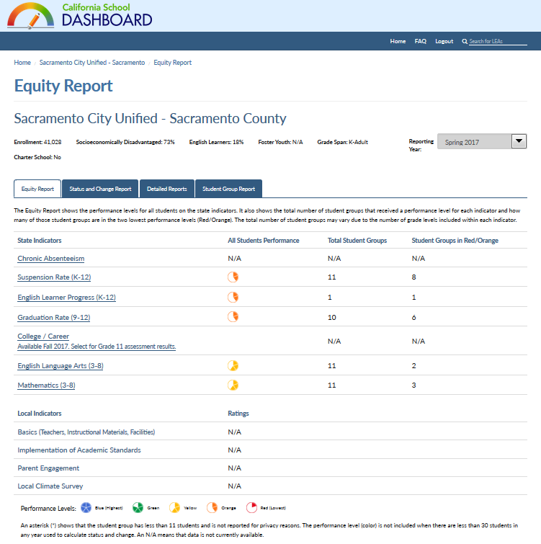
Notes:
This is the visualization for the district’s page.
First arrow: the “landing page” for the CA Dashboard is always going to be this Equity Report. One of the defining purposes of the dashboard through the Local Control Funding Formula is to identify areas where there are gaps between student groups.
The next arrow shows where the basic demographic information appears, and the pull-down for the year.
The orange arrow points to the list of state indicators. The first column is the rating for all students in the district. The second column details how many student groups are represented for that measure. The third column indicates how many student groups are shown as being in need with a red/orange rating.
Any area that shows “N/A” is those areas where more data will be coming in the fall.
Note that anything underlined is clickable, so the area can be expanded to show more detail.
The purple arrow points to the list of local indicators.
Finally, on the right, the red arrow points to the different tabs that may be explored for greater detail.
NOTE: If you would like to share the live Dashboard, click the link at the top right.

Slide 11
Comparison: SCUSD Data Dashboard
SCUSD Dashboard Provides Metrics | California School Dashboard Provides Indicators
Demographics | Limited
Attendance | Not included
State standardized testing in ELA and Math | State standardized testing in ELA and Math
Benchmark Tests | Not applicable
Graduation Rate | Graduation Rate
Chronic Absence | Coming Fall 2017
Suspension Rate | Suspension Rate
Notes:
Many of you are familiar with our district’s Data Dashboard, which was launched in October 2016. Unfortunately, both the district and the state are using the term, Dashboard. This table shows some of the differences between the offerings of each dashboard.

Slide 12
Resources and Learning Opportunities
Website: www.caschooldashboard.org
Free Community Workshop (by CDE)
March 28, 2017
10 a.m. – 4 p.m. at the Hyatt Regency Sacramento
Register in English
http://tinyurl.com/h5ymwcm
Registrase en español
http://tinyurl.com/hb798ed
LCAP English Learner Parent Advisory Committee
Tuesday, March 21, 2017
6:00 p.m. – 8:00 p.m. at the Serna Center

