Slide 1

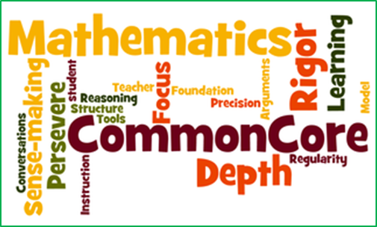
Transition To The Common Core
Mathematics
DELAC
June 4, 2014

Slide 2

Agenda
What is Common Core?
Let’s do some math!
Resources for support

Slide 3
Outcomes
Participants will:
Increase their knowledge and understanding of Common Core Math
Know how and where to access resources for clarification and support

Slide 4
What do you know about Common Core?
Write down everything you know about Common Core and/or your questions about Common Core.
Share with someone at least two items (what you know or questions) from your list.
Whole group share-out.
Notes:
NEED: Half sheets of paper; writing instruments
Chart paper/markers for recording
1-1 min.
2-2 min.
3-3 min.

Slide 5

What is Common Core?
http://vimeo.com/51933492
Notes:
Need to imbed link—On website….
Video gives insight into reason for adopting Common Core Standards, in general. Tonight we will focus on the math standards.
So, let’s look at Sac City USD’s framework of implementation.

Slide 6

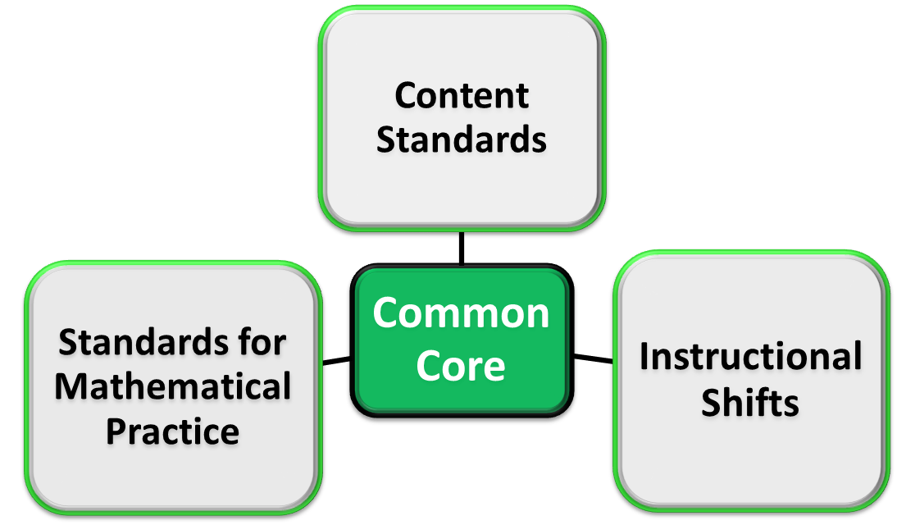



SCUSD Framework for Common Core Implementation
Curriculum
Notes:
Framework that guides implementation
1st focus on Instructional Shifts

Slide 7
Common Core Instructional Shifts for Mathematics
FOCUS strongly where the Standards focus
COHERENCE: Think across grades, and link to major topics within grades
RIGOR: In major topics, pursue conceptual understanding, procedural skill and fluency, and application

Slide 8
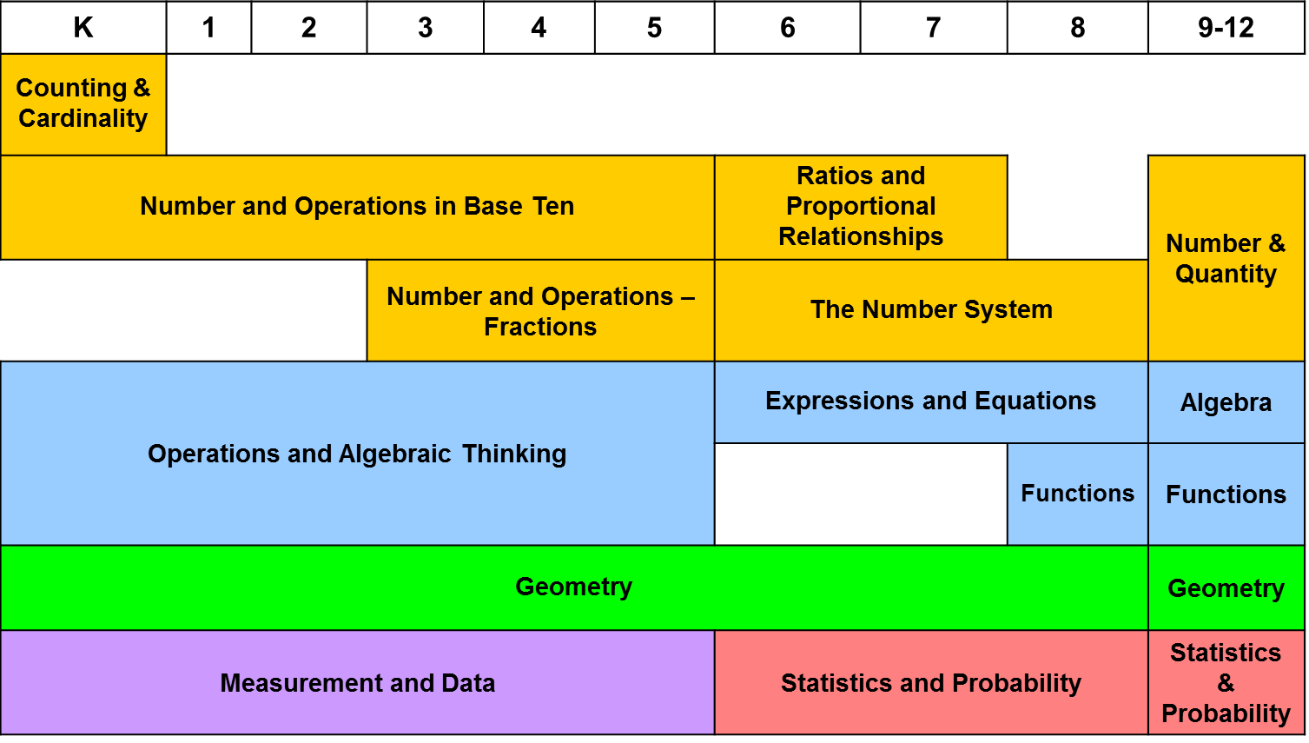
Common Core Mathematics
Coherence of Content Standards
Notes:
What will your children be learning in math?
Address integration K-12
No more Algebra, Geo, etc. courses for secondary level

Slide 9
Let’s do some math!
Complete the chart by adding three more pairs of In and Out values. What is the rule?
In | Out
aardvark giraffe hippo ? ? ? | a a o ? ? ?
Notes:
From Good Questions for Math Teaching
Copy function table on other side of ½ sheet (What do you know about CC?)
Functions are introduced in 8th grade
To address Rigor( conceptual understanding, procedural skill and fluency, application) Let’s do some math.
Conceptual understanding: What is the concept in the table? What does it mean to have a rule?
Fluency: After the rule is established (is there only one?), can you easily find the output of any input?
Application: Let’s put some money in the bank and let it earn simple interest…. I=prt Can we add another column for Balance?
Let’s try another problem from the released assessment items for the state test—we’ll get into the testing part of CC soon.

Slide 10
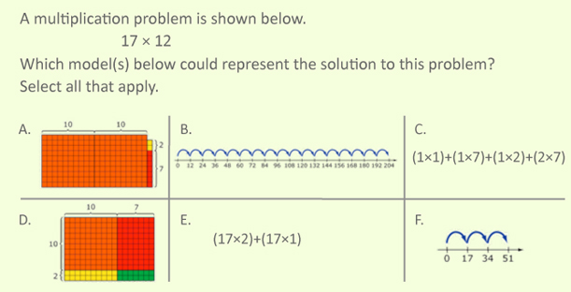
Apply your mathematical knowledge
Notes:
Bring copies of this for better viewing.
2 by 2 multiplication is a 4th grade standard (4.NBT.5)
Ask participants to explain their reasoning—How do you know it is an answer?
Does the question ask for the product? (Old CST would)
Is there only one model? (no)

Slide 11
The Standards for Mathematical Practice (a.k.a. “practice standards” or “SMPs”)
L
Make sense of problems and persevere in solving them ***
6. Attend to precision ***
Legend
2. Reason abstractly and quantitatively
3. Construct viable arguments and critique the reasoning of others
Reasoning & Explaining
Modeling &
Using Tools
Model with mathematics ***
Use appropriate tools strategically
Seeing Structure & Generalizing
7. Look for and make use of structure
8. Look for and express regularity in repeated reasoning
Overarching Habits of Mind of a Productive Mathematical Thinker
Notes:
The Common Core proposes a set of Mathematical Practices that all teachers should develop in their students. These practices are similar to NCTM’s Mathematical Processes from the Principles and Standards for School Mathematics, however now they will be assessed.
“Mathematically proficient students will…”

Slide 12

SCUSD Website Resources
http://www.scusd.edu/common-core

Slide 13
Thank you
Please provide feedback.
Contact me with math questions
Mikila Fetzer, Math Project Lead, 643-9254
Mikila-Fetzer@scusd.edu

