Slide 1

DELAC Update
Local Control & Accountability Plan (LCAP)
Strategy & Innovation Office
Cathy Morrison, LCAP Coordinator
May 2016

Slide 2
Local Control & Accountability Plan (LCAP)
The plan that each district creates, outlining goals, and specific actions and services to achieve those goals.
Expenditures are detailed in the LCAP, specifically showing the funds that support the actions.
Outcomes are reported by review of data and actual expenditures.
Notes:
The LCAP is a plan that each district creates, outlining goals, actions and services to achieve the goals, specifically for the Supplemental and Concentration grant funds.
We will start by looking at the district needs assessment.
Expenditures are detailed in the LCAP, showing how actions are supported.
The plan is not the entire district budget: it may include other funding sources that support our goals and actions.
We must show that we are directing Supplemental and Concentration grant funds toward meeting goals for low-income students, English learners, homeless youth and students in foster care.

Slide 3
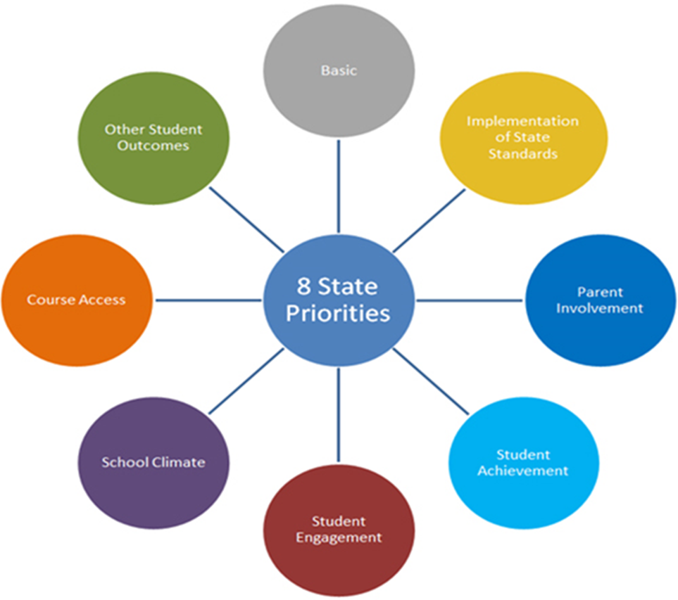
Accountability
Evidence of support for each of the eight state priorities.
Increased or improved services for identified students:
  Low-income
  English Learners
  Homeless and Foster Youth
How stakeholders were consulted as the district develops and updates the plan.
Notes:
Important point here – the law gives districts flexibility, but with limits.
Must include state priorities and measures
The plan must be created based on needs identified through student data.
Must include evidence of consultation with stakeholders, and must show impact of their involvement in the narrative of the plan. The plan must be reviewed and updated annually, including the feedback from stakeholders.

Slide 4
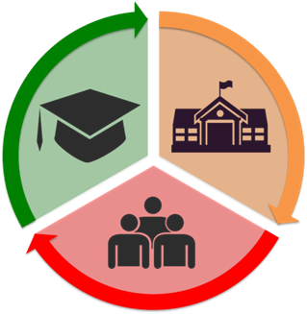
SCUSD 2015-18 LCAP Goals
Increase the percent of students who are on-track to graduate college- and career-ready.
Students will be provided with a safe, clean, healthy
and emotionally healthy school.
Parents, families and community members will become more fully engaged as partners in the education of students in SCUSD.
Notes:
SCUSD goals were established in the 2013-14 school year.
About 80% of respondents in this year’s survey and community meetings agreed that the goals should continue to drive our vision.
The three goals are named on the next slides, along with examples of districtwide actions to support those goals.

Slide 5

Goal #1 Districtwide Actions
Class Size Reduction (K-3) in all schools
Implementation of the Common Core State Standards
Early Kinder/Transitional Kindergarten
High School and Middle School Counselors
Linked Learning and Career Technical Education
Support for Students who are English learners
Foster Youth Services
Notes:
These are the district’s actions that support college and career readiness.

Slide 6

Goal #2 Districtwide Actions
Plant Managers and Custodians
School Resource Officers
Central Office Drop Out and Attendance Support
District Social Workers and Nurses
Programs to support positive school climate, such as SEL, PBIS and Restorative Practices
Notes:
These are the district’s actions that support safe, clean and healthy schools.

Slide 7

Goal #3 Districtwide Actions
District Parent Engagement staff to support outreach, parent education and training
Parent/Teacher Home Visit Project and Academic Parent-Teacher Teams
Translation services throughout the district, both written and verbal.
Notes:
These are the district’s goals that support family and community engagement.

Slide 8
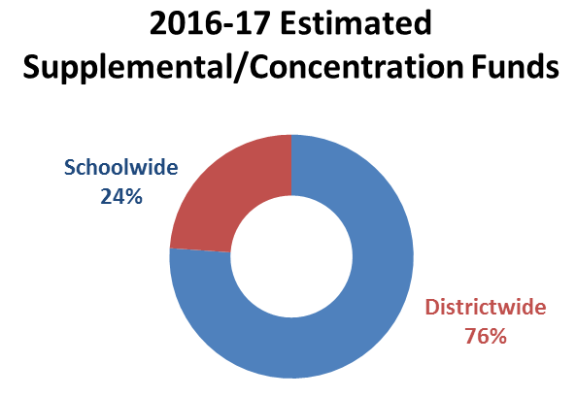
Local Control for Districts and Schools
Approximately 25% of SCUSD Local Control Funds are allocated to school sites.
LCFF funds are built into each school’s Single Plan for Student Achievement (SPSA).
Notes:
SCUSD is also allocating LCFF’s supplemental and concentration grant funds to schools.
LCFF funds are built into each school’s Single Plan for Student Achievement (SPSA).
These plans are created by School Site Councils made up of teachers, staff, parents, administrators and students (at the high school level).
This year, like last year, SCUSD allocated $9.8 million in LCFF funds to schools and the balance to district-wide programs and initiatives.

Slide 9

Funds Allocated at School Sites
Every SCUSD school receives a portion of LCFF based on the percent of Low income and English learner students.
The use of funds is described in the Single Plan for Student Achievement (SPSA) created by the School Site Council (SSC).

Slide 10
School Site Funding
Resource teachers or training specialists
Bilingual instructional assistants
Instructional materials
Learning support coordinator/social worker
Health & safety staff
Library staff
Parent Advisors
Translation
Notes:
These are the activities and services that are used most frequently in School Site Plans, and incorporated into the LCAP.

Slide 11
Comments for the Superintendent

Slide 12
Contact Information
  Cathy Morrison (916)643-9222
  Read more about the plan and district resources on the web page:
  www.scusd.edu/LCAP

