Slide 1
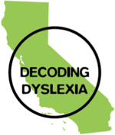
Dyslexia California
Transforming public education with early assessment and intervention for dyslexia
Reneé Webster-Hawkins
Regional Leader
Renee.SacDDCA@gmail.com
916.804.1107
Notes:
Overview:
Who I am and why my involvement with Decoding Dyslexia is important to parents, educators and students in SCUSD.
Dyslexia 101, to:
address common myths and affirm facts
describe dyslexia
describe impacts of unremediated dyslexia on students and society
Describe interventions that can be used both in main class and SpEd
Share important events in law and policy to address the growing awareness of and demand for better dyslexia intervention.
Steps being taken by CDE and districts in the State.

Slide 2
What is dyslexia?
A type of specific learning disability (SLD)
Neurological and hereditary in origin.
  Brains are structurally and chemically different than neurotypical learners. (International Dyslexia Association, Dyslexia and the Brain Fact Sheet)
Deficits in language processing
  Phonological
  Auditory
  Visual
  Sequential
Why does it matter?
  Up to 20% of population ---> Genetic!
  Higher occurrence of functional illiteracy in incarcerated individuals
  People with dyslexia and related learning disabilities have a much higher rate of suicidal behavior. (Attitude Magazine, Study: People with Learning Disabilities More Likely to Attempt SuicideJuly 17, 2017)
Notes:
Dyslexia is a specific learning disability that is neurobiological in origin and is characterized by difficulties with accurate and/or fluent word recognition and by poor spelling and decoding abilities, which typically result from a deficit in the phonological component of language that is often unexpected in relation to
other cognitive abilities and the provision of effective classroom instruction, whose secondary consequences may include problems in reading comprehension and reduced reading experience that can impede growth of vocabulary and background knowledge; and
Dyslexia is a language-based disability that is neurobiological in origin.
Dyslexia is characterized by difficulties with accurate and/or fluent word recognition and by poor spelling and decoding abilities, and it occurs in a continuum from mild to severe.
It is also the most common learning disability in the nation.Up to 20% of the general population, or over 1 million students in California K-12 public schools display signs or symptoms of dyslexia

Slide 3

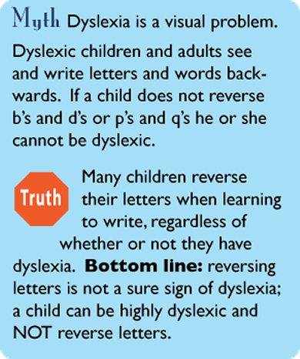
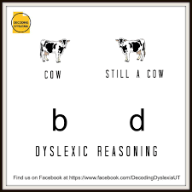
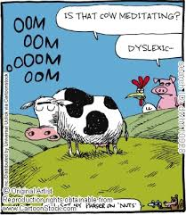
Notes:
Dyslexia primarily affects boys.

Slide 4

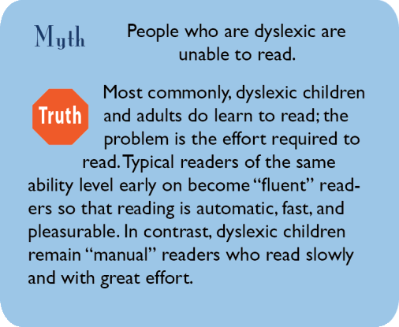
Notes:
People with dyslexia are below average in intelligence.
You cannot diagnose dyslexia before first or second grade.u

Slide 5
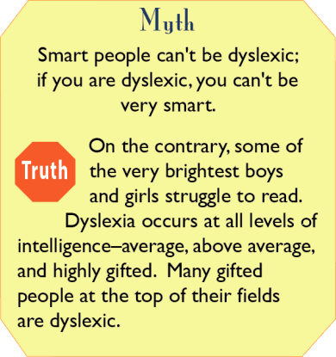
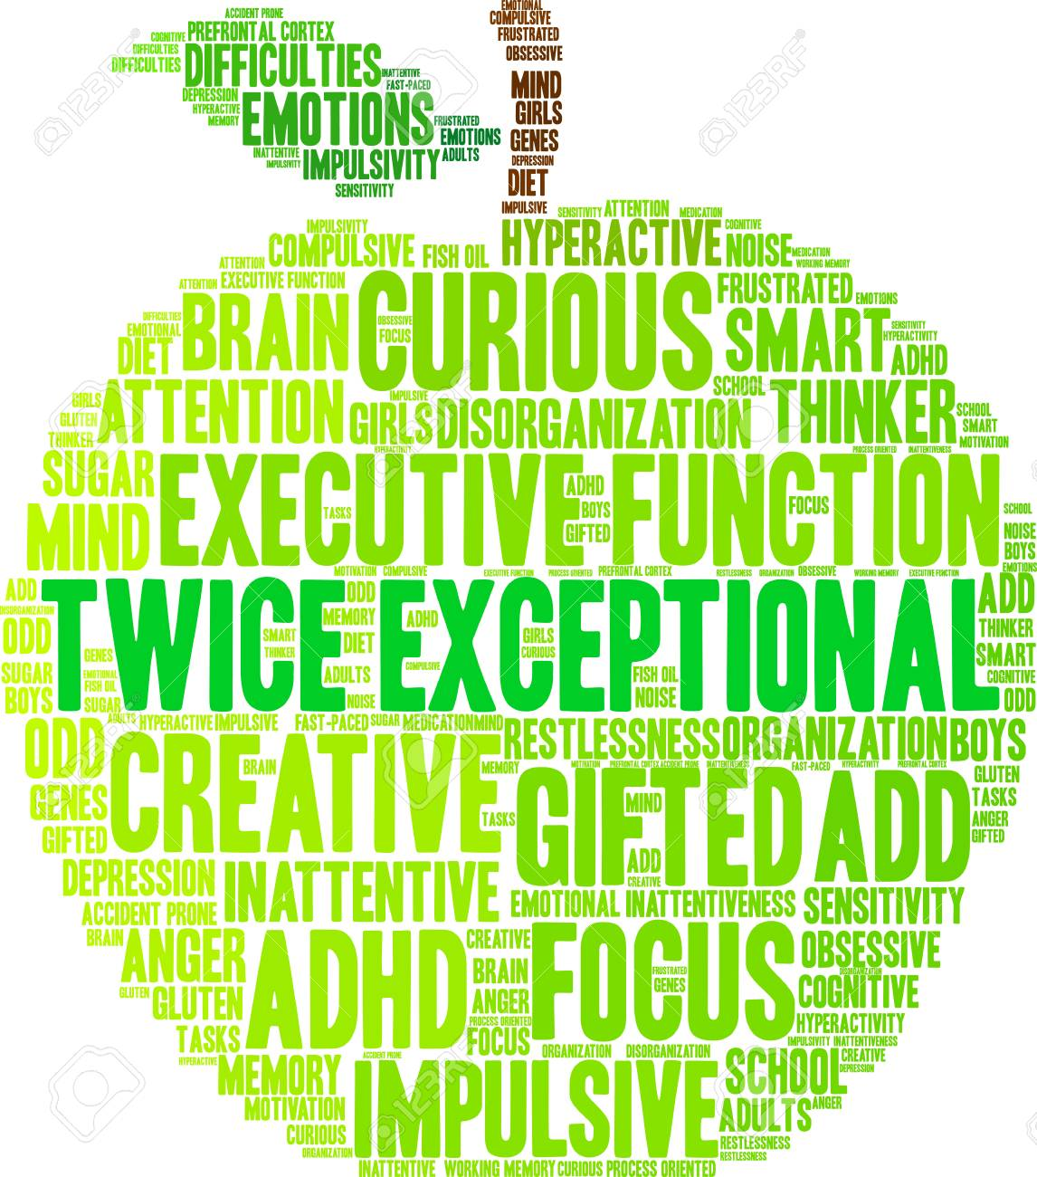
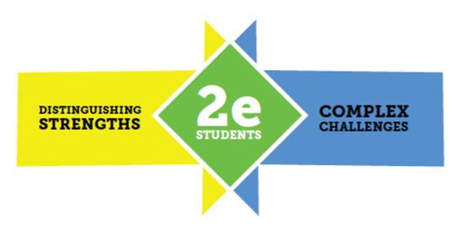
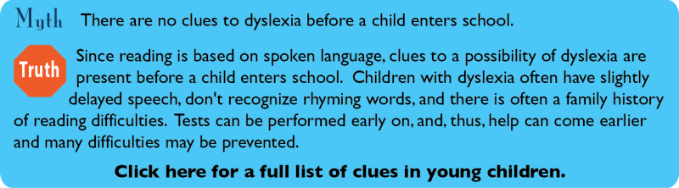
For more dyslexia myths go to:
http://dyslexia.yale.edu/Myths.html

Slide 6
How does it impact students?
Impaired access to instruction
  Language: reading, writing and spelling, decoding fluency
  Math: math facts and sequential problem solving
  Executive functioning: organization
  Impaired memory: of facts and events
Social and emotional impacts!
  Perceived as “lazy” “messy” or “not willing to work hard”.
  Anxiety, low self-esteem, targets for bullying
Improved support for struggling readers was the top-ranked priority among parents and educators in Sacramento Unified City School District’s Strategic Planning Survey Fall 2015!
80% of students who don’t graduate were “struggling readers”
85% of teenagers in juvenile hall are functionally illiterate
70% of incarcerated individuals cannot read above a 4th grade level
  Source: National Assessment of Adult Literacy

Slide 7
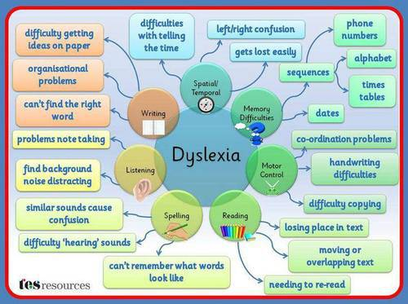
What does dyslexia look like?
Never ask someone with dyslexia to focus or work harder. They are focusing and working harder than people for whom reading is automatic.
Notes:
Although slow in reading, the same person is often a very fast and able thinker.

Slide 8
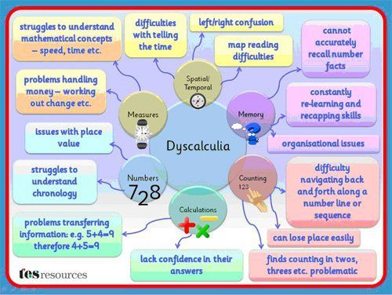
What is dyscalculia?
Like dyslexia, it is a real disruption in the complex set of motor and information processing
skills.
http://www.ldonline.org/
Notes:
Teachers might recognize these students in their classroom.

Slide 9
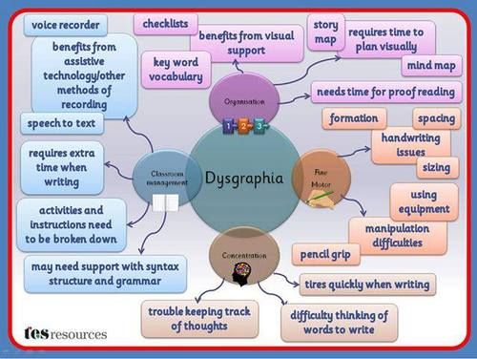
What about dysgraphia?
Like dyslexia, it is a real disruption in the complex set of motor and information processing
skills.
http://www.ldonline.org/
Notes:
Teachers might recognize these students in their classroom.

Slide 10
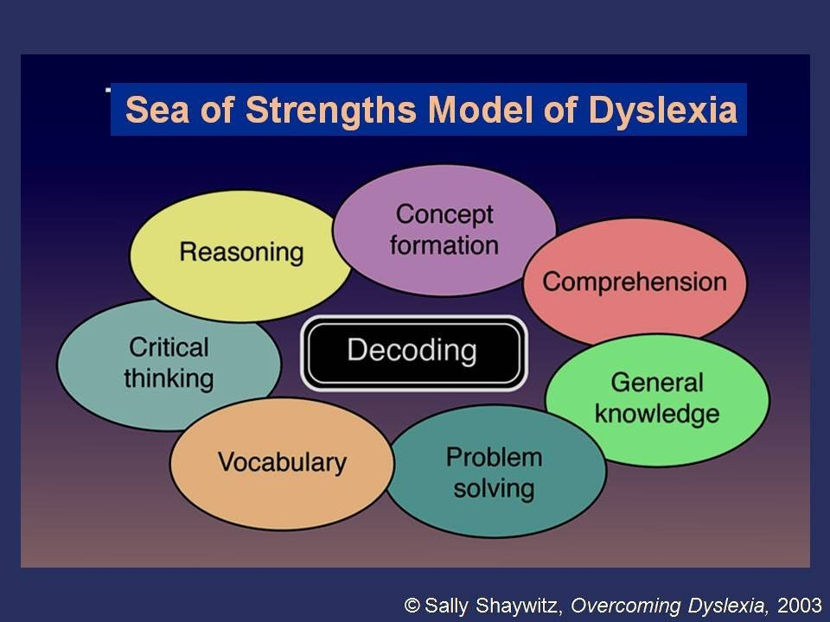
What does dyslexia look like?
The paradox
Notes:
Although slow in reading, the same person is often a very fast and able thinker.

Slide 11
What is Decoding Dyslexia?
We aim to raises dyslexia awareness, empower families, to support their children, and inform policy makers on best practices to identify, remediate, and support students with dyslexia in California schools.
Grassroots organization of parents and educators
All 50 states
Organized to promote the awareness of dyslexia, dyscalculia and dysgraphia, and the implementation of evidenced-based instructional interventions and accommodations
  Main classroom
  Special education
  Teacher training
  Parent and student empowerment
Educate.
Advocate.
Legislate.
https://decodingdyslexiaca.org/
Notes:
Parents like me. Struggling to understand why my kid isn’t learning to read, despite being smart and surrounded by great teachers.
Due to the work of DD nationally, 30 states have dyslexia laws, and 13 have legislation pending.

Slide 12
What does AB 1369 do?
Include “phonological processing” in the description of the basic psychological processes, in which an impairment may form the basis of a determination of eligibility for special education services
Develop guidelines
  Assessment and intervention
  Main classroom
  Special education
  Early identification
Defines “educational services” as evidence-based, multisensory, direct, explicit, structured, sequential instructional approach for students with dyslexia
Statewide taskforce
Beginning 2017-18 academic year
Notes:
AB 1369 requires the State Board of Education to include “phonological processing” in the description of basic psychological processes. Phonological processing is related to the ability to recognize and understand or process units of words, and is distinct from Auditory or Visual processing
AB1369 Requires the Superintendent of Public Instruction to develop program guidelines for dyslexia to be used to assist regular education teachers, Sped teachers, and parents to identify and assess student’s w/ dyslexia, and to plan, provide, evaluate, and improve educational services to student’s w/ dyslexia.
AB1369 defines “educational services” as an evidence-based, multisensory, direct, explicit, structured, and sequential approach to instructing students who have dyslexia.
State Task Force met:
The Superintendent shall complete the program guidelines in time for use no later than the beginning of the 2017-2018 academic year.
Future work:
Mandate: This bill is only the beginning of what still needs to be accomplished for 20% of the California student population. AB1369 is a Special Education Bill, but 70% of dyslexics can be identified and remediated in General Education w/ appropriate RTI instruction.
Teacher training

Slide 13


What can help students with dyslexia?
Structured Literacy
  Evidenced-based instruction
    Multi-sensory
    Direct
    Explicit
    Structured and
    Sequential approach to instructing
  Delivered with fidelity by highly qualified educators
Robust Accommodations! See Understood.org! ---------> ---------> ---------->
Criteria outlined by International Dyslexia Association
  Several methods and approaches compared and recognized
  Orton-Gillingham based, Wilson, Barton, Slingerland, Lindamood-Bell
Main Classroom: Structured Literacy works for all students!
Special Education: Individual & Small group instruction enables the programs to be delivered at the individualized pace of each student

Slide 14


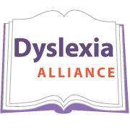


Dyslexia Primary Resources
California Dyslexia Guidelines (2017)
https://www.cde.ca.gov/sp/se/ac/documents/cadyslexiaguidelines.pdf
Yale Center for Dyslexia & Creativity
Yale School of Medicine
https://www.dyslexia.yale.edu/
“Dyslexia is a real disability.”
“Dyslexia is an unexpected difficulty in learning to read. Dyslexia takes away an individual’s ability to read quickly and automatically, and to retrieve spoken words easily, but it does not dampen one’s creativity and ingenuity.”
Notes:
Dyslexia is a visual problem.

Slide 15
Groundswell of Awareness and Leadership
U.S. Senate Resolution 275 (October 2015)
  "early diagnosis is critical for ensuring that individuals with dyslexia receive focused, evidence-based intervention"
U.S. Department of Education Dear Colleague Letters
  "nothing in IDEA that prohibits the use of the terms dyslexia, dyscalculia or dysgraphia in IEP documents." #saydyslexia (October 2015)
  annual goals must be aligned with statewide grade-level standards (November 2015)
Assembly Bill 1369 (Frazier)
  Unanimous in Senate and Assembly
  Signed into law October 2015
California Parent Teacher Association Business Resolution A
READ Act (signed by President Obama February 2016)
  $2.5 million annually to NSF for research in intervention, curriculum and professional development
Notes:
Senate Resolution 275:
AB 1369 Supported by:
California PTA
Disability Rights Education & Defense Fund
International Dyslexia Association
UCSF
Lt. Gov. Gavin Newsom
Congresswoman Julia Brownley

Slide 16
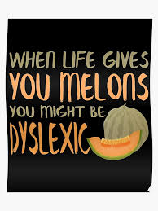
Next steps in SCUSD: Possibilities?
(Not so) Radical Proposition for MTSS in SCUSD: Training ALL classroom teachers and resource specialists alike in evidence-based practices in dyslexia, dyscalculia and dysgraphia to fundamentally shift the needle and improve graduation rates for all students across all subgroups in SCUSD!
  correlation between illiteracy, dropout rates and dyslexia
  embrace the best practices for intervention
    main classroom and special education settings
    assistive technology for students with IEPs and 504 plans
  universal PD supports early assessment = more effective remediation
Scale up Dyslexia Pilot to all schools, all grades, all classrooms

