Slide 1

California English Language Development Test
Coordinator Training
2012-2013
Presented by
Melody Hartman
District CELDT Coordinator
Assessment, Research & Evaluation
August 2012
Serna Center

Slide 2
Training Goals
Apprise you of what is new and different with CELDT this year
Standardize the administration of the CELDT
Reliably score the writing and speaking items
Answer any questions/concerns and provide support
Notes:
EDS is trying to go more green so you will see less rather than more paper
Sure everyone is administering the CELDT in the same manner
Support on line now for practice scoring writing and speaking
Prepare you to train others
Answer all of your questions

Slide 3
What’s New for 2012-2013?
District and Test Site Coordinator’s Manual (DTSCM) instead of Test Site Coordinator’s Manual.
Answer Book: Demographic Pages The fields on the demographic pages have been reordered and renumbered. Pay close attention to these changes to avoid data bubbling mistakes.
New Oral Vocabulary Item Type. Form 3 at all grade spans includes four additional field test items representing a new Oral Vocabulary item type scored on a 0-1-2 rubric. Directions, scoring rubric, examiner Say statements, items, and sample responses are included in the Forms 2–6 Examiner’s Manuals.
Rubric Clarifications for 4-Picture Narrative, Sentences, and Short Compositions. These rubrics have been revised to reflect clarifications approved by the CDE. Updated rubrics along with sample responses are included in the Examiner’s Manuals.
Local Scoring Use Section for Writing. Answer Books for grades K–12 now include optional local scoring use sections for filling in local scores for K–1 Writing, Sentences, and Short Compositions items. For all grades, this Local Scoring Use section appears on the last page of the Answer Book.
TRANSITIONAL KINDERGARTEN STUDENTS MUST BE TESTED IF LANGUAGE IS OTHER THAN ENGLISH

Slide 4
What’s New for 2012-2013?
EXAMINER’S MANUAL
The “Before Testing” directions Under “Administering the Test” now include the following direction: “Remove or cover information displayed on bulletin boards, whiteboards, or charts that could be used by students to help answer test questions.
For the Writing and Speaking domains, directions have been added to the Examiner’s Manuals to remind students to provide responses in English.
For each of the Oral Vocabulary, Speech Functions, and Choose and Give Reasons Speaking components, an excerpt from Table 4, Test Administration Procedures, has been included in the directions. The excerpts include the information about practice items, repeating a question, and prompting.
The Writing section of the Student Score Sheet has been modified. For Writing Sentences, there is now a space to enter one total score rather than a score for each of the four sentences. For Writing Short Compositions, the space to record the item number has been removed.
Scoring – Clarifications have been made to the 4-picture Narrative, Writing Sentences, and Writing Short Compositions rubrics, and a change has been made to the Oral Vocabulary Scoring Guidelines (singular vs. plural)

Slide 5
Purpose of CELDT
Help teachers and school administrators identify pupils who are limited English proficient
Determine the level of English language performance
Assess progress of limited English proficient students in acquiring the skills of: listening, speaking, reading and writing in English
Notes:
California English Language Development Test
Identify
Determine performance levels
Asses progress of LSRW

Slide 6
Who Should Take the CELDT?
Initial Assessment (IA) (MOC)
All students whose primary language is not English, based on a home language survey, and who have not previously taken the CELDT, must be given an IA within 30 days from the date of first enrollment.
Answer documents for these students must be sent in for scoring on a monthly basis.
Annual Assessment (AA)
Students who have previously taken the CELDT and were identified as English learners (ELs) must be tested annually during the AA Window (July 1 to October 31) until they are reclassified as fluent English proficient (RFEP) based on the guidelines for reclassification established by the State Board of Education (Education Code Section 313[d]).

Slide 7

Unusual Testing Situations
Scenario 1: The current district is unable to confirm with a previous district in California whether the student took the current Edition of the CELDT.
Action: Administer the CELDT. If the student has taken the CELDT during any previous year,
mark AA as the test purpose; if not, mark IA.

Slide 8
Unusual Testing Situations
Scenario 2: A student took a portion of the test and then moved out of the district.
Action: If it is known which district the student moved to, contact the CELDT District Coordinator and ship the incomplete test to them. Securely ship the materials only to the current CELDT District Coordinator on file (check the CELDT District Coordinator list on the secure District Portal for the official names and addresses to use) and confirm receipt of the document.
If it is not known which district the student moved to, do not return the Answer Book for scoring. Write the word “MOVED” on the cover and retain it with the test materials scheduled for destruction at the end of the school year.
Do not return this document in the scorable shipment.

Slide 9
Unusual Testing Situations
Scenario 3: A student completed the test and then moved out of the district.
Action: Return the Answer Book for scoring and notify the district the student moved to (if known) that a test for the current Edition has been submitted for scoring. Provide a local score to the new district if one is available. Upon receipt of the Student Performance Level Report and Student Record Label, forward them to the new district.
To request the test results of a student who moved into your district, you may use the CELDT Score Request Form letter and Request Form available on the Resources page of the CDE Web site at http://www.cde.ca.gov/ta/tg/el/resources.asp.
Regulations require the previous district to provide score information within 20 days of the request of the receiving district.

Slide 10
Unusual Testing Situations
Scenario 4: A student began the test within the AA Window, but due to special circumstances, was not able to finish by October 31.
Action: Continue to make every effort to finish testing the student and return for scoring as soon as possible.
This student’s report may show the test purpose as AA Outside the Window.

Slide 11

Unusual Testing Situations
Scenario 5: An AA student was absent or did not take the test during the AA Window.
Action: Test the student upon return to the district and submit the test for scoring as soon as possible. This student’s report may show the test purpose as AA Outside the Window.

Slide 12
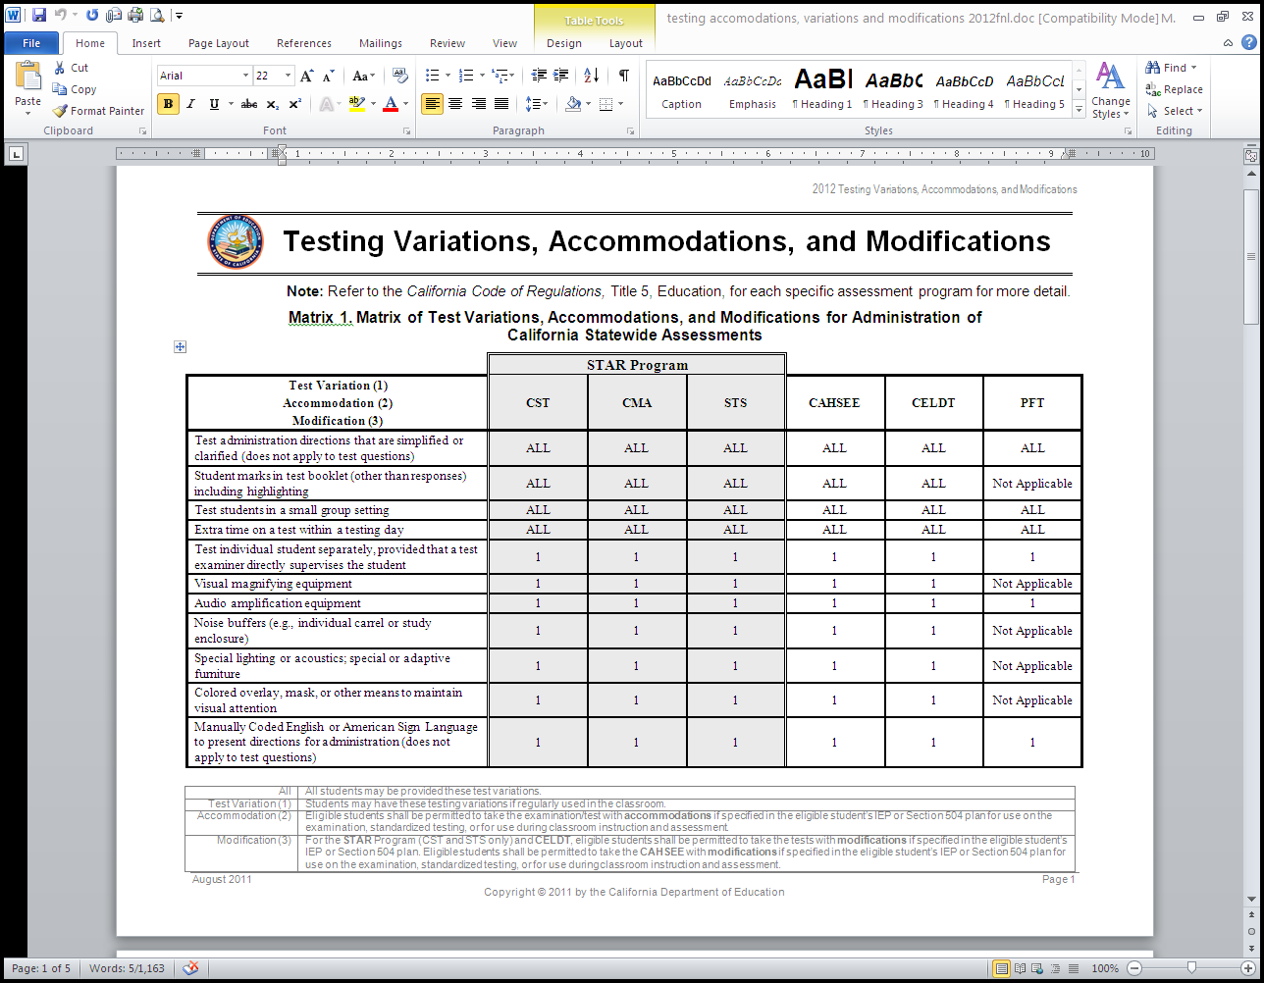
Testing Variations, Accommodations, and Modifications
Section 2 pages 23-27

Slide 13
Alternate Assessment
If it is written in a student’s IEP to take an alternate assessment, you must still complete a testing booklet with student’s information and on #23 mark “alternate assessment” for Listening, Speaking, Reading and/or Writing and turn it in.
Must be in their IEP or 504 and for what sections
Students will receive the Lowest Obtainable Scale Score (LOSS)
Braille is not an alternate assessment.
Notes:
In the IEP there must be goals that you want the student to accomplish for LSRW and which domains are needed for an alternate assessment.
Or if you know a student will not be able to accomplish the CELDT, have an emergency IEP . The assessment still gets turned in.
Students who take an alternate assessment will not score above beginning.

Slide 14
Roles and Responsibilities
The CELDT Site Coordinator is the test coordinator at the school level who is responsible for managing the CELDT testing program at the school, coordinating and training all test examiners, ensuring the proper administration of all testing procedures, maintaining the security of all test materials at the site, and assuring the proper packing and return of test materials to the CELDT District Coordinator.
The Test Examiner administers and scores the test, and proctors assist test examiners during group administration of more than 20 students. Test examiners and proctors, along with all others handling CELDT materials, must sign the Test Security Affidavit (Page 41) prior to the use of the materials.

Slide 15
Reporting Testing Irregularities
Testing Irregularities include but are not limited to:
Cheating by students
Failure to follow test administration directions
Rushing students through the test or parts of the test
Coaching students, including but not limited to:
Discussing questions with students before, during, or after testing
Giving or providing any clues to the answers
Administering the wrong grade span test to a student
Writing on the Answer Book by an examiner or scorer and therefore needing to transcribe the responses to a new Answer Book
Using mismatched test materials (such as a Form 1 Examiner’s Manual and a Forms 2–6 Test and Answer Book)

Slide 16
Reporting Security Breaches
Security Breaches include but are not limited to:
Sharing of test items or other secure materials with anyone who has not signed the Test Security Affidavit
Discussing the test content or using test materials outside training and administration
Allowing students to take the test out of the designated testing area
Allowing examiners or scorers to take the test home
Allowing students to watch the STOT workshop training DVD

Slide 17

Inventory Test Materials
  Check inventory with what is on your packing list.
  Secure materials in a secure locked place.
  Anyone who will be handling or have access to the secure materials, needs to fill out a Test Security Affidavit.
  Keep your CELDT boxes to return nonscorable materials for destruction in June.

Slide 18
Testing Security
To ensure test security over the CELDT, be sure to:
Have test examiners and proctors sign the required Test Security Affidavit (copy in back of your binder)
Train all test administrators and proctors in proper test administration procedures (use Moodle)
Keep all CELDT materials in a secured, locked storage at all times when not in use
Any breach of security, loss of materials, failure to account for materials, or any deviation from acceptable security procedures must be reported to Melody Hartman, the District CELDT Coordinator.
All personnel, including administrators, test administrators, proctors , custodians, office managers, or anyone else who will have access to CELDT test booklets and answer documents must sign the Test Security Affidavit. (Keep these copies at school site.)
Also, all principals must sign the Test Security Agreement and fax it to 643-9474.
Notes:
Test security agreement, office manager, principal and you

Slide 19
Before Testing…
  READ – The CELDT District and Test Site Coordinators Manual and the Examiner’s Manuals.
  TRAIN each individual who will be testing or proctoring for the CELDT.
  REVIEW security issues with all individuals at your site who will have access to CELDT materials, and collect SIGNED CELDT Security Affidavits from them.
  PREPARE test books (grades K-2) and/or answer books (grades 3-12) for testing.
  PREPARE test materials for distribution.
  MAKE copies of the School/Group List (SGL)
  PLAN testing schedule
  Do not photocopy any part of a test booklet.
  NOTE: Disclosure of any secure information in any form is a serious breach of test security and is prohibited
Notes:
Pre ID labels Can’t order until June 21

Slide 20
Errors- Grades K-5 Examiner’s Manuals
Educational Data Systems has discovered an error impacting the Domain Raw Score Conversion tables in the 2012–13 Edition Examiner’s Manuals. The error affects local scoring for students in kindergarten through grade five as well as the Local Scoring Tool (LST).
The tables below outline the grade spans, pages, and domains that are affected in the examiner’s manuals.
Form 1
Examiner’s Manual | Page Numbers | Domain(s) Affected
Grades K–1 | 118, 120 | Speaking
Grade 2 | 74 | Speaking
 | 75 | Reading
Grades 3–5 | 78, 80, 82 | Listening & Reading

Slide 21
More Errors- Grades 6–8 Examiner’s Manuals
A discrepancy has been found between the wording of one Writing Short Composition question in the Grades 6–8 Examiner’s Manuals and the wording in the Answer Books. The wording in the Answer Books is correct. To correct this discrepancy, please make the following change in your Examiner’s Manuals depending on which form your district is using:
Grades 6–8 Examiner’s Manuals
Form 1, Page 38, Short Compositions, Number 24. Please cross out the words “short essay” in the examiner’s directions to the students and replace them with the word “paragraph” to match the wording students will see in the Answer Book (on page 4).

Slide 22
More Errors- Grades 3-5 Examiner’s Manuals
A discrepancy has been found between the wording of one Extended Listening Comprehension question in the Grades 3–5 Examiner’s Manuals and the wording in the Test Books. The wording in the Test Books is correct. To correct this discrepancy, please make the following changes in your Examiner’s Manuals depending on which form your district is using:
Grades 3–5 Examiner’s Manuals
Form 1, Extended Listening Comprehension Question 20. Please cross out the word “lesson” in this question and replace it with the word “passage” to match the wording students will see in the Test Book (on page 7).

Slide 23
During Testing…
  Make sure all students who need to be tested are (A list will be coming in September)
  Follow directions in Examiner’s Manual for testing
  Students in grades K-2 will have individual test books
  Students in grades 3-12 must use the same Answer Book for the Listening & Speaking test as used for the Reading & Writing tests
  Test administrators should check each students answer book for completion and bubbling
  Also make sure your test administrators collect and count all test books and/or answer books prior to dismissing students from a testing session
  Work with AR&E to resolve any testing or scoring problems

Slide 24
After Testing…
  Make sure ALL students who needed to were tested
  Reconcile the quantities of test materials collected with those distributed

Slide 25
After Testing (continued)
DTSCM page 30
  Review Scorable answer documents
  Check that Demographic information is complete and accurate
  Check Demographic pages to ensure:
    Legible
    Marks are neat
    Problem situations are resolved
  Prepare completed materials using EDS procedures for pick-up by AR&E
DTSCM page 31

Slide 26
Important Things to Remember
#5 - Completing Disability info for ALL students
#8 - Bubbling in wrong Student number and not starting with 00
Filling in bubbles for name, DOB
#18 - Filling in Program Participation if II
#17 - Writing in language or #14 CELDT score dates other than what is on form
#14 - No date on Date Testing Completed

Slide 27
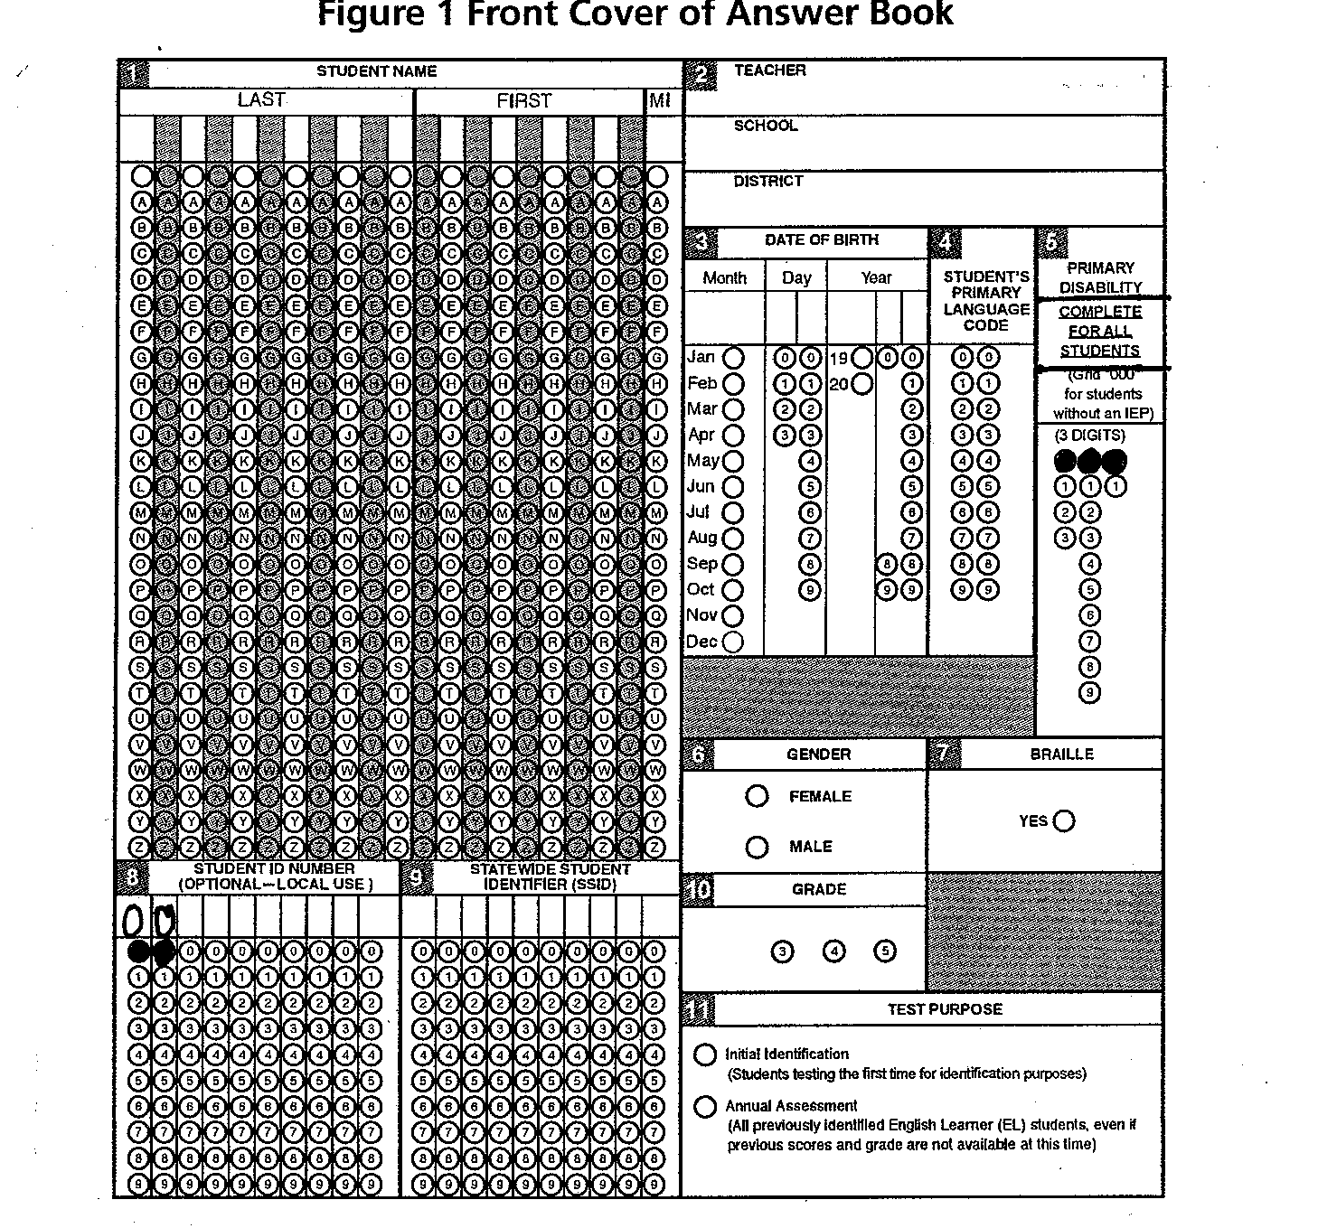
Front Cover of Answer Book
DTSCM page 22-29

Slide 28
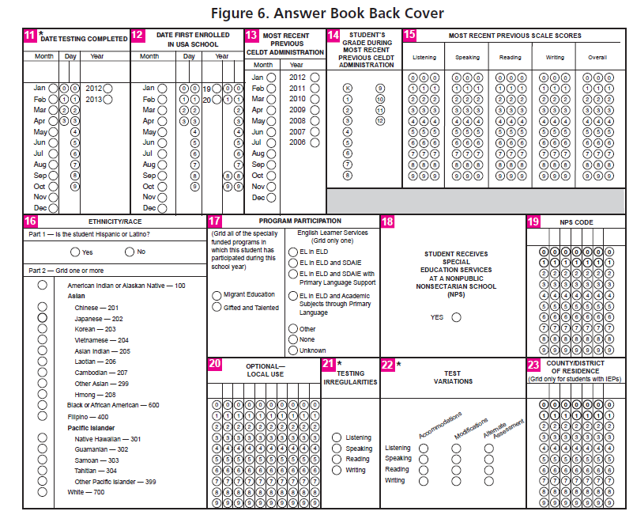
Back Cover of Answer Book
DTSCM page 22-29

Slide 29
After Testing (continued)
  Create Grade Groups and complete forms required for the scorable return shipment
  1. Complete Group Identification Sheets (GIS)
  2. Package Grade Groups
  -place Answer books along with GIS in plastic baggie with the GIS on top
  3. Label Scorable Materials Return baggies if a grade level is too large for one bag
  4. Complete the School Group List (SGL)
TSCM pages 31-35

Slide 30
Preparing to send to district office
  Do not send by school mail until requested to have picked up.
  1. Place answer books into baggies
  2. Make sure you have a GIS for each grade level
  3. Complete the SGL
  DO NOT SEND BACK ALL OF YOUR TEST MATERIALS WHEN YOU ARE DONE TESTING IN OCTOBER!!!!!!
TSCM pages 31-35

Slide 31

What’s New Test Material Changes
No Field Testing this year
Examiner’s Manuals and Scoring Guides are combined only using Form 1
New Color Scheme on Test Books
K-1: Purple 2: Blue
3-5: Red 6-8: Brown
  9-12: Green
Notes:
Next year we will be a field test district but this year we all get to use form 1 all year
Save hours of testing time (no field questions)
Simplify test administration
Reduce test material costs

Slide 32
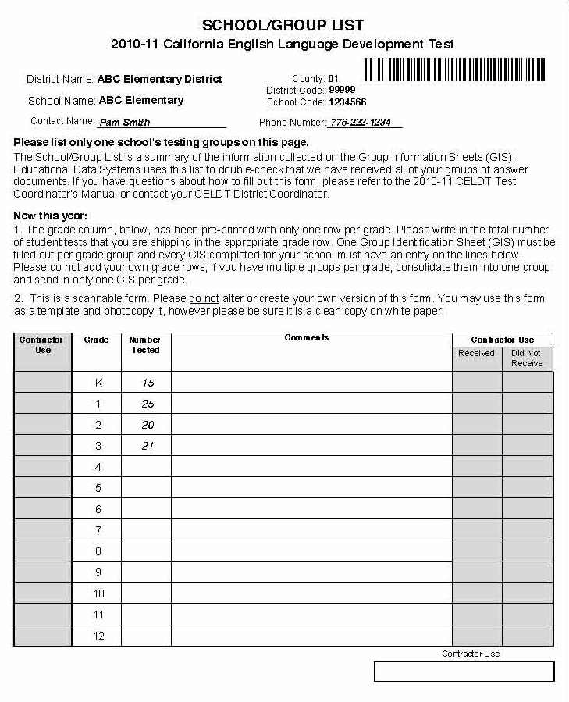
School Group List (SGL)
  Grades are pre-printed
  Scannable document
  White paper only
  Only 1 per school

Slide 33
Please…
If have IFEP or RFEP information from another school district fax to 9474 or send to Box 780 so we can update students records in Zangle
Make sure it is legible and has student local ID # (60912345)
If you need additional materials please fill out a request and fax to us
http://www.scusd.edu/celdt

Slide 34
RFEPs
Get your paper work back to Multilingual ASAP for the March 1, 2013 reporting of RFEP students.
Affects pre-id on testing
Needs to be reported in CAL-PADS before students leave our district.

Slide 35
SEND TO THE MOC
20 Group Identification Sheets (GIS)
Send via school mail to: Box 745

Slide 36
Resources for Training
www.moodle.celdt.org
http://www.scusd.edu/celdt

Slide 37
Available Upon Request Only
Speaking Audio CD
Training Video

Slide 38

Incoming Kindergarteners
Due to the errors in the scoring tables, the MOC could not score tests
Scoring will be done by EDS
Pre-id

Slide 39
Pre-Id Labels
Labels will not be ordered until
September 10
You may still test students
  Write their name on answer sheets and date completed
  Pre-Id labels should arrive beginning of October

Slide 40
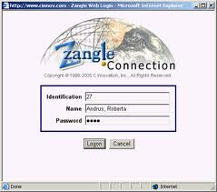
HOW TO FIND EL STUDENTS IN ZANGLE
List of students and proficiency levels
Els without proficiency levels
EOs with proficiency levels

Slide 41
WHERE TO FIND EL STUDENTS DEMOGRAPHIC INFORMATION IN ZANGLE

Slide 43
Questions and Comments

