Slide 1


Moving Beyond Right and Wrong:
Using Contrastive Analysis to Teach Language
CCSS ELA – ELD Breakout
March 10-11

Slide 2
PURPOSE and OUTCOMES
Discover rule-based language learning
Learn one strategy, contrastive analysis, for making the rules of language, contexts, genres, etc. explicit

Slide 3

Language and culture
Language is the road map of culture. It tells you where its people came from and where they are going.
-Rita Mae Brown

Slide 4
The Framework
Ch. 1 Introduction
Ch. 2 Key Considerations
Ch. 3 Grades TK-1
Ch. 4 Grades 2-3
Ch. 5 Grades 4-5
Ch. 6 Grades 6-8
Ch. 7 Grades 9-12
Ch. 8 Assessment
Ch. 9 Access and Equity
Ch.10 Learning in the 21st Century
Ch. 11 PL, Leadership, and Program Support
Ch. 12 Guidance for Instructional Materials
Notes:
Grade level teacher can dig in. More extensive discussion on read-alouds.
Disciplinary literacy.
Overview where five themes (circles on turtle) are discussed more specifically for span and grade level

Slide 5
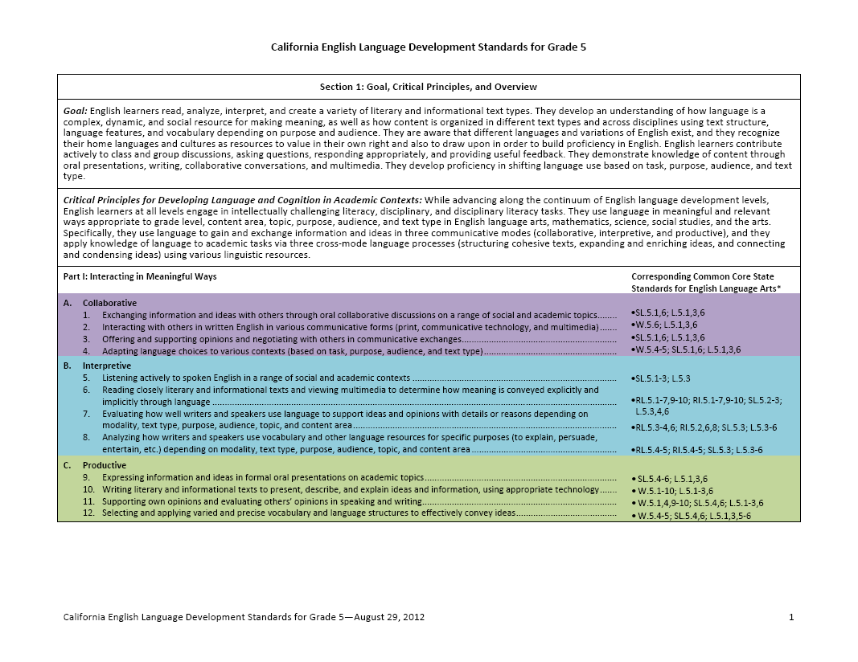
The New California ELD Standards
Part I: Interacting in Meaningful Ways
Part II: Learning About How English Works

Slide 6

Read the excerpts from Chapter Nine of the CA ELA/ELD Framework
Be prepared to discuss with a partner:
How does this reading challenge or affirm
your thinking about language
your experiences with teaching and learning language?

Slide 7

Jamila Lyiscott
Poet and Educator
TED Talk
Notes:
Grade level teacher can dig in. More extensive discussion on read-alouds.
Disciplinary literacy.
Overview where five themes (circles on turtle) are discussed more specifically for span and grade level

Slide 8


Slide 9
TED Talk
In your table group, discuss:
What was Jamila Lyiscot’s purpose in creating this performance?
What are some of the language choices she made and why?

Slide 10
Grammatical Rules in Different Languages
Spanish: no form of do/does/did as an auxiliary form exists
In English, Where did he go?
In Spanish, He went?
Hmong: No plural form for nouns, rather Hmong uses quantifiers:
In English, I see four dogs.
In Hmong, I see four dog.
First languages influence second language acquisition.

Slide 11
Contrastive Analysis Compares Two or More Things
Primary Language (foreign) Second language
Second language Primary Language (foreign)
English Dialect (AAVE, Chicano English) Standard English
Standard English English Dialect (AAVE, Chicano English)
Everyday English Academic English
Narrative text Informational text
Etc.
Noticing patterns and rules in text examples Noticing same and contrasting/comparing

Slide 12
Integrated & Designated ELD:
Working in Tandem
Both/And
Integrated ELD: All teachers with ELs in their classrooms use the CA ELD Standards in tandem with the CA CCSS for ELA/Literacy and other content standards.
Designated ELD: Teachers use the CA ELD Standards as the focal standards in ways that build into and from content instruction.
Notes:
I’ve been hearing interesting things like We’ve decide to do integrated ELD– but it’s not a choice
ANY teacher with an EL in their classroom- is=using the ELD standards
A specific time during the day where we are taking alser-like focus of the ELs using the ELD standards as the focal standards. It is NOT isolated language instruction- it MUST build into and from what is happening the rest of the day. Chapter two describes this piece. Explained in depth in 2 ans each grade level chapters and multiple vignettes Don’t just tell us what it is, we want to see what it looks like.
Figures : complex because this stuff is really complex..
The relationship between integrated ELD, where the CA ELD Standards are used during content instruction, and designated ELD, where the CA ELD Standards are used as the focal standards, is a close one. Designated ELD builds into and from content instruction.
Use the CA ELD Standards as a lens or guide for:
Routinely examining texts and tasks
Identifying opportunities for highlighting and discussing language
Observing students’ language use
Adjusting instruction
Understanding EL students’ language learning needs
Addressing the language students need to develop for success in school tasks
Identifying opportunities for delving deeper into language
Continuously linking language learning to content knowledge

Slide 13
Designated ELD Lesson
HMONG ENGLISH
I have many brother and sister.
My uncle has two car.
All the student got into trouble.
I did three page of math.
RULE:

Slide 14

Using Rules to Teach Genres
Create an account of a video you’ll watch that is written according to your designated genre.
Share your account with another.
How is it similar?
How is it different?
Can your partner guess some of the rule of your genre?

Slide 15
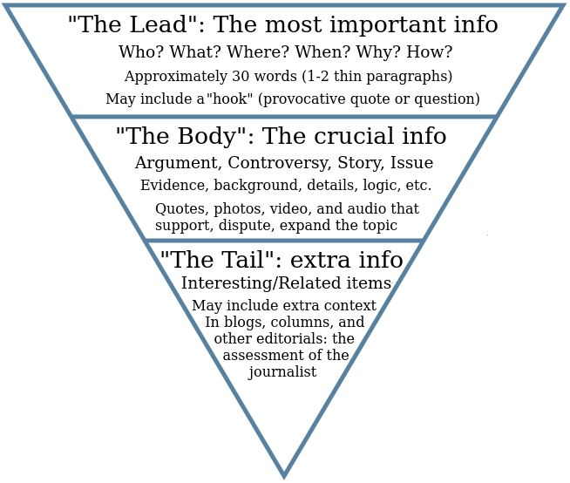

Slide 16

Cohesion:
Refers to how a writer connects ideas and facilitates understanding for the reader.

Slide 17
Noticing Cohesion
2

Slide 18
Debrief Lesson:
How did this lesson situate language as a meaning-making resource rather than a set of rules?
Notes:
Also discuss difference between just writing word, and writing words/phrases in a frame.

Slide 19
Think-Table Group-Share
Review your handouts and notes from this session and ponder this question:
How might you teach differently as a result of this breakout?
Is there anything form this breakout that you might be able to share wit others?
Be ready to share.

