Slide 1



Practice and Training Tests

Slide 2
Preparing Students and Staff
There are multiple ways to prepare students and staff for the Smarter Balanced summative assessments:
  Practice Tests
  Training Tests

Slide 3
Important Notes About
Practice and Training Tests
Practice Tests and Training Tests do not:
  Assess all of the standards that will be in the operational tests
  Predict or gauge a student’s success on the operational assessments
  Produce scores

Slide 4
Purpose of the Practice Tests
Allow students and administrators to become familiar with:
  The experience of a grade-level assessment
  A variety of grade-specific items and difficulty levels
  Performance tasks (PTs)
  The format and structure of the operational assessments
Notes:
Not computer adaptive

Slide 5
About the Practice Tests
Practice Tests are available in each grade level for grades 3–8 and 11 for English language arts/literacy (ELA) and mathematics
Each Practice Test contains approximately 30 items
Performance tasks are available for both ELA and mathematics
Scoring rubrics and answers are available on the TA Resource Web page at http://caaspp.org/ta-resources/index.html
All universal tools, designated supports, and accommodations are available

Slide 6
Purpose of the Training Tests
Allow students and administrators to become familiar with the test delivery system and interface features
Allow students to become familiar with:
  Accessing the tests (log on process)
  The testing software
  The navigational tools

Slide 7
Practice Tests vs. Training Tests
 | Practice Test | Training Test
Purpose | Provide students with a grade specific testing experience similar in structure and format to the summative assessments | Provide students with an opportunity to quickly become familiar with the software and interface features. There are no performance tasks (PTs).
Grade Levels | Each grade: 3–8, 11 | Grade bands: 3–5 6–8 High school
Number and Types of Items | Approximately 30 items in ELA and 30 items in math per grade level Includes 1 ELA PT and 1 math PT per grade level | Approximately 15 items per grade band (6 in ELA and 8–9 in math); PTs are not available
Universal Tools, Designated Supports, and Accommodations | All | All
Scoring | Results are not scored, however answer keys and scoring rubrics are available | Results are not scored

Slide 8
Accessing the Practice and Training Tests
There are two means for accessing the Practice and Training Tests:
  Through http://caaspp.org on a Web browser
  Through the secure browser
    Simulates operational online testing environment
    TAs may create test sessions for the Practice Tests or Training Tests on the TA Practice and Training Site
      Students may return to a Practice Test and/or Training Test session

Slide 9
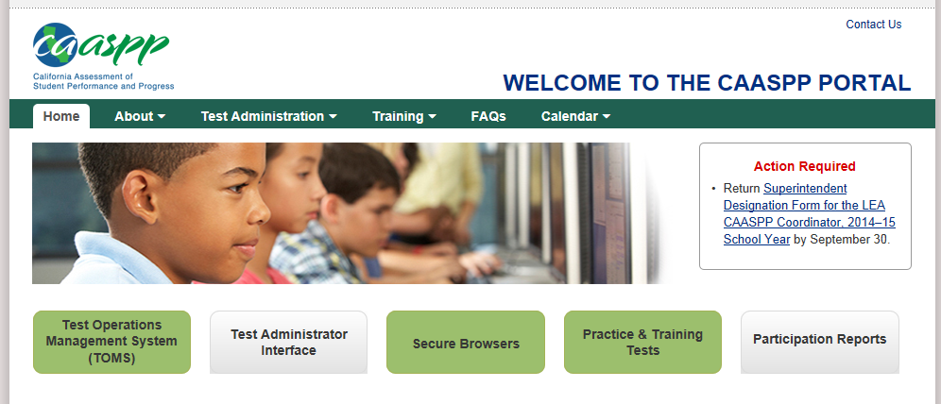
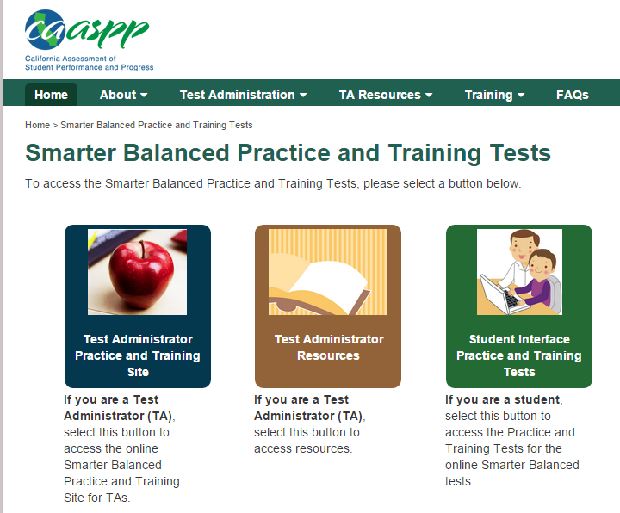
Accessing the Practice and Training Tests
1
Students and parents who wish to access the Practice Test and/or Test via an Internet browser will select the button below
2
3

Slide 10
Practice and Training Tests Resources
Using the Online Practice and Training Tests archived Webcast
  http://caaspp.org/rsc/videos/archived-webcast_110514.html
  http://caaspp.org/ta-resources/index.html

