Slide 1
Field Test Training
February 24-27, 2014
Presenter: Melody Hartman
Notes:
Welcome,

Slide 2
Objectives
Overview
Roles and Responsibilities
Preparing Students and Staff for the Field Test
Field Test Administration
Designating Student Accessibility and Accommodation Options
Test Security
Support
Are You Ready?
Questions

Slide 3
Purpose of the Smarter Balanced Field Test
TAM pg 7
“Test the test”
Evaluate testing software
Ensure quality of test questions
Evaluate the effectiveness of the test administration and training materials
Establish scoring and reporting levels
“Dress rehearsal” for operational assessments in 2015
“Stress test” LEA technology
Familiarize educators, administrators, and students with online testing
Notes:
Page 7 overview and purpose of the field test

Slide 4
SBAC Field Test Pilot Overview
All 3rd – 8th Graders and 11th graders must take
25 Questions ELA
25 Questions Math
1 Performance Task (ELA or Math)
Test should take approximately 3-4.5 hours total depending on which Performance Task your students get
Testing window: April 7 – May 16
Testing website not available April 10-11 & May 8-9
Paper tests April 1 – May 2 or April 28 – May 19 Wave 1 Wave 2
Notes:
Pg 7

Slide 5
Field Test Participation in California
5% of students will take Field Test items from one content area (ELA or mathematics) .
95% of students will take Field Test items from both content areas.
All students will receive one Performance Task (PT) in either ELA or mathematics.
There is roughly same amount of testing time for all students.
Content areas will be assigned by grade and school level.
Content area assignments will be available in March (projected availability, 3/10). There are four scenarios:
ELA+Math, with ELA PT - ELA+Math, with Math PT
ELA, with ELA PT - Math, with Math PT
Notes:
Pg 7

Slide 6
Examples of Field Test Participation in California
Example 1: Elementary School X
Grade 3 was assigned both ELA and math, which includes an ELA performance task (PT).
Grade 4 was assigned both ELA and math, with a mathematics PT.
Example 2: High School Y
Grade 9 was selected to participate and is taking a single content area (math), which includes a math PT.
Grade 11 is not in the sample. They were assigned ELA and math with an ELA PT.

Slide 7
Field Test Format
Note: The Field Test is computer-based, not computer adaptive.
Need to try out the test questions during the Field Test before tests can be made adaptive for the first operational administration in 2015.
Two components:
Performance task (PT)
A set of complex questions that is centered on a common theme or problem; requires classroom activity
Non–performance task (non-PT)
E.g., Selected Response, Drag and Drop, Matching Tables

Slide 8
Roles and Responsibilities

Slide 9
New Terminology for Roles
TAM
pg 8-10
Other important roles
LEA Technology Coordinator – Terry Kritsepis
LEA CALPADS Administrator – Joanne Corby
Notes:
Pg 8-10

Slide 10
Secure Browser
Specifically designed by Smarter Balanced to provide secure access to the Field Test.
Prevents students from accessing other hardware and software functions.
A secure browser must be installed on all student computers/devices. (This will be done by Technology Services in the next few weeks)
Updated and reinstalled annually
‘CA’ will need to be selected on each instance of secure browser the first time it is run.
Test Administrator computers will use a standard Web browser.
TAM
pgs 25-27
Notes:
TAM pgs 25-27

Slide 11
Secure Browser (cont.)
Students must use the secure browser to log in to the Student Interface and access the Field Test.
Prohibits access to external applications or navigation away from the test
Prior to testing, TAs should verify that:
External user applications are closed
The secure browser will not work if the computer detects that a forbidden application is running.
No testing on computers with dual monitors
Students must not take the test on computers connected to more than one monitor.

Slide 12
Preparing Students and Staff for the Field Test

Slide 13
TAM
pg 65
Field Test Item Types
Selected response
one correct response
multiple correct responses
two-part
Matching tables
yes/no
true/false
Fill-in tables
Select or order text or graphics
Drag and drop
Graphing
Equation or numeric response
Short text
Long essay
Notes:
TAM pg 71

Slide 14
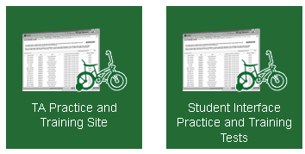
SBAC Practice Tests for Students
TAM
pgs 30-32
http://californiatac.org/
You should have students try practice test in all rooms planning to use for testing at the same time to check for any connectivity issues, etc.
Notes:
Tam page 30-32 go to practice tests and have them review

Slide 15
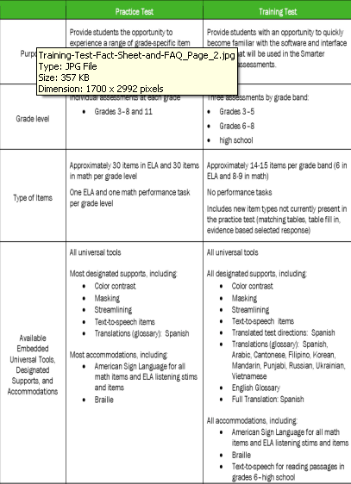
SBAC Tests for Students
Notes:
Page 30-32

Slide 16
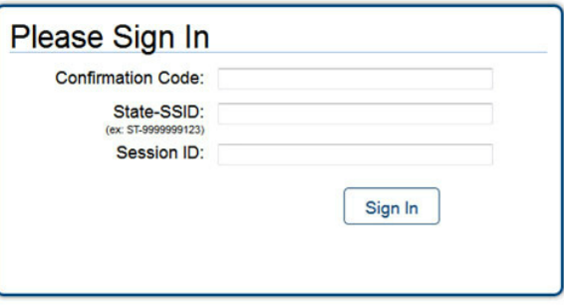
TAM
pg 29
Students Log In Information
Need their official first name in Calpads
State Student ID number
Number generated from on-line test
Johnny
CA-1234567890
APR-7471
Notes:
Pg 29

Slide 17
Field Test Registration

Slide 18
TIDE User Guide
Test Information Distribution Engine (TIDE)
TIDE is a password-protected Web site that provides administrators with tools to manage users and students participating in the Smarter Balanced Field Test.
Repository for student information, including initial test settings and accommodations
Different levels of user access
Just for the Field Test, not remaining paper-pencil tests

Slide 19
Importance of CALPADS
CALPADS is the sole source for student demographic and program participation data for TIDE.
Student accommodations and supports will not be uploaded in CALPADS.
LEAs cannot update student demographic or program participation data in TIDE; must be updated in CALPADS.
It is critical for LEAs to update CALPADS regularly.
Processing time from CALPADS to TIDE is 48 hours.
Notes:
Important to have current student information in Zangle or Infinite Campus so that Joanne can pull

Slide 20
Importance of TIDE
School coordinators must set designated supports and accommodations for students in TIDE.
Demographic data or program participation cannot be updated in TIDE.

Slide 21
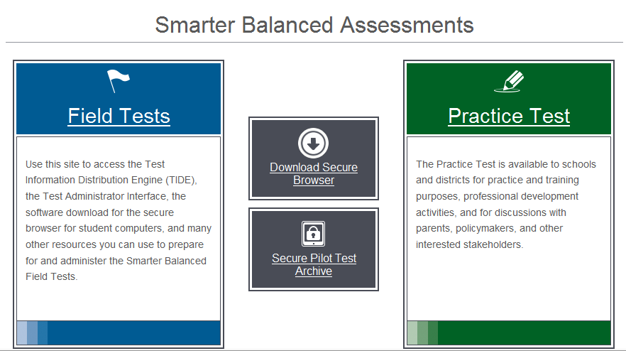
Note: DCs add SC users;
SCs add TA users.
Accessing TIDE
Users may access a link to the California Smarter Balanced Portal on the California TAC website at http://californiatac.org. Selecting the portal link will bring you to the page below.
To access TIDE, select the Field Test link.
A direct link to the California Smarter Balanced Portal may be found in the TIDE User Guide. (linked on our CAASPP website)

Slide 22
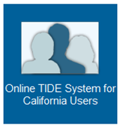
Accessing TIDE
Select the Online TIDE System for California Users card.
When logging into TIDE for the first time, users will be prompted to change their password.

Slide 23
TIDE: First-Time Users
When a user is added to TIDE, the user will receive an automated email from Smarter-CA-DoNotReply@airast.org that contains the following:
User role
Temporary password that must be changed upon initial login
If user has not received the e-mail with temporary password, he or she should contact CAASPPSupport@scusd.edu or CalTAC.

Slide 24
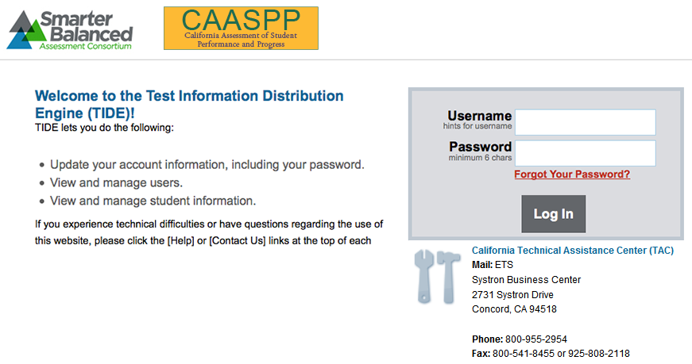
Accessing TIDE
Notes:
http://sbac.portal.airast.org/wp-content/uploads/presentations/TIDE/

Slide 25
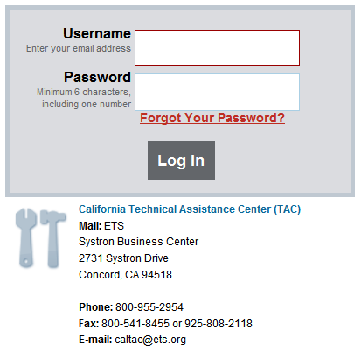
TIDE: Logging In
To log in, the user should enter his or her username and password.
If a user has access to multiple schools or districts, he or she may be prompted to choose an LEA, and/or a school
Notes:
Have participants go to and log in

Slide 26
TIDE: Manage Users Tab
The Manage Users tab may be used to:
Add new user (individual user)
Search for existing user records
View and/or edit existing user records
Delete an existing user record

Slide 27
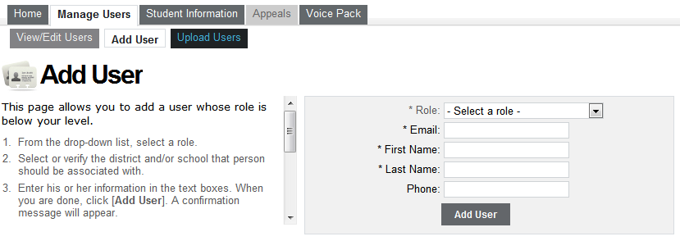
TIDE: Adding an Individual User
The Add User tab allows you to enter details for a single individual and add them to the system.
DCs and SCs will be able to add users.

Slide 28
TIDE: Export a List of Users
For reference purposes, a user may choose to export a list of users in his or her school or district.
Users may conduct a search for other users.
To export the resulting list of users, select [Export] and select the desired format (Excel or CSV).
You may select a subgroup of users for export by selecting the check box next to each record you want to include in the export.

Slide 29
TIDE: Student Information Tab
The Student Information tab may be used to:
Search for existing student records
Export a list of existing student records
View an existing student record
View and update student test settings

Slide 30
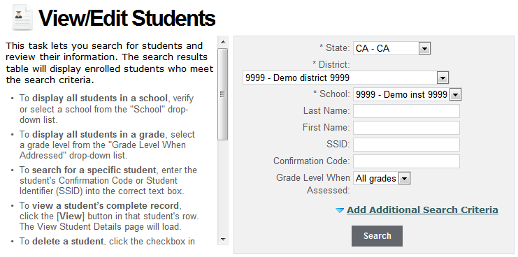
TIDE: View Student Information
To search for existing student records, select the sub-tab [View Students].
Select a district and school from the drop-down menu.
Note: Users only have access to students in districts and schools with which they are associated in TIDE.

Slide 31
TIDE: Export of List of Students
The search will result in a table similar to the one shown below.
Results may be sorted by selecting the column header above the data.
It may be helpful to export a list of students in order to verify the correctness of their information and assist them in logging in to the test.
Users may export the full results table or a subset of those results in Excel or CSV format.
Notes:
Go to TIDE

Slide 32
TIDE: Check your List of Students
Any missing or wrong information on students, email CAASPP@scusd.edu
We will get your concerns to Joanne Corby the Calpads Coordinator to rectify
Notes:
Go to TIDE

Slide 33
Field Test Administration
Notes:
So now that we have the test administrators able to access the students and assign the students’ tests, let’s look at Field test administration

Slide 34
TAM
pg 35
Scheduling Testing Time: Things to Note
Estimated testing times are available in the California Online Field Test Administration Manual.
Note: The estimates do not account for any time needed to start computers, load secure browsers, and log in students.
To help estimate number of days and associated network bandwidth required, schools should access the Smarter Balanced Technology Readiness Calculator at http://www3.cde.ca.gov/sbactechcalc/.
Based on number of students, computers, and hours per day computers are available
Calculator is meant for operational tests; for the FT, users should cut the time estimate by 50%

Slide 35
Plus an additional 30 minutes for the Classroom Activity
Scheduling Testing Time: Estimator
Table 1 |  |  |  |  |  |  |  |  | Table 2
 | Grade |  |  |  |  |  |  |  |  | Grade |  |  |  |  |  |  | Total
 | 3 | 4 | 5 | 6 | 7 | 8 | 11 |  |  | 3 | 4 | 5 | 6 | 7 | 8 | 11
a. Testing Time ELA/Math (in minutes) | 90 | 90 | 90 | 105 | 105 | 105 | 120 |  | A. Enrollment | 94 | 94 | 60 | 50 | 0 | 0 | 0 | 298
b. Testing time Math PT (in minutes) | 60 | 60 | 60 | 60 | 60 | 60 | 60 |  | B. Maximum Class Size | 32 | 32 | 30 | 25 | 0 | 0 | 0
c. Total Testing Time (in minutes) | 150 | 150 | 150 | 165 | 165 | 165 | 180 |  | C. Number of Classes | 3 | 3 | 2 | 2 | 0 | 0 | 0 | 10
d. Number of Minutes per Session | 90 | 90 | 90 | 90 | 90 | 90 | 90 |  | D. Total Number of Testing Sessions | 6 | 6 | 4 | 4 | 0 | 0 | 0 | 20
e. Total Number of Sessions per Student | 2 | 2 | 2 | 2 | 2 | 2 | 2
 |  |  |  |  |  |  |  |  | E. Number of sessions per day |  |  |  |  |  |  |  | 2
 |  |  |  |  |  |  |  |  | F. Number of computer labs available |  |  |  |  |  |  |  | 2
 |  |  |  |  |  |  |  |  | G. Total number of days needed to test |  |  |  |  |  |  |  | 5
Notes:
TAM page 35 also on our website under site coordinator responsibilities we have a tool to use

Slide 36
Scheduling Testing Time: Things to Note
TAM
pgs 35-41
Scheduling is a collaborative effort.
Each school is assigned a 6-week window.
TESTING SITE NOT AVAILABLE APRIL 10-11 & MAY 8-9
SPRING BREAK: APRIL 14-18
21 TOTAL DAYS AVAILABLE FOR TESTING
Recommended: Non-PT first, PT second.
Classroom activity should be completed within 3 days prior to starting the PT.
ELA PTs have 2 parts and can be completed over 2 days.
Math PTs have 1 part and can be completed in 1 day.
Recommended: PT should not be administered on the same day as non-PT
Notes:
TAM page 35-41

Slide 37
Establishing Appropriate Testing Conditions
Testing students in classroom-sized groups is preferable.
Reduces test fear and anxiety
Facilitates monitoring and control for TAs
Administer in a room that does not crowd students.
Room should have good lighting, ventilation, and freedom from noise and interruptions.
Displayed information (on bulletin boards, chalkboards, or dry-erase boards, etc.) that might be used by students to help answer questions must be removed or covered, including:
Rubrics, vocabulary charts, student work, posters, graphs, charts, etc.
Notes:
TAM page 35

Slide 38
Establishing Appropriate Testing Conditions (cont.)
Cell phones or other electronic devices are not allowed to be used during testing (i.e., turned off and put away).
Place a “TESTING—DO NOT DISTURB” sign on the door.
Post an “Unauthorized Electronic Devices May Not Be Used at Any Time During the Testing Session” sign so that it is clearly visible to all students.
May also be helpful to post signs in halls and entrances rerouting hallway traffic.
Notes:
TAM page 48-62

Slide 39
Establishing Appropriate Testing Conditions (cont.)
Make appropriate seating arrangements prior to test administration.
Students should be seated so that they cannot view the answers of others.
Establish procedures to maintain a quiet testing environment throughout the test session.
Remember that some students will finish more quickly than others.
Notes:
TAM page 48-62

Slide 40
TAM
pgs 48-62
General Rules During the Field Test
Students must answer all test items on a page before moving on to the next page.
Students may not return to a test segment once it has been completed and submitted.
Students must answer all test items before the test can be submitted.
Students may not return to a test once it has been completed and submitted.
There is a difference between “segment” and “session.”
Expiration and pause rules vary between PT and non-PT.
Notes:
TAM page 48-62

Slide 41
Test Administrator Interface
TAs need to use the interface to administer a test session.
The Test Administrator User Guide will be available on the California Smarter Balanced portal under Field Test > Resources and Documentation.
This document will contain complete instructions on how to complete tasks in the Test Delivery System (TDS).
Reminder: The easiest way to reach the California Smarter Balanced Portal is by visiting http://californiatac.org and selecting the portal button.
Video time
Notes:
Show video of Test Administrator Interface http://sbac.portal.airast.org/wp-content/uploads/presentations/tainterface/

Slide 42
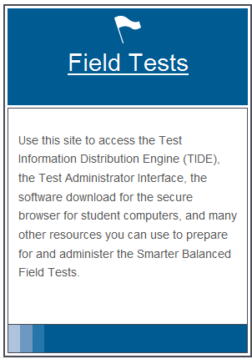
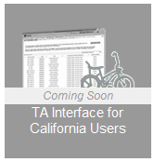
Accessing the Test Administrator Interface
On the California Smarter Balanced Portal, select [Field Tests] on the left-hand side of the page.
The TA Interface button will be available to select.
Notes:
TAM page 35

Slide 43
Test Administrator Home Page
After you log in, you will see the home page of the TA Interface.
Figure 1. Before Starting a Test Session
Figure 2. After Starting a Test Session
Notes:
TAM page 35

Slide 44
Starting a Test
Using the TA Interface (not TIDE), TAs must start a test session before students can log in to a test.
A test can be selected by selecting the checkbox next to the test’s name.
Notes:
TAM page 35

Slide 45
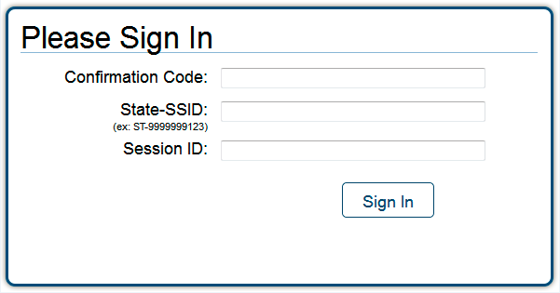
Student Login
To log in to the FT, each student will need:
Confirmation Code: Student’s legal first name as spelled in CALPADS
State-SSID: State abbreviation (CA) followed by a hyphen and the student’s Statewide Student Identifier
Session ID
Note: TAs must follow the “DFA SAY” script exactly each time a test is administered. Refer to the DFA section of the Test Administration Manual
Notes:
TAM page 35

Slide 46
Distributing Student Login Information
TAs need to provide students with the Test Session ID, SSID, and confirmation code (CALPADS student first name) for login.
This may be provided on a card or piece of paper.
TAs may also write the Test Session ID on the board or where students can see it.
Make sure students know that the Test Session ID must be entered exactly as it is written, without extra spaces or characters.
NOTE: Student personal information is secure and must be collected and securely destroyed at the end of a test session.
Notes:
TAM page 35

Slide 47
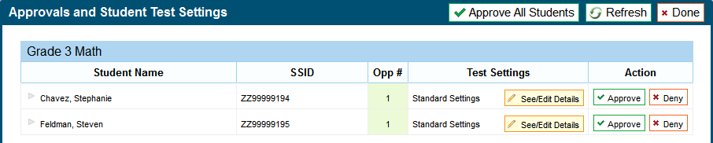
Approving Students for Testing
TAs can either select [Approve] for each individual student (recommended) or select [Approve All Students].
Reminder: If any student’s test settings are incorrect, do NOT approve that student.
To refresh the list of students awaiting approval at any time, select the [Refresh] button at the top of the pop-up window.
Notes:
TAM page 35

Slide 48
Monitoring Student Progress
The “Students in Your Test Session” table displays students who have logged in and been approved for testing
Notes:
TAM page 35

Slide 49
Pausing Tests
Through the TA Interface, TAs may:
Stop an entire session; or
Pause individual student tests.
Users should exit or log out of the Test Administrator Interface only after stopping the test session.
If there is a technical issue (i.e. power outage or network failure), students will be logged out and the test will automatically be paused.
Regardless of when or how users log out or navigate away from the Test Administrator Interface, student data will NOT be lost.
Note: If a test is paused for any reason or length of time, the student must log in again to resume testing. Highlighted text and item notes will not be preserved
Notes:
TAM page 35

Slide 50
Pause Rules During the Field Test: Non-Performance Task
During the non-PT test, if testing is paused for more than 20 minutes, the student is:
Presented with the test page containing the test item he or she was last working on (if page contains at least 1 unanswered item) OR
Presented with the next test page (if all items on the previous test page were answered);
NOT permitted to review or change any test items on previous test pages.
Notes:
TAM page 35

Slide 51
Pause Rules During the Field Test: Performance Task
There is no pause rule for the performance task.
Even if a test is paused for 20 minutes or more, the student can return to the current section and continue.
ELA PTs are divided into 2 parts. After a student completes Part 1, he or she cannot return to it.

Slide 52
Pausing Tests: Individual Students
TAs may pause an individual student’s test in the Students in Your Test Session table.
This will not affect other students’ tests.

Slide 53
Test Timeout Due to Inactivity
As a security measure, students are automatically logged out of the test after 20 minutes of inactivity.
Activity means:
Selecting an answer
Using a navigation option in the test (i.e. selecting [Next] or [Back], using the Past/Marked Questions drop-down list)
NOTE: Moving the mouse or selecting an empty space on the screen is NOT considered activity.

Slide 54
Test Timeout Due to Inactivity (cont.)
Before the system logs out, a warning message will be displayed.
If a student does NOT select [Ok] within 30 seconds, the student will be logged out.
Selecting [Ok] will restart the 20 minute inactivity timer.

Slide 55
Stopping Tests: Entire Session
To stop the session (and pause tests for all students in the session):
Select the [Stop Session] button in the upper-left corner of the screen. An “Important!” box will appear, requesting verification to end the session and log students out.
Select [OK] to continue or [Cancel] to keep the test session open.

Slide 56
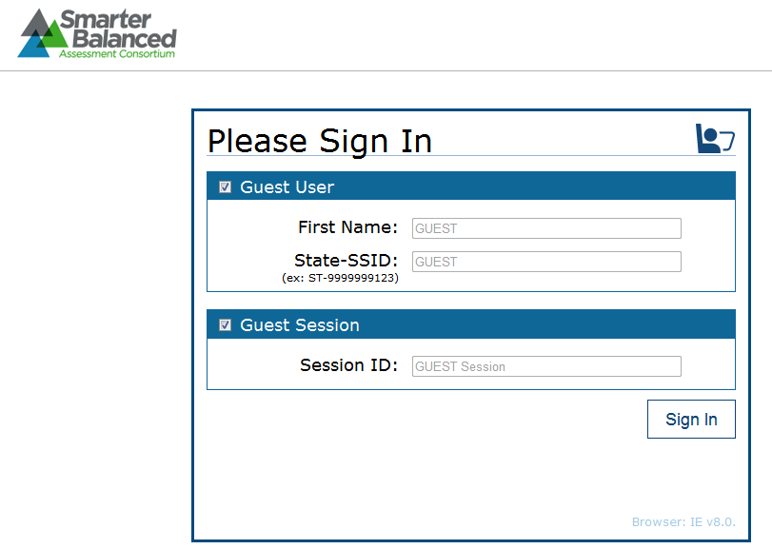
Student View of Testing
http://sbac.portal.airast.org/ca/practice-test-ca/
Notes:
There is a student interface video module about 20 minutes long that is good. Have them go to practice test and go through the sections

Slide 57
Universal Tools
All students have the ability to:
Highlight text in passages and test questions
Zoom in and out of test pages (affects all item content)
Mark specific items for review
Strikethrough (cross out answer options)
Use the Notepad or Calculator (depending on the test)
Use the [Expand] button to display a reading passage or a science simulation
Notes:
Show on test how to highlight, strikethrough, zoom, expand, notes and mark

Slide 58
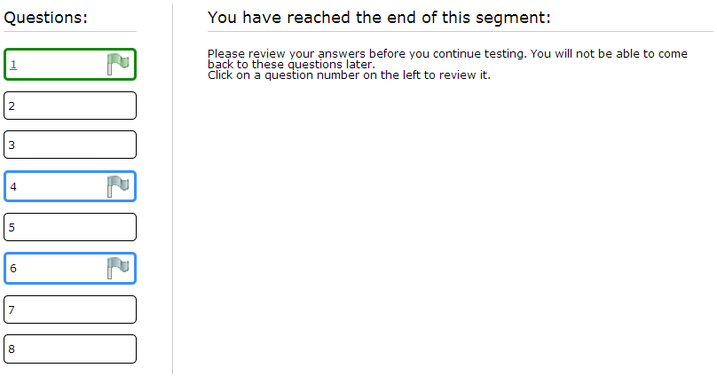
Reviewing Items
Notes:
Show on test how to highlight, strikethrough, zoom, expand, notes and mark

Slide 59
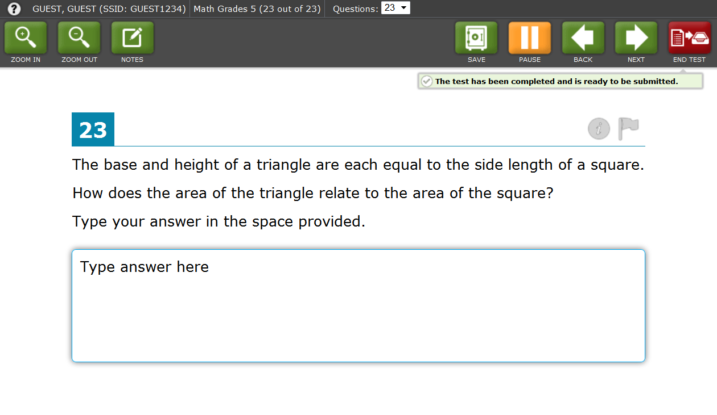
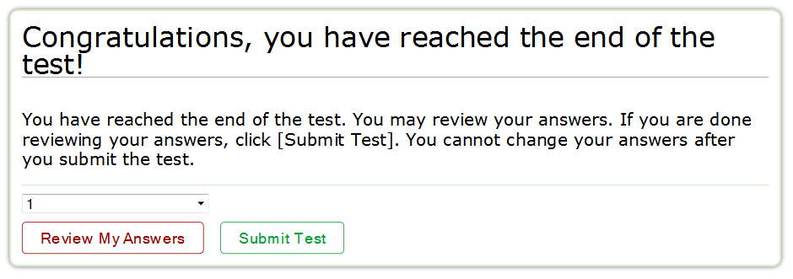
Ending the Test
Notes:
Show on test how to highlight, strikethrough, zoom, expand, notes and mark

Slide 60
Test Expiration
Students are recommended to complete all FT components within 5 days of starting testing.

Slide 61
Classroom Activity Administration Guidelines
TAM
pg. 51
Classroom Activity Purpose: To provide students with important context, concepts, and key terms prior to taking the Performance Task.
All students will have a classroom activity before they complete a PT in the assigned content area.
May be administered in a classroom or any other appropriate space.
May take place on a separate day from the PT.
Recommended: No more than a 3-day lapse between the classroom activity and the PT administration.
TA may need a chalkboard or dry-erase board.
Notes:
Performance task overview video 10 minutes long

Slide 62
Classroom Activity Administration Guidelines (cont.)
TAM pg. 51
Computers, projectors, and other technology are allowed but not required for the classroom activity.
Involves the participation of all students in an instructional task.
PT will be completed by individual students in the computer-based test delivery system.
Students may take notes during the classroom activity, but the notes must be collected before proceeding to the PT.

Slide 63
Classroom Activity Administration Guidelines (cont.)
Designed to fit into a 30-minute window.
Will vary due to complexity of topic and individual student needs.
The SC should download the assigned classroom activity and provide to TAs at least 1–2 days prior.
After receiving the activity from the SC, the TA or classroom teacher should administer the classroom activity.
Provide the appropriate accommodations for students who normally use them during instruction.
Notes:
Show on test how to highlight, strikethrough, zoom, expand, notes and mark

Slide 64
Classroom Activity and Performance Task Administration
(SCs) Online reporting
Step 1: Identify the classroom activities for your school.
Assigned by grade for each individual school.
Assignments will be posted on the portal.
Locate your state and then use the menus within the file to filter for your school.
Beside the name of the school will be a listing of the classroom activities assigned to each grade/content area.

Slide 65
Classroom Activity and Performance Task Administration
(SCs)
Step 2: Download the classroom activity.
Materials are posted in alphabetical order.
(TAs)
Step 3: Review the teacher directions for the classroom activity carefully.
Notes:
Show on test how to highlight, strikethrough, zoom, expand, notes and mark

Slide 66
Classroom Activity and Performance Task Administration
(TAs)
Step 4: Complete the classroom activity.
SCs should ensure that the TA has presented the classroom activity prior to PT administration.
Classroom activities include directions associated with that specific classroom activity.
Note: The classroom activity does not require computers.

Slide 67
Classroom Activity and Performance Task Administration
(TAs)
Step 5: Administer the make-up classroom activity.
For students who are absent on the day of the classroom activity, it is recommended that a make-up session be scheduled.
Notes:
Show on test how to highlight, strikethrough, zoom, expand, notes and mark

Slide 68
Classroom Activity and Performance Task Administration
Step 6. Administer the performance task.
The students must work independently
The PT is administered online
ELA PT: 2 parts (Part 1 and Part 2)
Recommended: Each part administered on separate days.
Part 1: Students will read sources and answer three research questions.
Part 2 (full write): Students will provide a written response using those sources.
Mathematics PT: 1 part
The mathematics PT should be administered in 1 session.
Notes:
Show on test how to highlight, strikethrough, zoom, expand, notes and mark

Slide 69
Designating Student Accessibility and Accommodation Options
TAM
pgs. 42-46
Notes:
Pgs 42-46 there is also a video module available on our website

Slide 70
What are Universal Tools, Designated Supports, and Accommodations?
Universal Tools:
Available to all; based on student preference and selection (e.g., breaks, strikethrough, highlighter).
Designated Supports:
Need to be indicated by an educator or group of educators (e.g., color contrast, read aloud, glossary, magnification).
Accommodation:
Based on individualized education programs (IEPs) or Section 504 plans (e.g., American Sign Language, scribe).
Notes:
No longer as with STAR accommodations and modifications

Slide 71
Universal Tools, Designated Supports, and Accommodations on the Field Test
on the Field Test
The FT includes embedded and non-embedded universal tools, designated supports, and accommodations to maximize accessibility.
Embedded: part of the computer administration (i.e., digital notepad, calculator)
Non-embedded: provided outside the computer administration (i.e., scratch paper, multiplication table)

Slide 72
Universal Tools, Designated Supports, and Accommodations
on the Field Test

Slide 73
Designating Supports and Accommodations
Both DCs and SCs are authorized to set supports and accommodations for students.
Must be set prior to the test session
Set in system by content area.
Reminder: For CA, adding, uploading, or editing student demographic information is only through CALPADS.

Slide 74
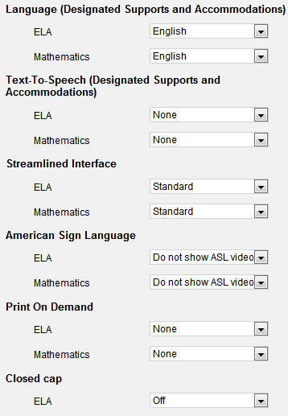
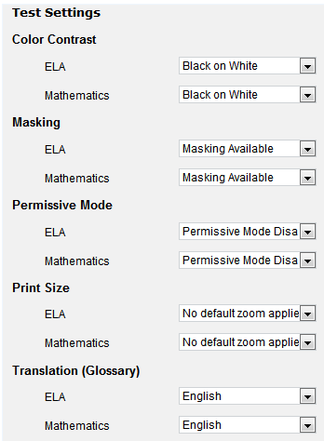
Viewing Student Test Settings in TIDE
Test Settings include embedded accommodations and embedded designated supports.
Notes:
Show on test how to highlight, strikethrough, zoom, expand, notes and mark

Slide 75
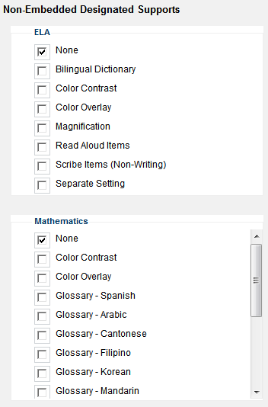
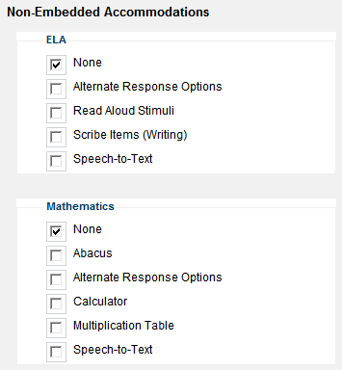
Non-Embedded Accommodations and Designated Supports
Non-Embedded Accommodations and Designated Supports may also be adjusted manually

Slide 76
Accommodations and Supports for SBAC

Slide 77
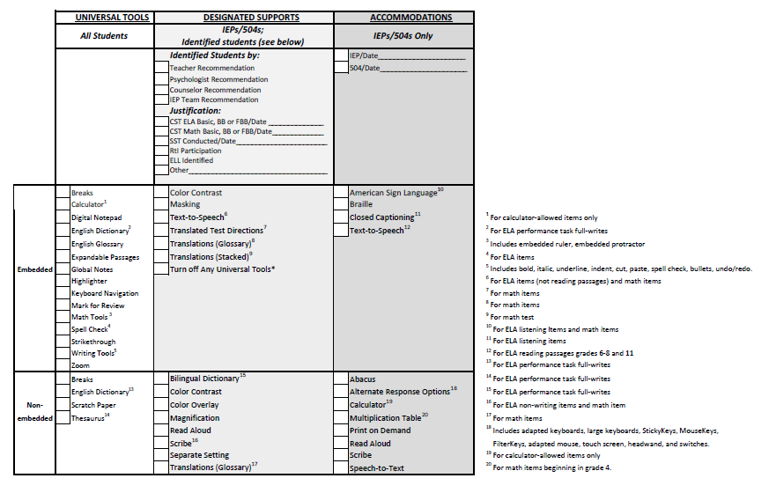
SBAC Usability, Accessiblity and Accommodation Guidelines

Slide 78
SCUSD Process for Field Test Accessibility and Accommodations
Sped Teachers determine accommodations using the CST to SBAC crosswalk
Sped Teachers fill out the usability form for each student
Sped Teachers give one form per student (not for students taking CAPA or CMA Science) to their school site testing coordinator who inputs the accommodations into TIDE

Slide 79
Test Security

Slide 80
New Test Security Forms for the 2013-2014 School Year
The STAR Test Security Agreements no longer valid.
SCs must sign the new test security agreement and send a copy to the district.
TAs must sign the new test security affidavit and send a copy to the district.

Slide 82
TAM
pgs. 63-70
Test Security
There are 3 different types of test security incidents:
Impropriety
Irregularity
Breach

Slide 83
Test Impropreity
Unusual circumstance that has a low impact on the testing individual or group of students
Low risk of affecting student performance, test security, or test validity
Correctable and containable at local level
Must be reported to LEA CAASPP Coordinator or Test Site Coordinator
Example: Students talking during testing
Notes:
Show on test how to highlight, strikethrough, zoom, expand, notes and mark

Slide 84
Test Irregularity
Unusual circumstance that impacts the testing individual or group of students
May affect student performance, test security, or test validity
Correctable and containable at the local level
Submitted in the online system for resolution of the Appeal for testing impact
Must be reported to LEA CAASPP Coordinator or Test Site Coordinator within 24 hours
Examples: Student cheating or providing answers to another; student accessing or using electronic equipment (e.g., cellphone)
Notes:
Show on test how to highlight, strikethrough, zoom, expand, notes and mark

Slide 85
Test Breach
Event that threatens test validity (e.g., release of secure materials)
External implications for the Consortium
A breach incident must be reported within 24 hours
Examples:
Administrator or coordinator modifying student responses or record at any time
Administrator allowing students to take home test items, passage, prompts, or scratch paper
Notes:
Show on test how to highlight, strikethrough, zoom, expand, notes and mark

Slide 86
TAM pgs. 63-70
Test Security Actions Steps
There are processes for reporting test security incidents.
Refer to CA TAM for test security action steps.
California regulations require that breaches and irregularities be reported to the CDE within 24 hours (California Code of Regulations, Title 5, Education, § 859 [e]).
Contact Melody Hartman immediately
Notes:
Show on test how to highlight, strikethrough, zoom, expand, notes and mark

Slide 87
Visit Our Website for support
http://www.scusd.edu/california-assessment-student-performance-and-progress-caasp
http://www.scusd.edu/pod/2014-caaspp-test-site-coordinator-responsibilities
Notes:
Go to website and show resources, etc.

Slide 88
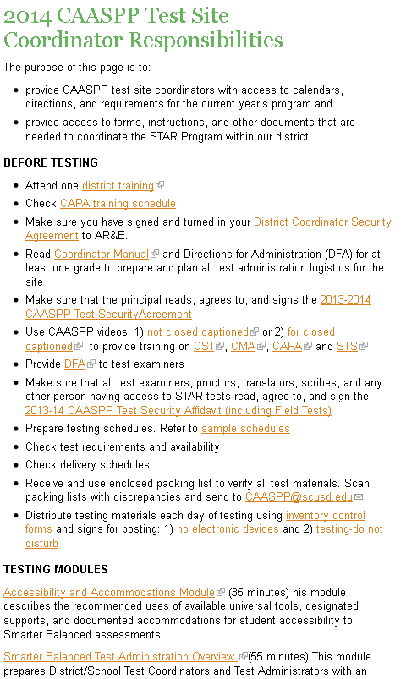
Online Training Modules
Visit our website:

Slide 89
Testing Schedule for Field Test
Please send to CAASPPSupport@scusd.edu your testing schedule for the Field Test

Slide 90
TA and Proctor Training
Will have PowerPoint available on the website
Good Video modules to use at staff meetings, etc.
How to Use Your MacBook Air - (4 minutes)
Smarter Balanced Test Administration Overview (54 minutes)
TIDE – Test Information Distribution Engine Online Training Module (20 minutes)
Test Administrator (TA) Interface for Online Testing (16 minutes)
Student Interface for Online Testing (22.5 minutes)
Universal Tools (14 minutes) –
Performance Task Overview (11 minutes)

Slide 91
Resources to use with students
PRACTICE TESTS
KEYBOARD COMMANDS FOR STUDENTS – This document provides keyboard commands students can use to navigate between test elements, features, and tools
Universal Tools (14 minutes) – This module acquaints students and teachers with the online, universal tools (e.g., types of calculators, expandable text) available in the Smarter Balanced assessments. This module should be shown to students in a classroom/group setting. For grades 3-8 it is encouraged that the teachers be in the room to answer questions from the students as they view the module
High School or Middle School Smarter Balanced Field Test Video (5 minutes) – This brief student video gives key information about the upcoming Smarter Balanced Field Test, where to find the online practice test, and how to get additional information for the State of California.
How to Use Your MacBook Air - (4 minutes) The keyboard and trackpad of the MacBook Air are both intuitive and easy to use, as we’ll demonstrate in this tutorial.

Slide 92
Are You Ready ???
TAs and Proctors trained and signed Security Affidavits
Review and use School Coordinator Check List
Computer rooms set up
New browsers on computers
Headphones available for ELA
Students have enough room to test
Testing Administrator computer for logging in to TA Interface
Proctors to assist
Students know how to use MacBook Air
Students have taken Practice tests several times and our familiar and comfortable with test including students with accommodations
Students verified in TIDE and accommodations if needed set up
Students have card with their log in information
School testing schedule prepared and copy sent to CAASPPSupport

Slide 93
School Support - CAASPPSupport@scusd.edu

Slide 94
Questions
Notes:
Show on test how to highlight, strikethrough, zoom, expand, notes and mark

