Slide 1

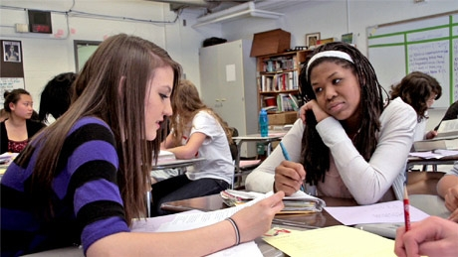
Academic Conversations in the Common Core Classroom
Secondary
ELA Leadership Institute
Session 2
January 2015

Slide 2
PURPOSE and OUTCOMES
Review basic principles and dimensions of Academic Conversations
Learn several strategies for teaching students to facilitate conversations in teacher-like ways
Read about a strategy for creating engaging prompts.
Notes:
State the outcomes of todays’ session.

Slide 3
Creating an understanding of the role of academic conversations in 21st century learning
“To build a foundation for college and career readiness, students must have ample opportunities to take part in a variety of rich, structured conversations—as part of a whole class, in small groups, and with a partner. Being productive members of these conversations requires that students contribute accurate, relevant information; respond to and develop what others have said; make comparisons and contrasts; and analyze and synthesize a multitude of ideas in various domains.” Notes on Speaking and Listening, CCSS Anchor Standards
Notes:
Instead of citing standards in support of academic conversations, I wanted to share with you these Notes on Speaking and lIstening Standards

Slide 4
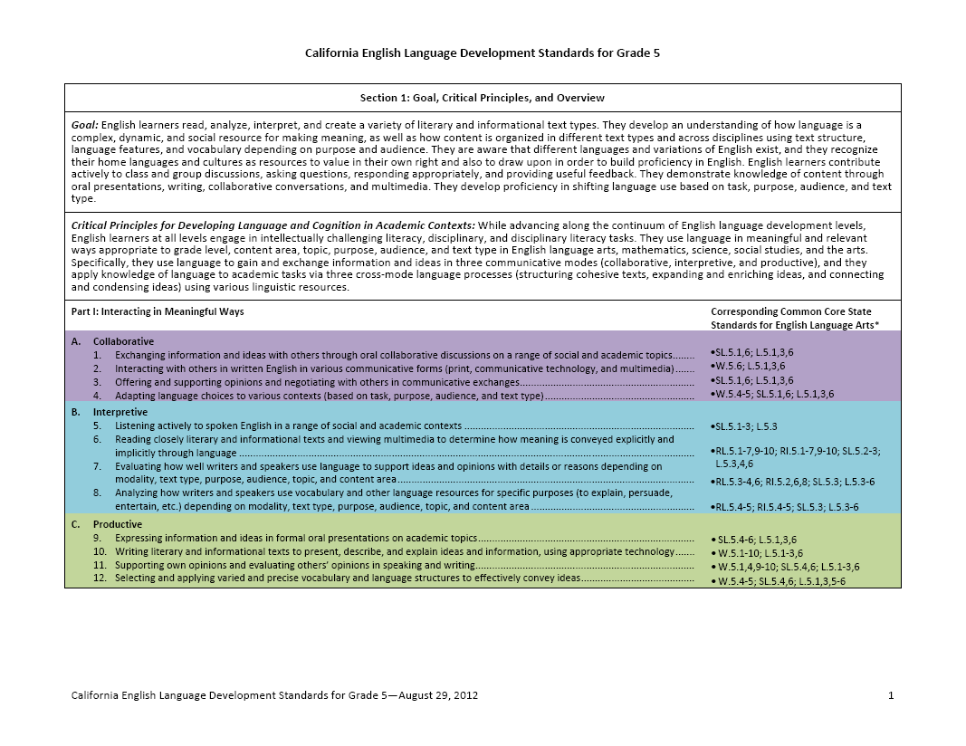
The New California ELD Standards
Part I: Interacting in Meaningful Ways
Part II: Learning About How English Works
Collaborative: Exchanging information and ideas with others through collaborative conversations. Offering and supporting opinions and negotiating with others.
Interpretive: Evaluating how well writers and speakers use language to support ideas and
opinions with details or reasons.

Slide 5
Building Academic Conversations
Establishing expectations for academic conversations
Implementing conversation protocols
Increasing depth of academic conversations
Setting up physical environment that promotes conversation
Rare Occasional Frequent
Notes:
This slide is animated. Click once for the following talking points:
We are each on a journey in developing effective academic conversations. This graphic provides some milestones that we pass, and perhaps revisits cyclically, as we move forward: After a quick overview, we’ll go into more detail in for each area in the next few slides. We begin with…
Setting up the physical environment: Students must be able to talk with each other during class with just a quick instructional transition. This means either having students sit in configurations in which they have partners and small groups for discussion, or being able to move into them quickly and efficiently.
Establishing expectations for academic conversations: Teachers and students will want to co-create expectations for academic conversations,(including basic skills such as eye contact, voice volume, and speaking respectfully0 to expectations for the use of academic language, and expectations for collaboration, such as asking questions, clarifying, pushing others to provide evidence, etc. As students’ skills improve, greater expectations can be considered
Implementing conversation protocols: Protocols are helpful for structuring interaction. When chosen and taught strategically, they can be effective in helping students meet the goals of an academic conversation. The provide accountability and often, outcomes.
Increasing depth of academic conversations: This is the “holy grail” of our journey. When students can sustain academic conversations by initiating ideas, agreeing, disagreeing, negotiating, and building new understandings based on the input of others, they are building mastery of these standards.
This slide is animated. Click again for the following talking points:
Another dimension that may help us in our journey is by reflecting on the frequency of conversations I our classroom. Do they occur rarely, occasionally or frequently?

Slide 6
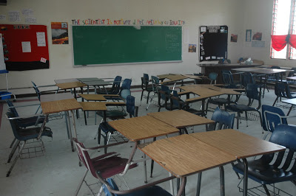
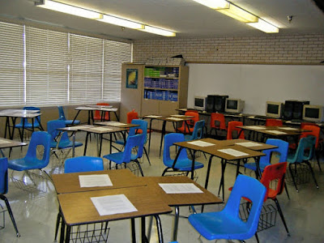

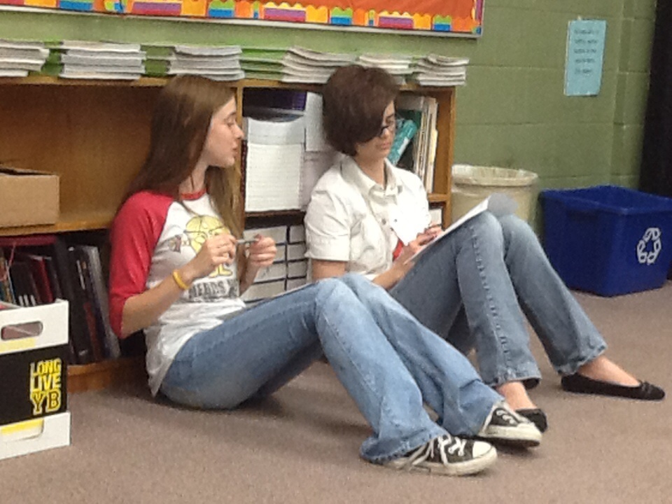
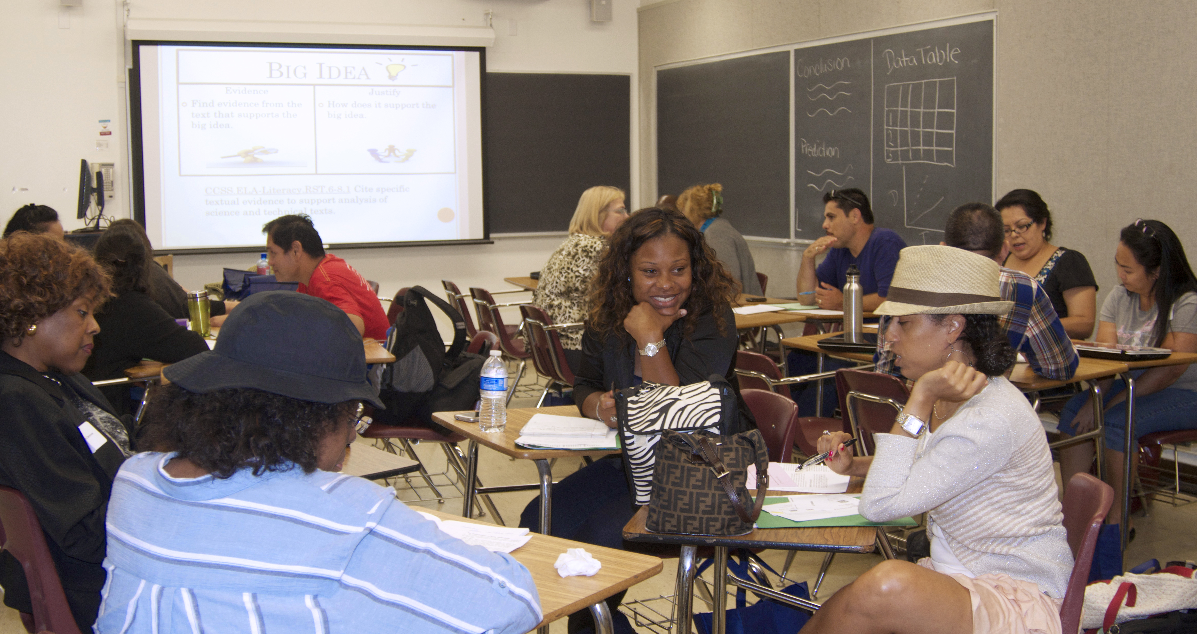

Setting Up Physical Environment
Notes:
Slide is animated:
Click 1: Here is one desk arrangement that is conducive to academic conversations. You can use this easily for discussion between pairs or in small groups
Click 2: And another, though triads have shown to be a less effective grouping that pairs or pairs within quads
Click 3: But even if tyou feel rows like these are essential for their classrooms, then…
Click 4: teachers can teach a routine in which desks are quickly moved into discussion groups, like this…
Click 5: or this…
Click : or this, in which students move just themselves to different areas of the room
In most cases, students should not be allowed to choose their own partners. Teachers lose an opportunity to group students strategically when this occurs. Additionally, it is time-consuming and unfair to less popular students.

Slide 7
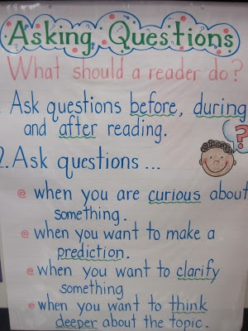
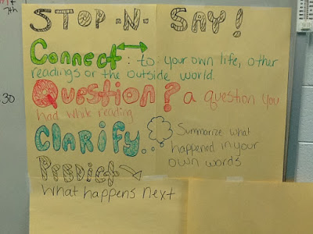
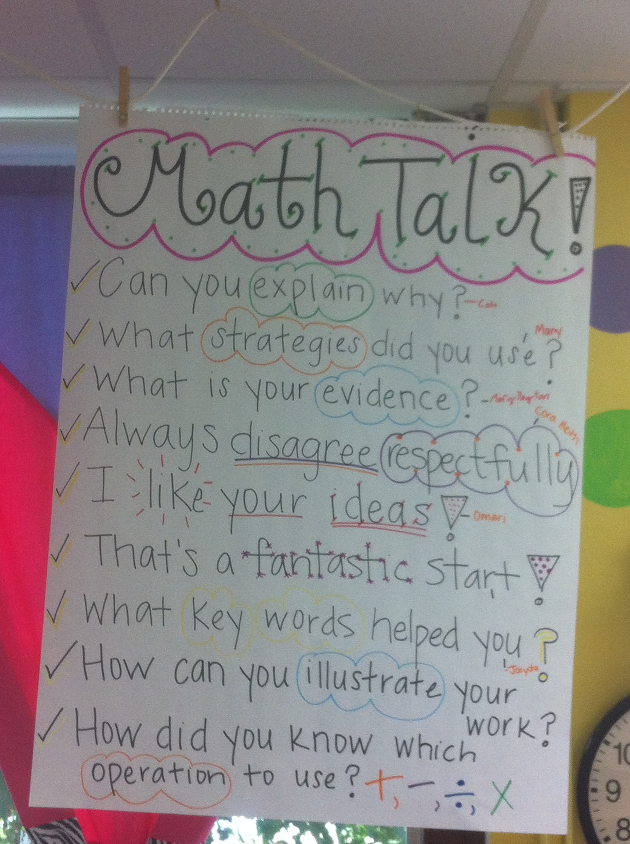
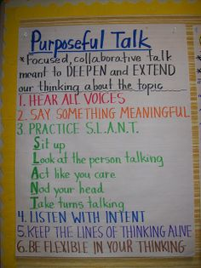
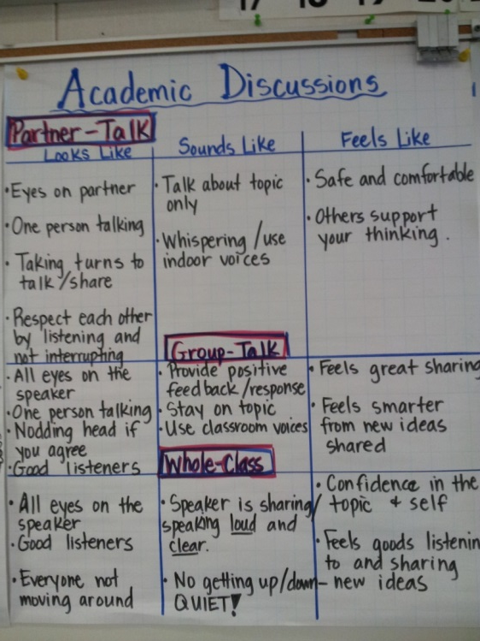
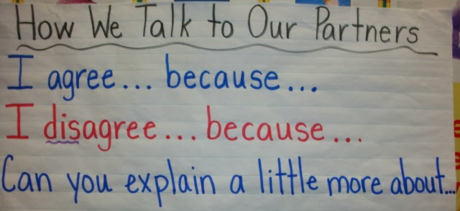
Establishing Expectations for Academic Conversations
Notes:
Talking points:
Here are some anchor charts created by students or co-created with the teacher, that display expectations for academic conversations. Expectations can be set in many categories:
Conversation basics, such as making eye contact, facing your partner, speaking audibly, etc.
Academic language, such as using the vocabulary currently being studied, using connectives to connect ideas or to draw contract, using sentence structures (sentence stems) that match the purpose of the statement.
Expectations for collaboration, such as asking questions, clarifying, pushing others to provide evidence, etc.

Slide 8
Building Academic Conversations
Establishing expectations for academic conversations
Implementing conversation protocols
Increasing depth of academic conversations
Setting up physical environment that promotes conversation
Teaching students to facilitate conversations in teacher-like ways
Creating clear and engaging prompts
Rare Occasional Frequent
Notes:
The first three bullets are, of course, basic building blocks for achieving greater depth and complexity in conversations. Conversing in deep ways about complex topics is a multi-faceted goal that can be approached in myriad ways. The human brain finds categories helpful, and so today we’ll look at two categories of strategies for increasing the depth and complexity of AC:
Teaching students to facilitate conversations in teacher –like ways
Creating clear and engaging prompts
As usual, I’ve borrowed heavily from two teacher-friendly books on academic conversations and academic language in the common core. (Show boooks)

Slide 9
Increasing Depth of Conversations
Depth of Knowledge/Levels of Complexity
Recall/Reproduction – Recall a fact, information, or procedure; process information on a low level
Skill/Concept – Use information or conceptual knowledge, two or more steps
Strategic Thinking – Requires reasoning, developing a plan or a sequence of steps, more than one reasonable approach
Extended Thinking – Requires connections and extensions, high cognitive demands and complex reasoning, creation
(
Notes:
Implementing conversation protocols: Protocols are helpful for structuring interaction. When chosen and taught strategically, they can be effective in helping students meet the goals of an academic conversation. The provide accountability and often, outcomes. However, even with the least-complicated protocols, like Think-Pair-Share, teaching is important.
When introducing a new discussion protocol, it is important to address each of these areas in order to set your students up for success.
What it is, why we use it – we use different protocols for different reasons. Share your reasons with the students so they see the logic and can build theor own faciltiation skills.
Establish partnerships – We can increase the success of this protocol through strategic partnering. This can mean heterogeneous or homogeneous pairs based on ability or talents in a content area. Also, establish routines if studnts’ partners are absent. In most cases, students should not be allowed to choose their own partners. Teachers lose an opportunity to group students strategically when this occurs. Additionally, it is time-consuming and unfair to less popular students.
Model – Modeling of this protocol can take many forms. The teacher can model with a student; two students can model for the rest of the class in a fish bowl; you can take the class to visit another class etc.
Practice with student-friendly topics – In order to provide students a chance to be meta-cognitive about the structure of the protocol, they can practice with a topic that is comfortable and engaging. Even though the topic is student-friendly, the task should require the same type of conversation you expect students to engage in
Debrief – Perhaps the most important and the most frequently left out. The debrief can be general, such as “what worked/didn’t work” or focused on a particular area, such as “how did we do with staying on topic?” Debriefs are the ticket to continuous improvement.
Talk with your small group for just 90 seconds: Do you typically incorporate debriefs after conversations or group work? Why or why not?

Slide 10
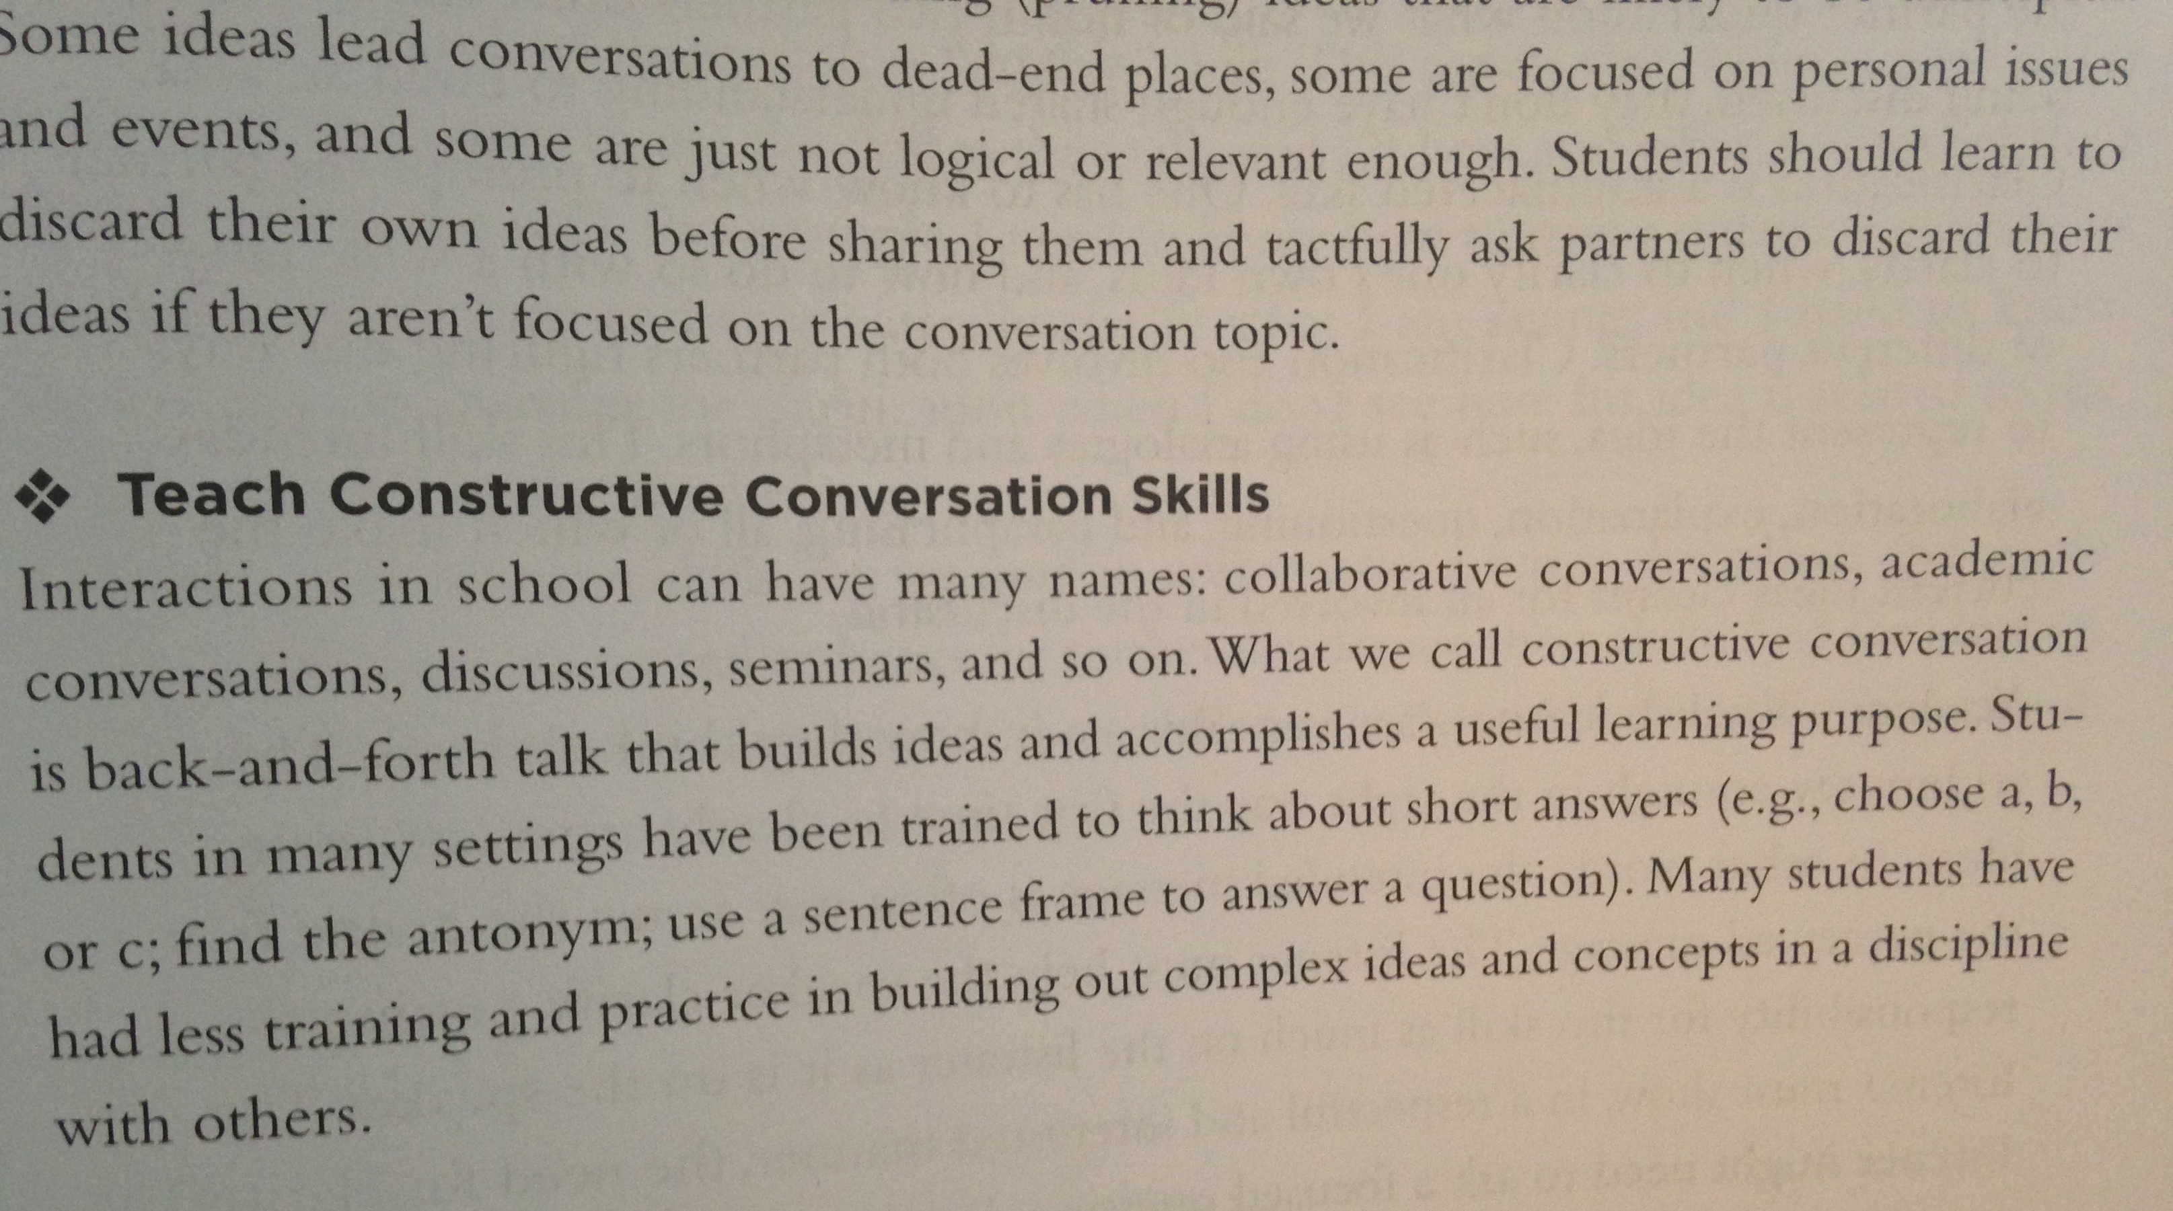
Increasing Depth of Conversations
Teach students to facilitate conversations in teacher-like ways
Briefly review the book excerpt and poster on constructive conversation skills to refresh our memory of the facilitation skills that teachers use.
Notes:
Animated Slide
Please take a moment to read what might be considered a typical exchange between students who have not been taught and coached on how to engage in academic conversations.
Does this sound familiar to anyone?
If students are not familiar with the types of academic conversations in which we are asking them to engage, it is up to us to show them, teach them and coach them.
Click:
Increasing depth of conversations allows you to use academic conversations to push students’ thinking in all curricular areas.
Here’s one caveat: Not all student interactions are going to be deep academic conversations. Particularly at the beginning stages of a study of something… a new novel, a new science or math concept, etc., students may be asked to use conversations to “buiild foundational knowledge– knwledge they will need to later go deep.

Slide 11

Increasing Depth of Conversations
Three strategies: jigsaw reading
Form a triad
Assign each member a reading task:
  A (pp 9-10) Ways to model academic conversations
  B (pp 11-12) Using content observers
  C (pp 13-14) Using rubrics with students
Read and annotate to include your interpretations of the reading that you’d like to share
Every member shares their content, interpretation, and the implications for practice for teachers

Slide 12
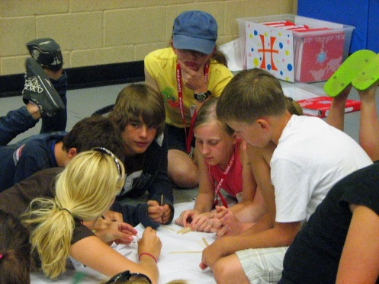
Increasing Depth of Conversations with Clear and Engaging Prompts
One way to increase depth of conversation is through clear and engaging prompts that require complex thinking and “real world” applications.
Read the excerpt entitled “Clear and Engaging Purposes for Conversations
Briefly discuss its content with your group.
Next, choose a reading standard and try creating a conversation prompt that would address the standards AND a “real world” application.
Be prepared to share your thought process and prompt.
Notes:
A second way of increasing the depth of academic conversations is by providing clear and engaging prompts AND structures that require complex thinking.
With additional time:
See the various examples of prompts in the handout, pp. ____
What do you notice about these prompts/activities?

Slide 13
Think-School Team-Share
Review your handouts and notes from this session and ponder this question:
What is one action you can take immediately to improve the quality or quantity of academic conversations in your classroom or at your school? Be prepared to discuss why you chose this action and how you will undertake it.
Notes:
We are all at different places in our journey toward frequent and deep academic conversation in our classroom. Look at handouts to review what we have discussed. Think about where your classroom is with regards to academic conversation. What would the next logical step be to move the conversations in your classroom? 2 minutes to think first. Now you have 3 minutes to discuss with partner. As you discuss with your partner, practice the conversation skill of clarifying. You may use the starters from your poster if you find them helpful.

