Slide 1
Approve the Submission of a Credential Waiver Application to the California Commission on Teacher Credentialing
Board Meeting-December 15, 2022
Agenda Item No. 9.5
Presented by:
Cancy McArn, Chief Human Resources Officer, and
Tami Mora, Human Resources Audit & Compliance Analyst
Notes:
Good evening Board President, Board Members and Superintendent Aguilar. We are here this evening to present to you and ask for your approval of a credential waiver application.

Slide 2
Submission of a Credential Waiver Application to the California Commission on Teacher Credentialing
Education Code EC §44253.3 allows school districts to waive a portion of the requirement for a Certificated teacher in order to allow time for program completion
California Commission on Teacher Credentialing (CCTC) requires that every waiver request go through a public notice process at the local level and must be Board approved in a public meeting prior to the submission of the employing agency to CCTC
Notes:
Ed Code provides an opportunity for Districts to waive a portion of credential requirements in order to allow educators a little more time to complete their credential requirements.
In order to submit credential waiver applications for certificated employees in need, CTC (The Commission on Teacher Credentialing), requires a public notice process and board approval, prior to submission of any waiver applications.
That is why we are here this evening.

Slide 3
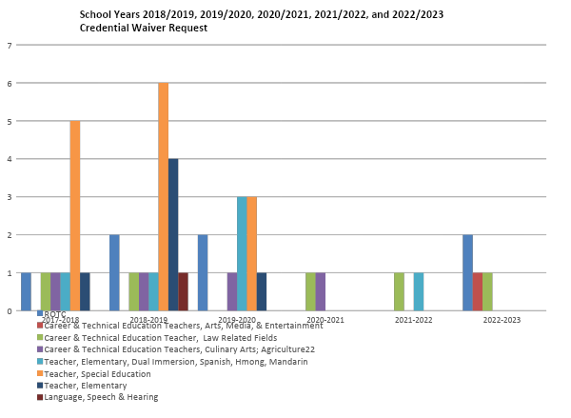
Notes:
Here are the data trends of credential waiver requests for our district over the last few years. We are continuously working with our employees to meet their credential requirements.

Slide 4
Submission of a Credential Waiver Application to the California Commission on Teacher Credentialing
A waiver is being requested for the following Career and Technical Education (CTE) teacher, as they complete their Clear Credential requirements, which will include English Language Authorizations (ELA):
Matthew Marsango, CTE credential in Arts, Media, and Entertainment (Albert Einstein Middle School)
Notes:
The applicant listed here is currently working on meeting their CTC requirements in order to obtain their English Language Authorization to provide instruction to English Learners.

Slide 5
Submission of a Credential Waiver Application to the California Commission on Teacher Credentialing
Specially Designed Academic Instruction Delivered in English (SDAIE) to English Learners (EL) is the area being requested in the waiver this evening.
This waiver will enable this teacher the opportunity to complete the requirements set forth by CTC and to remain in their positions while they continue their work with students.
Staff recommends approving this waiver request.
Notes:
The waiver requested this evening, will allow this teacher the additional time needed in order to complete their English Language Authorization, while they continue to work with our students.

Slide 6
Questions & Answers

