Slide 1
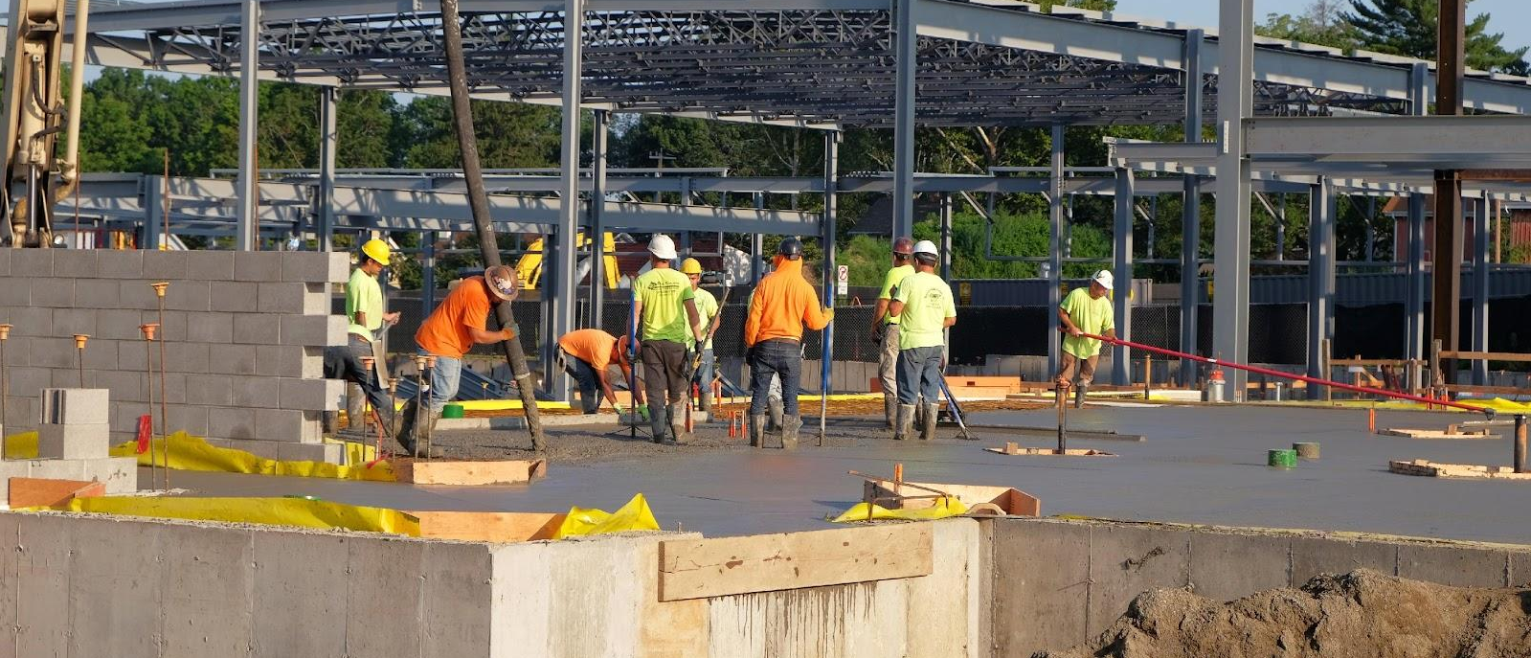

DEC | 15 | 2022
Approve Board Policy Board Policy
7310 Naming of Facilities

Slide 2
Acronyms
BP | Board Policy

Slide 3
Current Policy
BP 7310 was last updated in the late 1990’s.
Language currently does not call out a required alignment with the District’s vision and mission.
It only allows for the naming of facilities after individuals or geographic locations.
Outlines a vague need for community involvement without proper checks and balances.
Allows for the renaming of facilities only under “extraordinary circumstances.”

Slide 4
Proposed Policy Revisions
First reading was held on November 17, 2022.
Calls for the naming of facilities that reflect the District’s mission and vision.
Allows for the naming for facilities after individuals whose “primary legacy” aligns with the District’s mission and vision; geographic areas, landmarks, cultural events, or historic events; flora and fauna within our region; and other criteria such as an academic focus or other.
Refines language around the oversight of community engagement and the ability of the Board to rename facilities.
Notes:
Modeled after Riverside Unified policy

Slide 5
Impetus for Proposed Policy Revisions
The current renaming effort of Sutter, Kit Carson, and Peter Burnett have outlined areas of opportunity in current policy language.
The proposed policy revisions are important in the alignment of facilities naming moving forward.
Notes:
Alignment with District vision and mission
Provide more clarity around the implementation of the policy
Increase the possible areas of naming criteria

Slide 6
Next Steps
Approve the policy revisions.
Continue with the renaming efforts of Sutter, Kit Carson, and Peter Burnett.

Slide 7

Questions?
Notes:
Thank you.

