Slide 1
2022-23 School Mural Project Update
Board Meeting January 19, 2023
Agenda Item No. 9.2
Presented by: Niki Kangas, Community Engagement Manager
Nathaniel Browning, Director of Facilities

Slide 2
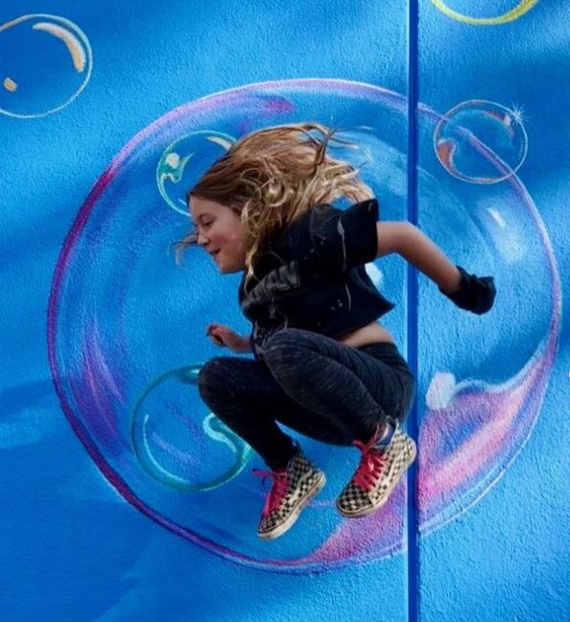
Agenda
School mural project overview & goals
Impact to date
School selection criteria
Upcoming 2022-2023 Wide Open Walls events and community fairs
2022-2023 Wide Open Walls partnership scope
Q&A
2
Notes:
Nathaniel

Slide 3
Acronyms
ESSER = Elementary and Secondary School Emergency Relief
3
Notes:
Nathaniel

Slide 4
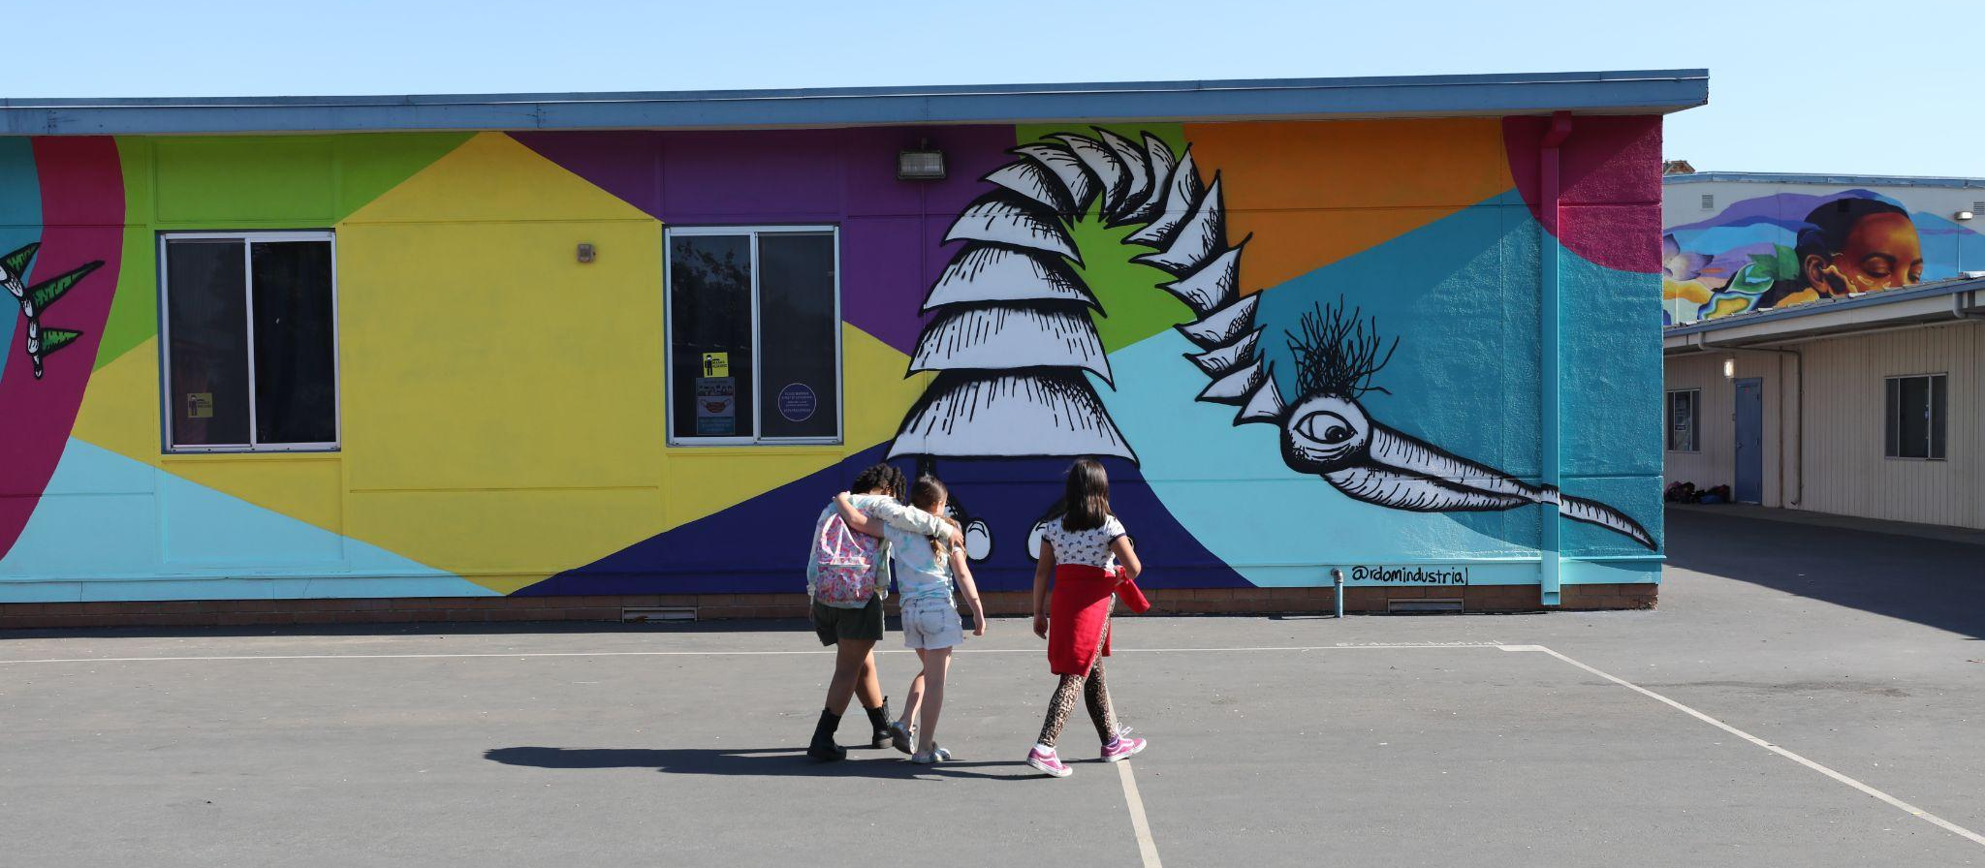
Why School Murals?
Campus beautification
Mitigating chronic absenteeism and student achievement
Inspiring students
Creating connection and joy through artists enrichment and expression
Engaging the community through community fairs
We are focused on building a sense of community as we position our schools as hubs in our city and make our schools a place that students and their families want to be.
4
Notes:
Nathaniel
The partnership with WOW is beneficial for a number of reasons.
First, and the most obvious from the street corner is campus beautification. We know from our previous facilities master planning process that our district had $3.5 billion in facilities needs in 2019. In today’s dollars that amount is much higher due to inflation. WOW is able to assist the District in addressing curb appeal at a handful of our sites throughout the District which pays dividends beyond the needed curb appeal of our sites.
Peer-reviewed research has found a relationship between the quality of a school facility and student achievement. Specifically, significant correlations have been found between poor structural, conditional, and aesthetic attributes of school buildings and low student attendance, learning and achievement. We aim to improve student outcomes through addressing our facilities needs in this manner.
We are also endeavoring to create student and community inspiration and joy through these artistic expressions. And as we did with the Facilities Master Plan, we are looking beyond the property lines of our schools in order to create a deeper bond within the community within which we serve.
Part of the bigger effort to bring in the Community into our space.

Slide 5
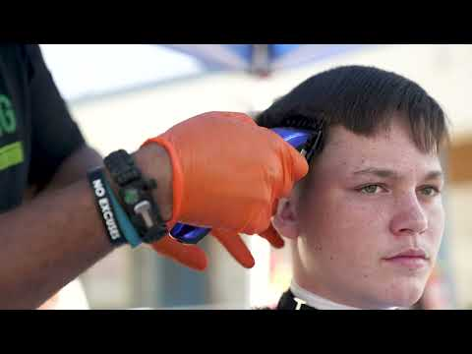
A Sac City Unified Community Fair…
5
Notes:
Niki
More on community impact of community fairs
Here is a short video we would like to share that shows the overall feel of the WOW events that have taken place throughout the District to this point.

Slide 6
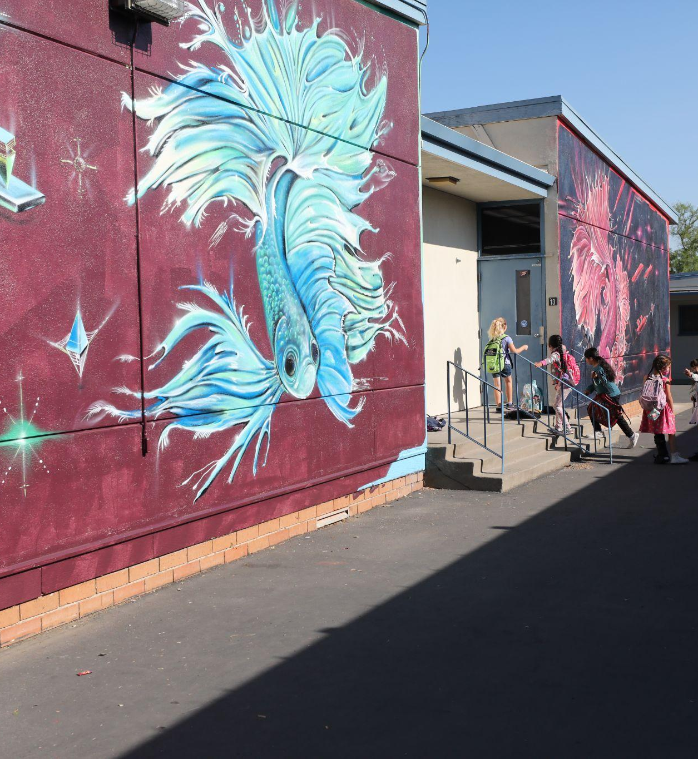
Impact To Date
Luther Burbank High
Tahoe Elementary
Elder Creek Elementary
Bret Harte Elementary
6
Notes:
Niki - At Luther Burbank, WOW donated materials and a street art workshop to 12 students who were selected to paint live at the May 2021 Community Fair. WOW and their sponsors donated all of the murals painted at Tahoe Elementary. Our current contract with WOW began this fiscal year and we kicked things off at Elder Creek where 18 murals were painted in September. Then, in November, we went to Bret Harte where 30 murals were painted!

Slide 7
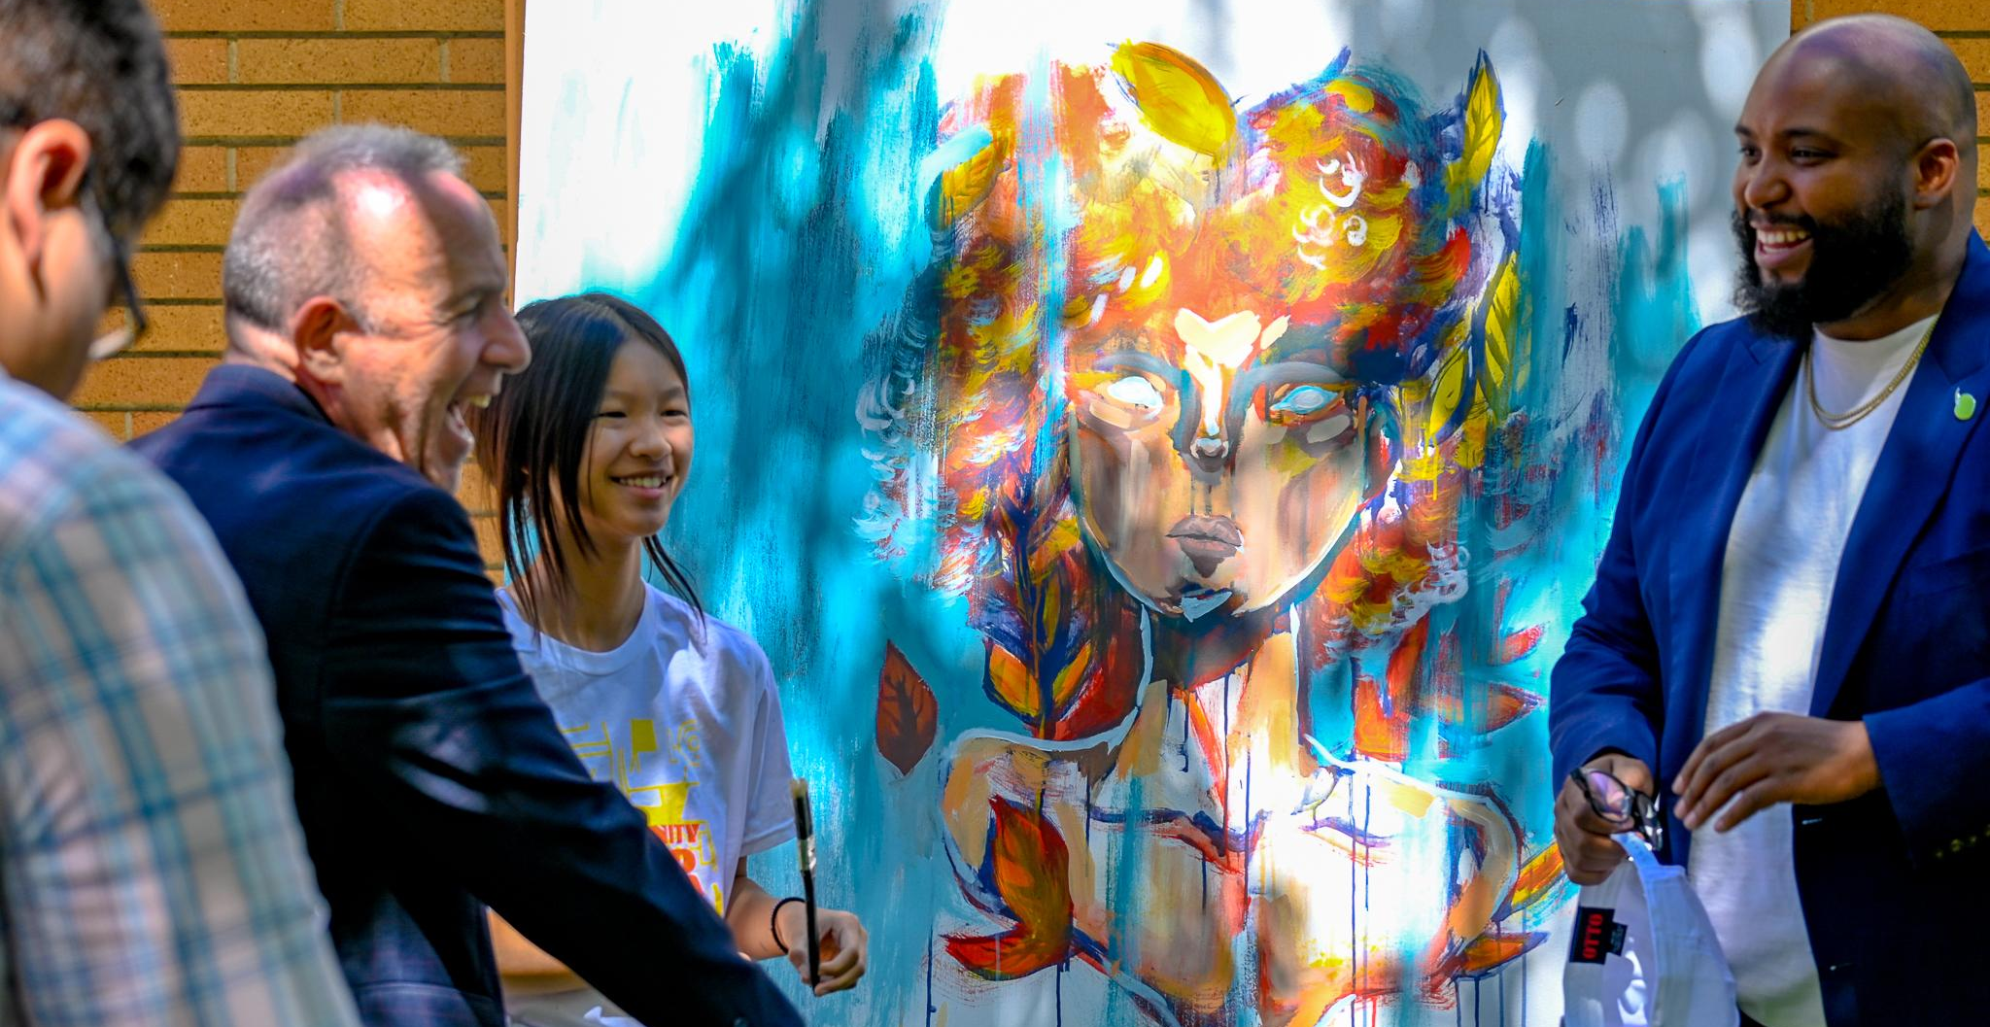
Impact To Date
Through our community partnerships and District efforts, so far at our 6 post-pandemic fairs, we have:
Hosted approximately 7,000 attendees.
Provided approximately 4,000 free meals.
Distributed over 4,000 pantry boxes.
Fixed over 400 bicycles.
Provided over 250 COVID vaccinations.
Distributed 100 backpacks filled with school supplies.
… and so much more, like free haircuts, books, jackets and entertainment!
7
Notes:
Niki - We’ve paired our Wide Open Walls events with our community fairs to amplify both. Hosting our community fairs on the weekends that we invite artists to take over our campuses has allowed families across the district to be exposed to live mural painting and our local arts scene while enjoying much needed community and resources. Over the past 8 months since our Luther Burbank fair, we’ve forged many community partnerships that have enabled us collectively to provide more critical goods and services than we could alone to families in need district-wide.

Slide 8
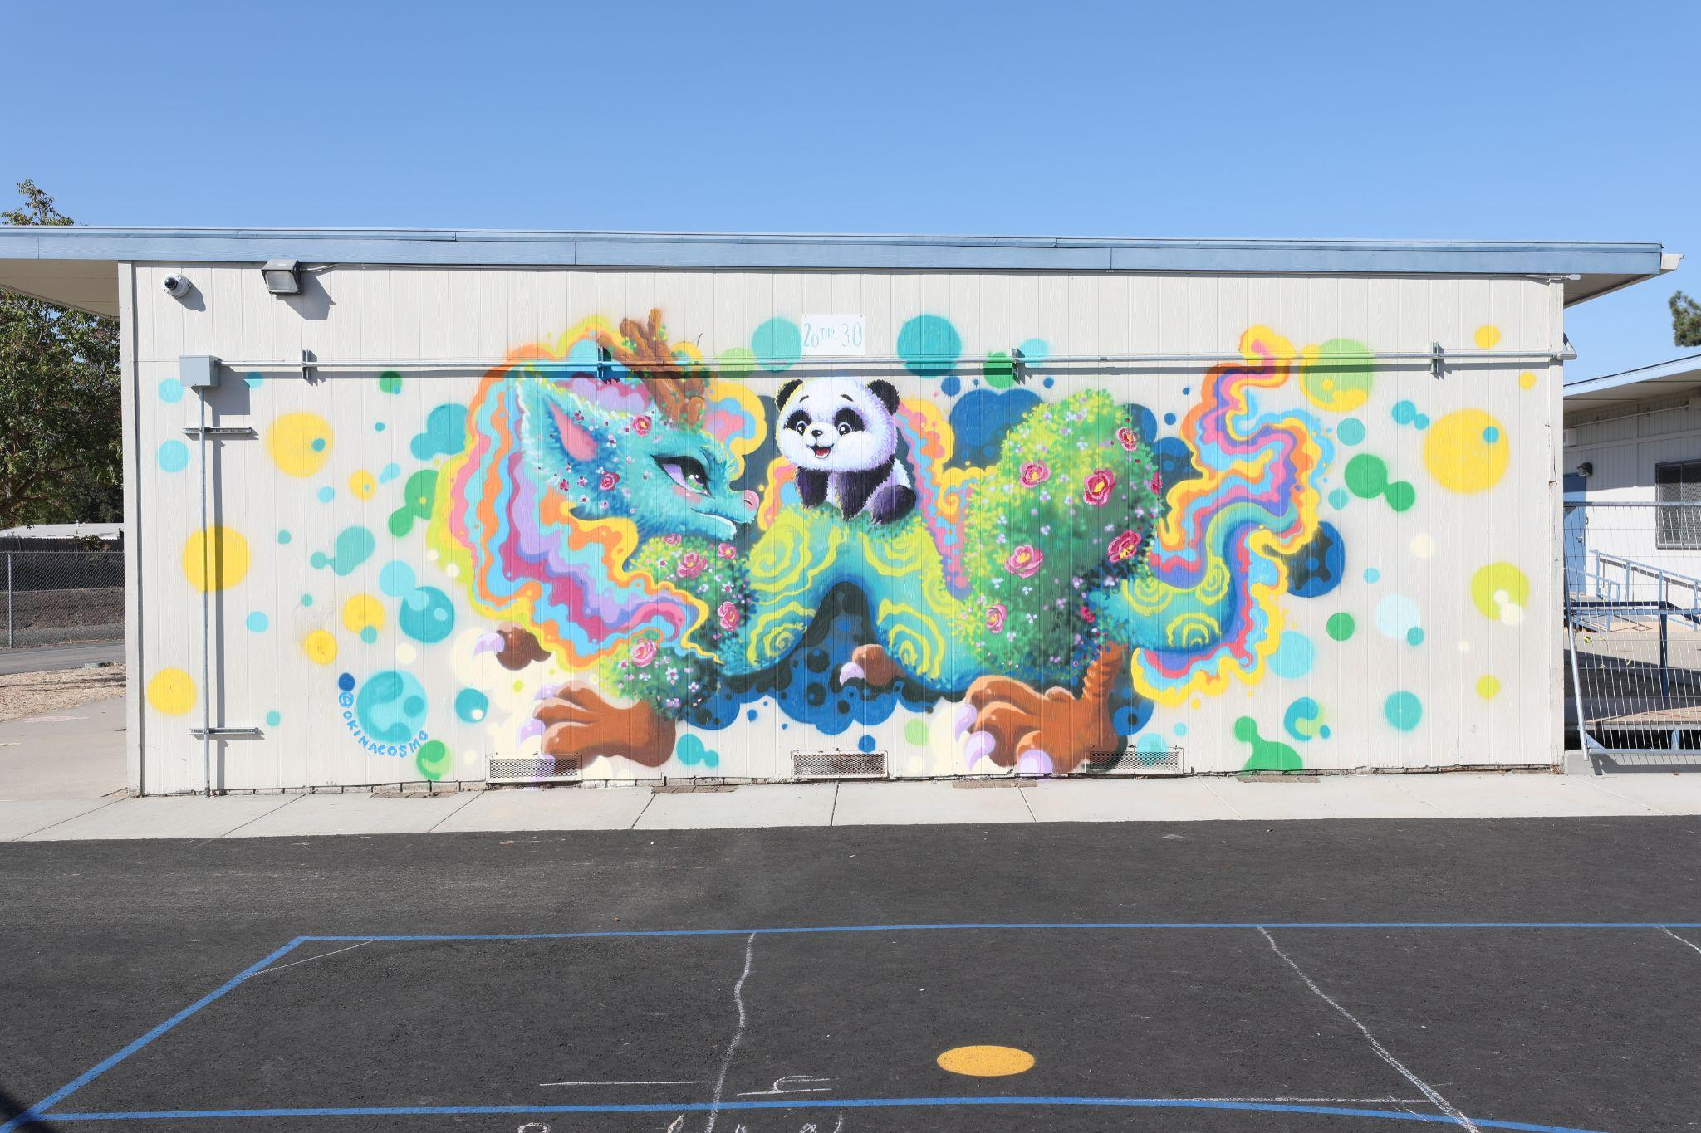
Impact To Date
I can't express enough how much Wide Open Walls' mural project has impacted the students and families of Elder Creek Elementary school. Over one weekend, we were transformed from a plain, run-of-the-mill 50-plus year old elementary school - in an often forgotten about neighborhood - into a place that stands out and just sparkles. Elder Creek has always been an essential part in the lives of our wonderful families and community, and now it truly looks the part!”
Brandon Frink, Principal of Elder Creek
8
Notes:
Niki - Here’s what Brandon Frink, the Principal of Elder Creek Elementary, had to say about his experience working with Wide Open Walls.

Slide 9
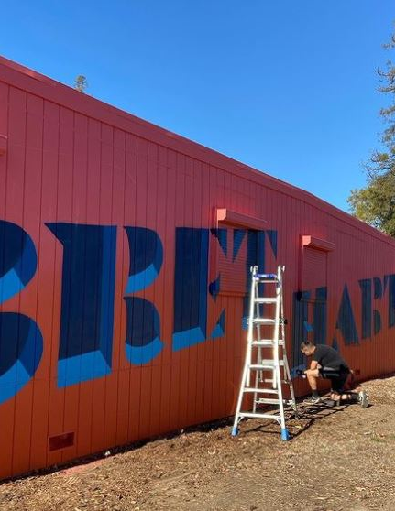
Impact To Date
The work that was completed at the school has greatly affected our school climate… I have classroom teacher walking the different spaces enjoying the work and talking about what they see and feel from each mural. Students are learning to express themselves through art and words. Many neighbors say as they walk the neighborhood they always find something new in the artwork and enjoy viewing the work each time they walk by.”
Dr. Roxanne Wolfe, Principal of Bret Harte
9
Notes:
Niki -

Slide 10
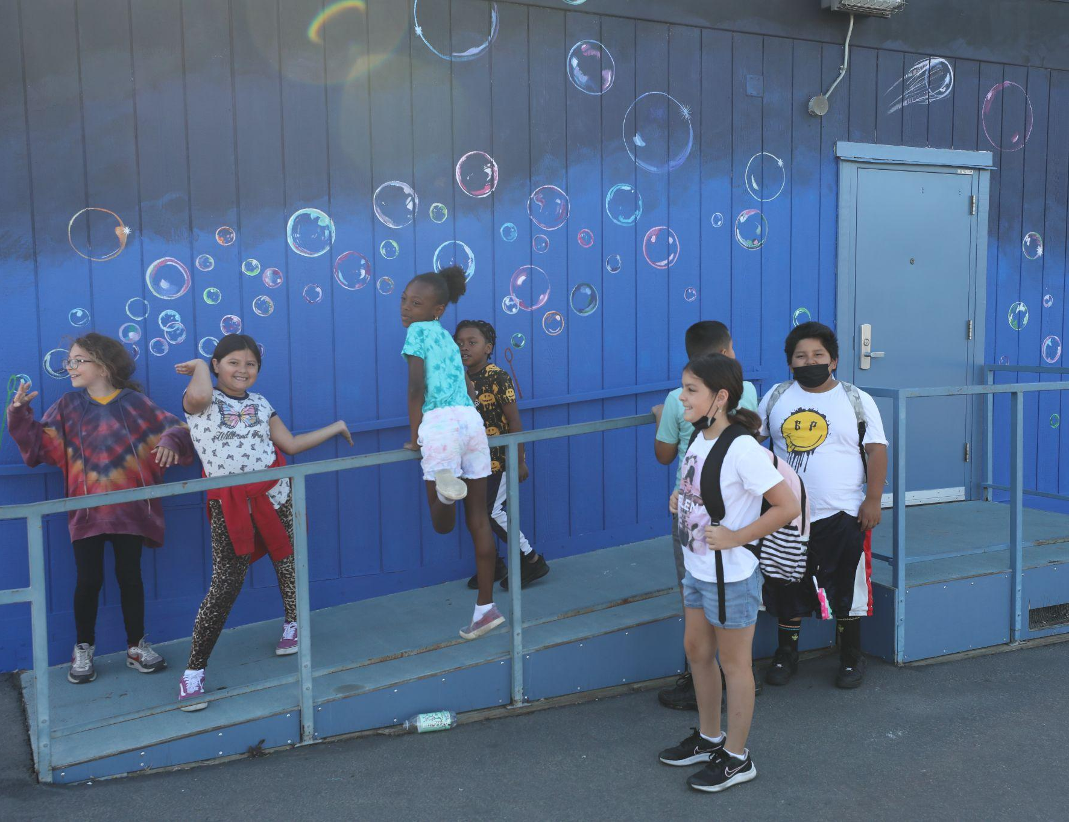
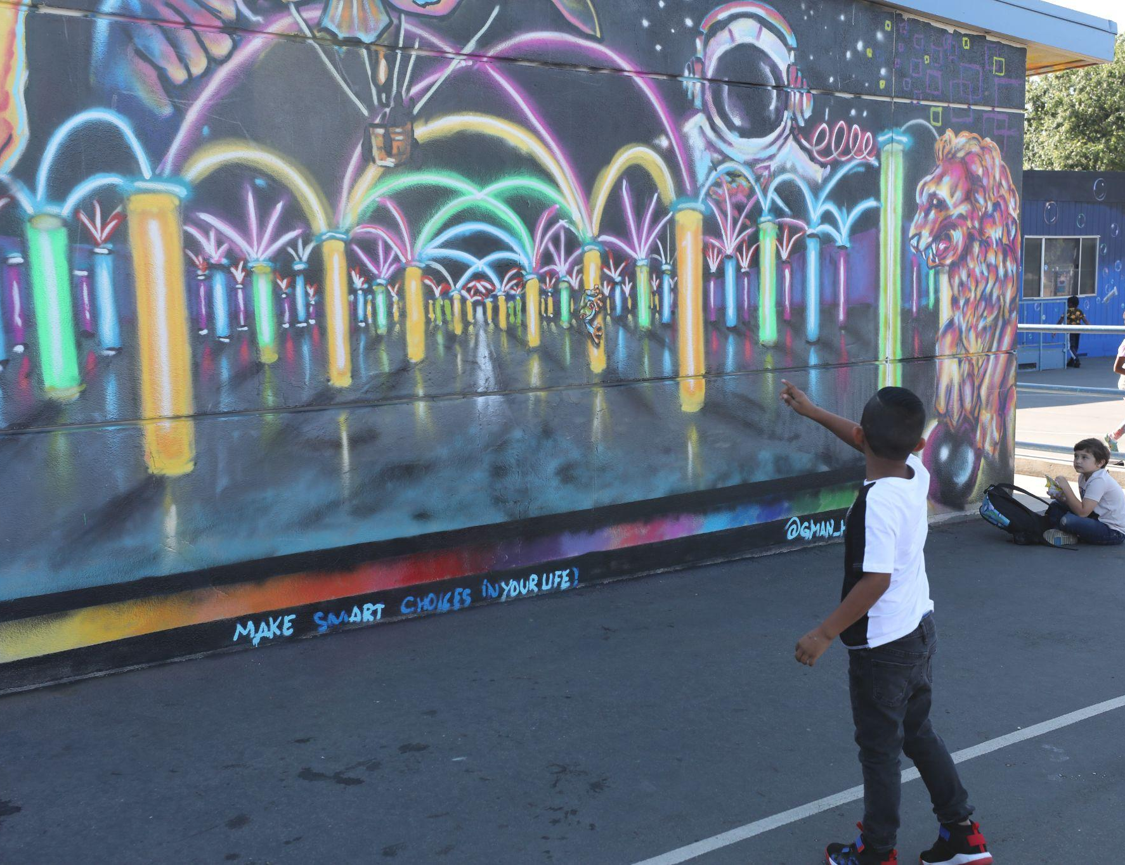
School Selection Criteria
Inter-departmental committee developed criteria to prioritize which schools would be beautified during this year’s partnership.
The starting point in selecting schools was looking at our Facilities Master Plan equity index map.
Other deciding factors include neighborhood-facing walls for positive impact beyond campus, slated rebuild or major construction projects within the next several years, whether the school has a large number of walls that are not made of brick, and whether the school has an existing arts education program (prioritizing schools that do not have this).
10
Notes:
Nathaniel

Slide 11
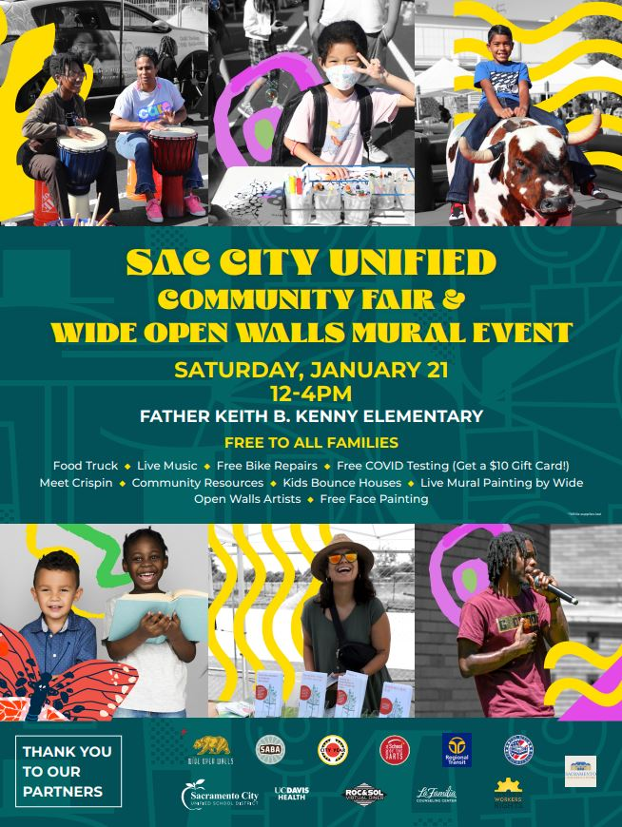
2022-2023 School Year Schedule
September 17-18: Elder Creek (Area 4)
November 19-20: Bret Harte (Area 1)
January 21-22: Father Keith B. Kenny (Area 7)
February 18-19: Hiram Johnson (Area 2)
March 18-19: John Cabrillo (Area 6)
April 15-16: Abraham Lincoln (Area 3)
May 20-21: Rosa Parks (Area 5)
11
Notes:
Niki - Please join us this weekend! Wide Open Walls artists are taking over Father Keith B. Kenny K-6 in Vice President Phillips’ trustee area. We’ll also be hosting our community fair from 12-4pm, and there will be free meals, live music, free covid testing, bike repairs, community resources and more! We’ll be at one of our schools every third Saturday of the month through May and hopefully we’ll do it all again at 7 or more schools during the 2023-2024 school year.

Slide 12
Wide Open Walls (WOW) Partnership Scope and Budget
$250,000 this fiscal year per Board recommendation, funded with ESSER III for Student Opportunities: Visual and Performing Arts.
WOW scope is to paint 12+ murals at one school per trustee area, for a total of 7 schools
Tahoe received murals in May 2022 that were not funded by the District.
12
Notes:
Nathaniel
This partnership is focused on facilities, arts on campuses, and student engagement. There is a forthcoming block grant that will focus on student arts at a deeper level and this partnership acts as a catalyst to increase the level of arts integration throughout these campuses as a starting point. This is not the only arts initiative.

Slide 13
Q&A

