Slide 1


2022-23
First Interim Report
Board Meeting December 15, 2022
Agenda Item No. 9.2

Slide 2
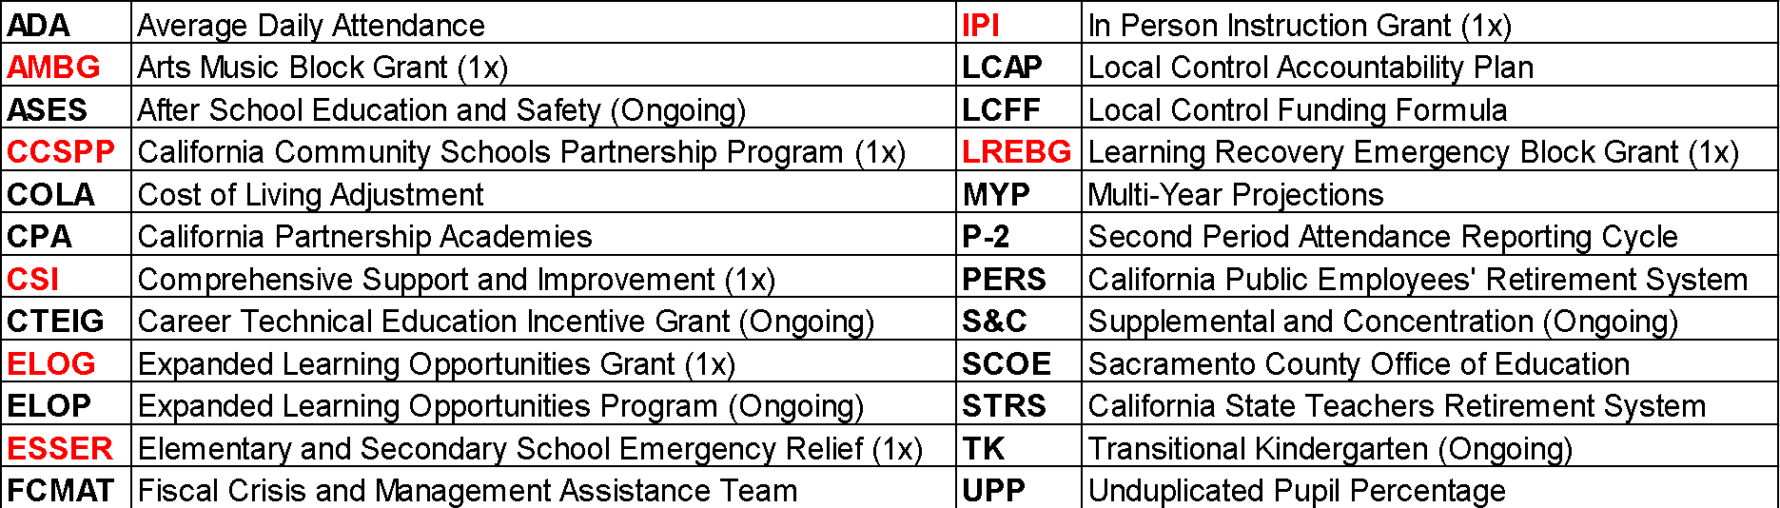
Acronyms
*Items in red are one time restricted funding sources.
2

Slide 3
Agenda
Financial Reporting Requirements & District’s Fiscal Status
First Interim Overview
Unrestricted and Restricted Changes
Multi-Year Projections Update
Areas of Need
Summary
Approve 2022-23 First Interim Budget
3

Slide 4
California School District Financial Reporting Requirements
Education Code 42130 – Requires school districts to file their fiscal condition for TWO reporting periods, October 31 and January 31, including projections of the budget through June 30.
Education Code 42131 – Requires the Board of Education to certify, based on current projections, whether or not the school district is able to meet its financial obligations for the current fiscal year and subsequent two fiscal years.
Education Code 33127 – Requires a district that has received a qualified or negative certification of its interim report(s) to file a third report through April 30
4

Slide 5
First Interim Overview
2022-23 District Adopted Budget - 6/23/2022
  State budget not final
  Uncertainties: COLA, ADA Relief, & 1X Funds
2022-23 State Enacted Budget – 6/30/2022
  LCFF COLA augmentation of 6.70%
  Additional transportation funding
  Arts, Music & Instructional Materials Discretionary Block Grant
  Learning Recovery Emergency Block Grant
  ELOP
First Interim Report – 12/15/2022
  Incorporates above changes from State Enacted Budget plus:
    Fund balance commitments and areas of need added to budget
    Budget revisions since the District Adopted Budget
    Updated beginning fund balance from 2021-22 Unaudited Actuals
    1X Carryover revenue and expenditures from 2021-22 year
5

Slide 6

Adopted Budget in June vs First Interim Today
On June 23, 2022 the Board adopted a projected budget with revenues of:
Projected total revenue amount with First Interim Report:
$167.4M
$689.9M
$857.3M
More than expected
$-17.9M
$185.3M
UNRESTRICTED
(Less than expected)
RESTRICTED
(More than expected)
6

Slide 7
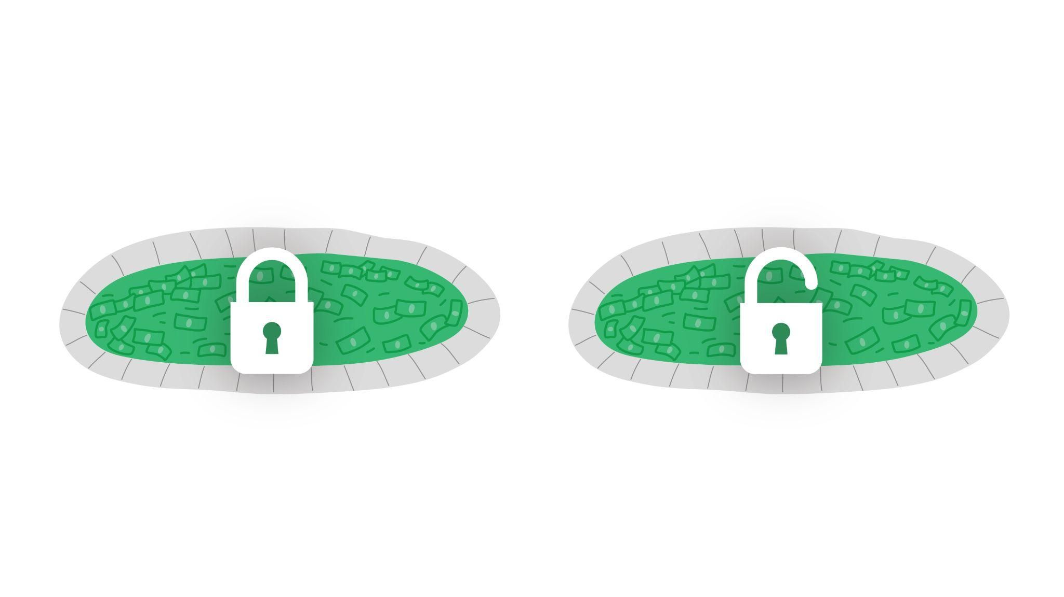
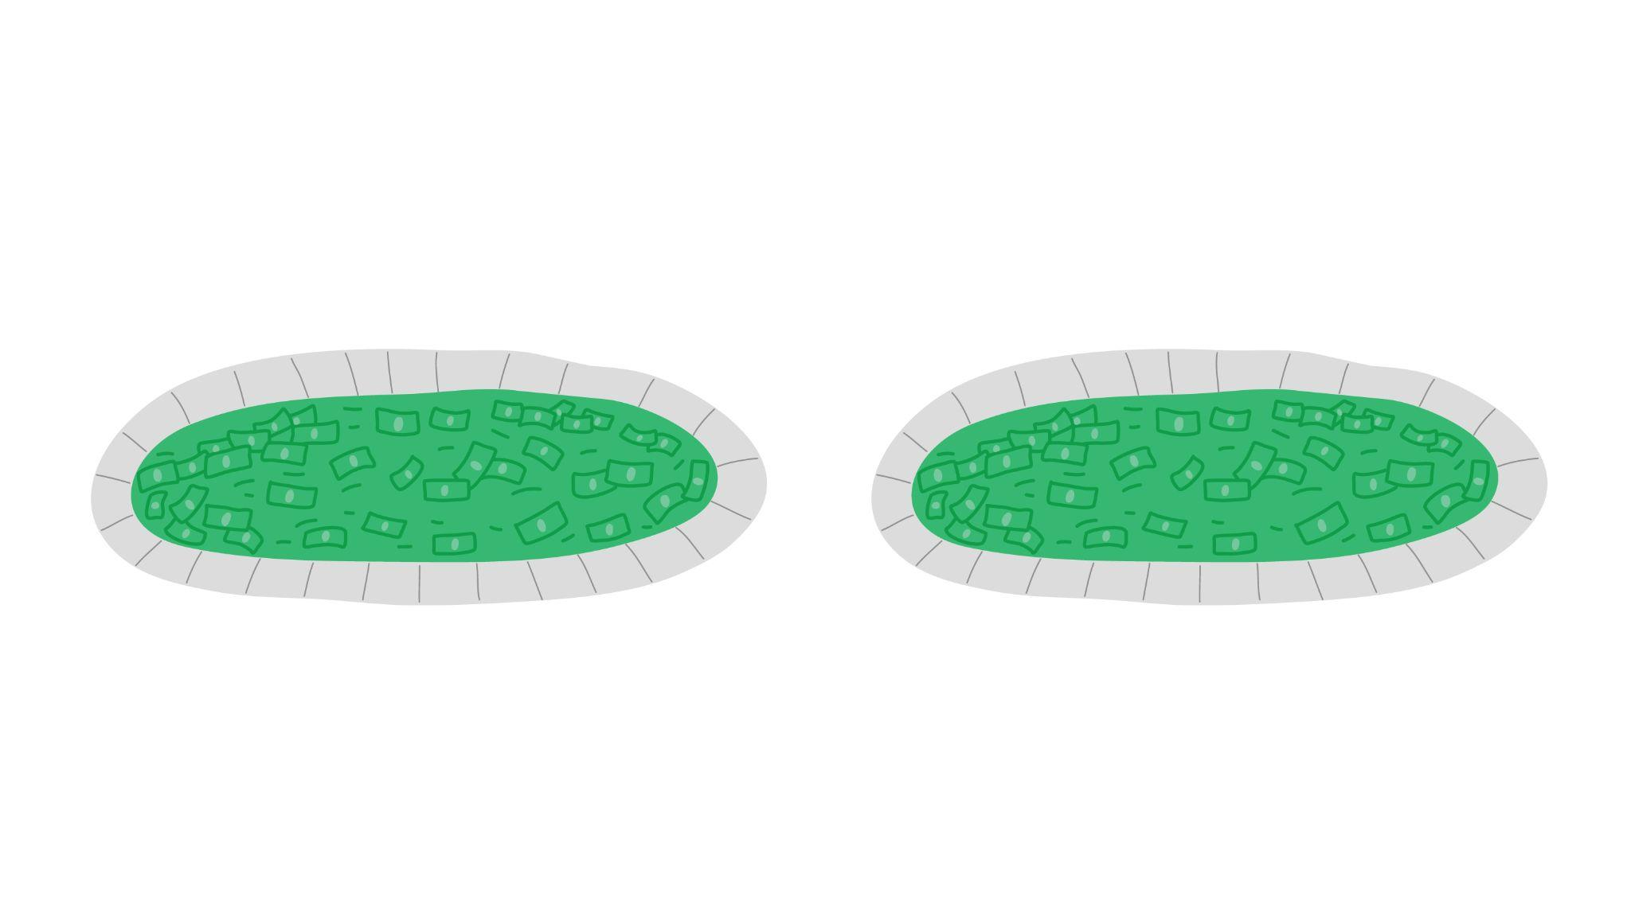

Restricted
Unrestricted
Restricted vs Unrestricted Funds
NOTE: There may still be some restrictions on unrestricted funds.
7
Notes:
Add slide explaining difference between restricted and unrestricted definitions, including examples of how restricted funds have to be spent on certain activities – Potential language - specific purposes for which it can be used - learning recovery, targeted student populations.
Think of Funding as two pools of money.
These pools are restricted and unrestricted funds. Restricted funds (explanation). Unrestricted funds (explanation)

Slide 8
What makes up the change of -$17.9M in unrestricted funds?
$ -17.9M
Unrestricted Funds
$ -45.6M
= Includes additional amount for Transportation & removing $49M we expected in unrestricted funds but shifted to restricted grants per State Enacted Budget
$ 28.0M
= Increased LCFF COLA + Investment from 9.86% to 13.26% and ADA Relief
$ -0.3M
= Decreases in local revenues
8
Notes:
Rose – 45.6 change offset by the additional 3.3M in transportation revenue

Slide 9
What makes up the change of +$185.3M in restricted funds?
+$185.3M
Restricted Funds
$ 75.1M
= Federal Revenue - Includes budgeting 1x carryover for ESSER II/III, Title I/II/III/IV, CSI, ELOG and ASES
$ 109.8M
= State Revenue – Includes addition of $55.7M Learning Recovery and $21.8M Arts/Music
Block Grants, and budgeting 1x carryover for IPI, CTEIG, CPA and CCSPP
$ .35M
= Local Revenue – Includes budgeting local grant carryover
9
Notes:
Speak to carryover funds being one time.

Slide 10
Unrestricted and Restricted Revenue Changes
Unrestricted Revenue Changes
Description | 2022-23 Adopted Budget | 2022-23 First Interim | Variance
LCFF Revenues | $454,072,523 | $482,045,473 | $27,972,950
State* Revenues | $56,524,860 | $10,945,417 | -$45,579,443
Local Revenues | $5,910,294 | $5,657,295 | -$253,000
TOTAL | $516,507,677 | $498,648,185 | -$17,859,493
Restricted Revenue Changes
Description | 2022-23 Adopted Budget | 2022-23 First Interim | Variance
General Purpose Revenues | $2,251,179 | $2,251,179 | $0
Federal Revenues | $91,620,567 | $166,767,829 | $75,147,262
State Revenues** | $77,161,859 | $186,922,553 | $109,760,694
Local Revenues | $2,348,651 | $2,697,751 | $349,099
TOTAL | $173,382,256 | $358,639,311 | $185,257,055
*Transportation Add on requires board approved spending plan by April 1, 2023
**Arts, Music, & Instructional Materials Discretionary Block Grant requires board approved spending plan. The Learning Recover Emergency Block Grant does not require a spending plan, but is recommended.
10
Notes:
Color in red negatives

Slide 11
Unrestricted Expenditure Changes
Description | 2022-23 Adopted Budget | 2022-23 First Interim | Variance
Certificated Salaries | $177,131,600 | $175,173,341 | -$1,958,259
Classified Salaries | $39,061,130 | $39,811,546 | $750,416
Benefits | $126,337,116 | $123,506,005 | -$2,831,111
Books & Supplies | $8,011,516 | $14,901,486 | $6,889,969
Contracted Services & Other Operating Expenses | $23,735,745 | $25,704,202 | $1,968,457
Capital Outlay | $29,000 | $261,354 | $232,354
Other Outgo | $1,540,000 | $1,540,000 | $0
Indirect Charges | -$8,279,893 | -$8,395,279 | -$115,386
TOTAL | $367,566,215 | $372,502,655 | $4,936,440
11

Slide 12
Restricted Expenditure Changes
Description | 2022-23 Adopted Budget | 2022-23 First Interim | Variance
Certificated Salaries | $65,846,912 | $66,906,176 | $1,059,265
Classified Salaries | $31,616,783 | $32,555,635 | $938,852
Benefits | $89,430,083 | $91,201,020 | $1,770,936
Books & Supplies | $21,326,015 | $44,698,607 | $23,372,592
Contracted Services & Other Operating Expenses | $61,790,517 | $127,490,198 | $65,699,681
Capital Outlay | $5,400,251 | $36,351,903 | $30,951,651
Indirect Charges | $7,088,334 | $7,023,814 | -$64,520
TOTAL | $282,498,895 | $406,227,353 | $123,728,458
12

Slide 13
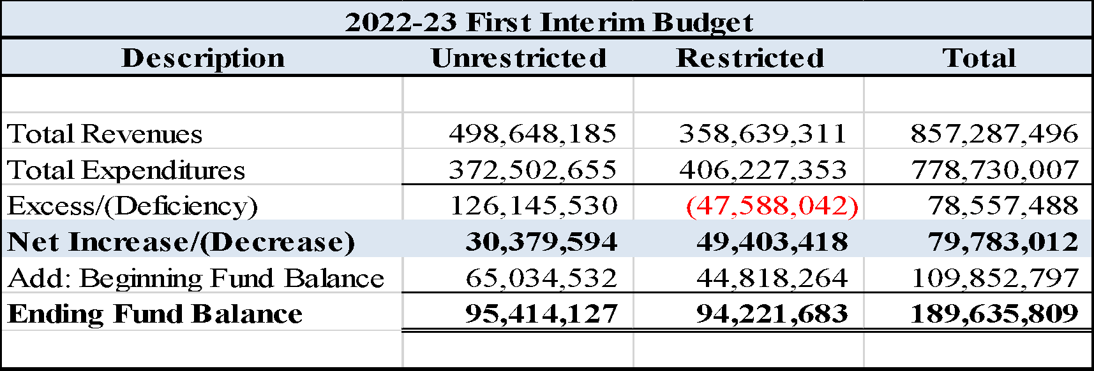
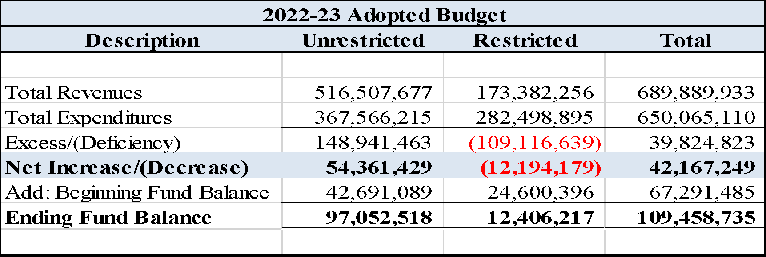
2022-23 First Interim Report Compared to Adopted Budget
13
Notes:
Point to starting balance change due to unaudited actuals.

Slide 14
Multi-year Projection Revenue Assumptions
2023-24 & 2024-25 Unrestricted Revenue Assumptions
  LCFF COLA of 5.38%, 4.02% respectively
  Federal, state and local revenues projected to remain constant.
  Contributions to Special Education were increased by $8.6M and 9.2M for projected expenditures per historical trends
2023-24 & 2024-25 Restricted Revenue Assumptions
  Federal Revenue was reduced by $77M to remove 1x carryover funds for Title I/II/III/IV, CSI, ESSER II/III, ELOG, and ASES. In FY 24-25 reduced by $43.2M to remove ESSER III funds
  State Revenue was reduced by $84.7M to remove carryover funds for CCSPP Grant, CTE programs, ELOG, and the one-time Learning Recovery Block Grant and Arts Music Grant.
  Local Revenue is projected to decline $227K with the removal of one time funds
  Contributions to Special Ed were increased by $8.6M and $9.2M respectively
14
Notes:
Make clear budget assumptions and removal of 1x funds throughout each fo the years. Change colors of words for 1x vs ongoing.

Slide 15
Multi-year Projection Expenditure Assumptions
2023-24 & 2024-25 Unrestricted Expenditure Assumptions
  Certificated salaries – Step and column, 6 FTE reduction for projected enrollment declines, removal of 3 PD days from 22-23, and adjustment for 1x vacancy savings
  Classified Salaries – Step and column, adding back 1x vacancy savings, removal of 1x settlement agreement costs
  Benefits - adding back 1x savings, increases in dental for all units, projected 8% increase in health benefits, adjustments per salary adjustments described above
  Books and Supplies - net decrease in 23-24 due to the add back of the 1x FRP textbook reduction offset by the removal of 1x carryover textbook purchase and removal of S&C carryover funds. Increase in 24-25 for increased supplemental and concentration funds.
  Services have been decreased by $938K to account for the removal of 1x district areas of need budgeted in 22-23 and increase in 24-25 for projected increases in supplemental and concentration funds.
15

Slide 16
Multi-year Projection Expenditure Assumptions
2023-24 & 2024-25 Restricted Expenditure Assumptions
  Certificated and Classified Salaries - step and column costs, removal of 1x expenditures offset by additional special education positions. In FY 24-25, adjustments include removal of ESSER III offset by district areas of need positions budgeted under Learning Recovery and Arts Music Block grants.
  Benefits – adjustments in FY 23-24 and 24-25 to reflect the salary changes noted above and a projected 8% additional increase for health benefits
  Books and Supplies – Decrease due to removal of 1x carryover funds and grant funds including Title I/II/III/IV, ESSER III, and ELOG. Adjustment also includes increase to special education materials and supplies
  Services – Decrease due to removal of 1x carryover funds including ESSER III, ELOG, CSI, Title I/II/III/IV, ELOP and special education services adjustments
16

Slide 17
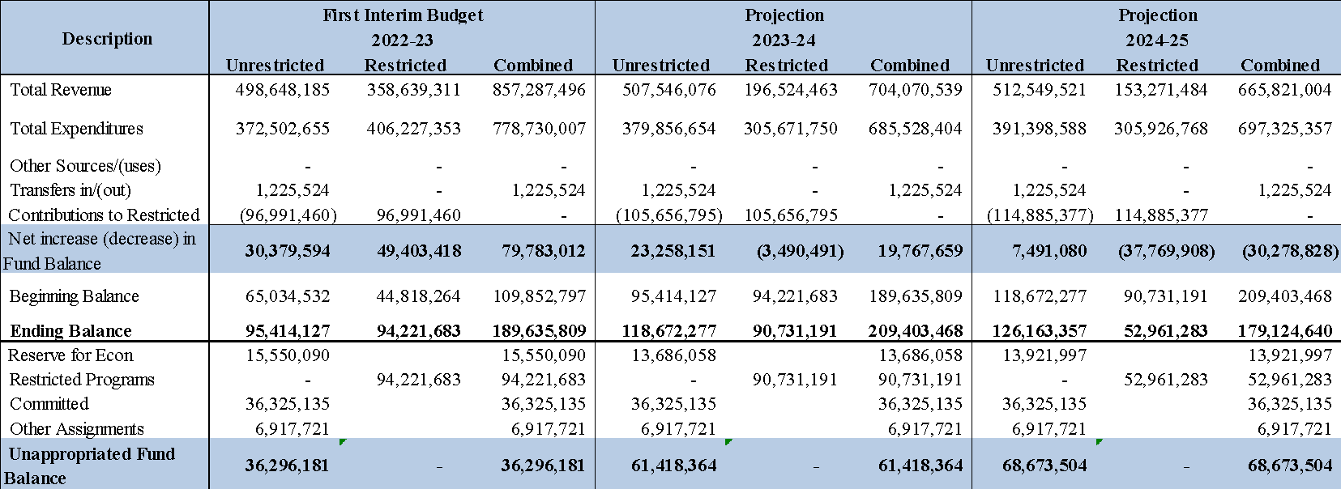
General Fund Multi-Year Projections
17

Slide 18
ESSER III Funded Positions
Counselors
Nurses
Psychologists
Behavior Analysts
Social Workers
Teachers
Attendance and Enrollment Specialists
Student Support Specialists
Notes:
Speak to ESSER III positions budgeted through the MYP.

Slide 19
Multi-Year Projections Summary
Unrestricted
Unrestricted surplus in FY 2024-25 of $7.49M
Restricted
ESSER III and other COVID funding fully budgeted and expended by 2023-24
Total of $77.6M one time Learning Recovery and Arts Music Grants
$33.9M of ESSER III positions and $3.9M Professional Learning budgeted to Learning Recovery and Arts Music Grants in 2024-25
$39.8M one-time funds remaining to be allocated
$ 77.6M
One-Time Grants
$ -33.9M
ESSER III Positions
$ -3.9M
Professional Learning
$ 39.8M
Restricted Funds
$+7.49M
Unrestricted Funds
$ 47.29M
To Meet Areas of Need
19

Slide 20

Sample Areas of Need
Staff Recruitment and Retention
Student
Support
Attendance
Support
Safe Learning Environments
20

Slide 21


Areas of Need
Professional development for staff, including Science of Reading and Anti-racist & Anti-Bias training
Enhance dual language immersion programs
Hire and retain more instructional aides
Replace aging and worn classroom furniture
Increase school site discretionary funds
Install more cameras and secure access points
Increase safety staffing
Expand year-round athletics opportunities
College application stipends
21

Slide 22
Risks and Opportunities
Risks
Uncertainty regarding ongoing State funding for K12 Districts
Potential future impact of recessionary economy
Enrollment
Additional Unfunded COVID-19 related expenses
Opportunities
Improved State budget and funding for K12 Districts
Stable/increased Enrollment
Potential to make up instructional days lost during 2021-22 school year through State Waiver process
22

Slide 23
Summary
2022-23 First Interim Positive Certification
District 2022-23 Adopted Budget conditionally approved by SCOE
  2021-22 Adopted Budget conditionally approved
  District’s budget has been disapproved for 3 years (2018-19, 2019-20, 2020-21)
  SCOE Fiscal Advisor will remain assigned with Stay & Rescind Authority
23

Slide 24
Approve 2022-23 First Interim Budget

