Slide 1


2016 California Alternate Assessment Coordinator Training
2016
Presented by
Melody Hartman-Palmero
Assessment, Research & Evaluation

Slide 2
Purpose of Today’s Workshop
Provide background information on the California Alternate Assessments (CAAs).
Provide instruction on:
  How to prepare for the CAA administration
  How to administer the CAAs
  How to train others to administer the CAAs

Slide 3
CAA Training Resources
Resource | Description | Availability
Test administration tutorial | Online training module specifically for test examiners | February
“How to” videos | Short, topic-specific training videos (e.g., how to start a CAA test session, response modes, etc.) | February/March
Training test | To familiarize test examiners and students with testing interface, item types, and accessibility resources | February
Training Test Directions for Administration (DFA) | Accompanies the training test with scripts and guidelines; familiarizes test examiners with the format of the operational DFAs. | February
CAA Test Administration Manual | CAA-specific test administration manual | February

Slide 4
Learning Goals
Participants will understand:
The purpose and use of the CAAs
The various components of preparing for the CAA administration
The step-by-step procedures for administering the CAAs to students
How to train tests examiners to administer the CAAs

Slide 5
Success Criteria
Participants can:
Identify the purpose of the CAAs and the students for whom the assessment is designed.
Identify the tools and resources needed to set up the CAA administration at their LEA.
Administer CAAs to a student.
Train others (test examiners) on how to administer the CAAs to students.

Slide 6
Agenda
Overview of the California Alternate Assessments (CAAs)
Roles and Responsibilities
Preparing for Test Administration
Accessibility Resources
Administering the CAAs
Test Security

Slide 7

Overview

Slide 8
Overview: About the CAAs
For students whose individualized education program (IEP) team designates the use of an alternate assessment
Online, summative, grade-level assessments
English language arts (ELA) and mathematics
Grades 3–8 and grade 11
Part of the California Assessment of Student Performance and Progress (CAASPP) System
Replaces the California Alternate Performance Assessment (CAPA) for ELA and Mathematics
One-on-one assessment

Slide 9
Overview: Purpose of the CAAs
Provide students with significant cognitive disabilities the opportunity to demonstrate achievement by taking a test commensurate with their abilities as indicated in the student’s IEP:
  Students are assessed through alternate achievement standards linked to Common Core State Standards (CCSS).
    The tests are aligned to Core Content Connectors (CCCs) developed by the National Center and State Collaborative.
    The items are written to grade-level CCCs.

Slide 10
Overview: Multistage Design
STAGE 1
STAGE 2
START WITH
Survey of Student Characteristics (Completed only once per student)
Stage 1A* (Items 1–11)
Stage 1B
(Items 12–21)
Stage 2, T1
(Items 22–27)
Stage 2, T2
(Items 22–27)
Stage 2, T3
(Items 22–27)
*Some students will be routed automatically from Stage 1A to Stage 2, T1. However, most students will complete both Stage 1A and Stage 1B before proceeding to one of three Stage 2 sections.

Slide 11
Overview: 2016 CAA
Testing Window
The testing window for the CAAs is April 11 through June 17, 2016 for all LEAs:
  Scheduling within this window is according to local preference.
  LEAs are not required to inform ETS or CDE of their testing schedule.
  All testing must take place within the window.
  Starting in 2017, the CAA testing window will merge with the Smarter Balanced Summative Assessment window.

Slide 12
Overview: Student Eligibility
A student is eligible to take the CAAs if:
The IEP team designates the use of an alternate assessment
  The CDE recommends IEP teams base their decisions on the use of an alternate assessment on the following:
  The student has a significant cognitive disability.
  The student is learning content derived from the CCSS.
  The student requires extensive direct individualized instruction and substantial supports to achieve measurable gains in the curriculum.

Slide 13
Overview: Student Participation
All students who are eligible to take the CAAs are required to participate.
    Students in ungraded programs must be assigned grade levels.
  All students who are eligible to take the CAAs and are enrolled in/assigned to grades 5, 8, or 10 will take the CAPA for Science.

Slide 14
Overview: Test Administration
The CAAs are administered online only; there are no paper versions.
They are administered one-on-one by a test examiner.
CAA administration requires two Internet-connected devices:
  Student testing device
  Test examiner device
A CAASPP secure browser must be installed on student testing devices.
Test examiners must use the proper grade- and version-specific Directions for Administration (DFA).
  DFAs must be downloaded or printed.

Slide 15
Overview: DFAs
Each DFA includes both content areas.
DFAs are downloadable from the Test Operations Management System (TOMS).
They are grade- and version-specific PDFs.
Versions are assigned at the school level.
  Example: John Doe Elementary School is assigned “Version 1” of the grade 3, 4, 5, and 6 CAA DFAs.
  Version assignments for each school will be posted at http://www.caaspp.org/ in late March.

Slide 16

Roles and Responsibilities

Slide 17
Roles and Responsibilities:
CAASPP Test Site Coordinator
CAASPP test site coordinators are responsible for the following:
  Ensure that test examiners are properly trained.
  Identify certificated or licensed test examiners.
  Collect signed CAASPP Test Security Affidavits from test examiners.
  Enter test examiners into TOMS.
  Enter and/or verify accessibility resources in the Test Settings and Unlisted Resources tab in TOMS for students.

Slide 18
Roles and Responsibilities:
CAASPP Test Site Coordinator (cont.)
  CAASPP test site coordinator responsibilities (cont.):
  Create testing schedules and procedures for the school.
  Work with technology staff to set up technology infrastructure.
  Coordinate with test examiners to ensure that all assessments are administered.
  Mitigate and report all test security incidents.
  Securely destroy all secure test materials (i.e., DFAs, print-on-demand materials).

Slide 19
Roles and Responsibilities:
Test Examiner
Test examiners:
  Are trained by the LEA and/or view the test administration tutorial, print the certificate, and submit it to the LEA.
  Read and submit the CAASPP Test Security Affidavit.
  Ensure the student’s accessibility resources in TOMS is consistent with his/her IEP.
    Note: LEA CAASPP coordinators may provide test examiners with temporary site coordinator-level access to TOMS; otherwise, LEA CAASPP coordinators or CAASPP test site coordinators will have to enter all accessibility resources into TOMS for the test examiner.

Slide 20
Roles and Responsibilities:
Test Examiner (cont.)
Test examiners (cont.):
  Download DFAs from TOMS.
  Read the DFAs before testing.
  Complete the Survey of Student Characteristics (SSC) for each student.
  Conduct a Student Response Check (SRC) for each student.
  Administer the tests.
  Securely destroy all secure testing materials.

Slide 21

Preparing for Test Administration

Slide 22
Registering Students for the CAAs
Students must be registered in TOMS for the CAAs one of two ways:
    Via the user interface (one student at a time) OR
    Through spreadsheet template upload (multiple students)
TOMS will not process CAA registration if the student does not have an IEP in CALPADS (IDEA indicator and a primary disability code).
Students must be assigned a grade in CALPADS.
  Grade levels for students in ungraded programs (UE, US or UU) are calculated by subtracting 5 from their chronological age on September 1, 2015. For example, a student who was 10 years old on September 1 would be given the grade 5 test (10 years – 5 = Grade 5).

Slide 23
Registering Students for the CAAs (cont.)
Register students for the CAAs before the LEA’s last day to order (see Test Admin tab in TOMS).
Recommended: Complete registration as soon as possible so student rosters reflect the correct test assignments and to allow for IEP addendums.
Register students for the correct test before assigning accessibility resources in TOMS.

Slide 24
Assigning Accessibility Resources
Ensure that accessibility resources assigned to the student in TOMS is consistent with the student’s IEP through one of two methods in TOMS:
    Via the user interface (one student at a time)
    Through spreadsheet template upload (multiple)

Slide 25
Assigning Accessibility Resources (cont.)
For unlisted resources, request review and approval by filling out the Web form in the Unlisted Resources tab in TOMS.
Note: Test examiners may configure accessibility resources for students. For this reason, LEA CAASPP coordinators may provide test examiners with temporary site coordinator-level access to TOMS; otherwise, LEA CAASPP coordinators or CAASPP test site coordinators will have to enter all accessibility resources into TOMS for the test examiner.

Slide 26
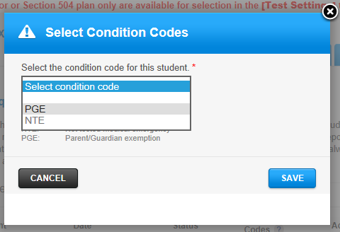
Indicating Parent/Guardian Exemptions
Set the parent/guardian exemptions in TOMS prior to testing.
The Parent/Guardian Exemption (PGE) condition code can be set in
the Score Status
tab of the student’s
profile in TOMS.

Slide 27
Preparing Technology
All online CAASPP assessments have the same technological requirements.
CAASPP secure browsers must be installed on all student testing devices:
  A list of supported systems, devices and browsers can be found at http://ca.browsers.airast.org/supported-browsers/.

Slide 28
Preparing Technology (cont.)
Two devices needed:
  Test examiner device
    Log onto the Test Administrator Interface.
    Create a test session.
    Display an electronic version of the DFA.
  Student testing device
    Log onto and take a test on the student testing interface.
Assistive devices are:
  Identified in a student’s IEP or Section 504 plan.
  Used according to the communication and response method of each student.

Slide 29

Preparing Technology (cont.)
INTERNET
STUDENT TESTING DEVICE
TEST EXAMINER DEVICE
CAASPP secure browser (student testing interface)
  Survey of Student Characteristics
  ELA test
  Mathematics test
PDF version of DFAs
  May download or print a hard copy
Test Administrator Interface
  Select test or Survey of Student Characteristics to administer
  Generate test session ID

Slide 30
Using the Training Test
Designed to allow test examiners and students to try out the accessibility resources to establish the most optimal test setting experience for the student
  Familiarize test examiners and students with item types, the testing interface and functionalities
One ELA and one mathematics training test, used in conjunction with the CAA Training Test DFA
  Six to seven items each
  Not grade-specific
  Not to be used to measure content knowledge

Slide 31
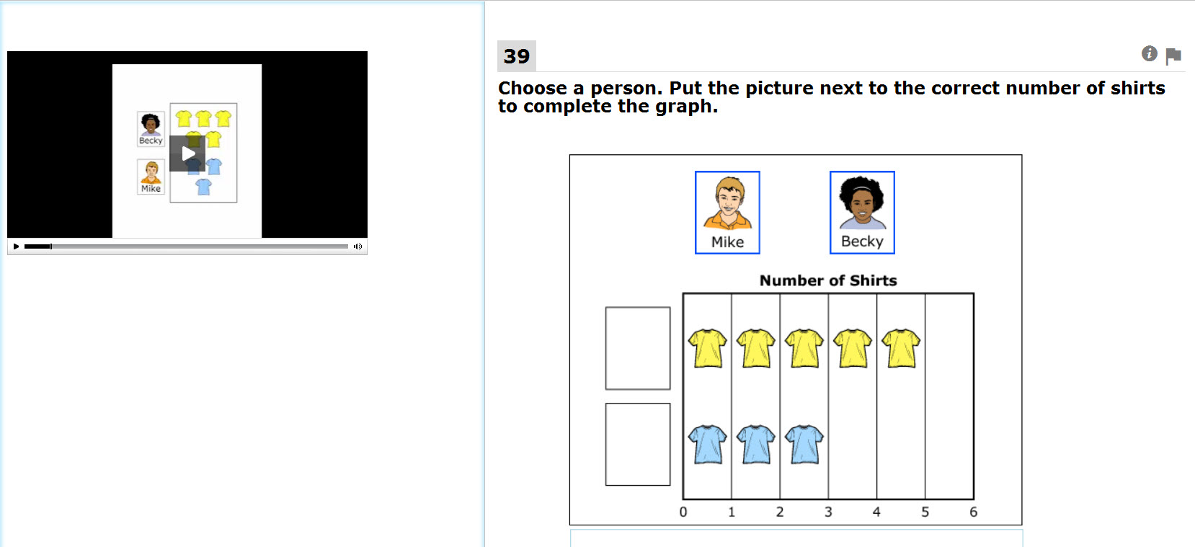
Example Mathematics Item:
Not Answered

Slide 32
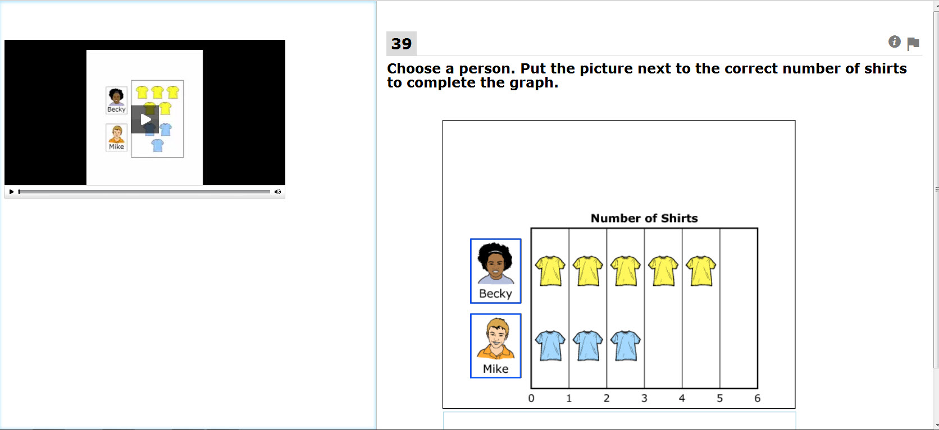
Example Mathematics Item: Answered

Slide 33
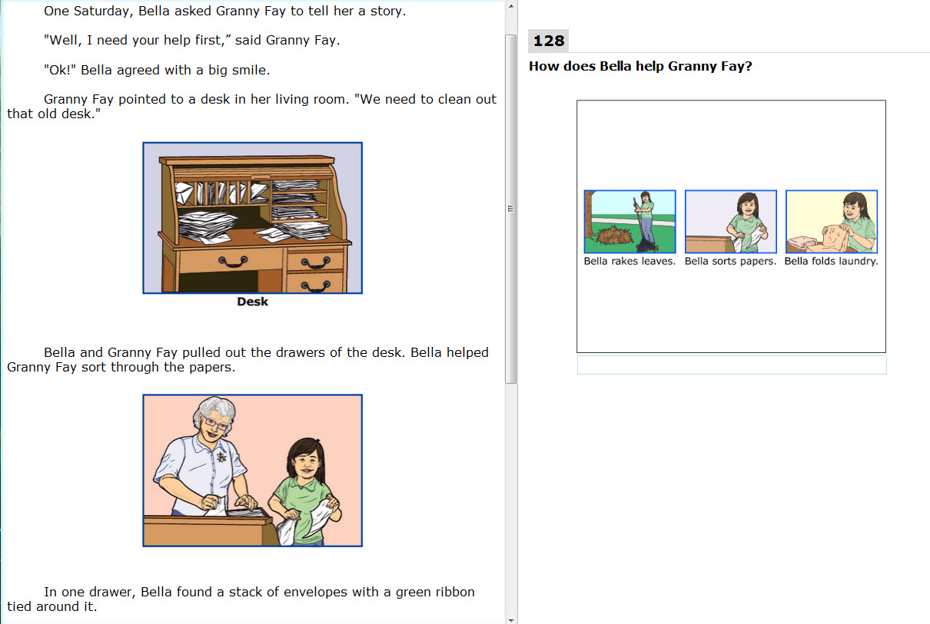
Example ELA Item: Not Answered

Slide 34
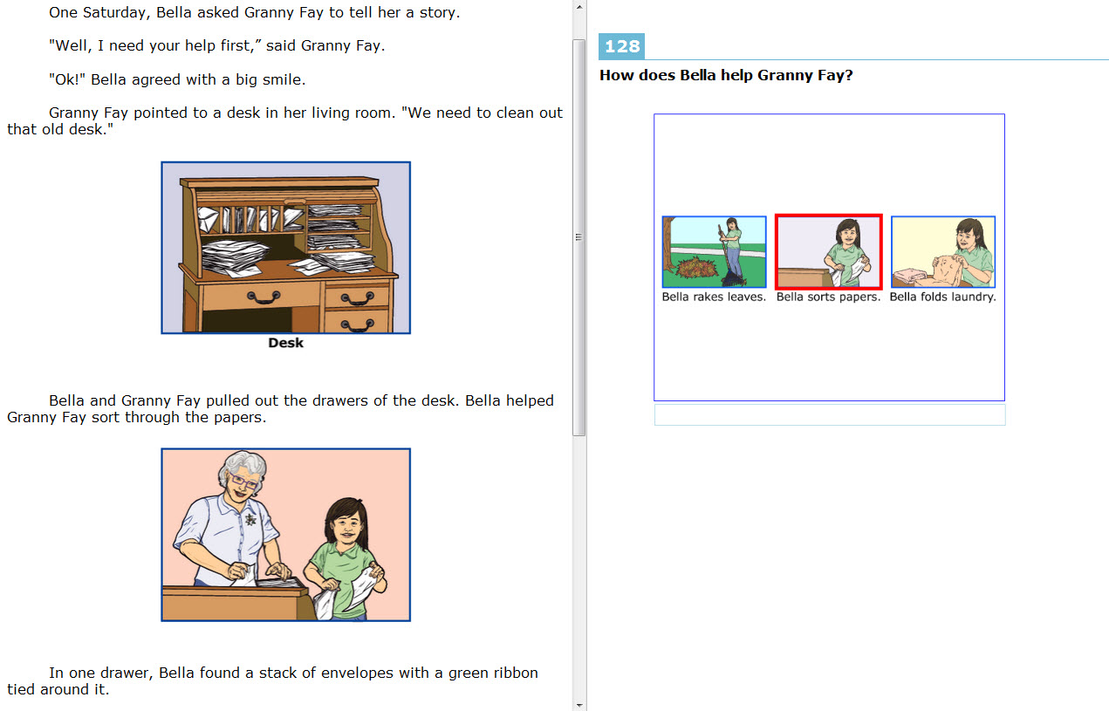
Example ELA Item: Answered

Slide 35

Accessibility Resources

Slide 36
Universal Tools, Designated Supports and Accommodations
CAAs provide the same universal tools, designated supports, and accommodations (UDAs) as other online CAASPP assessments:
  Universal tools are available to all students by default.
  Designated supports are provided at the discretion of a teacher familiar with the student’s needs.
  Accommodations must be specified in a student’s IEP or Section 504 plan.
  All embedded and non-embedded designated supports and accommodations are assigned to individual students in TOMS.

Slide 37
Embedded
Accessibility Resources for CAAs
Designated Supports | Accommodation
Color contrast | Streamlined interface
Masking
Print size
Permissive mode
Turn off any universal tools*
*Must be activated in the test delivery system; cannot be activated in TOMS.

Slide 38
Non-embedded
Accessibility Resources for CAAs
Designated Support | Accommodation
Color contrast | Abacus
Color overlay | Alternate response options
Magnification | Calculator
Noise buffers | Multiplication table
Read aloud | Print on demand*
Scribe | Read aloud passages
Separate setting | Scribe
 | Unlisted resources
 | Instructional supports (CAAs only)
*Print on demand cannot be activated in TOMS; contact CalTAC to request access.

Slide 39
UDAs: Considerations for CAAs
It is always permissible for the CAAs to be administered in the language of instruction.
Response modes:
    Mouse/keyboard
    Verbal response
    Touch screen, gestures, or point
    Augmentative and/or alternate communication device
    Eye gaze
    Instructional supports:
      Anything listed in the student’s IEP

Slide 40

Administering the California Alternate Assessments (CAAs)

Slide 41
About This Section
This part of the training will prepare you to train your test examiners to administer the CAAs to students.
These slides are available for you to use in your trainings.
“Check for Understanding” slides can be used to reinforce key points.

Slide 42
About This Section (cont.)
Important reminders:
Test examiners must be licensed or certificated and familiar with the students they will test.
Each test examiner must complete a training session before administering the CAAs by either:
  Completing a local training based on the content of today’s workshop, or
  Completing the forthcoming “Test Administration Tutorial,” a stand-alone online training module.
The amount of training required will depend on the level of prior experience with the CAAs.
Test examiners must sign and return the CAASPP Test Security Affidavit.

Slide 43
Learning Goals
Participants will understand:
The flow of CAA testing
The various components of preparation needed prior to administering a CAA to a student
The step-by-step procedures for administering a CAA to students

Slide 44
Success Criteria
Participants can:
Identify the components of administering a CAA to a student in sequential order.
Identify how to engage students for CAA testing through the Student Response Check (SRC).
Administer CAAs to a student.

Slide 45
CAAs: An Introduction for
Test Examiners
Question | Answer
Who takes the CAAs? | All students enrolled in or assigned to grades 3 through 8 and grade 11 whose IEP team designates the use of an alternate assessment.
Which content areas do the CAAs cover? | ELA and mathematics
How many items are on a test? | A student will see no more than 27 items per content area.

Slide 46
CAAs: An Introduction for
Test Examiners (cont.)
Question | Answer
How do the students take the tests? | CAAs are administered online only and one-on-one by a test examiner.
Who can administer the CAAs? | A certificated or licensed test examiner who is familiar with the student.
What do I need in order to administer the CAAs? | A student testing device, test examiner device, and grade- and version-specific DFA.
How are the CAAs scored? | Mostly by computer. Test examiners provide ratings for a small number of ELA items for which the student provides short written responses.

Slide 47
CAAs: How Testing Works
Use the same test delivery system as the Smarter Balanced tests
Two Internet-connected devices needed for testing:
  One device for the test examiner to manage testing
  One device (with a CAASPP secure browser installed) for administering the test to the student
You will use specific login information on each device:
  Test examiner device: TOMS credentials for Test Administrator Interface
  Student testing device: Student’s SSID, first name, and test session ID

Slide 48
Check for Understanding
Q: Who should be administered the CAAs?
A: Students with an IEP indicating a significant cognitive disability.
Q: How many devices are needed for CAA testing?
A: Two.
Q: Can more than one student be tested at once by the same test examiner?
A: No. The CAAs are administered only one-on-one.

Slide 49
CAAs: How Testing Works
INTERNET
STUDENT TESTING DEVICE
TEST EXAMINER DEVICE
CAASPP secure browser (student testing interface)
  Both test examiner and student interact with this device
  Use device student is familiar with
  Log on with student info
Complete Survey of Student Characteristics (SSC)
  Administer ELA and mathematics tests
  Ensure that he student’s Augmentative or Alternative Communication is programmed
Test Administrator Interface
  Any device (tablets recommended)
  Log on with TOMS username and password
  Start test sessions by generating a Session ID
Can be used to read PDF version of the Directions for Administration (DFA)

Slide 50
CAA Testing Components
Directions for Administration (printed or PDF)
Before student tests
Log-on
Survey of Student Characteristics
Student Response Check
Test examiner
stop?
Test examiner
stop?
Adaptive Route
Adaptive Route
Stage One
Log-on
Q1 Q2 Q3 Q4 Q5 Q6 … Q11 … Q12 … 21
T1 Q22 Q23 Q24 Q25 Q26 Q27
Stage Two
Log-on
or
T2 Q22 Q23 Q24 Q25 Q26 Q27
or
T3 Q22 Q23 Q24 Q25 Q26 Q27

Slide 51
Directions for Administration
Directions for Administration (printed or PDF)
Before student tests
Log-on
Survey of Student Characteristics
Student Response Check
Test examiner
stop?
Test examiner
stop?
Adaptive Route
Adaptive Route
Stage One
Log-on
Q1 Q2 Q3 Q4 Q5 Q6 … Q11 … Q12 … 21
T1 Q22 Q23 Q24 Q25 Q26 Q27
Stage Two
Log-on
or
T2 Q22 Q23 Q24 Q25 Q26 Q27
or
T3 Q22 Q23 Q24 Q25 Q26 Q27

Slide 52
Directions for Administration (cont.)
The CAA DFAs are grade- and version-specific:
  Guide test examiners step-by-step.
  Include item-specific instructions, scripts, and scoring rubrics for some items.
  Provide as PDFs
Version assignments for your school are posted at http://www.caaspp.org/about/caa/,
Download secure DFA(s) from TOMS:
  Use electronic or print format according to local preference.
  Keep secure at all times.
  Securely destroy after testing.

Slide 53
Directions for Administration (cont.)
Each school in California is assigned either Version 1 or Version 2.
Same version assignment for all grades within a school:
  Example: School A is assigned Version 1, and is testing a student in grade 4 and a student in grade 5. The test examiner needs the “Grade 4 Version 1” DFA and the “Grade 5 Version 1” DFA.
Ensure you are using the right version at the start of testing.

Slide 54
Survey of Student Characteristics
Directions for Administration (printed or PDF)
Before student tests
Log-on
Survey of Student Characteristics
Student Response Check
Test examiner stop?
Test examiner stop?
Adaptive Route
Adaptive Route
Stage One
Log-on
Q1 Q2 Q3 Q4 Q5 Q6 … Q11 … Q12 … 21
T1 Q22 Q23 Q24 Q25 Q26 Q27
Stage Two
Log-on
or
T2 Q22 Q23 Q24 Q25 Q26 Q27
or
T3 Q22 Q23 Q24 Q25 Q26 Q27

Slide 55
Survey of Student Characteristics
  A survey about the student to explore whether teacher knowledge of their students can be used to improve and shorten the test
  Selected to administer in the Test Administrator Interface
  Completed by the test examiner before engaging the student for testing
    On the student testing device through the secure browser
    Required by the test delivery system
  Field tested in 2016; will not impact ELA or mathematics tests this year

Slide 56
Survey of Student Characteristics: Example A
  Please specify the level of text at which this student demonstrates all listed skills consistently (e.g., usually):
  summarize a literary text from beginning to end
  use details from a literary text to answer specific questions
  High text complexity – Text with detailed and implied complex ideas and relationships; a variety of sentence types including phrases and transition words.
  Moderate text complexity – Text with clear, complex ideas and relationships and simple; compound sentences.
  Low text complexity – Brief text with straightforward ideas and relationships; short, simple sentences.
  Student does not display consistent proficiency on these skills at any level of text complexity.

Slide 57
Survey of Student Characteristics: Example B
  Please specify the task complexity level at which this student demonstrates this skill consistently (e.g., usually):
  find the surface area of three-dimensional right prism
  High task complexity – Multiple mathematical ideas presented in problems using various mathematical terms and symbolic representations of numbers, variables, and other item elements
  Moderate task complexity – Common problems presented in mathematical context using various mathematical terms and symbols
  Low task complexity – Simple problems using common mathematical terms and symbols
  Student does not demonstrate consistent proficiency on these skills at any level of task complexity.

Slide 58
Check for Understanding
Q: What document do you need in hand before starting testing with a student?
A: The appropriate grade- and version-specific DFA.
Q: Where can the DFAs be found?
A: DFAs are downloaded from TOMS after identifying grades for testing and the school’s assigned version number.

Slide 59
Check for Understanding (cont.)
Q: Can I administer tests without the DFA?
A: No. The DFA contain critical, item-specific information that is needed for testing.
Q: What do I do with the DFA after testing has been completed?
A: For paper versions of the DFA, shred or otherwise destroy them. For electronic versions, permanently delete the PDF files from all devices.

Slide 60
Check for Understanding (cont.)
Q: What is the first step before administering an ELA or mathematics test?
A: Log on to the student testing interface through the secure browser and complete the SSC before sitting the student for testing.
Q: Is the Survey of Student Characteristics (SSC) optional?
A: No. The SSC is required this year, and the system will not allow ELA or mathematics to be started until the SSC is completed.

Slide 61
CAA Student Testing
Directions for Administration (printed or PDF)
Before student tests
Log-on
Survey of Student Characteristics
Student Response Check
Test examiner stop?
Test examiner stop?
Adaptive Route
Adaptive Route
Stage One
Log-on
Q1 Q2 Q3 Q4 Q5 Q6 … Q11 … Q12 … 21
T1 Q22 Q23 Q24 Q25 Q26 Q27
Stage Two
Log-on
or
T2 Q22 Q23 Q24 Q25 Q26 Q27
or
T3 Q22 Q23 Q24 Q25 Q26 Q27

Slide 62
Student Response Check
Directions for Administration (printed or PDF)
Before student tests
Log-on
Survey of Student Characteristics
Student Response Check
Test examiner stop?
Test examiner stop?
Adaptive Route
Adaptive Route
Stage One
Log-on
Q1 Q2 Q3 Q4 Q5 Q6 … Q11 … Q12 … 21
T1 Q22 Q23 Q24 Q25 Q26 Q27
Stage Two
Log-on
or
T2 Q22 Q23 Q24 Q25 Q26 Q27
or
T3 Q22 Q23 Q24 Q25 Q26 Q27

Slide 63
Student Response Check (cont.)
  The purpose of the Student Response Check is to confirm that the student has a consistent and observable way of indicating responses to test items and whether he or she can orient to the task.
  Typical student response modes must be known before testing.
    The test examiner is responsible for indicate the student’s response mode as part of the Survey of Student Characteristics (SSC).

Slide 64
Student Response Check (cont.)
The SRC is identified by the student’s response to the first four test questions in a content area:
  After Q1: If no orientation and no response Select “End Test”; this will completely end and submit the test.
  After Q4: If the student orients but does not respond to questions 1–4 select “End Test”; this will completely end and submit the test.
  The SRC process is outlined in the DFA with specific scripts and guidelines.

Slide 65
Student Response Check (cont.)
  For students who do not orient to the first (or first four) questions or provide an observable, consistent response to the test item(s), test examiners should end the assessment by selecting the “End Test” button.
  Test examiners are responsible for administering the SRC according to guidelines provided in the DFA. They may not end a test early if a student:
    Orients and/or responds to question 1, or
    Orients and responds to any of questions 1–4
  Students providing responses must be administered the entire assessment.

Slide 66
Cues and Wait Times
  Guidelines for establishing whether a student responds or orients to the task:
  Student should be allowed at least five seconds if a verbal response is expected or seven seconds if a physical or motor response is expected.
  Wait times are appropriate; you know your students and the appropriate time for a response.
  Directions may be repeated if necessary.

Slide 67
Identifying Response Mode
If the student does not have the fine motor skills to consistently and independently use a mouse, keyboard, or touchscreen, identify alternate response options.
The test examiner may input responses that the student indicates by verbalizing, gesturing or pointing, using assistive technology, or using an eye gaze chart.
Use the training test to try out various response options.
  Augmentative and/or alternative communication (AAC) devices may be used as response modes.
    May require item-by-item configuration; test examiners may review the test by its stages prior to administering it to make necessary configurations.

Slide 68
Possible Response Modes
Independent use of mouse, touchscreen, or a computer keyboard
Verbal response
Gestures
Pointing independently to indicate a response
Print-on-demand accommodation and indicating responses using paper
AAC devices
Eye gaze
Other

Slide 69
Inputting Student Responses
If indicated by the student’s IEP, a student may enter his or her responses by circling or marking the answers on locally printed test items for transcription by the test examiner later:
  Requires the “print-on-demand” accommodation to be activated. Contact your coordinator.

Slide 70
Inappropriate Test Practices
  Responses to test questions that are not from the student.
  Hand-over-hand or other physical prompting by the test examiner.

Slide 71
Accessibility Resources
  Any instructional supports identified in the student’s IEP may be used during testing.
    “Test how you teach.”
  There are embedded and non-embedded accessibility resources.
  Training tests will allow you and the student to preview what the supports look like and determine what the student needs.
  Consult the Smarter Balanced Usability, Accessibility and Accommodations Guide when identifying the right supports for your student.

Slide 72
Accessibility Resources (cont.)
  Accessibility resources are configured in TOMS for each student.
    Can be modified only in TOMS.
  At least two business days before testing, check student profile in TOMS to ensure that it is accurate.

Slide 73
Check for Understanding
Q: When administering Question 1 of the test, what must the student do in order to move on to Question 2?
A: The student should respond to the item stem (the question) OR orient to the activity.
Q: At what point(s) can I (the test examiner) make a decision to end testing with a student?
A: After Question 1, if the student doesn’t respond or orient to activity; OR after Question 4, if the student hasn’t responded to Questions 2–4 and has only oriented to the activity.

Slide 74
CAA Student Testing
Directions for Administration (printed or PDF)
Before student tests
Log-on
Survey of Student Characteristics
Student Response Check
Test examiner stop?
Test examiner stop?
Adaptive Route
Adaptive Route
Stage One
Log-on
Q1 Q2 Q3 Q4 Q5 Q6 … Q11 … Q12 … 21
T1 Q22 Q23 Q24 Q25 Q26 Q27
Stage Two
Log-on
or
T2 Q22 Q23 Q24 Q25 Q26 Q27
or
T3 Q22 Q23 Q24 Q25 Q26 Q27

Slide 75
Student Testing
STAGE 1
STAGE 2
Stage 1A* (Items 1–11)
Stage 1B
(Items 12–21)
Stage 2
T1 (Items 22–27)
Stage 2
T2 (Items 22–27)
Stage 2
T3 (Items 22–27)
*Some students will be routed automatically from Stage 1A to Stage 2, 22–27. However, most students will complete both Stage 1A and Stage 1B before proceeding to one of three Stage 2 sections.

Slide 76
Student Testing
  Each student is administered a maximum of 27 items in three test segments for each content area.
  Some students will see only two segments and 17 items.
  There are three different possible sets of items in the third segment.
  System uses automatic routing rules to present the most appropriate items for each student.
  IMPORTANT: DFAs contain instructions for all items and possible routing outcomes. The system will prompt you to turn to the appropriate section of the DFA to administer the assigned segments. Ensure that you are reading the appropriate items in the DFA.

Slide 77
Check for Understanding
Q: How will you know you are on the right question for your student?
A: The system will automatically route to the next set of numbered questions; DFAs have matching question numbers that you should always check.
Q: When is it appropriate to hit the “end test” button in the student interface?
A: After Question 1 or 4, based on SRC results; or after the last item of test.

Slide 78
Check for Understanding (cont.)
Q: How many items will a student take in a CAA?
A: Students will take no more than 27 items, automatically selected from 39 total available items.
Q: At what point(s) does the system make a decision to route the student?
A: Some students will be routed after Question 11, and all other students will be routed after Question 21.

Slide 79

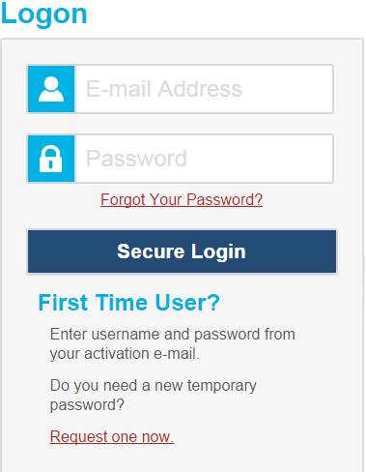
Step-by-Step: Starting a CAA
Open Web browser on test examiner device and navigate to the CAASPP portal (http://www.caaspp.org/):
  The DFA should be in hand (hard copy) or open on device (PDF).
Select the Test Administrator Interface button.
Enter TOMS username and password; log on.

Slide 80
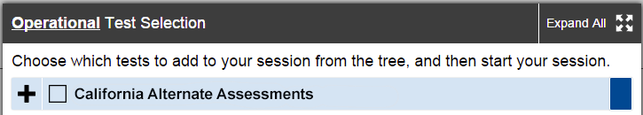
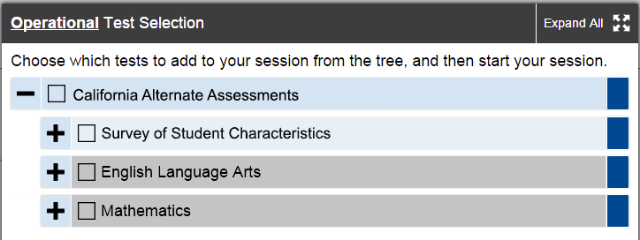
Step-by-Step: Starting a CAA (cont.)
Select tests to administer (beginning with the SSC):
  Note: The screenshots below show samples of the selection menus for the CAAs. Final menus may vary slightly from the samples below when testing launches on April 11, 2016.

Slide 81
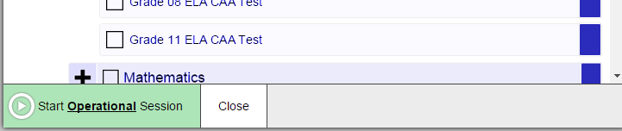
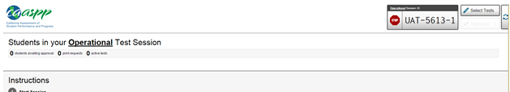
Step-by-Step: Starting a CAA (cont.)
Generate a Session ID by starting a test session.
Make note of the test Session ID that is created when a session is started.

Slide 82
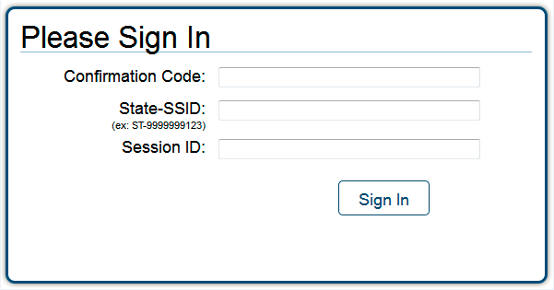
Step-by-Step: Starting a CAA (cont.)
On the student’s testing device, close all other applications, open the secure browser and log on to the student’s test session using the student’s first name, SSID, and Session ID:
    First Name (Confirmation Code): Student’s legal first name as spelled in CALPADS
    State-SSID: “CA” followed by a hyphen “-” and the student’s SSID
    Session ID: Generated
    in Step #5

Slide 83
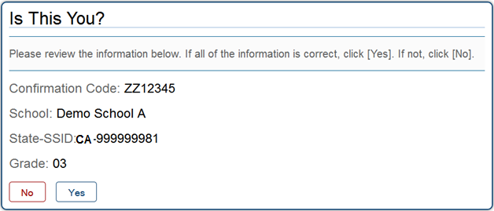
Step-by-Step: Starting a CAA (cont.)
Verify student identity:
  After logging student on, you will see the “Is This You?” screen.
  Select Yes to continue.

Slide 84
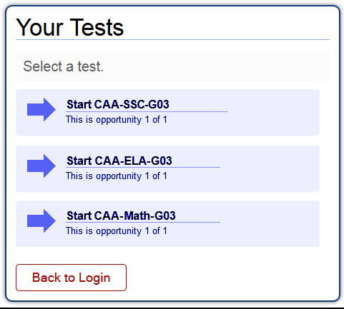
Step-by-Step: Starting a CAA (cont.)
Student interface displays only those tests selected from the Test Administrator Interface that match the student’s grade:
    Survey of Student Characteristics (SSC)
    ELA test
    Mathematics test
Note: The final display may vary slightly from this sample when testing launches on April 11, 2016.

Slide 85
Step-by-Step: Starting a CAA (cont.)
Test examiner completes the Survey of Student Characteristics (SSC).
Test examiner starts ELA or mathematics test and administers the Student Response Check (SRC):
  Completing the SRC is required for all students.
ELA and mathematics tests are untimed.
  A test examiner can provide breaks for the student as many times as necessary. (Pause and log out; return and create a new Session ID, and then log on again.)

Slide 86
Testing System Tips
The CAAs may be paused and resumed as many times as necessary to elicit the student’s best testing performance.
When a test is paused, you must log the student back on to resume testing. You will automatically be directed to the first page that has an unanswered item.
In the event of a technical issue (e.g., power outage or network failure), student’s test will be paused and the student will be logged off.
As a test security measure, student tests are automatically logged off after 30 minutes of test inactivity.

Slide 87
Testing System Tips (cont.)
Training tests are the best way to gain familiarity with the testing system and interactions.
CAAs are designed to be administered in the language of instruction. This can include, but is not limited to, braille, American Sign Language, and other languages.
  It is permissible for a test examiner or scribe to preview test items to prepare translations or other materials.
  Tests must be previewed and administered in segments because of the routing design.
    Segment 1: Items 1–11
    Segment 2: Items 12–21
    Segment 3: Items 22–27

Slide 88

Test Security

Slide 89
General Test Security Protocol
Follow the same security guidelines as for other CAASPP assessments.
Information about items, including DFA content, should not be shared with anyone not directly responsible for test administration.
DFAs and print-on-demand materials must be securely handled during the test administration and securely destroyed afterward.

Slide 90
Test Security Incidents
CAA security incidents are prohibited actions because they compromise the secure administration of the assessments.
Three types of test security incidents are:
  Impropriety
  Irregularity
  Breach
All test security incidents must be reported to the LEA CAASPP coordinator and/or the CAASPP test site coordinator.

Slide 91
Test Impropriety
  Unusual circumstance that has a low impact on the testing individual or group of students
  Low risk of affecting student performance, test security, or test validity
  Correctable and containable at local level
  Must be reported to the LEA CAASPP coordinator or the test site coordinator
  Coordinator must report the impropriety, using the Security and Test Administration Incident Reporting System (STAIRS) form within 24 hours of the incident

Slide 92
Test Irregularity
  Unusual circumstance that impacts the testing individual or group of students
  May affect student performance, test security, or test validity
  Correctable and containable at local level
  Must be reported to the LEA CAASPP coordinator or the test site coordinator
  Coordinator must report the irregularity, using the STAIRS form within 24 hours of the incident

Slide 93
Test Breach
  Event that threatens test validity (e.g., release of secure materials)
  Example: Test examiner takes a photograph and posts to social media
  Must be reported to the LEA CAASPP coordinator or the test site coordinator
  Coordinator must report the breach, using the STAIRS form within 24 hours of the incident

Slide 94
Test Security and Appeals
New: STAIRS (Security and Test Administration Incident Reporting System) requires LEA CAASPP coordinators and CAASPP test site coordinators to submit an online form to report an incident
  If an appeal is required, an e-mail will be sent instructing the coordinator to file an appeal in TOMS

Slide 95
Secure Testing Appeals Information Reporting System
LEA CAASPP coordinators and CAASPP test site coordinators are responsible for reporting all test security incidents in the STAIRS available at http://www.caasp.org.
An e-mail containing a case number and the next steps to be taken will be sent.
  In some cases, the e-mail may provide instructions to file a specific appeal in TOMS.
  Appeals cannot be filed TOMS without first reporting the incident in STAIRS.
Ensure that the e-mail address irregularities_appeals@cde.ca.gov is whitelisted.

Slide 96
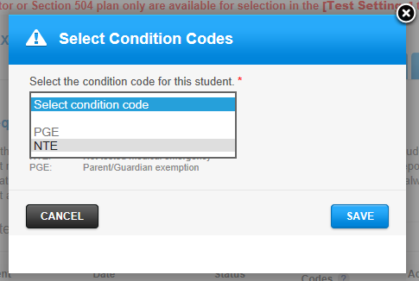
After Testing
CAASPP test site coordinators must ensure that all DFAs are collected and securely destroyed:
  Shred or otherwise destroy printed copies.
  Permanently delete electronic PDF copies from all devices.
As necessary, enter
any special testing
condition codes in
TOMS.

Slide 97

Scoring and Reporting

Slide 98
Scoring and Reporting
A single Student Score Report will be provided for students that includes results from the CAAs and CAPA for Science (grades 5, 8, and 10).
Score reports will be provided in the fall of 2016.
There will be opportunities for stakeholders, including educators and parents, to provide input on the CAA student score report design.

Slide 99
Resources
All CAA materials and resources (except the secure DFAs) will be available on the CAASPP CAA Web page at http://www.caaspp.org/about/caa/.
Key resources for CAAs:
  CAA Test Administration Manual (TAM)
  Training Test Directions for Administration (DFA)
    Will be paired for use with training tests when available.
  Version-specific, grade-level DFAs (SECURE)
  Test Administration Tutorial for test examiners

Slide 100
Support
CAASPPSupport@scusd.edu

Slide 101

Questions?

