Slide 1


Board Meeting
August 1, 2019
Agenda Item No. 10.2
Presented by:
Stephan Brown, Constituent Services Office (CSO)
Constituent Services Report

Slide 2
Constituent Services Mission
The CSO’s mission is to guide Sac City parents and community members on the most effective route to address and resolve their concerns.

Slide 3
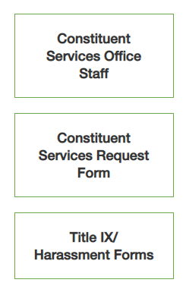
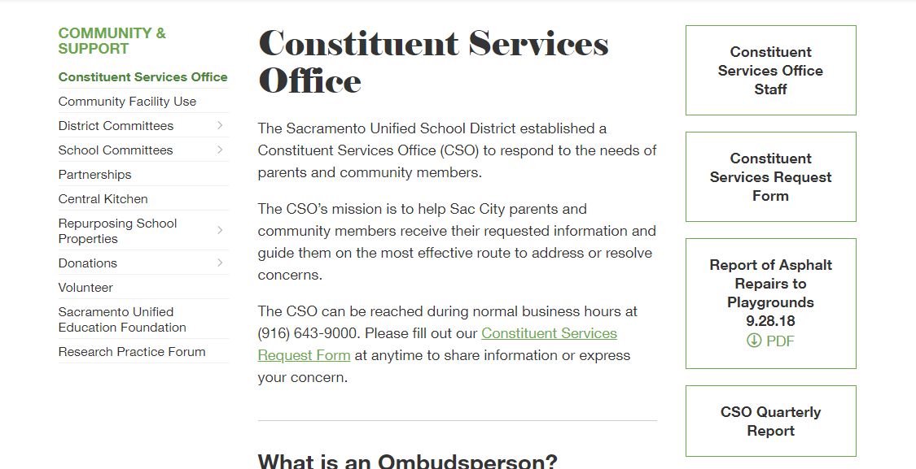
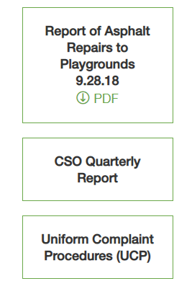

Slide 4
CSO Services
Facilitate Complaint Resolution
Support School Sites and Departments
Identify, Track and Report Trends
Develop and Propose Ideas for Goal Achievement

Slide 5
Contacts by Trustee Area
Trustee Area 1
Trustee Area 2
Leticia Garcia 195
Trustee Area 3
Christina Pritchett 213
Trustee Area 4
Michael Minnick 151
Trustee Area 5
Mai Vang 163
Darrell Woo 142
Trustee Area 6
Trustee Area 7
Jessie Ryan 145
Lisa Murawski 185
District General
District General 160

Slide 6
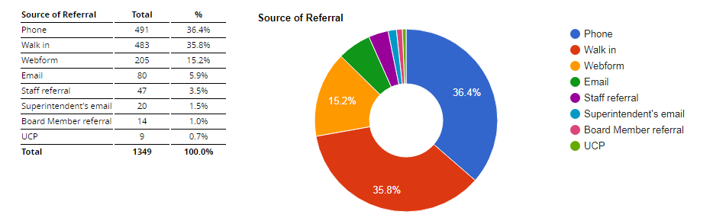
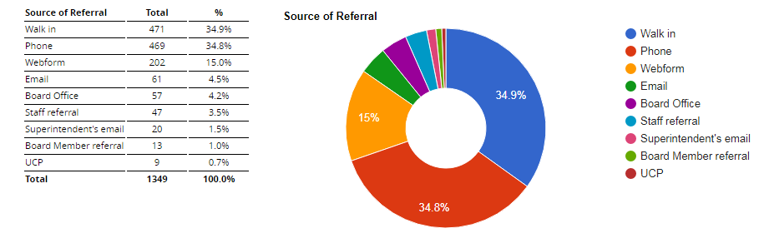
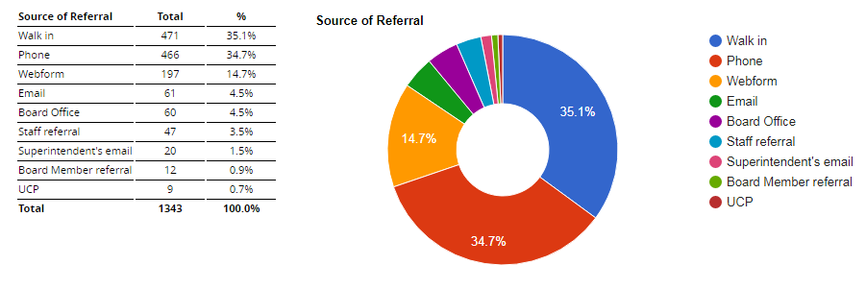
Method of Constituent Contact

Slide 7
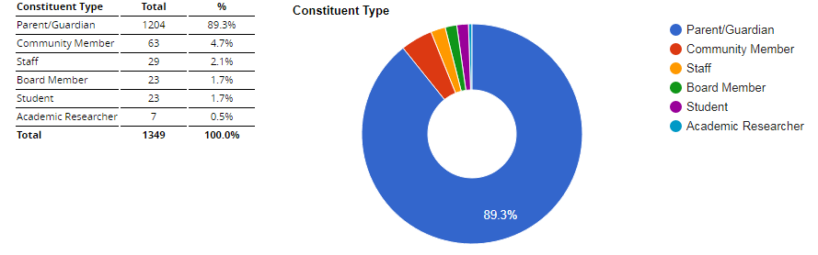
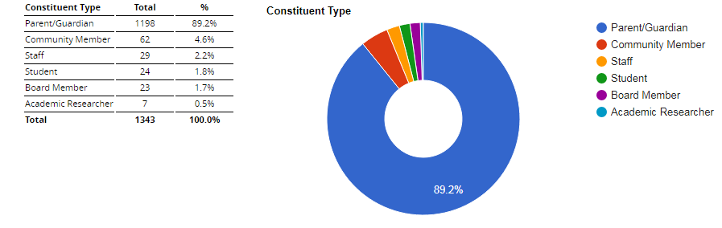
Source of Constituent Contact

Slide 8
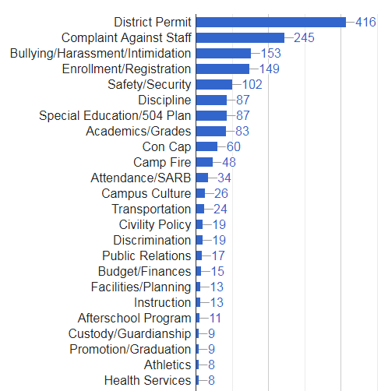
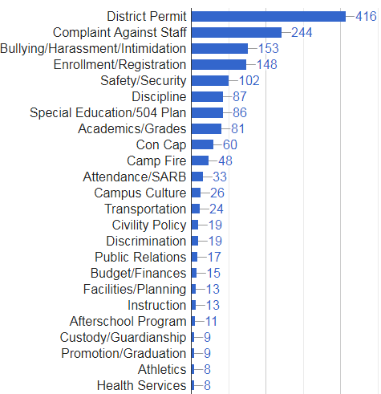
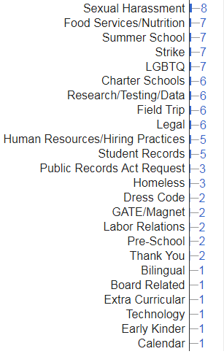
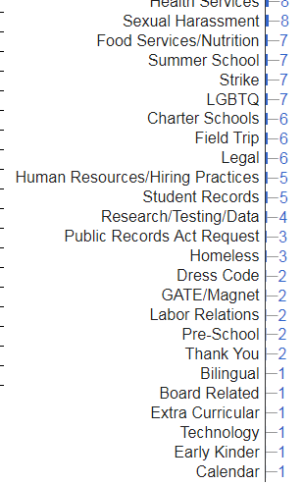
Constituent Services by Issue

Slide 9
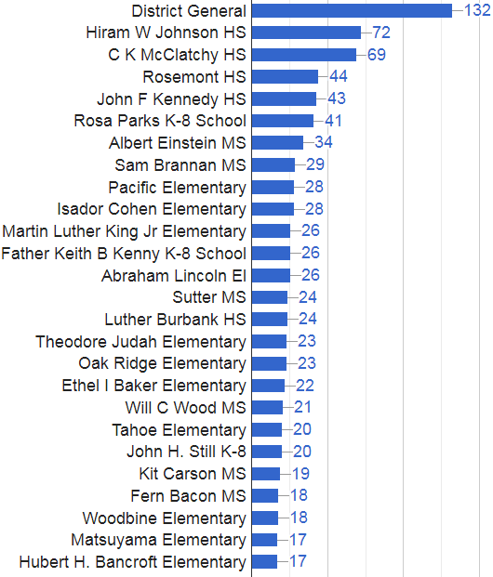
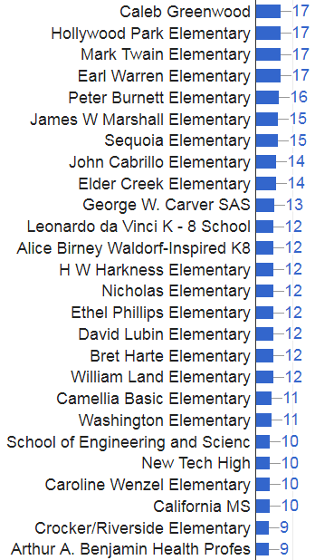
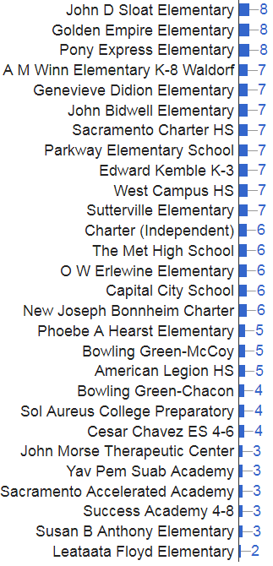
Constituent Services by School

