Slide 1
Approve the Submission of a Credential Waiver Application to the California Commission on Teacher Credentialing
Board Meeting
Date: January 19, 2023
Agenda Item No. 10.1
Presented by:
Tami Mora, Human Resources Audit & Compliance Analyst

Slide 2
Submission of a Credential Waiver Application to the California Commission on Teacher Credentialing
Education Code EC §44253.3 allows school districts to waive a portion of the requirement for a Certificated teacher in order to allow time for program completion
California Commission on Teacher Credentialing (CCTC) requires that every waiver request go through a public notice process at the local level and must be Board approved in a public meeting prior to the submission of the employing agency to CCTC

Slide 3
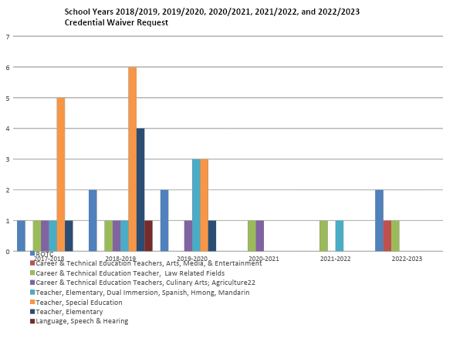

Slide 4
Submission of a Credential Waiver Application to the California Commission on Teacher Credentialing
A waiver is being requested for the following Career and Technical Education (CTE) teacher, as they complete their Clear Credential requirements, which will include English Language Authorizations (ELA):
Steven Tsuyuki, CTE credential in Public Service
(Luther Burbank High School)

Slide 5
Submission of a Credential Waiver Application to the California Commission on Teacher Credentialing
Specially Designed Academic Instruction Delivered in English (SDAIE) to English Learners (EL) is the area being requested in the waiver this evening.
This waiver will enable this teacher the opportunity to complete the requirements set forth by CTC and to remain in their positions while they continue their work with students.
Staff recommends approving this waiver request.

Slide 6
Q&A

