Slide 1
District English Language Advisory Committee (DELAC)
Wednesday, November 16, 2022
Notes:
Maria
Introduce our new coordinators
Introduce the DELAC leadership team
Welcoming remarks

Slide 2
Inclusive Opener
If you had the opportunity to be anywhere in the world, where would you be?
(Type your response in the chat.)
Notes:
Flor

Slide 3
DELAC Representative
Roll Call
Notes:
Vitalina–
Participants type their name, last name and name of the school they are representing.
For example, I am Olga Simms, Bowling Green Chacon Elementary.

Slide 4
Roll Call Attendance
Please take a moment to type your name and school in the chat.
Notes:
Vitalina

Slide 5
Simultaneous interpretation
If you do not require language interpretation, please click the globe icon and select English.
Haga clic en el icono del globo terráqueo y seleccione su idioma de preferencia
Thov nyem rau ntawm lub ntiaj teb lub cim thiab xaiv koj cov lus nyiam
請點擊地球圖標並選擇您的語言偏好
Vui lòng nhấp vào biểu tượng quả địa cầu và chọn ngôn ngữ của bạn
Нажмите на значок земного шара и выберите предпочтительный язык.
Notes:
Flor

Slide 6
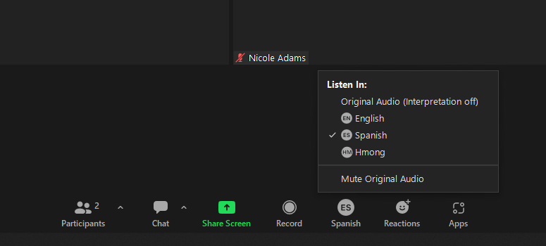
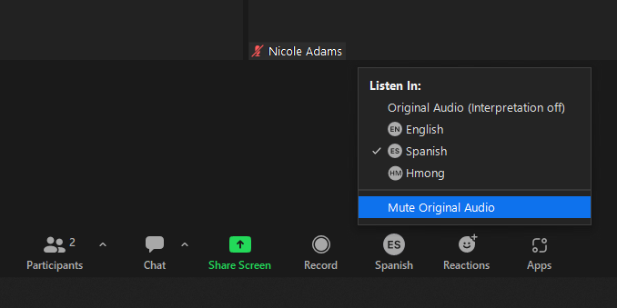
Language Translation Function
Notes:
Vlasti

Slide 7
This DELAC meeting is being recorded.
Should you stay, note that you are consenting to being recorded.
Notes:
Flor

Slide 8
Zoom Norms
It is up to you if you want your camera on or off. We encourage cameras to be on when participating, but you can decide for yourself.
Please mute your microphone when you are listening.
If you have a question or comment, please raise your hand (virtual icon or hold your hand up to the camera) and wait for the moderator to call on you. Please do not interrupt.
You can use the chat to write your question or comments, or to notify us if you’d like a turn to speak. You are welcome to write in your preferred language.
Please be respectful of everyone’s time.
If you are having audio or internet connectivity issues, please write your question or comment in the chat instead.
If you would like to contact District English Learner Advisory Committee (DELAC), you can email DELAC@scusd.edu
Notes:
Flor

Slide 9
Approval of Meeting Minutes
May 2022 Meeting Minutes
October 2022 Meeting Minutes
Notes:
Vitalina

Slide 10
Agenda
District English Learner Advisory Committee (DELAC)
Wednesday, November 16, 2022
5:30-7:30 PM
AGENDA
Welcome, Introductions/Bienvenida e introducciones ( Maria, 5 minutes)
Inclusive Opener/Apertura Inclusiva (Flor, 3 min.)
DELAC Norms Review & Update/Normas DELAC y Repaso (Flor, 5 minutes)
DELAC Representative Attendance/Asistencia DELAC (Vitalina, 5 minutes)
Language Translation/Traducciones (Vitalina, 5 min)
DELAC Survey Results/ Resultados de la encuesta (Maria, 5 min.)
Understanding Diverse Language Learner and Speakers in Our District (Dr. Villanueva/Dr. Krbecek, LTEL Data) (20 min.)
Break/Receso (5 min.)
College and Career Readiness Presentation/Preparacion universitaria y profesional (Christina Espinoza, 15 min.)
ESL/Clases de Ingles Presentation Charles A. Jones Skills Center (10 min.)
Public Comment/Comentario Publico
Upcoming Events/proximos eventos/Eventos
Optimistic Closure/Clausura optimistica
Notes:
Maria

Slide 11
Needs Assessment
Needs Assessment Results Review
Adult Services
Adult Education
English as a Second Language (ESL)
Parent Participation
Laws Every Student Succeeds Act
College Prep
Graduation requirements
Advanced Learning: Honors, AP, GATE, IB
World Language Tests
Seal of Biliteracy
Notes:
Maria/Olga
Servicios para adultos:
Escuela para adultos
Clases para aprender Inglés
Participación de padres en las escuelas
La ley Every Student Succeeds
Preparación para la universidad/colegio
Sistema de calificación
Programa avanzada (honores, colocación avanzada, bachillerato internacional)
Asesoramiento académico (tutoría, intervención, horarios)
Desafío de idiomas del mundo

Slide 12
Needs Assessment
Education Policy
Grading
Social Emotional Learning
State Assessments (ELPAC, CAASPP)
School Safety
Multilingual Programs
Notes:
Polizas de Educación
Sistema de calificación
Aprendizaje Socio emocional
Evaluaciones de estudiantes
Comité Asesor de Estudiantes de Inglés (ELAC)
Seguridad Escolar
Programas multilingues

Slide 13
Presentation:
Part I: Understanding Diverse Language Learners and Speakers in our District

Slide 14
Time for a 5 min Break!!
Notes:
Maria

Slide 15
Presentation: College and Career Readiness
Notes:
Vitalina

Slide 16
Presentation: ESL Classes
Notes:
Vitalina

Slide 17
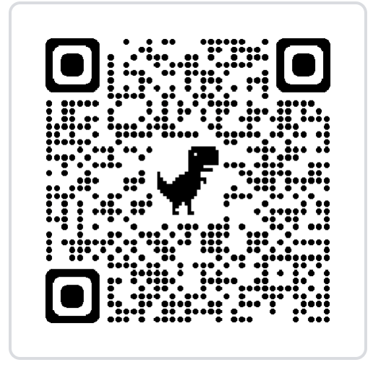
Public Comment
Public Comment
Notes:
Maria

Slide 18
Upcoming Events
DELAC Meeting
Wednesday, January 18, 2023 @ 5:30-7:30 p.m. (Hybrid)
SCUSD Board of Education Meeting
Thursday, November 17 @ 6:30 p.m. (In Person)
Thursday, December 15 @ 6:30 p.m. ( In Person)
Notes:
Maria

Slide 19
Optimistic Closure-What’s your ‘go-to’ nonverbal connection?
Notes:
Maria

Slide 20
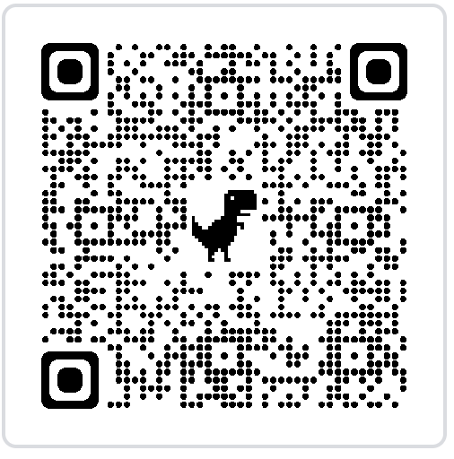
Feedback
https://forms.gle/2vrPXHreXFUB6cbF8

