Slide 1
District English Language Advisory Committee
DATE : April 15, 2024
TIME: 5:30-7:30 PM
South Carolina Meeting Room

Slide 2
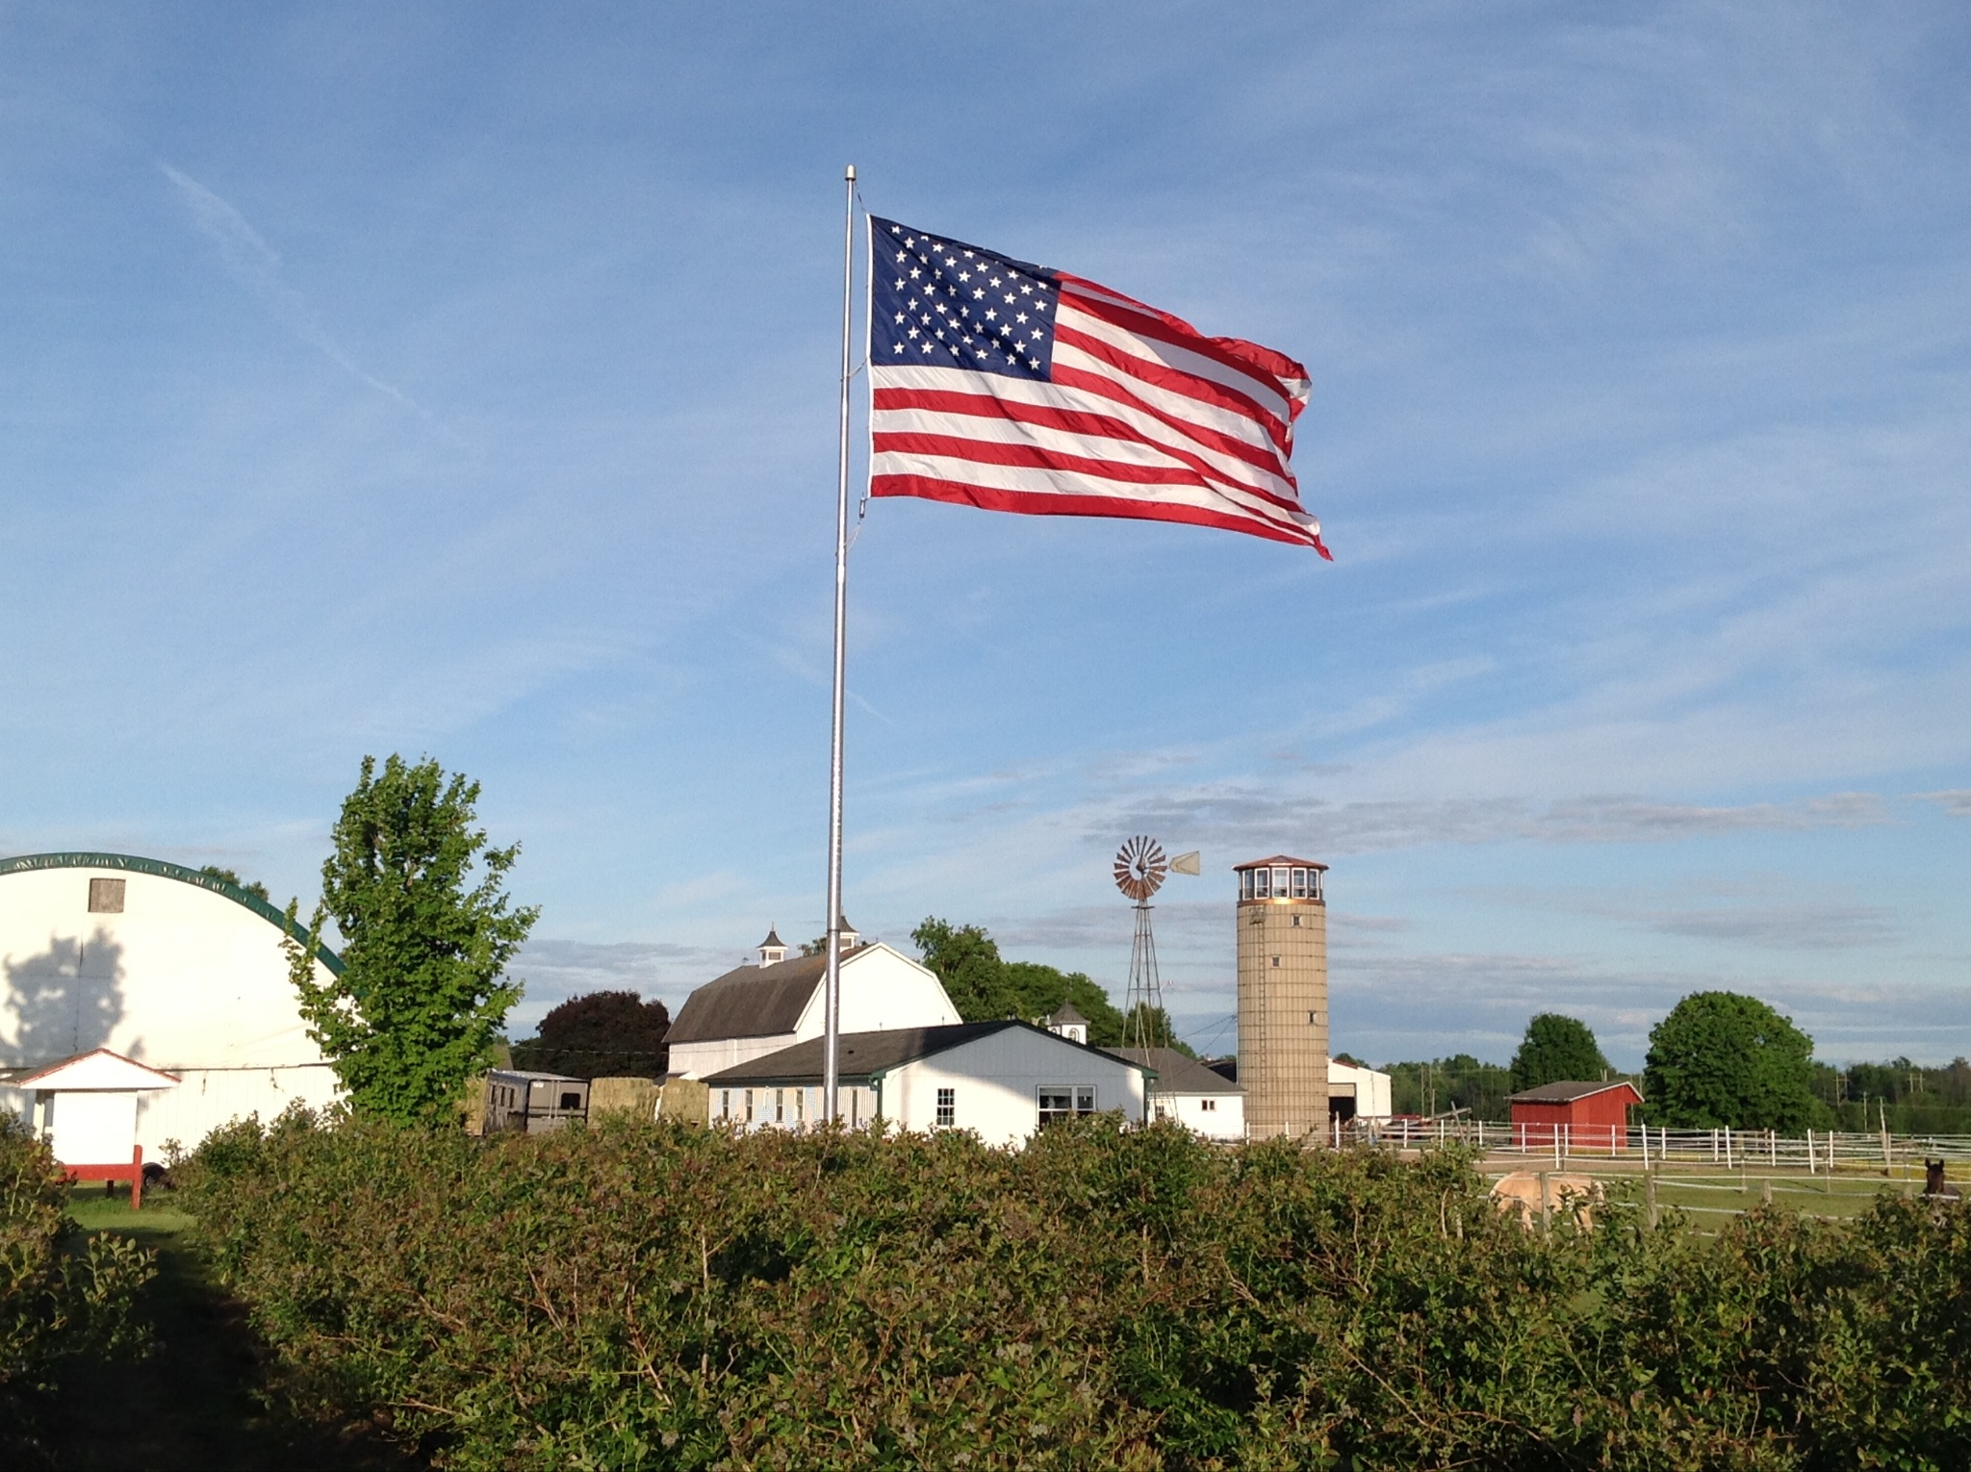
Pledge of Allegiance
Notes:
Mr. MD

Slide 3
Multilingual Literacy Department Outcomes
All emergent bilingual students improve on their overall Summative ELPAC Assessments by at least one performance level.
All emergent bilingual students improve on their CAASPP ELA assessments noted by the student’s scale score (3-8th CAASPP, 11th CAASPP);iReady ELA
Increase reclassification by 10% on a yearly basis.
90% of EBs will graduate from high school.
80% of High School Emergent bilingual students will be on track for college and career (students meeting A-G requirements).
All schools serving at least 21 or more emergent bilingual students will have a functional English Language Advisory Committee (ELAC).
Notes:
Mr. MD

Slide 4
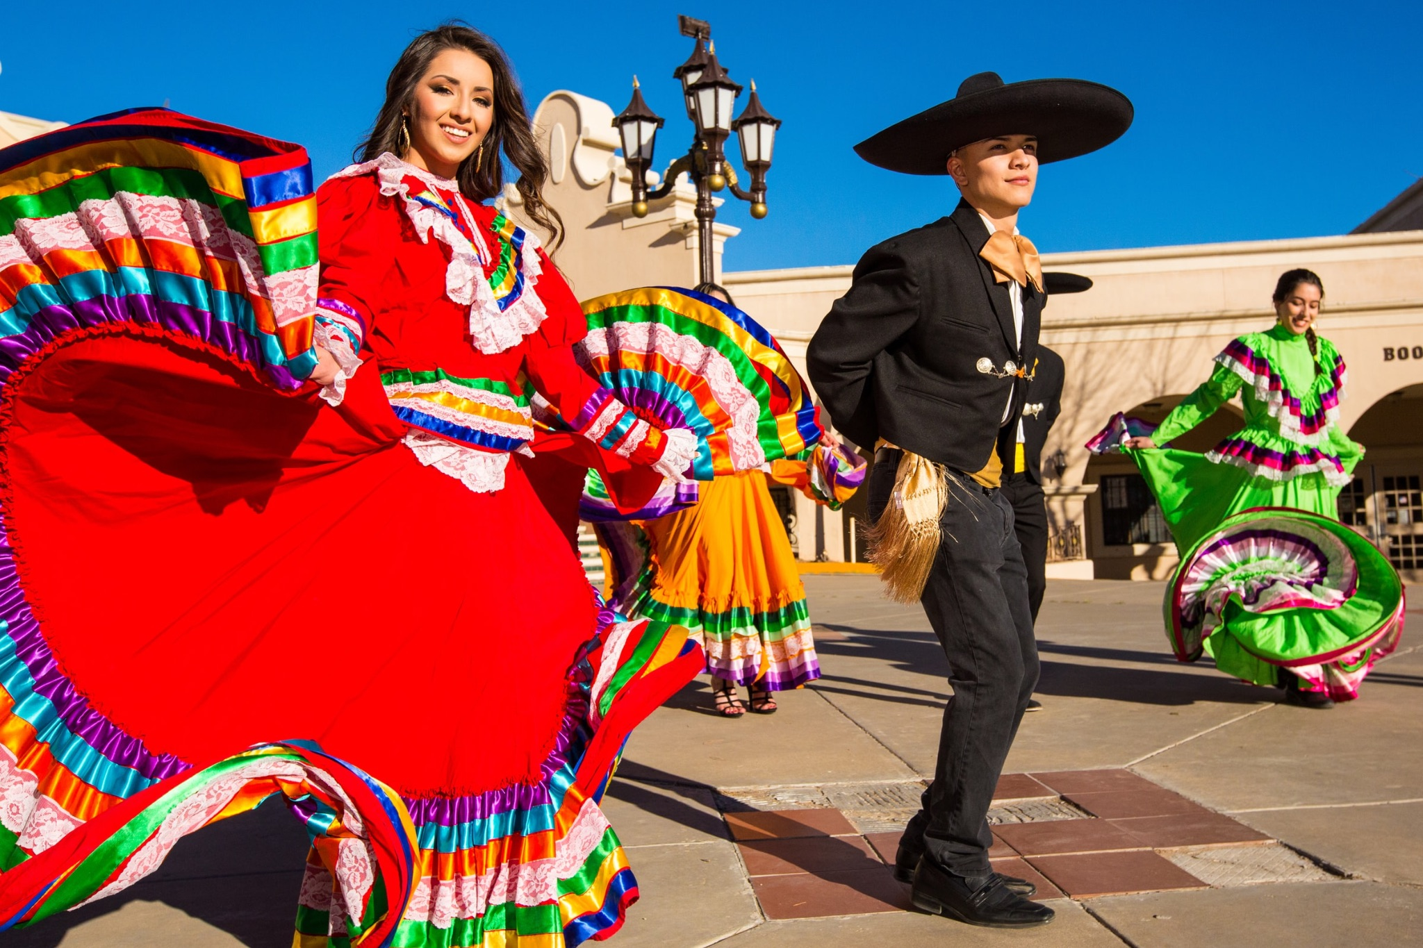
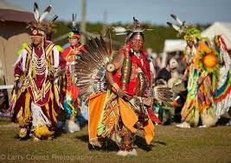
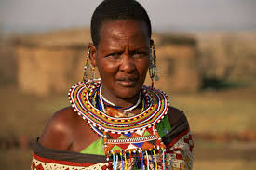
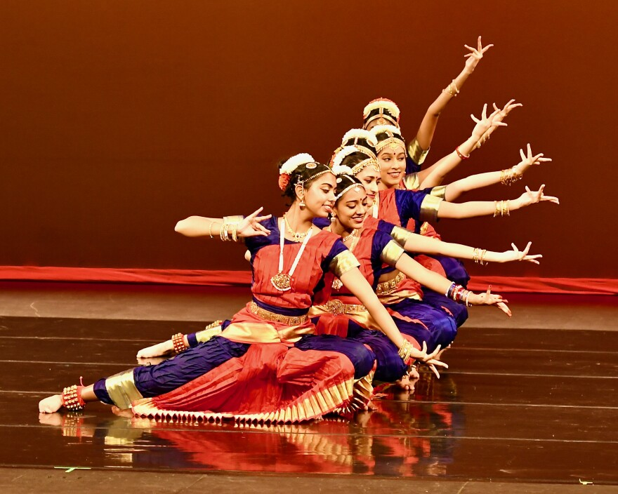

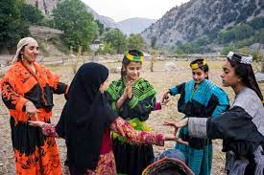
COMMUNITY CONNECTOR: What is your favorite culture? Why?
Notes:
Mrs. Anita

Slide 5

DELAC REPRESENTATIVE ROLL CALL
Notes:
Ms. Sujey

Slide 6
APPROVAL OF MEETING MINUTES
Monday, April 15, 2024
https://drive.google.com/file/d/12P5negQnS500nXshQTt8g8LfsO7IpA8V/view?usp=sharing
Notes:
Mr.K will link the notes Mr. MD

Slide 7
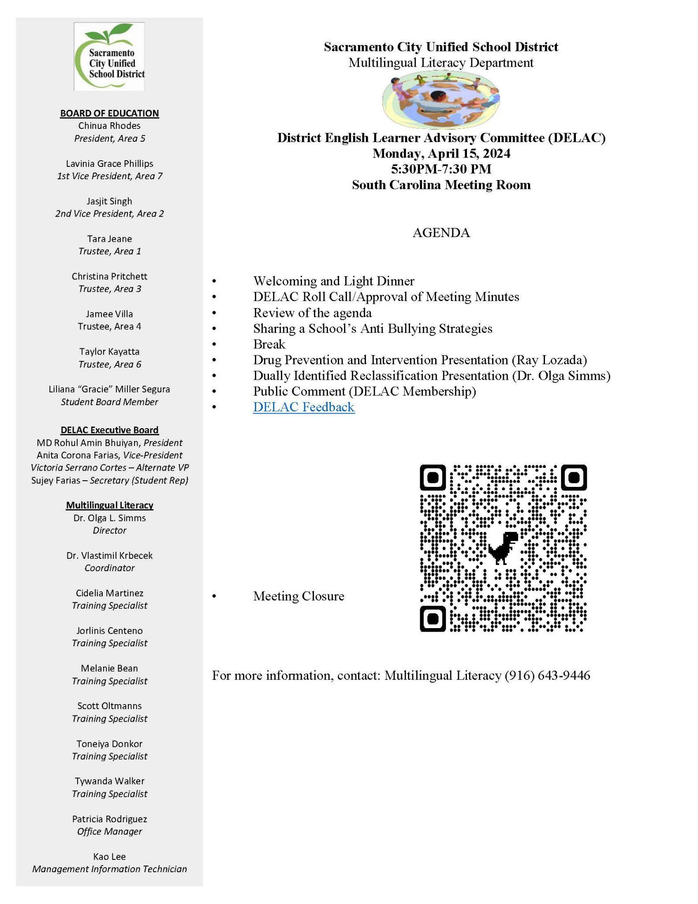

Slide 8
Sharing a School’s Anti Bullying Strategies
Mary Cha
Notes:
Mr. MD

Slide 9

BREAK: 10 Minutes
9
Notes:
Mrs. Anita and Sujey

Slide 10
Drug Prevention and Intervention Presentation
Ray Lozada
Notes:
Mr. MD

Slide 11
Dually Identified Reclassification Presentation
Notes:
Ms. Sujey

Slide 12
PUBLIC COMMENT
Notes:
Mrs. Anita and Mr. MD

Slide 13
Public Comment
DELAC PUBLIC COMMENT

Slide 14
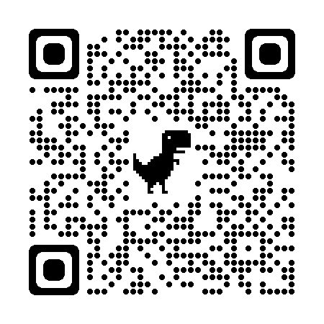
DELAC Feedback QR CODE
DELAC FEEDBACK LINK
Notes:
Mr. MD

Slide 15

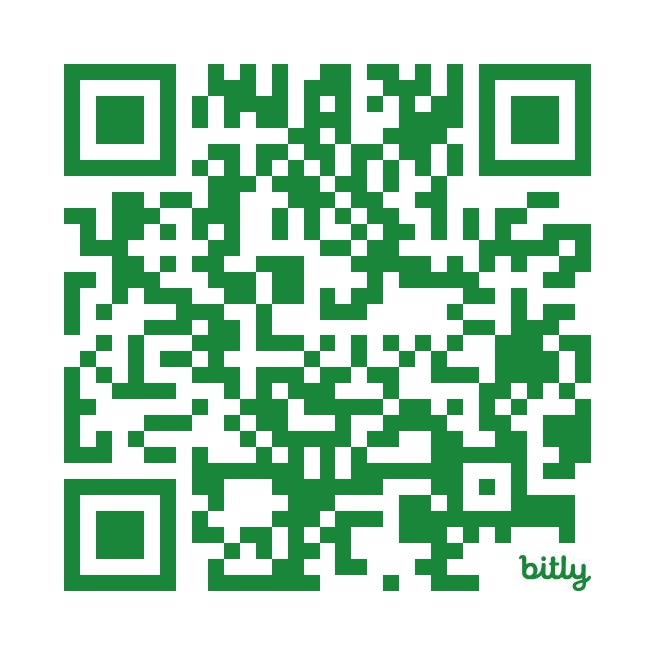
Parent Field Trip CSUS
This field trip will be covering the following topics:
1. Campus Tour
2. Detailed information about Admissions
3. Additional resources which we will share in the future.
https://bit.ly/4cI2LzB

Slide 16

Upcoming Meetings:
MPAC- Zoom Meeting
Monday, April 22nd, 6:00 p.m. - 7:30 p.m.
zoom jorlinis-centeno@scusd.edu
SCUSD BOARD MEETINGS- Community Rooms
Thursday, April , 6:30 p.m.
Notes:
Mr. MD and Ms. Victoria

