Slide 1
District English Language Advisory Committee
DATE : February 05, 2024
TIME: 5:30-7:30 PM
South Carolina Meeting Room

Slide 2
Big bold statement slide
Every system is perfectly designed to get the results it gets
SCUSD Core Value
We recognize that our system is inequitable by design and we vigilantly work to confront and interrupt inequities that exist to level the playing field and provide opportunities for everyone to learn, grow and reach their greatness.
SCUSD GUIDING PRINCIPLE
All students are given
an equal opportunity to graduate with the greatest number of postsecondary choices
from the widest array of options

Slide 3
SCUSD Five Strategic Priorities
High Quality Instruction to Meet the Needs of all Students with a Focus on Students Least Well Served
Multi-Tiered System of Supports (MTSS)
Culturally Responsive Professional Learning
Effective Talent Programs Focused on Recruitment & Retention in Service of High Quality Instruction
Network Upgrades and Centralized Workforce Processes; Including HR Enhancements in Service of High Quality Instruction

Slide 4
Multilingual Literacy Department Outcomes
All emergent bilingual students improve on their overall Summative ELPAC Assessments by at least one performance level.
All emergent bilingual students improve on their CAASPP ELA assessments noted by the student’s scale score (3-8th CAASPP, 11th CAASPP);iReady ELA
Increase reclassification by 10% on a yearly basis.
90% of EBs will graduate from high school.
80% of High School Emergent bilingual students will be on track for college and career (students meeting A-G requirements).
All schools serving at least 21 or more emergent bilingual students will have a functional English Language Advisory Committee (ELAC).

Slide 5
COMMUNITY CONNECTOR: Your favorite place to find relaxation is…

Slide 6
DELAC REPRESENTATIVE ROLL CALL

Slide 7
APPROVAL OF MEETING MINUTES
Monday, December 18, 2023 (English)

Slide 8
AGENDA
5:30-5:35 p.m. | Welcoming and Light Dinner Visit with Santa | Dr. Simms
5:35-5:40 p.m. | DELAC Roll Call | Patricia/Jo
5:40-5:45 p.m. | Review of the agenda | Dr. Krbecek
5:45-6:00 p.m. | Literacy Strategies for Parents | Toneiya Donkor, Training Specialist
6:00-6:10 p.m. | BREAK

Slide 9
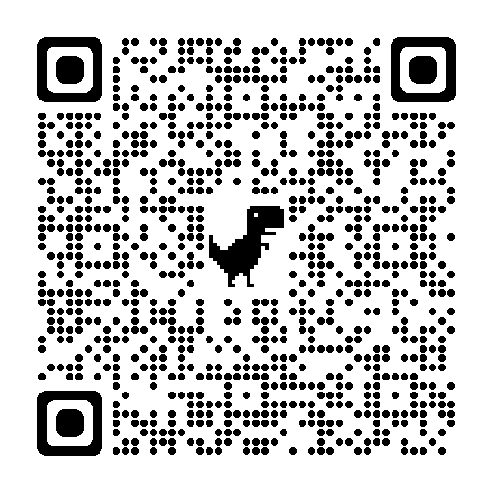
Agenda
6:10-7:00 p.m. | Reports: DELAC Announcement of Officers (Dr. Krbecek) English learner school attendance rates (Dr. Simms) | Dr. Simms/Dr. Krbecek
7:00-7:15 p.m. | Public Comment | DELAC Membership
7:15-7:30 p.m | DELAC Feedback Meeting Closure | Dr. Simms

Slide 10
Literacy Strategies for Parents

Slide 11
Literacy Strategies

Slide 12
BREAK: 10 Minutes
12

Slide 13
DELAC Officer Announcement

Slide 14
DELAC Officer Announcement

Slide 15
English Learner Student Attendance

Slide 16
Student Attendance and Chronic Absenteeism
PACE, 2024

Slide 17
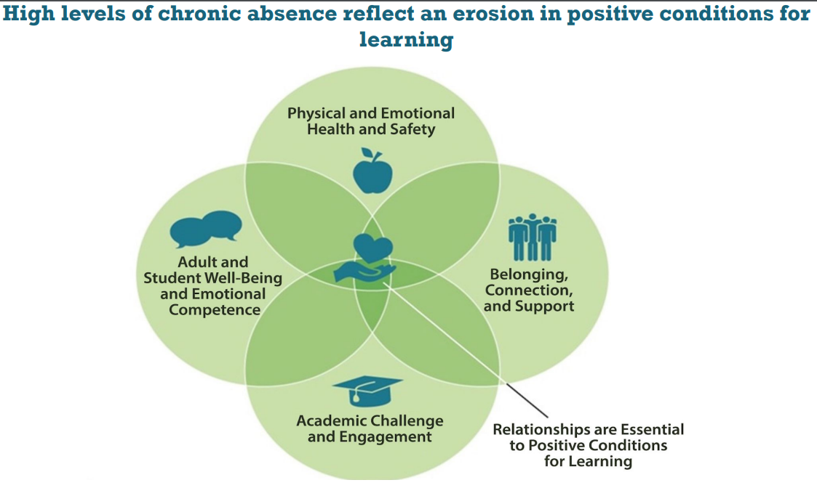
Why is monitoring attendance important?
www.attendanceworks.org

Slide 18
English Learner Student Attendance–Attendance Rate

Slide 19
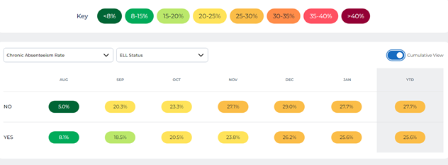
English Learner Student Attendance–Chronic Absenteeism

Slide 20
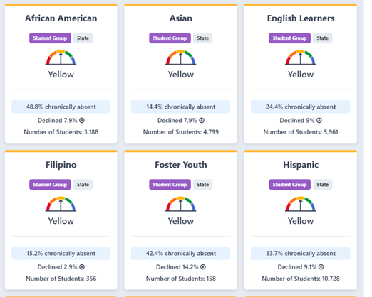
California Dashboard Attendance Metric

Slide 21
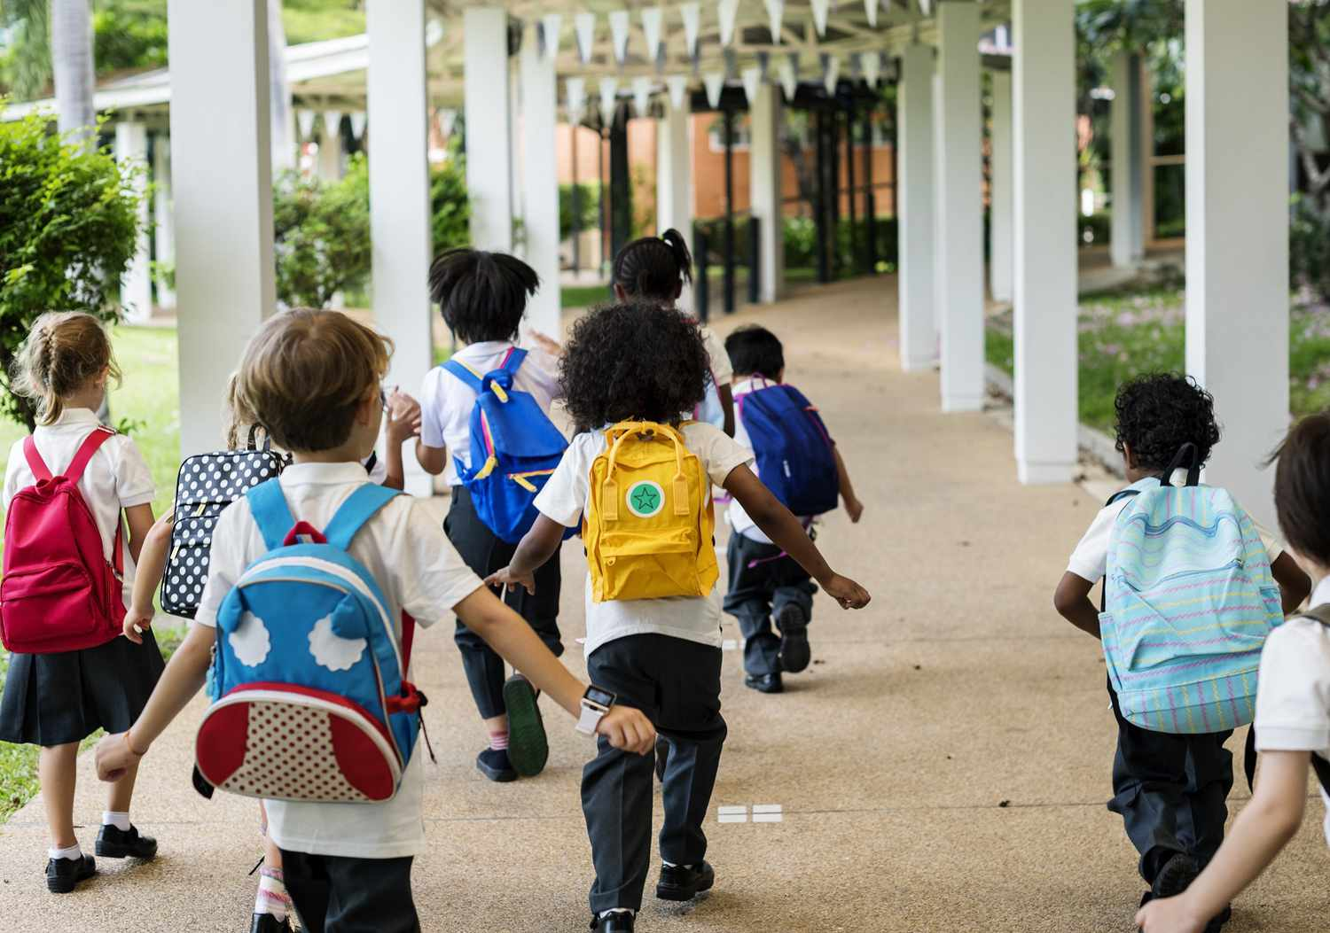

Slide 22
Needs Assessment Results
1. Importance of Regular School Attendance
2. Strategies/Questions for Parent-Teacher
3. Bullying/Cyber Bullying
4. Study Skills, homework strategies
5. Reclassification

Slide 23
PUBLIC COMMENT

Slide 24
Public Comment
DELAC PUBLIC COMMENT

Slide 25
Breathe and Exhale (4 Times)
Notes:
We will continue to work on communication skills

Slide 26
DELAC FEEDBACK

Slide 27
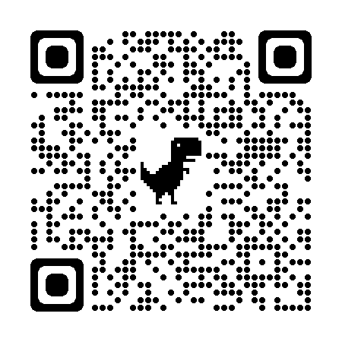
DELAC Feedback QR CODE
DELAC FEEDBACK LINK

Slide 28
Big quote
“Multilingualism promotes culture. A culturally diverse child is better prepared to participate and compete in a global society.”
–Maritere Bellas, Latina Author & Parenting Expert

Slide 29
Community Closing Activity
GRATITUDES…

Slide 30
Upcoming Meetings:
DELAC-South Carolina Room
Monday, March 18, 5:30-7:30 p.m.
Monday, April 15, 5:30-7:30 p.m.
MPAC- Zoom
Monday , February 23th , 6:00 p.m. - 7:30 p.m.
Monday , March 25 th , 6:00 p.m. - 7:30 p.m.
Monday, April 22nd, 6:00 p.m. - 7:30 p.m.
SCUSD BOARD MEETINGS- Community Rooms
Thursday, February 1, 6:30 p.m.
Thursday, February 15, 6:30 p.m.
Thursday, March 7, 6:30 p.m.
JOINT PAC/BAAAB/CAC/DELAC Mtg.-South Carolina
Monday, January 22nd, 6-8 p.m.

