Slide 1

District English Language Advisory Committee
DATE : December 5, 2024
TIME: 5:30-7:30 PM
Notes:
Sujey and Anita

Slide 2




COMMUNITY CONNECTOR:
Gratitud (Gratitude)
Ahora que se acercan los días festivos, ¿qué es lo que más agradece por esta temporada navideña?
As the holidays are upon us what are you most thankful for this Holiday season?
Notes:
Suje

Slide 3
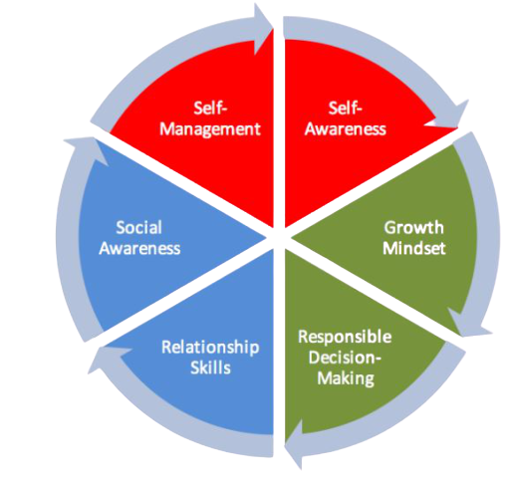

OUR INVITATION
To Engage in Anti-Bias/Anti-Racist/
Trauma-Informed Work
Identity | Be present as fully as possible.
Agency | Attend to equity of voice and speak your truth.
Belonging | You belong in this community exactly as you are.
Collaborative Problem Solving | Build on the cultures of collaboration that exist in our community.
Curiosity | When the going gets rough, turn to wonder.
Notes:
Intent: How we engage in today’s session with an Anti-Bias/Anti-Racist/Trauma-Informed lens
Speaker notes:
We invite you to participate so that we can all learn from each other.
This is our invitation for you to reflect on how you want to engage in our session today through an anti-bias/anti-racist/trauma informed lens. Please take a moment to review and then pick one that resonates with you and how you would like to engage in today’s session. (you can have 1-2 people share out/ or have them share with a partner)

Slide 4

2024-25 DELAC REPRESENTATIVE ROLL CALL
Notes:
Mr. Ahmadzai

Slide 5

APPROVAL OF MEETING MINUTES
October 17, 2024 Meeting Minutes (English)
Notes:
Marcela

Slide 6
AGENDA
5:30 - 5:40 p.m. | Welcoming and introduction of MLD Team and DELAC representatives | DELAC officers
5:40 - 5:45 p.m. | DELAC Roll Call | DELAC officers
5:45 - 5:50 p.m. | Review of the agenda | DELAC officers
5:50 - 6:00 p.m. | EL Reclassification Data Updates | Dr. Krbecek
6:00 - 6:30 p.m. | ELPAC Presentation | Dr. Isais/ Dr. Krbecek
6:30 - 6:40 p.m. | BREAK
6:40 - 7:10 p.m. | EL Master Plan Presentation | Dr. Simms
7:10 - 7:20 p.m. | Public Comment | DELAC Membership
7:20 - 7:30 p.m | DELAC Elections DELAC Feedback Meeting Closure | DELAC Officers
Notes:
Suje and Anita

Slide 7
EL Reclassification Data At A Glance
Dr. Krbecek
Notes:
Nangialy

Slide 8
Multilingual Literacy Department Outcomes
All emergent bilingual students improve on their overall Summative ELPAC Assessments by at least one performance level.
All emergent bilingual students improve on their CAASPP ELA assessments noted by the student’s scale score (3-8th CAASPP, 11th CAASPP);iReady ELA
Increase reclassification by 10% on a yearly basis.
90% of EBs will graduate from high school.
80% of High School Emergent bilingual students will be on track for college and career (students meeting A-G requirements).
All schools serving at least 21 or more emergent bilingual students will have a functional English Language Advisory Committee (ELAC).

Slide 9
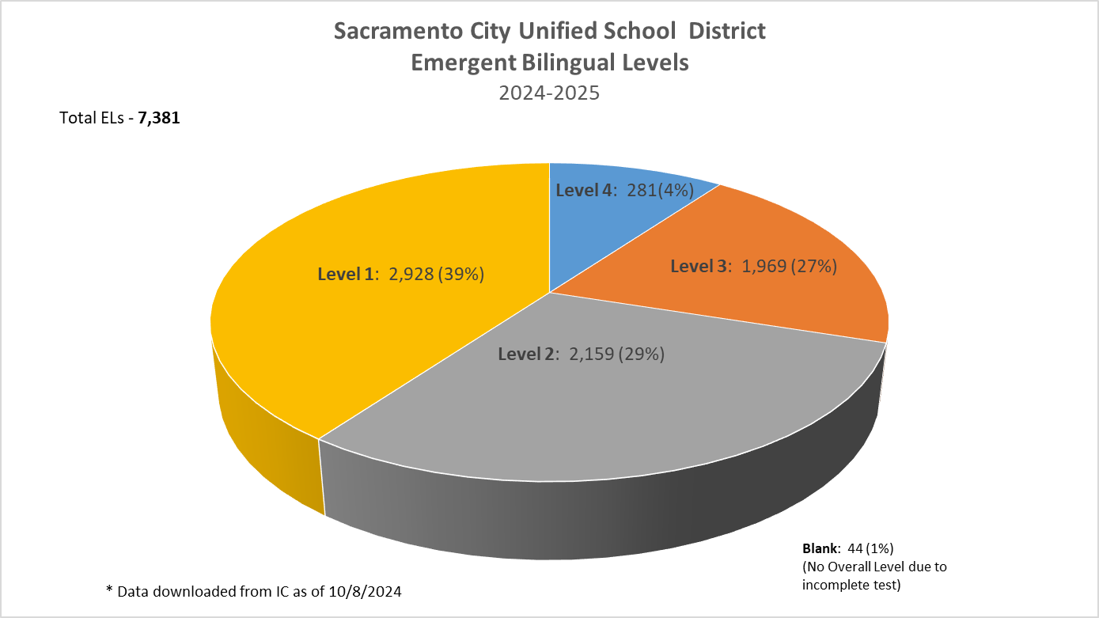

Slide 10
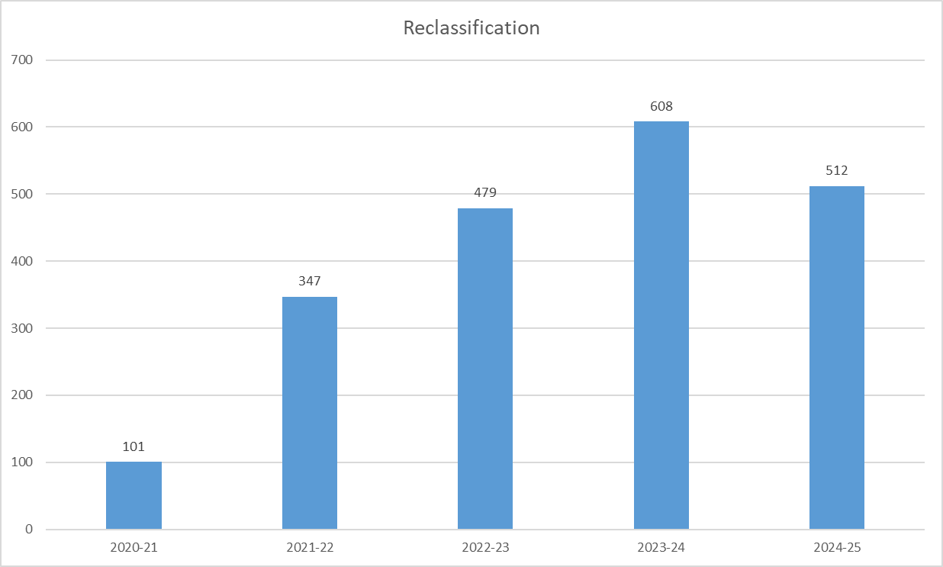
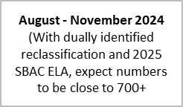
RECLASSIFICATION
School Year | Number of Emergent Bilingual Students
2020-21 | 101
2021-22 | 347
2022-23 | 479
2023-24 | 608 (111 are dually identified)
2024-25* | 480 (2 are dually identified - 1st Wave) 32 additional (with November iReady) —--------------------------- Total: 512 reclassified so far. (Still on-going until June 2025)
**This data reflects what MLD has identified through the process of reclassification as of November 2024. This is not reflective of CDE Dataquest.

Slide 11
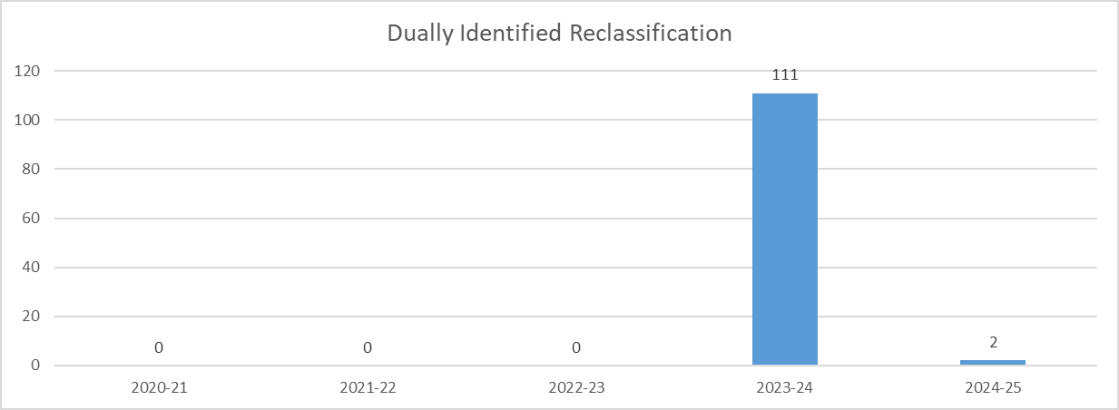
Dually Identified RECLASSIFICATION
School Year | Number of Dually Identified Students
2020-21 | 0
2021-22 | 0
2022-23 | 0
2023-24 | 111
2024-25* | 2 (Still on-going until June 2025)
August - November 2024
(Once schools start holding IEP Meetings, we expect this number to be around 120+ students)
**This data reflects what MLD has identified through the process of reclassification as of November 2024. This is not reflective of CDE Dataquest.

Slide 12
ELPAC
Dr. Isais/ Dr. Krbecek
Notes:
Marcela

Slide 13

BREAK: 10 Minutes
13
Notes:
Anita

Slide 14
EL Master Plan
Dr. Simms
Notes:
Marcela

Slide 15
DELA Elections
DELAC Elections / Nominee Introductions
Notes:
Anita and Suje

Slide 16
PUBLIC COMMENT
Notes:
Marcela

Slide 17
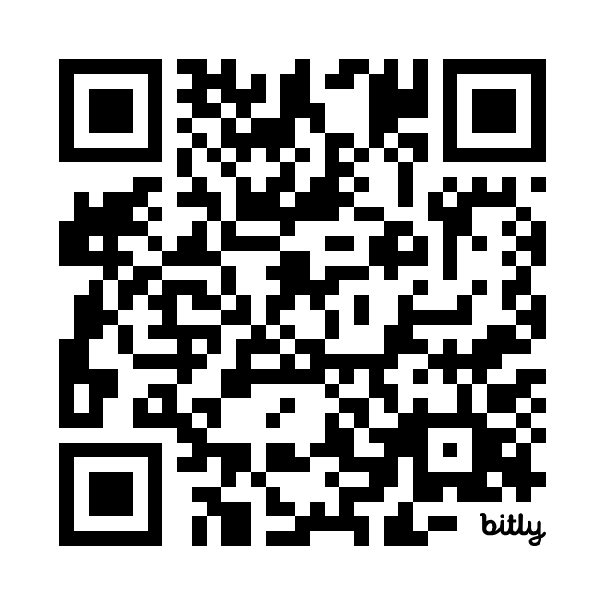
Public Comment
DELAC PUBLIC COMMENT

Slide 18

Notes:
We will continue to work on communication skills

Slide 19
Upcoming Meetings
DELAC
Thursday, January 30, 5:30-7:30 p.m.
Thursday, March 13, 5:30-7:30 p.m.
Thursday, May 22, 5:30-7:30 p.m.
MPAC
Monday , December 9th, 6:00 p.m. - 7:30 p.m. ( through zoom)
Monday , February 10th , 6:00 p.m. - 7:30 p.m. (through zoom)
Monday , March 10 th , 6:00 p.m. - 7:30 p.m.
Monday, April 14th, 6:00 p.m. - 7:30 p.m.
SCUSD BOARD MEETINGS
Thursday, December 19, 6:30 p.m.
Thursday, January 16, 2025 , 6:30 p.m.
Thursday, February 6, 2025, 6:30 p.m.
Thursday, February 20, 2025, 6:30 p.m.
Thursday, March 6, 2025, 6:30 p.m.
Thursday, March 20, 2025, 6:30 p.m.
Thursday, April 3, 2025, 6:30 p.m.
Thursday, April 10, 2025 , 6:30 p.m.
Thursday, May 1, 2025, 6:30 p.m.
Thursday, May 15, 2025, 6:30 p.m.
Thursday, June 5, 2025, 6:30 p.m.
Thursday, June 26, 2025, 6:30 p.m.
Notes:
Nangialy

Slide 20

Notes:
Marcela

Slide 21
DELAC FEEDBACK
Notes:
Mrs. Anita and Suje

Slide 22
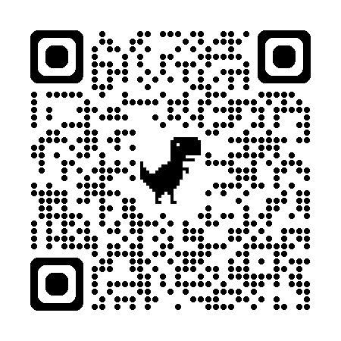
DELAC Feedback QR CODE
DELAC FEEDBACK LINK

Slide 23

Community Closing Activity

