Slide 1
District English Language Advisory Committee
DATE : December 18, 2023
TIME: 5:30-7:30 PM
South Carolina Meeting Room

Slide 2
Big bold statement slide
Every system is perfectly designed to get the results it gets
SCUSD Core Value
We recognize that our system is inequitable by design and we vigilantly work to confront and interrupt inequities that exist to level the playing field and provide opportunities for everyone to learn, grow and reach their greatness.
SCUSD GUIDING PRINCIPLE
All students are given
an equal opportunity to graduate with the greatest number of postsecondary choices
from the widest array of options

Slide 3
SCUSD Five Strategic Priorities
High Quality Instruction to Meet the Needs of all Students with a Focus on Students Least Well Served
Multi-Tiered System of Supports (MTSS)
Culturally Responsive Professional Learning
Effective Talent Programs Focused on Recruitment & Retention in Service of High Quality Instruction
Network Upgrades and Centralized Workforce Processes; Including HR Enhancements in Service of High Quality Instruction

Slide 4
Multilingual Literacy Department Outcomes
All emergent bilingual students improve on their overall Summative ELPAC Assessments by at least one performance level.
All emergent bilingual students improve on their CAASPP ELA assessments noted by the student’s scale score (3-8th CAASPP, 11th CAASPP);iReady ELA
Increase reclassification by 10% on a yearly basis.
90% of EBs will graduate from high school.
80% of High School Emergent bilingual students will be on track for college and career (students meeting A-G requirements).
All schools serving at least 21 or more emergent bilingual students will have a functional English Language Advisory Committee (ELAC).

Slide 5
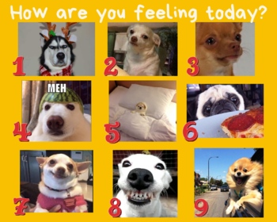
COMMUNITY CONNECTOR: How are you feeling today?
I feel…

Slide 6
DELAC REPRESENTATIVE ROLL CALL

Slide 7
APPROVAL OF MEETING MINUTES
Monday, October 16, 2023 (English)

Slide 8
AGENDA
5:30-5:35 p.m. | Welcoming and Light Dinner | Dr. Simms
5:35-5:40 p.m. | DELAC Roll Call | Patricia/Jo
5:40-5:45 p.m. | Review of the agenda | Dr. Krbecek
5:45-6:00 p.m. | Expanded Learning | Manpreet Kaur, Director III
6:00-6:10 p.m. | BREAK

Slide 9
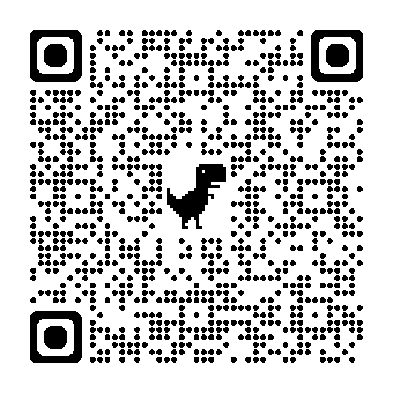
Agenda
6:10-7:00 p.m. | Reports: DELAC Election Announcement (5 min.) DELAC Officer Training and By-laws (20 min.) EL Reclassification Criteria & Data (10 min.) Needs Assessment Results (5 min.) | Dr. Simms/Dr. Krbecek
7:00-7:15 p.m. | Public Comment | DELAC Membership
7:15-7:30 p.m | DELAC Feedback Meeting Closure | Dr. Simms

Slide 10
Expanded Learning

Slide 12
BREAK: 10 Minutes
12

Slide 13
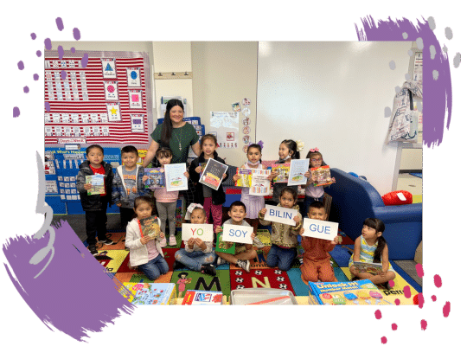

Slide 14
DELAC ELECTION & OFFICER TRAINING

Slide 15
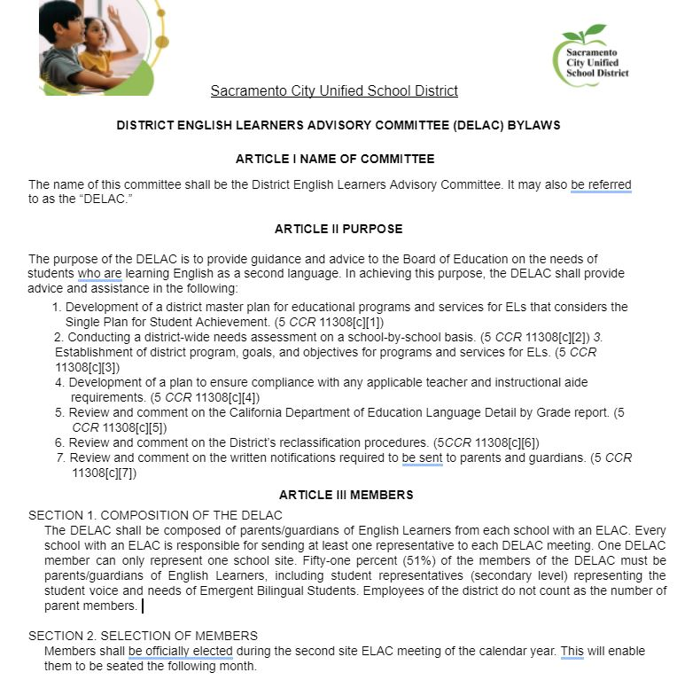
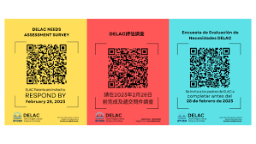
DELAC BYLAWS

Slide 16
EL RECLASSIFICATION CRITERIA & DATA

Slide 17
Roadmap to Reclassification: Grades K-6
Name:
1st Trimester:
2nd Trimester:
3rd Trimester:
ELPAC Score
ELPAC Performance Level 4
Teacher Evaluation
Assessment Data
ELA Report Card Proficiency Level: 3 or 4
CAASPP Nearly Met (Grades 3-6)
Benchmark Interim Assessment
2, 3, or 4:
Parent Opinion/Consultation
Yes!
Open Enrollment Window:
Current ELPAC Score:
Written
Reading
Writing
Oral
Speaking
Listening
Goal:
Current CAASPP/ Test Score:
Goal:
Current ELA Grade:
Goal:

Slide 18
Roadmap to Reclassification: Grades 7-12
Name:
1st Quarter _____________
2nd Quarter ____________
3rd Quarter _____________
4th Quarter _____________
ELPAC Score
ELPAC Performance Level 4
Teacher
Observation
CAASPP/ Test Score
ELA Class Grade A-C
Parent Consultation
CAASPP SBAC : Nearly Met
District Interim
PSAT/ SAT:
Yes!
On track for Graduation/ A-G:
__________/ 225 Credits
Current ELPAC Score
*Reading:
*Writing:
*Speaking:
*Listening:
Goal:
Current CAASPP/
Test Score:
Goal:
Current ELA/ ELD Grade: ___
Goal:

Slide 19
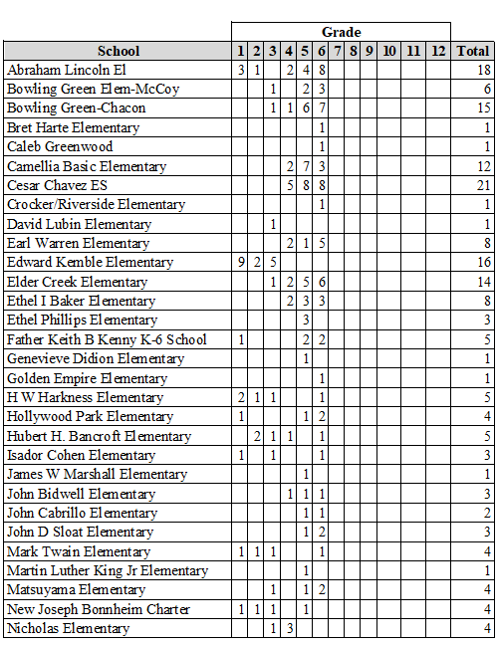
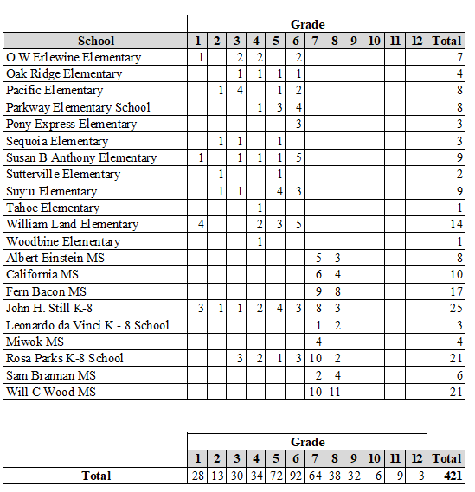
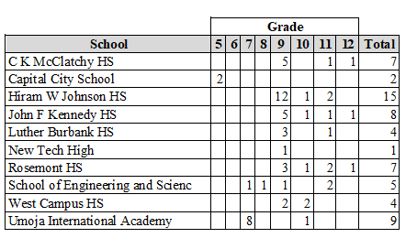
EL Reclassification (2023-2024)

Slide 20
EL Reclassification Three Year Comparison
Reclassification for school year 2023-24 will be ongoing until June 2024.

Slide 21
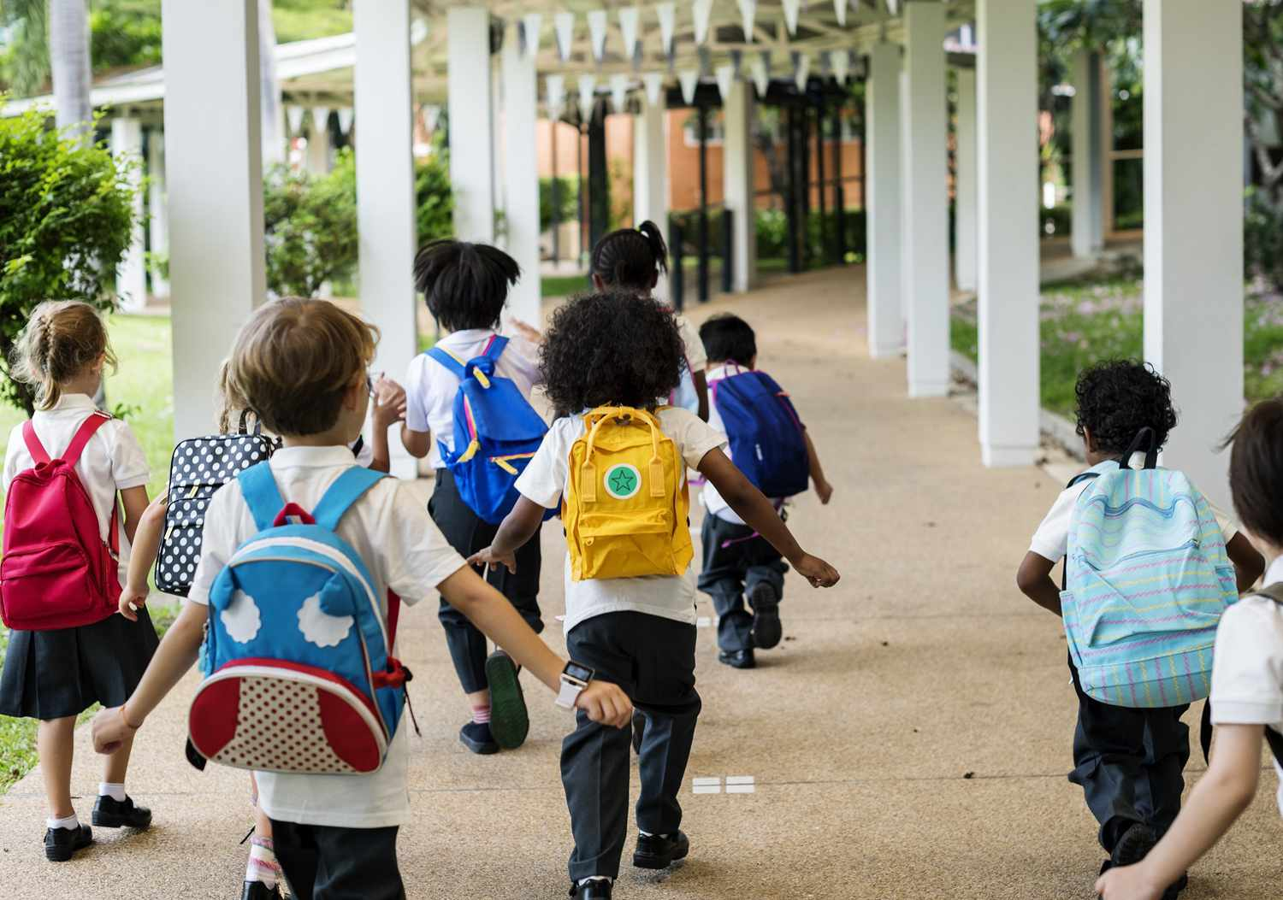

Slide 22
NEEDS ASSESSMENT

Slide 23
Needs Assessment Results
1. Importance of Regular School Attendance
2. Strategies/Questions for Parent-Teacher
3. Bullying/Cyber Bullying
4. Study Skills, homework strategies
5. Reclassification

Slide 24
PUBLIC COMMENT

Slide 25
Public Comment
DELAC PUBLIC COMMENT

Slide 26
Notes:
We will continue to work on communication skills

Slide 27
DELAC FEEDBACK

Slide 28
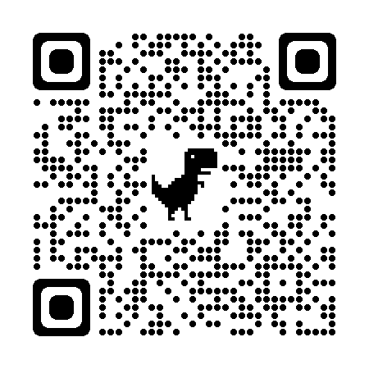
DELAC Feedback QR CODE
DELAC FEEDBACK LINK

Slide 29
Big quote
“When you give joy to other people, you get more joy in return. You should give a good thought to happiness that you can give out.”
— Eleanor Roosevelt

Slide 30
Community Closing Activity
GRATITUDES…

Slide 31
Upcoming Meetings:
DELAC-South Carolina Room
Monday, February 5, 5:30-7:30 p.m.
Monday, March 18, 5:30-7:30 p.m.
Monday, April 15, 5:30-7:30 p.m.
MPAC- Zoom
Monday , February 23th , 6:00 p.m. - 7:30 p.m.
Monday , March 25 th , 6:00 p.m. - 7:30 p.m.
Monday, April 22nd, 6:00 p.m. - 7:30 p.m.
SCUSD BOARD MEETINGS- Community Rooms
Thursday, November 2, 6:30 p.m.
Thursday, December 14, 6:30 p.m.
Thursday, January 18, 6:30 p.m.
Thursday, February 1, 6:30 p.m.
Thursday, February 15, 6:30 p.m.
Thursday, March 7, 6:30 p.m.

