Slide 1
District English Language Advisory Committee (DELAC)
Wednesday, January 18 2023
Notes:
Maria
Introduce our new coordinators
Introduce the DELAC leadership team
Welcoming remarks

Slide 2
Inclusive Opener
What are your new year resolutions?
(Type your response in the chat or share in person.)
Notes:
Flor

Slide 3
DELAC Representative
Roll Call
Notes:
Maria
Participants type their name, last name and name of the school they are representing.
For example, I am Olga Simms, Bowling Green Chacon Elementary.

Slide 4
Roll Call Attendance
Please take a moment to type your name and school in the chat.
Notes:
Maria

Slide 5
Simultaneous interpretation
If you do not require language interpretation, please click the globe icon and select English.
Haga clic en el icono del globo terráqueo y seleccione su idioma de preferencia
Thov nyem rau ntawm lub ntiaj teb lub cim thiab xaiv koj cov lus nyiam
請點擊地球圖標並選擇您的語言偏好
Vui lòng nhấp vào biểu tượng quả địa cầu và chọn ngôn ngữ của bạn
Нажмите на значок земного шара и выберите предпочтительный язык.
Notes:
Flor

Slide 6
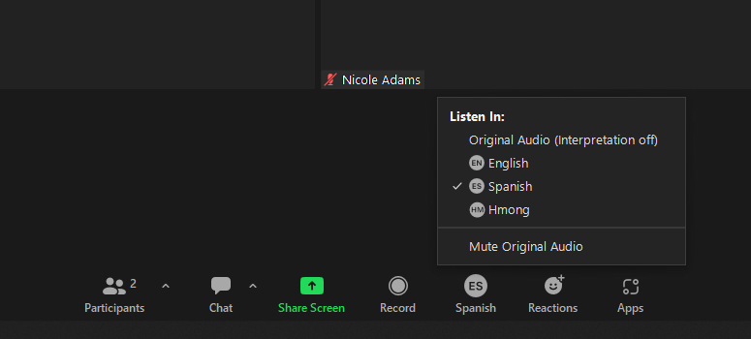
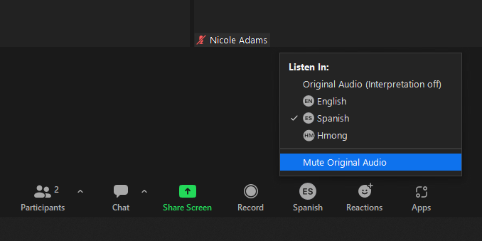
Language Translation Function
Notes:
Vlasti

Slide 7
This DELAC meeting is being recorded.
Should you stay, note that you are consenting to being recorded.
Notes:
Flor

Slide 8
Zoom Norms
It is up to you if you want your camera on or off. We encourage cameras to be on when participating, but you can decide for yourself.
Please mute your microphone when you are listening.
If you have a question or comment, please raise your hand (virtual icon or hold your hand up to the camera) and wait for the moderator to call on you. Please do not interrupt.
You can use the chat to write your question or comments, or to notify us if you’d like a turn to speak. You are welcome to write in your preferred language.
Please be respectful of everyone’s time.
If you are having audio or internet connectivity issues, please write your question or comment in the chat instead.
If you would like to contact District English Learner Advisory Committee (DELAC), you can email DELAC@scusd.edu
Notes:
Flor

Slide 9
Approval of Meeting Minutes
November Meeting Minutes
Notes:
Maria

Slide 10
Agenda
District English Learner Advisory Committee (DELAC)
Wednesday, January 18, 2023
5:30-7:30 PM
AGENDA
Welcome, Introductions/ Bienvenida e introducciones ( Maria, 5 minutes)
Inclusive Opener/Apertura inclusiva (Flor, 3 minutes)
DELAC Norms Review & Update/ Normas DELAC y Repaso (Flor, 5 minutes)
DELAC Representative Attendance/ Asistencia DELAC (Maria, 5 minutes)
Language Translation/ Traducciones (Flor, 5 min)
Emergent Bilingual Student Attendance, Behavior, and Academic Data (Dr. Krbecek, 15 minutes)
Glenni Pacheco - Youth Development Services (20 minutes)
Break/ Receso (5 min.)
Raymond Lozada - Re-Imagined School Safety (20 minutes)
Public Comment/ Comentario publico (5 minutes)
Upcoming Events/ Proximos eventos/ Eventos (5 minutes)
Optimistic Closure/ Clausura optimistica (5 minutes)
Survey/ Encuesta (5 minutes)
Notes:
Maria

Slide 11
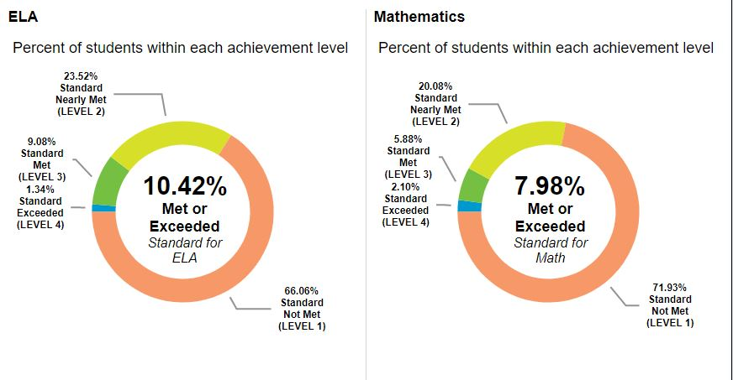
Emergent Bilinguals (SBAC ELA/MATH) for school year 2021-2022:

Slide 12
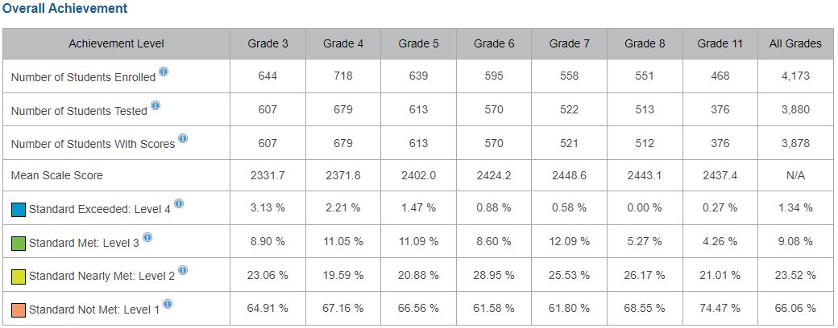
Emergent Bilinguals (SBAC) for school year 2021-2022: ELA

Slide 13
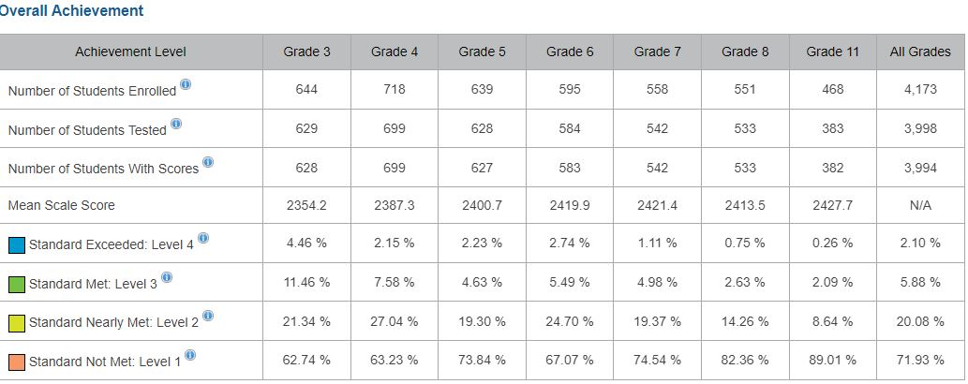
Emergent Bilinguals (SBAC) for school year 2021-2022: MATH

Slide 14
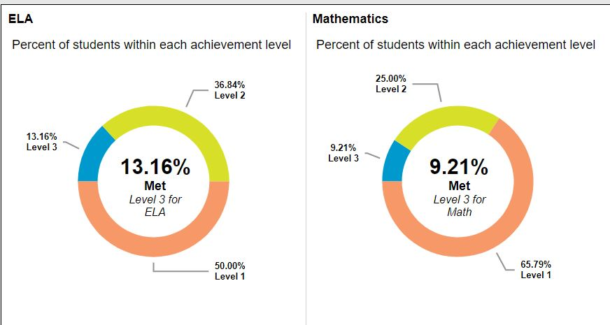
Dually Identified (Alternate English Language Arts/Literacy and Mathematics) for school year 2021-2022:

Slide 15
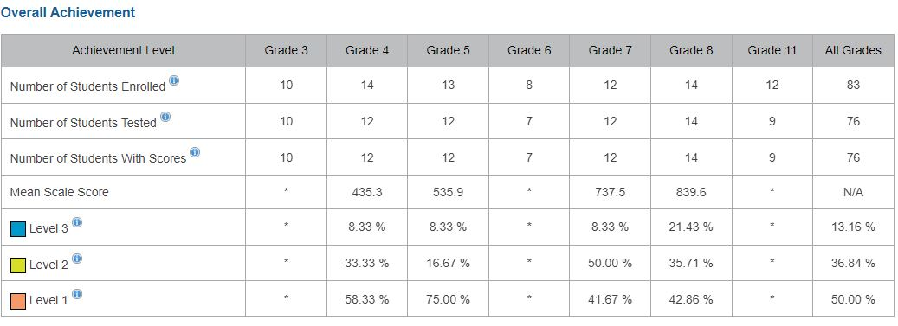
Dually Identified: ELA (Alternate English Language Arts/Literacy) for school year 2021-2022

Slide 16
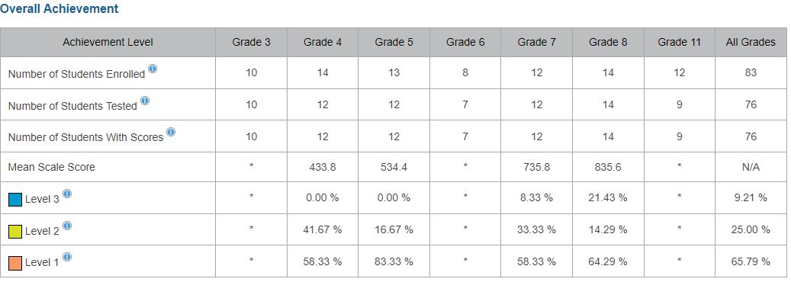
Dually Identified: MATH (Alternate English Language Arts/Literacy and Mathematics for school year 2021-2022)

Slide 17
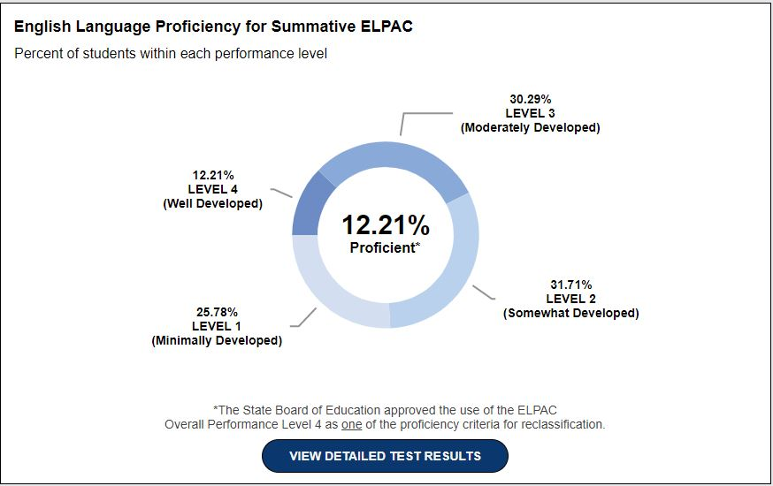
Emergent Bilinguals (Summative ELPAC) for school year 2021-2022:

Slide 18
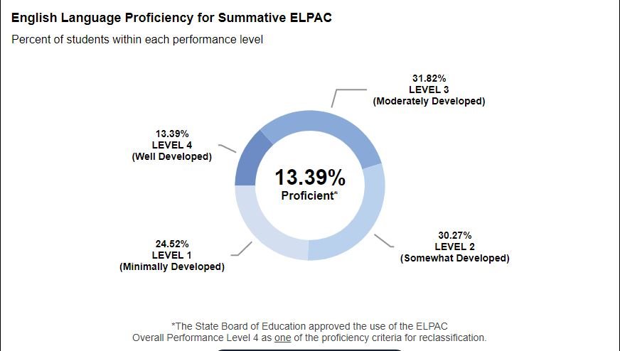
Dually Identified (Summative ELPAC) for school year 2021-2022:

Slide 19
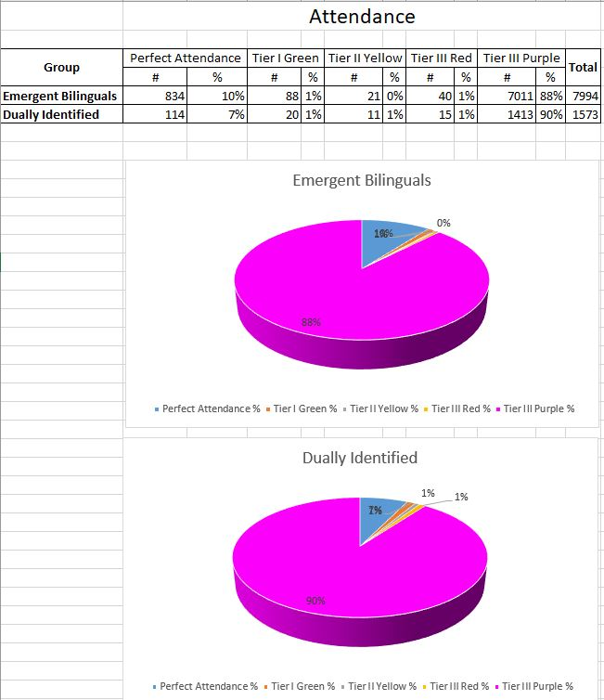
Attendance (As of 1-18-23)

Slide 20
Academics
Reclassification: Total number of RFEP Potentials for school year 2022-23 1st wave is 477 students.
437 students have been reclassified
3 dually identified (EL/Special Ed) have been reclassified
We are working with the school site on the reclassification of the remaining students
Our next reclassification window starts in February

Slide 21
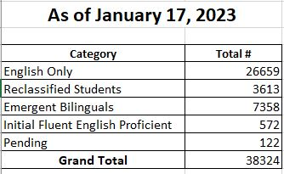
Reclassification
Currently there are:
3,613 reclassified students in our district
132 of those reclassified students are dually identified (EL/Special Ed).

Slide 22
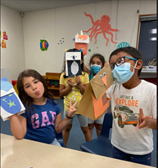
Welcome DELAC!
YOUTH DEVELOPMENT SUPPORT SERVICES (YDSS)
Wednesday, January 18, 2023 @ 6:00 PM
Manpreet Kaur, Director III
Glennielyn Pacheco, Coordinator II

Slide 23
YDSS Mission and Vision
MISSION
Every student in SCUSD has access to culturally relevant, high quality, and engaging
programming; receives equitable supports necessary to graduate from high school with the
greatest number of postsecondary choices from the widest array of options; and, has the
opportunity to use their voice in advancing social justice and improving outcomes for self,
family, school, and community.
VISION
All SCUSD youth will recognize themselves as agents of change within their own lives and
communities through engagement in positive, relevant school experiences preparing them for college, career and life long success.

Slide 24
YDSS PRIORITY AREAS
ENGAGEMENT
Intentionally develop high quality, meaningful, and relevant opportunities that engage students, families, staff, and communities in order to provide information, support, and services to underserved groups.
EQUITY
Maintain a laser-like focus on equity by providing education and awareness that promotes cultural humility and relevance in all approaches and services for youth.
EVALUATION
Foster an intentional focus on capturing, analyzing, and applying data in order to adopt a culture of continuous improvement and maximum impact.
SAFETY
Empower district staff and community partners to employ proactive measures that ensure physical, personal and emotional safety and healing of ourselves and our students.
Notes:
Evaluation - Collect parent, student, staff feedback. We collect youth voice through agency feedback. Specialist go into schools and ask students about program.

Slide 25
Expanded Learning Goals
To improve the academic performance in reading /language arts and math of
students who are low performing/failing or at high risk of failure
To improve the health and wellness of youth who participate in the Expanded
Learning program.
To enhance a student’s enrichment opportunities by providing a broad array of age-
appropriate, student- driven, high interest learning opportunities.
To provide information, educational resources, and activities to families, that will
enhance youth and adult learning.
To create and maintain relationships with the school day staff. There is a clear plan
for strengthening the school day and Expanded Learning program alignment.
Notes:
The Expanded Learning Programs operate with the following goals for each grant, which share a focus
on supporting children and youth’s development of physical, social and emotional, and academic skills.
Health & Wellness: this might include but not limited to: nutrition, physical fitness, social justice, bullying and
harassment prevention, safety issues (fire, bike, water, home alone, dating, car, etc.), social-
emotional development, and/or substance abuse prevention, etc.

Slide 26
Expanded Learning Funding
After School Education & Safety (ASES) for elementary, middle, and K-8 schools are state
funded. The ASES grants are a three year renewable funding source.
Expanded Learning Opportunities Program (ELO-P) are state funds for before school, afterschool, and summer school enrichment programs for Transitional Kinder (TK) through sixth grade students
21st Century Community Learning Center (21st CCLC) grants for elementary, middle, and K-8 schools are federally funded. The 21st CCLC grants are awarded based on a highly competitive application process, and grants last for five years.
21st Century After School Safety and Enrichment for Teens (ASSETS) grants for high schools are federally funded. 21st Century ASSETS grants are awarded based on a highly competitive
application process, and grants last for five years.
Notes:
SCUSD Expanded Learning Programs are funded through state and federal funding administered by the
California Department of Education (CDE), as well as SCUSD district funds. The funds are awarded to
specific school sites and community agencies as part of a competitive process. The base grants that CDE
awards to SCUSD for after school programs represent three funding sources:

Slide 27
Expanded Learning Programs
16 before school programs
68 after school programs
10 Main Providers
28 Supplemental Providers to provide enrichment
Summer Matters
Youth Employment Program
Sacramento Advisory Council
American Indian Education Program
Notes:
Summer Matters programming for past 10 years - serving 3,000 students on average
SAC: (Representatives from 8 high schools)
MWLA: 5 Comprehensive high schools running classes through the day- CKM, Rosemont, Hiram, JFK, Burbank
AIEP:
• Federally funded Indian Education Formula Grant (Title VI)
• Designed to address the unique cultural, language, and educationally related needs of American Indian and Alaska Native Students
• To ensure that all students meet the challenging state academic standards

Slide 28
Expanded Learning Programs Cont.
Men’s and Women’s Leadership Academy
Partnership with City Hall - Summer @ City Hall
Mentors for College and Career Readiness - Collaboration with Guidance and Counseling Department
Credit Recovery in High Schools
Small Group Academic Intervention and Support by Certificated Staff
Collaboration with SCUSD Athletics Department

Slide 29
ELP Program Logistics
Sample Before School Schedule
Monday -Friday, 7:30 am - 8:30 am
Components of the day:
7:30 am - Sign-in and Energizer
8:00 am - Structured Recreation
8:20 am - Closing Activity and Transition to Breakfast
8:30 am - Breakfast
8:50 am - Clean-up, Restroom, and Transition to Class line
Sample Daily Schedule
Monday-Friday, 2:00 pm - 6:00 pm
School release/After school program
2:30 pm - Supper
3:00 pm - Structured Recreation
3:30 pm - Academic Hour
4:30 pm - Enrichment/Supplemental Provider
5:15 pm - Snack
5:30 pm - 6:00 pm - Closing Activities and Sign-out

Slide 31
Stay Connected!
Manpreet Kaur
Youth Development, Director III
Manpreet-Kaur@scusd.edu
(916) 643-7992
Glennielyn Kenery, MPH
Youth Development, Coordinator II
Glennielyn-Pacheco@scusd.edu
(916) 643-9262

Slide 32
Questions?

Slide 33
Time for a 5 min Break!!
Notes:
Maria

Slide 34
Questions & Answers
Notes:
Add the name of your department in the title

Slide 35
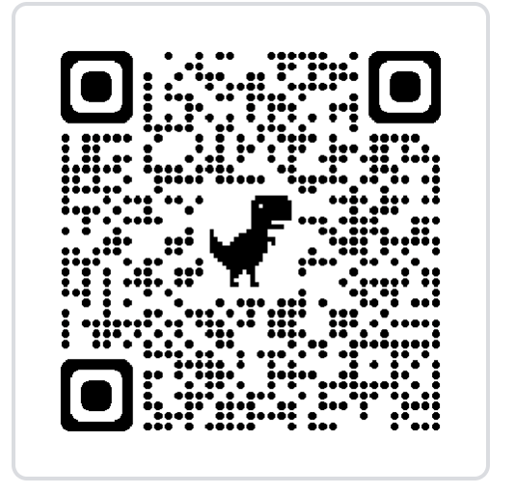
Public Comment
Public Comment
Notes:
Maria

Slide 36
Upcoming Events
DELAC Meeting
Wednesday, February 15, 2023 @ 5:30-7:30 p.m. (Hybrid)
SCUSD Board of Education Meeting
(Serna Center Community Rooms)
Thursday, January 19, 2023
Thursday, February 2, 2023
Notes:
Maria

Slide 37
Optimistic Closure-What’s your ‘go-to’ nonverbal connection?
Notes:
Flor

Slide 38
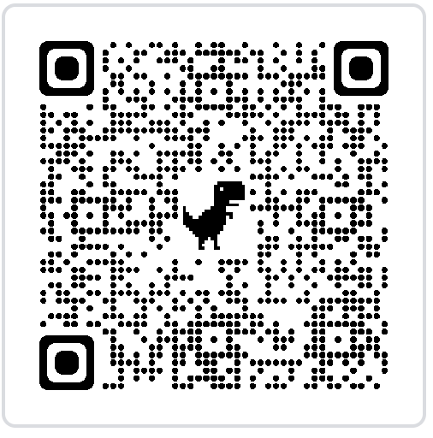
Feedback
https://forms.gle/2vrPXHreXFUB6cbF8
Notes:
Vlasti

