Slide 1
District English Language Advisory Committee (DELAC)
Wednesday, October 19, 2022
Notes:
Maria

Slide 2
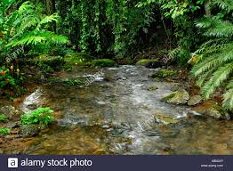
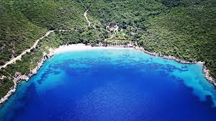
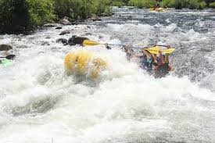
Welcoming/Inclusion Activity:
Which body of water reflects your current mood?
1
CREEK
BAY
2
3
4
RIVER
OCEAN
Notes:
Flor

Slide 3
Simultaneous interpretation
If you do not require language interpretation, please click the globe icon and select English.
Haga clic en el icono del globo terráqueo y seleccione su idioma de preferencia
Thov nyem rau ntawm lub ntiaj teb lub cim thiab xaiv koj cov lus nyiam
請點擊地球圖標並選擇您的語言偏好
Vui lòng nhấp vào biểu tượng quả địa cầu và chọn ngôn ngữ của bạn
Нажмите на значок земного шара и выберите предпочтительный язык.
Notes:
Kao-Vlasti

Slide 4
This DELAC meeting is being recorded.
Should you stay, note that you are consenting to being recorded.
Notes:
Kao-Vlasti

Slide 5
Zoom Norms
It is up to you if you want your camera on or off. We encourage cameras to be on when participating, but you can decide for yourself.
Please mute your microphone when you are listening.
If you have a question or comment, please raise your hand (virtual icon or hold your hand up to the camera) and wait for the moderator to call on you. Please do not interrupt.
You can use the chat to write your question or comments, or to notify us if you’d like a turn to speak. You are welcome to write in your preferred language.
Please be respectful of everyone’s time.
If you are having audio or internet connectivity issues, please write your question or comment in the chat instead.
If you would like to contact District English Learner Advisory Committee (DELAC), you can email DELAC@scusd.edu
Notes:
Vitalina

Slide 6
DELAC Representative
Roll Call
Notes:
Vitalina–
Participants type their name, last name and name of the school they are representing.
For example, I am Olga Simms, Bowling Green Chacon Elementary.

Slide 7
Agenda
District English Learner Advisory Committee (DELAC)
Wednesday, October 19, 2022
5:30-7:30 PM
AGENDA
Welcome, Introductions, ( Maria, 5 minutes)
DELAC Norms Review & Update (Flor,10 minutes)
DELAC Representative Attendance (Vitalina, 5 minutes)
DELAC Purpose (Vitalina, 10 minutes)
Defining Emergent Bilinguals (Flor, 3 minutes)
Data Overview (Flor, 7 minutes)
BREAK (Maria, 5 minutes)
DELAC Needs Assessment Review (Maria/Olga, 15 minutes)
-Needs Assessment Survey
Uniform Complaint Form (Christina Villegas, 15 min)
Public Comment (Maria, 10 minutes)
Optimistic Closure (Maria, 1 minutes)

Slide 8
Civil Rights Act of 1964; Title VI
Title VI prohibits discrimination based on a student’s race, color, national origin, and language proficiency.
This law was the start of English learner programs in the United States.
Notes:
Vitalina

Slide 9
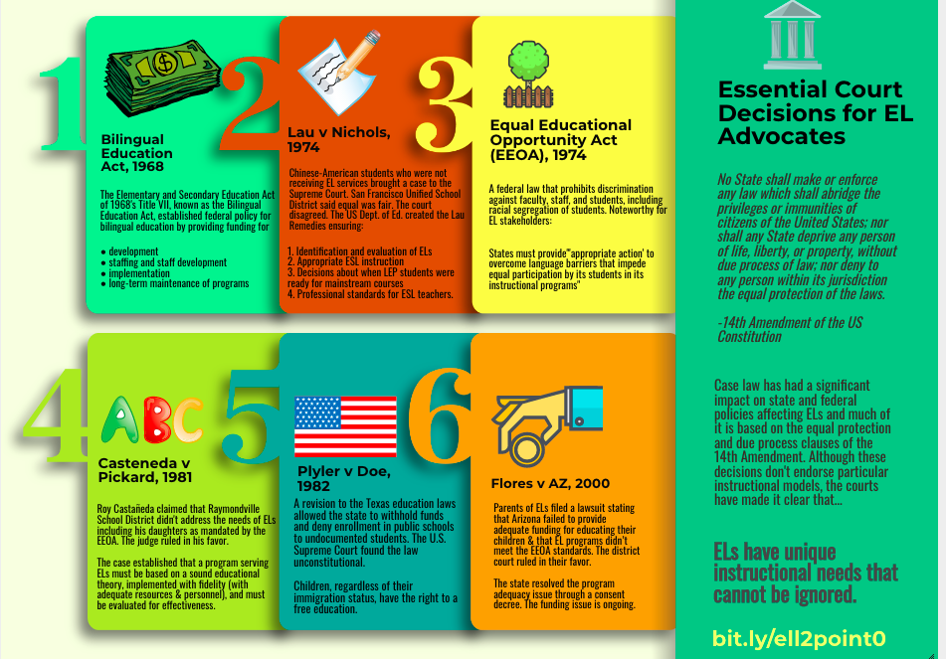
Notes:
Flor

Slide 10
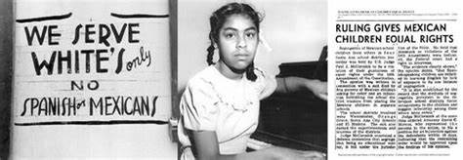
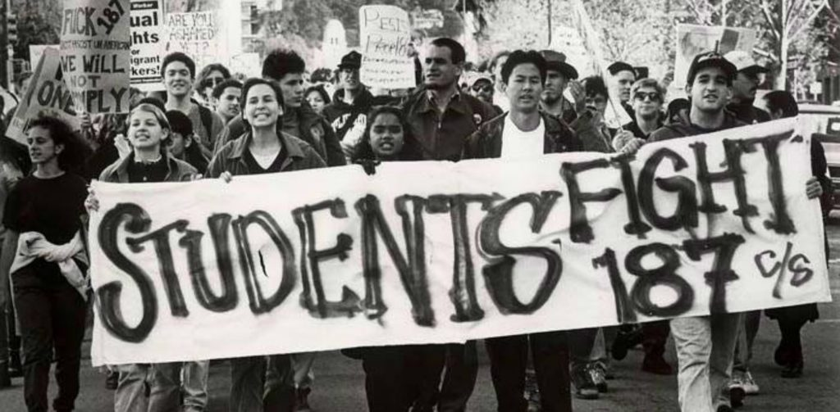
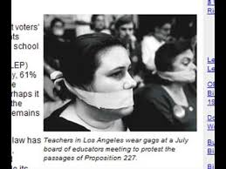
Landmark CA Cases and Propositions Impacting Emergent Bilingual Learners
Mendez v. Westminster: 1947
Struck down the legal justification for forced school segregation in California; paved the way for Brown v. Board decision
Prop 187: 1994
Prohibited undocumented immigrants from using public education
Prop 227: 1998
Required all public school instruction to be conducted in English
Prop 58: 2016
Repealed Prop. 227
AB 699 Educational Equity: 2017
AB 699 adds “immigration status” to the list of currently protected characteristics, such as race, gender, disability, and religion that are prohibited under discrimination law
Notes:
Flor

Slide 11
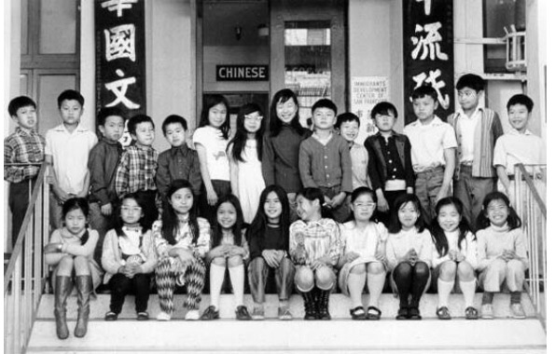
Our Legal Responsibility
There is no equality of treatment merely by providing students with the same facilities, textbooks, teachers, and curriculum; for students who do not understand English are effectively foreclosed from any meaningful education.
Lau v. Nichols
1974 Supreme Court Decision
Notes:
Flor

Slide 12
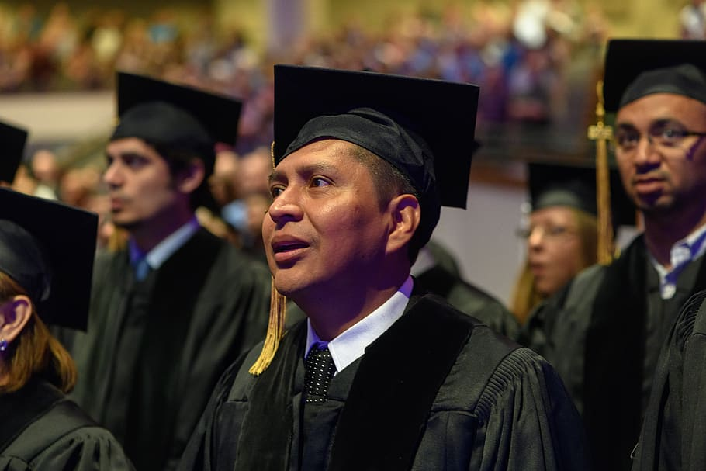
District English Learner Advisory Committee
DELAC

Slide 13
EL 02: District English Learner Advisory Committee (DELAC)
2.0 Each LEA with 51 or more ELs must form a DELAC unless the district designates for this purpose a subcommittee of an existing districtwide advisory committee. Parents or guardians, or both, of pupils of limited English proficiency who are not employed by the district shall constitute a majority of the DELAC. (EC sections 52176[a], 62002.5; 5 CCR Section 11308)
2.1 The DELAC shall advise the school district governing board on all of the following tasks:
(a) Development of an LEA master plan, including policies, per the State Board of Education (SBE) EL Roadmap Policy, guiding consistent implementation of EL educational programs and services, that takes into consideration the SPSAs.
(b) Conducting of an LEA-wide needs assessment on a school-by-school basis.
(c) Establishment of LEA program, goals, and objectives for programs and services for ELs per the SBE adopted EL Roadmap Policy.
(d) Development of a plan to ensure compliance with any applicable teacher and instructional aide requirements.
(e) Review and comment on the LEA’s reclassification procedures.
(f) Review and comment on the written notifications required to be sent to parents and guardians. (5 CCR Section 11308)
(g) Under the local control funding formula, LEAs with at least 50 ELs and whose total enrollment includes at least 15 percent ELs must establish a DELAC, and that DELAC must carry out specific responsibilities related to the Local Control and Accountability Plan (LCAP), including providing input regarding the LEA’s existing language acquisition programs and language programs, and, where possible, the establishment of other such programs. If the DELAC acts as the ELAC under EC sections 52063(b)(1) and 52062(a)(2), the DELAC shall also review and comment on the development or annual update of the LCAP. (5 CCR Section 11301)
Notes:
Vitalina

Slide 14
Why Emergent Bilingual and Not English Learner
“Calling children emergent bilinguals makes reference to a positive characteristic-not one of being limited or being learners...emergent bilinguals refers to the children’s potential in developing their bilingualism...it is recognized as a potential resource, both cognitively and socially.”
– García, O. (2009). Emergent Bilinguals and TESOL: What's in a Name?. Tesol Quarterly, 43(2), 322-326.
Notes:
Vitalina

Slide 15
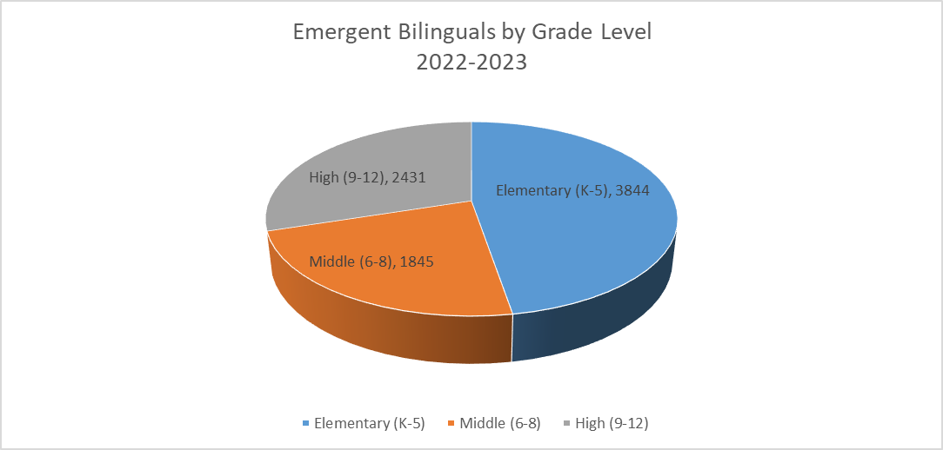
Who are our Emergent Learners?
Notes:
Flor

Slide 16
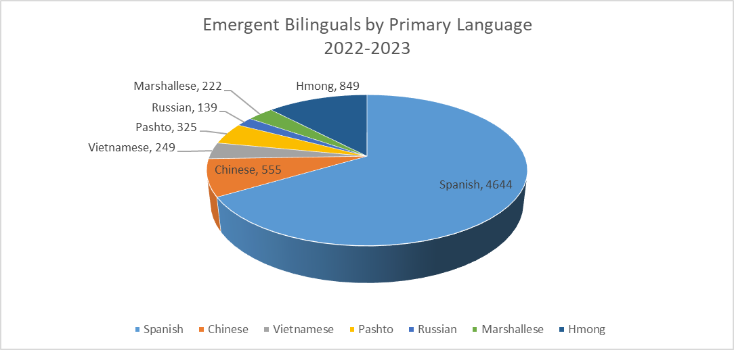
Top 7 Languages Spoken by Emergent Bilingual Learners
Notes:
Flor

Slide 17
Other Languages Spoken
Language | Total | Language | Total | Language | Total | Language | Total | Language | Total
Spanish | 4644 | Urdu | 69 | Burmese | 11 | Ilocano | 4 | Sign Language | 1
Vietnamese | 249 | Filipino | 59 | Amharic | 11 | Thai | 4 | Polish | 1
Chinese | 555 | Punjabi | 56 | Japanese | 10 | German | 3 | Assyrian | 1
Hmong | 849 | Arabic | 51 | Portuguese | 9 | Gujarati | 3 | Taiwanese | 1
Pashto | 325 | Mien | 40 | Khmer | 8 | Tigrinya | 3 | Nepali | 1
Marshallese | 222 | Armenian | 29 | Korean | 5 | Bengali | 3 | Swahili | 1
Russian | 139 | Lao | 28 | French | 5 | Unknown | 3 | Iranian Languages | 1
All Other Non English | 394 | Ukranian | 25 | Samoan | 5 | Cebuano | 2 | Lithuanian | 1
Farsi | 177 | Toishanese | 25 | Turkish | 5 | Fijian | 2
Hindi | 79 | Tongan | 24 | Rumanian | 5 | Hungarian | 1
Notes:
Flor

Slide 18
Uniform Complaint Process
As part of the Federal Program Monitoring it is required that the district share the Uniform Complaint Form with our parent committees
A written document informing LEA employees, students, parents, school and district advisory committee members, private school officials, and other interested parties of the UCP process.
Item Instructions: UCP 02: (1) Study UCP Instrument; (2) Revise document if necessary; (3) Distribute to employees, students, parents, advisory committee members, private school officials, and other interested parties; and (4) Link document and certify.
Related Items: UCP 02
Notes:
C. Villegas

Slide 19
Uniform Complaint Process Continued
Uniform Complaint Form (English)
Uniform Complaint Form (Spanish)
SCUSD.edu/uniform-complaint-procedure
SCUSD-Translations.edu/post/annual-uniform-complaint-procedure-ucp-notification-letters
Notes:
C. Villegas

Slide 20
Time for a 5 min Break!!

Slide 21
Needs Assessment
What needs do you recognize that the school site has?
What specific needs does the school have to support our Emergent Bilinguals?
Examples
Multilingual Libraries
Bilingual Counselors
Bilingual supports in the classroom (bilingual aides, books, technology, etc)
Please click on this link to fill out the Needs Assessment survey link:
https://docs.google.com/forms/d/e/1FAIpQLSc0OnuPyo3OtxXh2HBUF1rOU84Q6P6IpOSlcgOmVNDlBs8HhQ/viewform
Notes:
Maria/Olga

Slide 22
Public Comment
Public Comment
Notes:
Maria/Olga

Slide 23
Upcoming Events
DELAC Meeting
Wednesday, November 16, 2022 @ 5:30-7:30 p.m. (Zoom)
SCUSD Board of Education Meeting
Thursday, November 6, 2022 @ 6:00 p.m. (In Person)
Notes:
Maria

Slide 24
Optimistic Closure-What’s your ‘go-to’ nonverbal connection?
Notes:
Olga

