Slide 1
A Parent’s Guide to
Bullying/Cyberbullying Prevention
Jessica Wharton, Bullying Prevention Specialist, SCUSD

Slide 2
Training Objectives
One: WHAT? Bullying Definition
- Parent Tips
Cyberbullying, Media, and Instant Messaging
- Parent Tips
Two: WHO? Impact and Warning Signs
Three: HOW? Reporting Procedures
Four: WHAT? Parent Strategies

Slide 3
Types of Bullying
Direct
Indirect
Physical acts
Threats
Intimidation
Verbal abuse
Taunting
Other??
Making faces
Obscene gestures
Exclusion
Rumors
Posturing
Relational
Other??

Slide 4

WHAT is Bullying?
Intent to do Harm
Repeated Over time
Imbalance of Power

Slide 5
PEER ABUSE/BULLYING
A desire to hurt + a hurtful action + a power imbalance + repetition (typically) + unjust use of power + evident enjoyment by the aggressor + sense of being oppressed on the part of the target

Slide 6
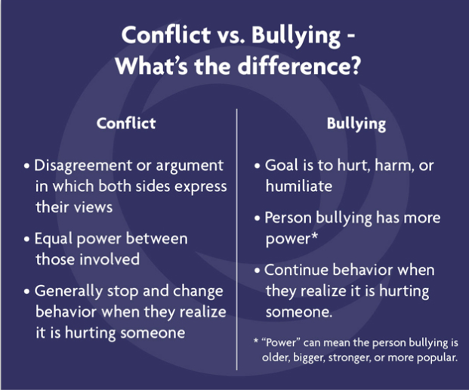
CONFLICT VS BULLYING

Slide 7
Relational Bullying
Usually refers to “girl to girl” bullying
Damages social standing in the school
Damages personal reputation
Damages friendships/relationships
Manipulation of friendships
Withhold friendship
Other??

Slide 8
Parent Tips - Bullying
Get Information from Your Child
  Who, What, Where, When, and Why
  Did You Report This to an Adult?
Work on Strategies With Your Child
Have Them Think About and Discuss Their Ideas
Ask Questions
  What Would You Do If That Didn’t Work?
List Options and Consequences
Role Play Their Strategies
Allow Them to Try Out Their Strategies
  Check in With Them
Inform the school administrator AND the teacher

Slide 9
Electronic/Cyberbullying
Use of Modern Communication Technologies:
    Email
    Instant messaging
    Chat rooms
    Web sites
    Social networking sites
    Cell phones and other forms of technology
To Intentionally Embarrass, Humiliate, Threaten or Intimidate an Individual or Group
To Attempt to Gain Power and Control

Slide 10
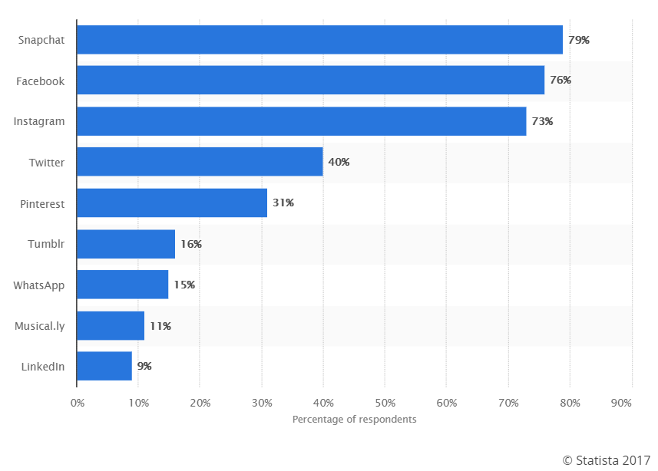
Reach of leading social media and networking sites used by teenagers and young adults in the US as of Feb 2017

Slide 11


Snapchat
Snapchat is a photo messaging application ("app"). Users can take photos, record videos, add text and drawings, and send them to recipients. These sent photographs and videos are known as "Snaps".
Users set a time limit for how long recipients can view their Snaps (1 to 10 seconds), after which they will be hidden from the recipient's device and deleted from Snapchat's servers.

Slide 12

Musical.ly is a social media platform for creating, sharing and discovering short music videos – think Karaoke for the digital age! Students use musical.ly as an outlet to express themselves through singing, dancing, comedy, and lip-syncing. The app allows users to create videos recorded in 15 seconds or less and share them across the musical.ly community
What are the potential risks?
Users may be exposed to bad language and content of a sexual nature.
Users can comment on other videos, but this leaves the potential for online bullying or negative comments.

Slide 13
Did you know…
71% of teens have established on-line profiles on social networking sites
Nearly half have public profiles viewable by anyone.
Teens with public profiles are more likely to receive messages by strangers or be harassed by peers.

Slide 14
Cyberbullying vs Cyberharassment
Cyberbullying = minors hurting minors
Cyberharassment/cyberstalking = anything with adults that involves spying, tracking and targeting one’s online activities, communication and friends
I.e. George

Slide 15
Sexting/Sextortion
When young people take nude pictures or video images of themselves posing or engaging in sexually provocative ways on their cell phones or webcams and sending them to others.
Research shows more conservative group than one thinks
Boys share the images when they break up with their girlfriends
Many minors are “sextorted” by older teen or adult predators into engaging in sexual acts or sending more images to keep their blackmailer quiet.

Slide 16
5 Tips To Stop Cyberbullying
Don’t respond or retaliate
Block the Bully (phone, screen names, email)
Save the evidence (print or screen shot)
Report it – most social media sites have a “report” button
Tell a friend or trusted adult

Slide 17
Instant Messaging/Texting
Approximately 79 Million People Text Regularly
Regular Users Use Acronyms and Text Messaging Shorthand
95% of parents didn't recognize the lingo kids use to let people know that their parents are watchin
89% of sexual solicitations are made in either chat rooms or Instant Messages
20% of children age 10-17 have been solicited sexually online; that's 1 out of every 5 kids

Slide 18
IM QUIZ
A/S/L
BF
B4N
GF
BRB
CD9
G2G
IDK
KPC
(L)MIRL (used in chat rooms)
LOL
MOS
NMU
P911
PAW (or PRW)
PIR
POS
PRON
S2R – (pictures)
TDTM
TTYL

Slide 19
Instant Messaging
A/S/L – age, sex, location
BF – boyfriend
B4N – bye for now
GF – girlfriend
BRB – be right back
CD9 – Code 9; means parents are around
G2G – got to go
IDK – I don’t know
KPC – keep parents clueless
(L)MIRL – (Let’s) meet in real life (used in chat rooms)
LOL – laugh out loud
MOS – mom over shoulder
NMU – not much, you?
P911 – parent emergency
PAW (or PRW) – parents are watching
PIR – parent in room
POS – parent over shoulder
PRON – porn
S2R – send to receive (pictures)
TDTM – talk dirty to me
TTYL – talk to you later

Slide 20
Parent Tips - Cyberbullying
Have Children Sign a Contract on Appropriate Usage
Discuss Scenarios With Them
  What Would You Do if Someone Posted Something Mean About Another Student?
Do Not Allow them to Have an Social Media Account at an Early Age (FB is 13YO)
Monitor Their Social Network Postings
Have Children Check Cellphones In and Out (7PM)
Do Not Erase, Omit or Alter Texts or Emails – This is Your Evidence
Teach “Netiquette” – Online Manners

Slide 21
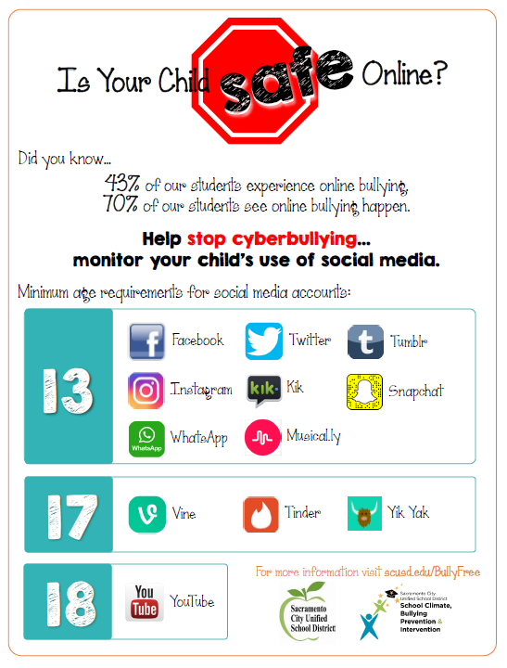
No student should have a social media account in elementary school.

Slide 22
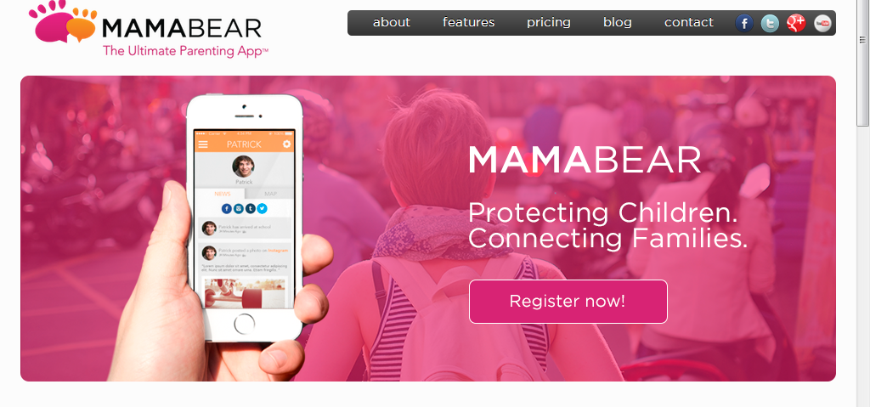
Parenting Apps
Mama Bear, The Ultimate Parenting App
  http://mamabearapp.com/
Qustodio, Protect, Understand, and Manage you child’s internet activity
  https://www.qustodio.com/en/
SelfieCop – parents can view child’s photos
  https://play.google.com/store/apps/details?id=com.selfiecopChild.android

Slide 23
Objective Two: Who is impacted by bullying and why?
Characteristics/Risk Factors
  Attendance
Warning Signs
  Student who is targeted
  Student who engages in bullying behavior
Faces of Bullying

Slide 24
Impact on Attendance
When a child is being bullied, they may not know how to talk about the situation or ask for help. Instead they may look for ways to avoid school and the bullying situation.

Slide 25
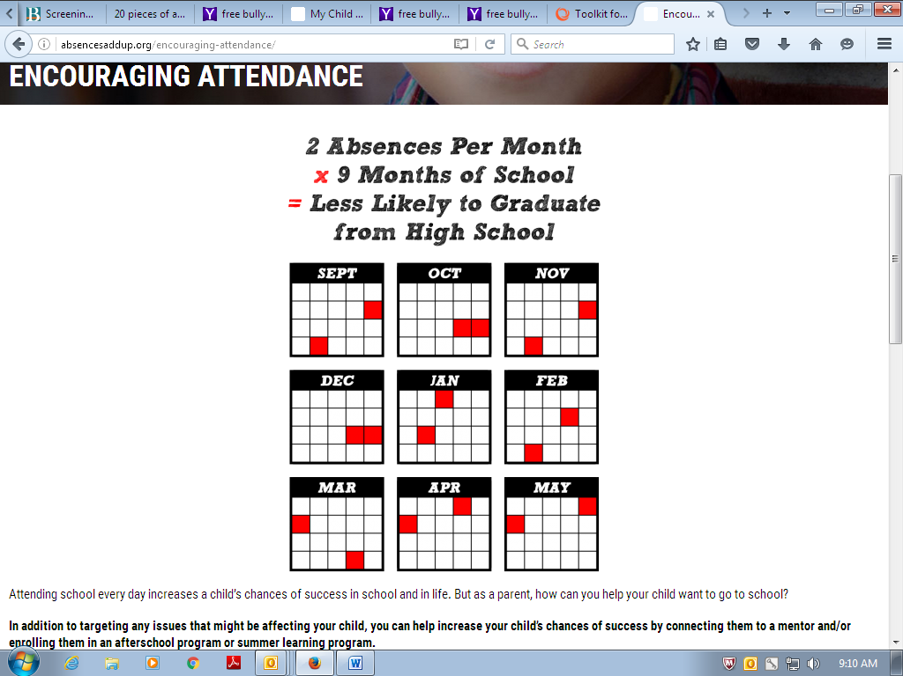

Slide 26
Warning Signs
A child being targeted by bullying may:
  Have unexplainable injuries
  Lost or destroyed clothing, books, electronics, or jewelry
  Frequent headaches or stomach aches, feeling sick or faking illness
  Changes in eating habits
  Difficulty sleeping or frequent nightmares
  Declining grades, not wanting to go to school
  Sudden loss of friends or avoidance of social situations
  Feelings of helplessness or decreased self esteem
  Self-destructive behaviors such as running away from home, harming themselves, or talking about suicide

Slide 27
Warning Signs (cont.)
A child engaging in bully behavior may:
  Get into physical or verbal fights
  Have friends who bully others
  Are increasingly aggressive
  Get sent to the principal’s office or to detention frequently
  Have unexplained extra money or new belongings
  Blame others for their problems
  Don’t accept responsibility for their actions
  Are competitive and worry about their reputation or popularity

Slide 28
Individual Risk Factors
For targeted students
Those who:
Have learning disabilities
Have Attention Deficit Hyperactivity Disorder (ADHD)
Have Autism Spectrum Disorder (ASD)
Have special health care needs or chronic diseases
Are overweight or underweight
Speak another language at home
Are questioning their sexual orientation or who are lesbians, gay, bisexual, or transgender
However, even if a child has these risk factors, it doesn’t mean they will be bullied

Slide 29
FACES OF BULLYING

Slide 30

AB 9, also known as Seth's Law or the Safe Place to Learn Act
Bullycide Prompts New Law
After years of being taunted and bullied by classmates, 13-year-old Seth Walsh was found unconscious, hanging from the branch of a plum tree in the backyard. He died nine days later.

Slide 31
'I don't want to die but I want to be saved from the pain': Mother shares heart-wrenching suicide note of bullied daughter, 14, as she seeks to get anti-bullying bill passed
Angelina Green hanged herself in March after years of bullying
In a suicide note to her mother, she pleaded with her to seek justice

Slide 32
Dear Mom,
I'm really sorry that I did this. Don't you EVER think it was your fault. Because it's not. I love you so much and I couldn't ask for a better mom. Thank you for caring and feeding and loving me for 14 years. I'm sorry once again. But my heart can't take this pain. I'm gonna miss you so much. I love you. And I can't wait till the day I get to see you again. I'll be waiting at heaven's gates for you. I love you.
Goodbye :(
Angelina Green
P.s. It's bullying that killed me. Please get justice.

Slide 33
Relationship between bullying and suicide
Although bullying alone is not typically the cause, kids who are bullied are at higher risk for suicide. Many issues contribute to suicide risk, including depression, problems at home, and trauma history.

Slide 34
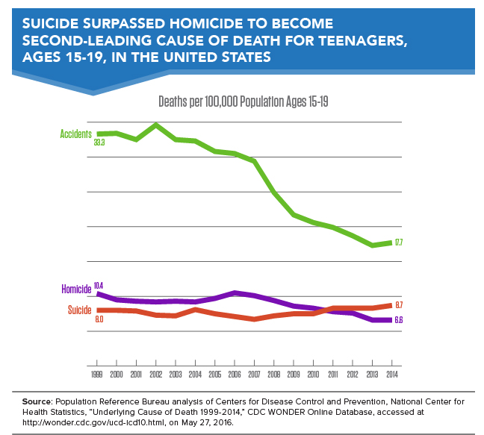
Suicide “is the SECOND leading cause of death among young people,”, according to the CDC

Slide 35
How to Report Bullying Behavior

Slide 36
Report Bullying
The district has a Report of Suspected Bullying Form
This form can be filled out by admin, school staff, parents, or students.

Slide 37
Steps to Take:
Anyone can report incidences of bullying behavior on the Report of Suspected Bullying
Site admin will investigate and determine if it is bullying
If bullying, Site admin will write a student safety plan and an action plan
Site admin will notify parents
If you feel the reported bullying is not taken seriously or if you don’t see improvement in your student’s safety, meet with the school staff

Slide 38
Anonymous Reporting
The district is utilizing the WeTip Bullying Reporting Hotline
1-855-86-BULLY
WeTip will contact district’s bully prevention specialist and send to site administrator

Slide 39
Parent Strategies

Slide 40
Parent Strategies
Never believe “Not my kid…”
Secure Computer in a Family Room
May Use Tracking/Screening Software
Check Web History
Check Cell Phone Files
    Texts
    Pictures/Videos
Monitor Your Cell Phone Bill
Be Aware of Warning Signs of Cyberbullying and Cyber Addiction
Periodically sit with them as they surf
Increase Your Knowledge
Do Not Rely Solely on Software
Notes:
Purpose: To continue to provide tips and strategies.
Note: Some of the items will require parents to increase knowledge and skills such as how to check web history; tips on if the web history has been erased; how to check cellphones.
Remind Parents: It is their duty and obligation to search rooms, computers and cellphones. Tell parents they should be up front with their children about these searches and that it is intended to keep them safe. This up front approach will not destroy trust but establishes one of the roles of the PARENT.
Parents may try to rely on software programs to restrict or monitor their children online. There are many sites that will over-ride the parent protection including proxy sites and instructions on how to override parental controls for computers, video games and cellphones. The following slides are examples of “cheats”.
Note: This is why parents are instructed to have a multi-layered approach to safety and security.

Slide 41
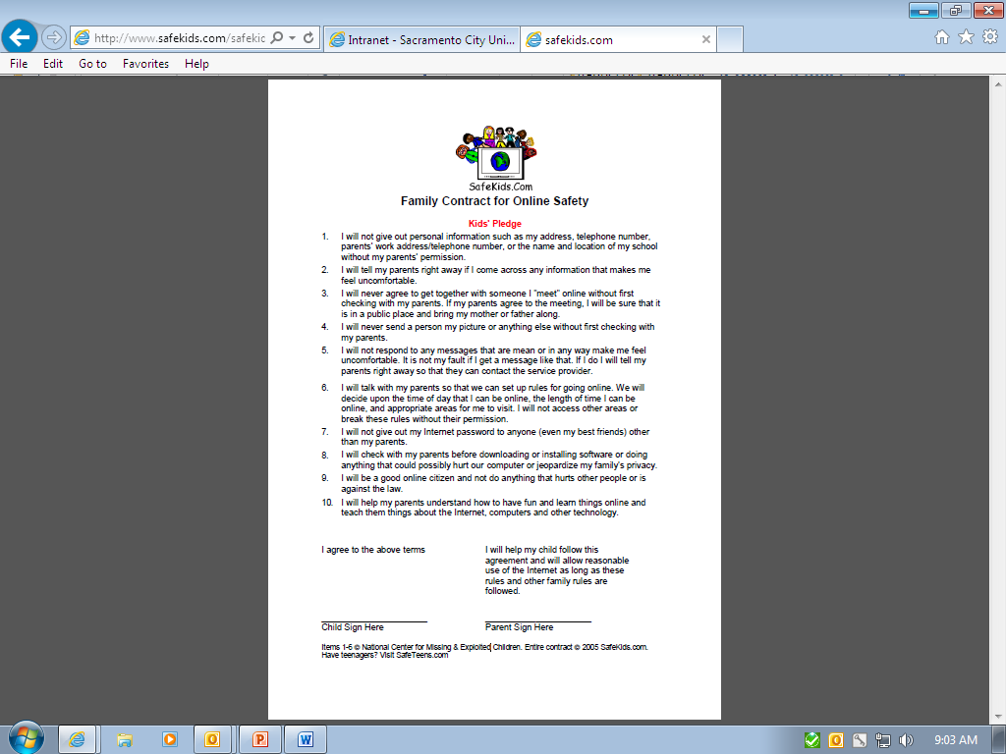

Slide 42
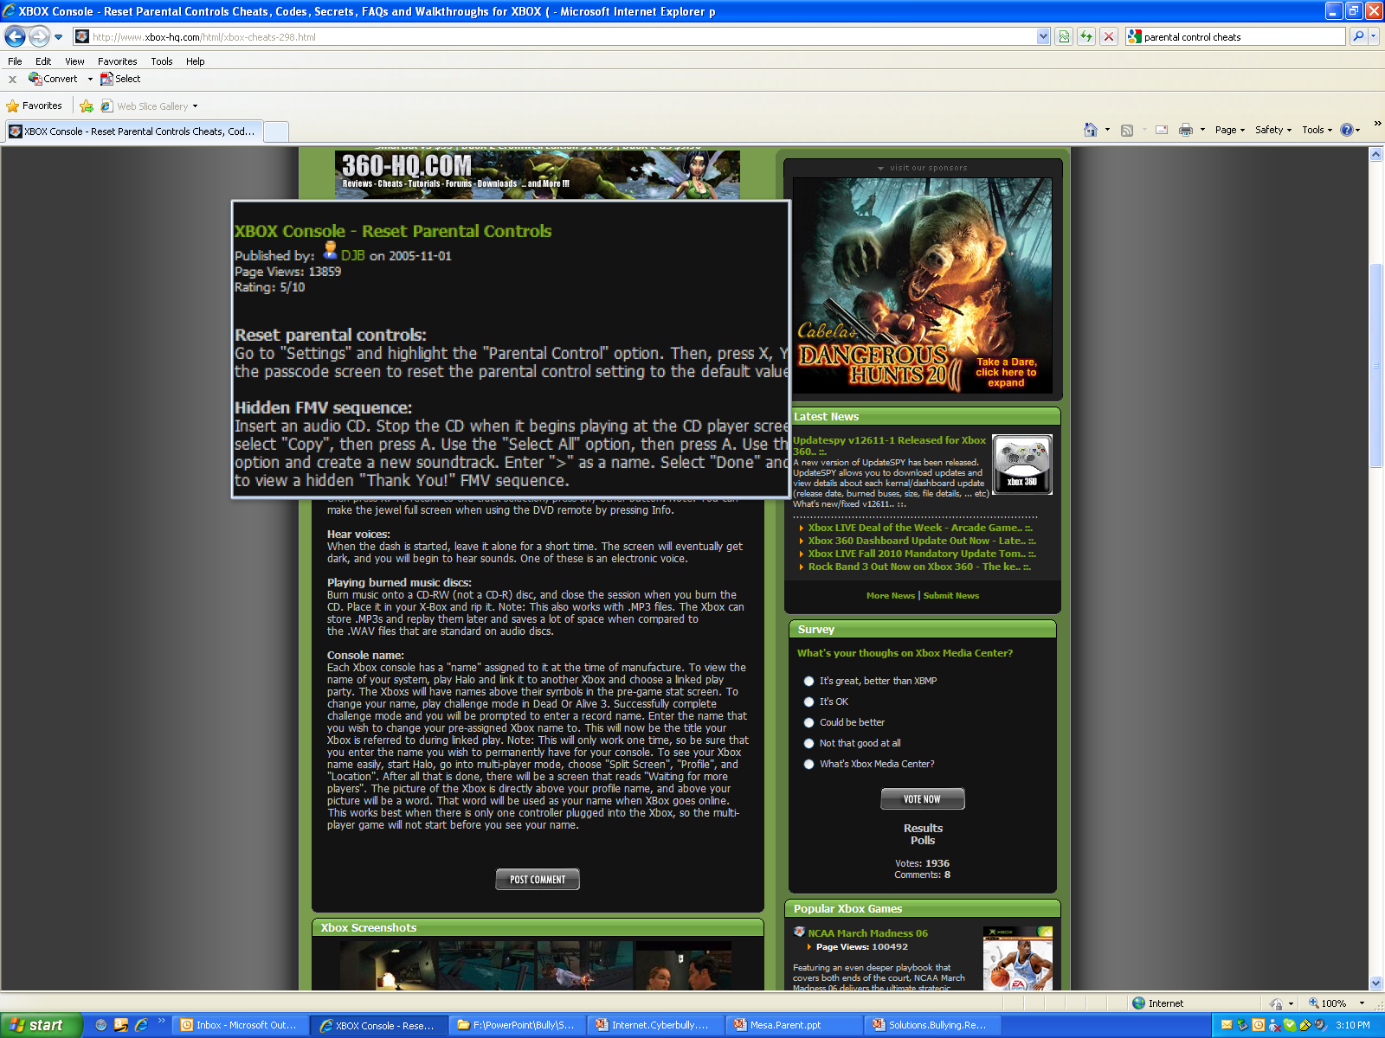
Notes:
Purpose: To show instructions on over riding parental controls for Xbox.

Slide 43
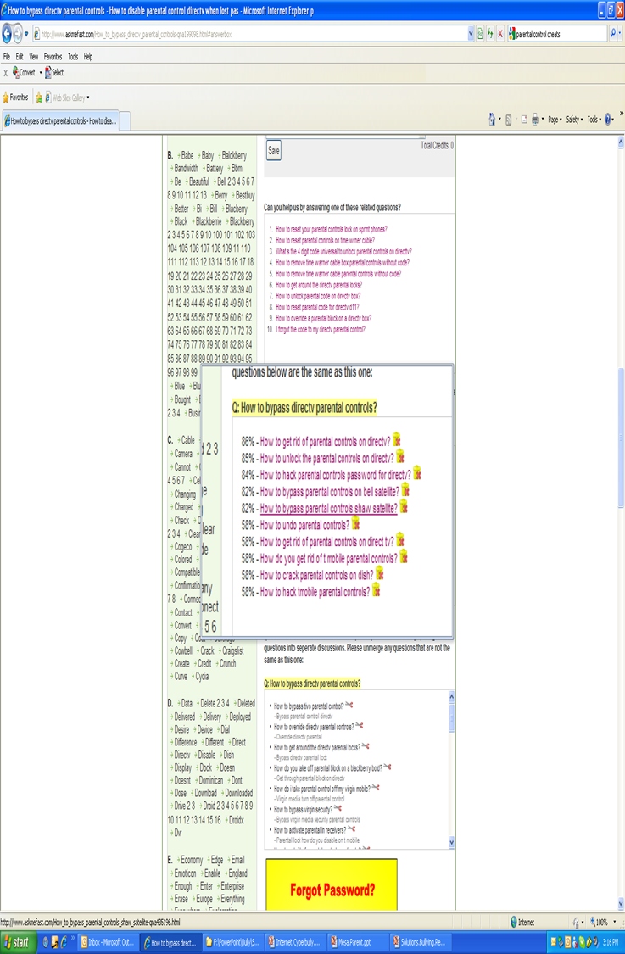

Slide 45
Bottom line…Talk to Your Kids
Privacy!!!
Only Add Real Friends You Know
Give your Password ONLY to Your Parents
Watch What You Post – It is FOREVER
If You Wouldn’t Say it in Person, Don’t Say it Online!
Be Careful in Posing for Pictures With Friends
Do NOT Cyberbully!
Do NOT Spread Rumors!
Do NOT Forward Mean Texts
Protect Your Friends
Remember to TURN-OFF Electronics – Give Yourself a Break!!!
Notes:
Purpose: To provide examples of tips that parents can provide their children.

Slide 46
Resources
For Students | For Teachers, Administrators, and School Staff | For Parents and Community
10 Ways to Respond to Bullying Cartoon Network’s Stop Bullying Speak Up Campaign NetSmartz Kids (Elementary) NetSmartz Teens (Middle & High School) Stop Bullying: U.S. Department of Health & Human Services – Elementary School Stop Bullying: U.S. Department of Health & Human Services – Middle and High School The Bully Project – Student Tools | National Education Association NetSmartz for Educators Teaching Tolerance: Bullying Basics The Bully Project – Educator Tools Tools for Bus Drivers Tools for Food Services staff Tools for Office Managers, Clerks, and Administrators Tools for Paraeducators | Common Sense Media National Crime Prevention Council NetSmartz Parents & Guardians Parent Advocacy Coalition for Educational Rights (PACER) - National Bullying Prevention Center Sacramento Countywide Bullying Prevention Collaborative The Bully Project – Parent Information

Slide 47
Questions???
Jessica Wharton, Bullying Prevention Specialist
jessica-wharton@scusd.edu

