Slide 1
Reclassification
for the
DELAC
December 14, 2017
Vanessa Girard, Director, Multilingual Literacy

Slide 2
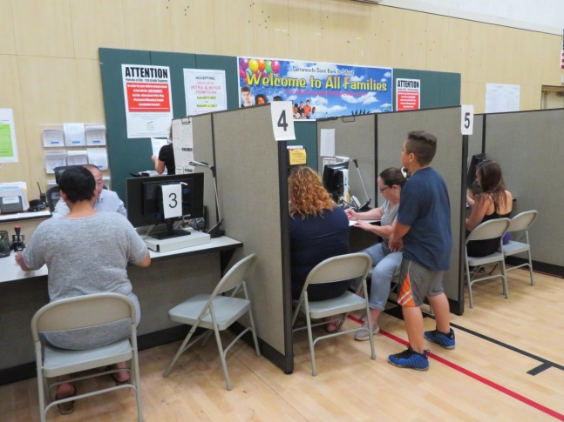
Parents bring their children to the Enrollment Center in SCUSD
Home Language Survey
Notes:
Instruction and Systems
Chapter devoted to telling publishers what’s worthy

Slide 3
Home Language Survey: Four Questions
Which language did your child learn when he or she first began to talk?
Which language does your child most frequently use at home?
Which language do you use most frequently to speak to your child?
Which language is most often spoken by adults in the home?
Notes:
Chapter 1 provides background on the development of both sets of standards, and describes how each are organized.
This overview chapter identifies the relationship of English language arts and literacy, English language development, and the content areas or disciplines is intentionally interdependent. Both sets of standards draw teachers’ attention to the reciprocal and inextricable relationship between content and language. Different approaches to collaboration are illustrated throughout the framework. (Handout 4)

Slide 4
Language Proficiency Assessment
Old:
CELDT
New:
ELPAC
Notes:
Chapter 1 provides background on the development of both sets of standards, and describes how each are organized.
This overview chapter identifies the relationship of English language arts and literacy, English language development, and the content areas or disciplines is intentionally interdependent. Both sets of standards draw teachers’ attention to the reciprocal and inextricable relationship between content and language. Different approaches to collaboration are illustrated throughout the framework. (Handout 4)

Slide 5
Expected progress for ELs
CELDT Level* | Beginning | Early Intermediate | Intermediate | Early Advanced | Advanced | Reclassifica tion
Progress Expected in Language Proficiency | Year One | Year Two | Year Three | Year Four | Year Five | Year Six
 |  | Year One | Year Two | Year Three | Year Four | Year Five
 |  |  | Year One | Year Two | Year Three | Year Four
 |  |  |  | Year One | Year Two | Year Three
 |  |  |  |  | Year One | Year Two
Commensurate Progress on SBAC | Standard Not Met | Standard Not Met | Standard Nearly Met | Standard Nearly Met | Standard Met | Standard Exceeded
SCUSD Expected Language Proficiency Growth for English Learners
*Once CA transitions from the CELDT to the ELPAC, students will receive Language Proficiency scores from 1-4. As over a million CA ELs progress through grades EK-12 taking the ELPAC, we anticipate guidance about expected time at each level until reclassification.

Slide 6
How students get reclassified
After we get results from SBAC or ELPAC, we:
Search our student data for students who have passed both criterion
Provide lists of these students to schools
Schools meet with the teachers and parents of the students on the list to decide on a recommendation
Schools complete a form online stating whether they recommendation the student for reclassification
Notes:
Chapter 1 provides background on the development of both sets of standards, and describes how each are organized.
This overview chapter identifies the relationship of English language arts and literacy, English language development, and the content areas or disciplines is intentionally interdependent. Both sets of standards draw teachers’ attention to the reciprocal and inextricable relationship between content and language. Different approaches to collaboration are illustrated throughout the framework. (Handout 4)

Slide 7
How students get reclassified (continued)
For kids who are recommended, the Multilingual Office:
Changes their status from EL to RFEP in the student information system
Prints a hard copy of the reclassification form for the student’s cumulative folder
Prints a letter to parents informing them of the reclassification and gives it to the schools for students to take home
Notes:
Chapter 1 provides background on the development of both sets of standards, and describes how each are organized.
This overview chapter identifies the relationship of English language arts and literacy, English language development, and the content areas or disciplines is intentionally interdependent. Both sets of standards draw teachers’ attention to the reciprocal and inextricable relationship between content and language. Different approaches to collaboration are illustrated throughout the framework. (Handout 4)

Slide 8
Reclassification Follow-Up
NEW! Students will be followed-up for four years, instead of two
Follow up includes:
Reviewing academic work, behavior, and attendance
Provide targeted intervention when necessary
Notes:
Instruction and Systems
Chapter devoted to telling publishers what’s worthy

