Slide 1
Local Control Funding Formula
July 1, 2013 Governor Brown signed historic school funding legislation: the Local Control Funding Formula (LCFF).
“Today, I'm signing a bill that is truly revolutionary,” said Governor Brown. “We are bringing government closer to the people, to the classroom where real decisions are made and directing the money where the need and the challenge is greatest. This is a good day for California, it’s a good day for
school kids and it’s a good day for our future.”
Notes:
Just a little refresher, LCFF was signed into law in July 2013 at California Middle School.

Slide 2
LCFF Requirement: Local Control and Accountability Plan (LCAP)
LCAP is the plan that each district creates, outlining goals, and specific actions and services to achieve those goals.
The plan includes expenditures that show which funds support the actions and services.
The plan includes a review of data and actual expenditures in an Annual Update.
Notes:
The LCAP is a plan that each district creates, outlining goals, actions and services to achieve the goals, specifically for the Supplemental and Concentration grant funds.
We will start by looking at the district needs assessment.
Expenditures are detailed in the LCAP, showing how actions are supported.
The plan is not the entire district budget: it may include other funding sources that support our goals and actions.
We must show that we are directing Supplemental and Concentration grant funds toward meeting goals for low-income students, English learners, homeless youth and students in foster care.

Slide 3
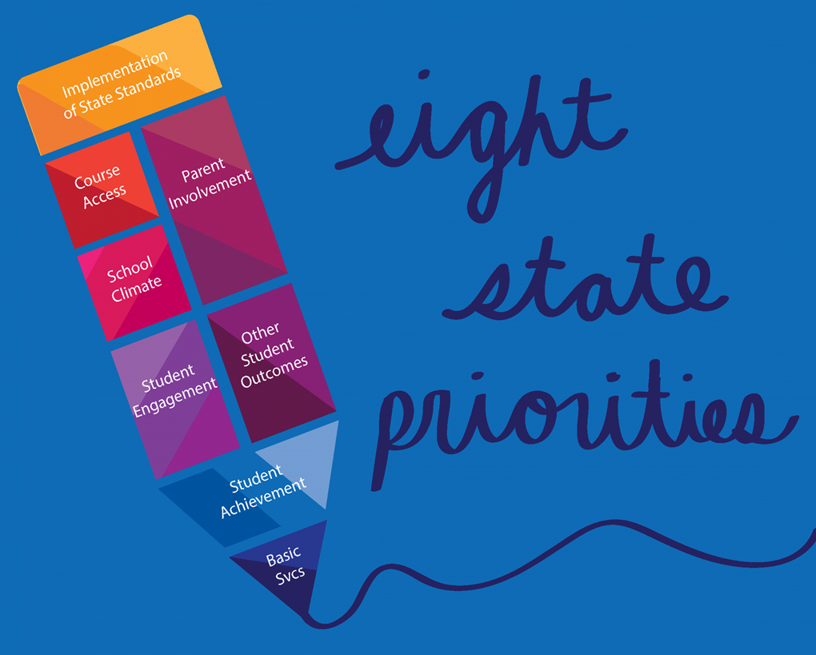
Accountability in the LCAP
Evidence of support for each of the eight state priorities.
Increased or improved services for identified students:
Low-income
English Learners
Homeless and Foster Youth
How stakeholders were consulted as the district develops and updates the plan.
Notes:
What defines accountability? We take responsibility for actions, and report on them.
In the LCAP, the law gives districts flexibility, but with limits.
Must include state priorities and measures
The plan must be created based on needs identified through student data.
Must include evidence of consultation with stakeholders, and must show impact of their involvement in the narrative of the plan. The plan must be reviewed and updated annually, including the feedback from stakeholders.

Slide 4
Local Control & Accountability Plan Goals
Notes:
SCUSD refined the LCAP goals last year to align with the four goals in our strategic plan.

Slide 5
LCAP Translations
We have printed copies of the LCAP for each of the district languages
Resource binders at each table
LCAP online:
www.scusd.edu/LCAP
SPSA Translations in process
Notes:
If you would like to read the full LCAP, each table has a binder with translated copies. These are our reference copies. You may request a printed copy be sent to you at your school site – see the sign up sheet on your table
We also have a linked copy of the translations on the district website.
If you are serving on a school site council, the Single Plan for Student Achievement (SPSA) translations are in process.

Slide 6
LCAP Development Timeline
November
California School Dashboard
Release
January
Feedback Survey
March
LCAP Annual Review
April-May
LCAP
Draft
June
Board Approval
D i s t r i c t D e v e l o p m e n t P r o c e s s
DELAC Subcommittee Studies the LCAP
Subcommittee Work
D E L A C M e e t i n g s
December
California
School
Dashboard
workshop
February
LCAP Annual Review
April
LCAP Draft
Release
May
DELAC comment on the LCAP
Notes:
The timeline for LCAP work is shown here.
The district work is shown along the top by the green arrow.
The DELAC meetings are shown under the blue arrow.
At the December meeting, we will have a hands-on workshop on the California School Dashboard, which is the state’s new accountability system for districts and schools. The Dashboard is one tool that the district will use when developing the LCAP.
The red arrow in the center shows the timeline for a DELAC subcommittee that will is voluntary. The DELAC, as representatives of English Learners, will review and comment on the LCAP draft for the next year. As in the past, the subcommittee will meet outside of the DELAC to study the document. If you are interested in serving on this committee, you may also indicate that on the sign-up sheet at your table.

Slide 7
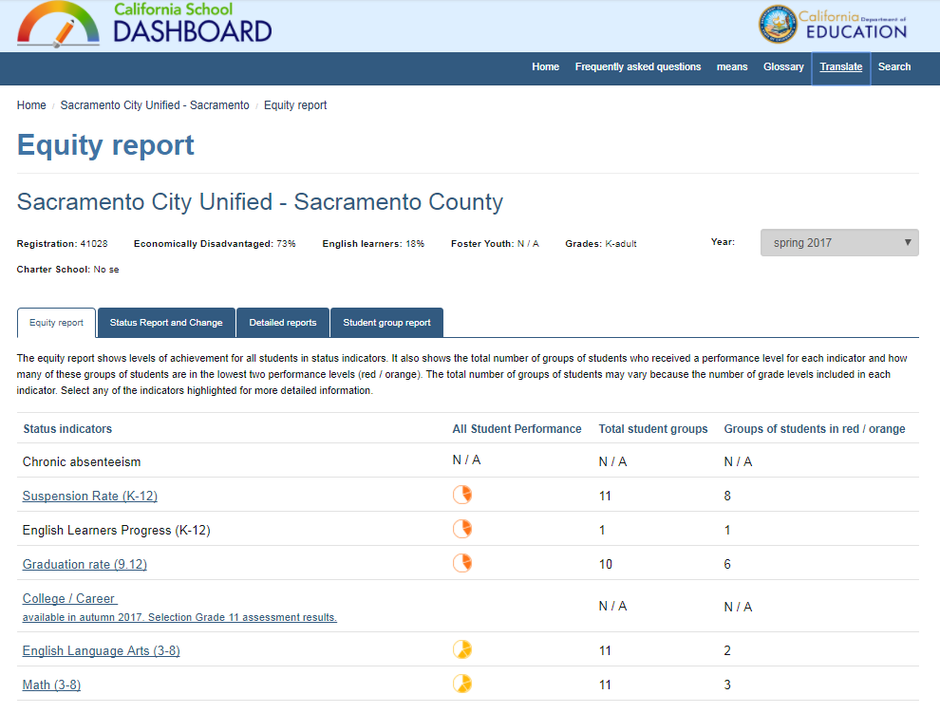
Next month: learn about the Dashboard
Notes:
As a reminder, please be sure to join us in December for a hands-on workshop to learn more about the California School Dashboard.

Slide 8
Contact
LCAP Coordinator
Cathy Morrison
Email: Cathy-Morrison@scusd.edu
(916) 643-9222
Notes:
If you would like to read the full LCAP, each table has a binder with translated copies. These are our reference copies. You may request a printed copy be sent to you at your school site – see the sign up sheet on your table
We also have a linked copy of the translations on the district website.
If you are serving on a school site council, the Single Plan for Student Achievement (SPSA) translations are in process.

