Slide 1

Supplemental Materials Sessions
August 2014
Academic Conversations to Support Common Core and
Core Ready Lesson Sets

Slide 2
ELA CCSS
Speaking and Listening standards call upon students to:
Participate in collaborative conversations with diverse partners
Engage effectively in a range of one-on-one and group discussions
Express their own ideas clearly
Build on other’s ideas
Notes:
Discuss importance of academic conversations in common core. All these come from Speaking and Listening Standard 1

Slide 3
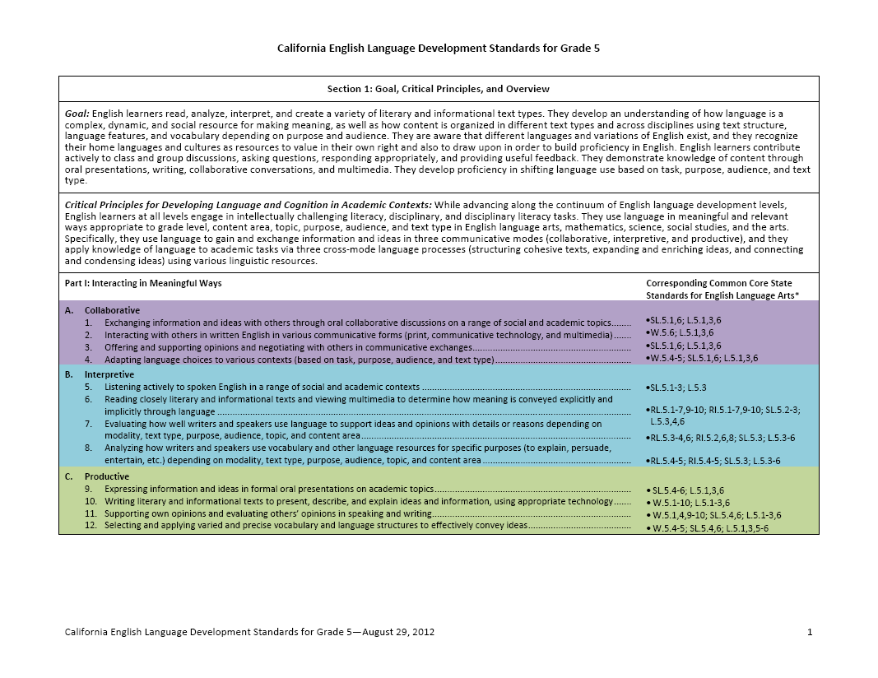

The New California ELD Standards
Part I: Interacting in Meaningful Ways
Part II: Learning About How English Works
New CA ELD Standards
Notes:
ELD standards created after CCSS and are closely aligned. They help shed light on language that ALL kids will need to be successful in the common core. Two parts… As we focus on academic conversations, we are addressing Part 1, Mode 1 (Collaboration)

Slide 4
Building Academic Conversations
Establishing expectations for all classroom talk
Implementing discussion protocols
Increasing depth of conversations
Setting up physical environment that promotes conversation
Rare Occasional Frequent
Notes:
Talking points:

Slide 5
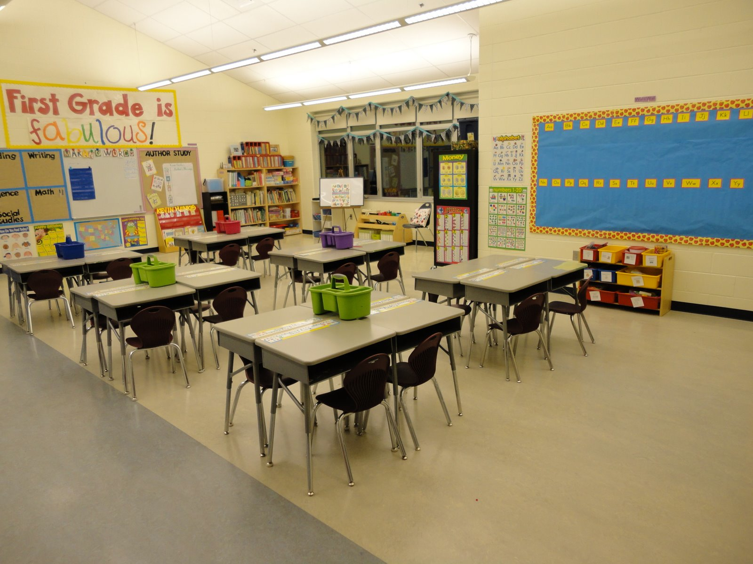
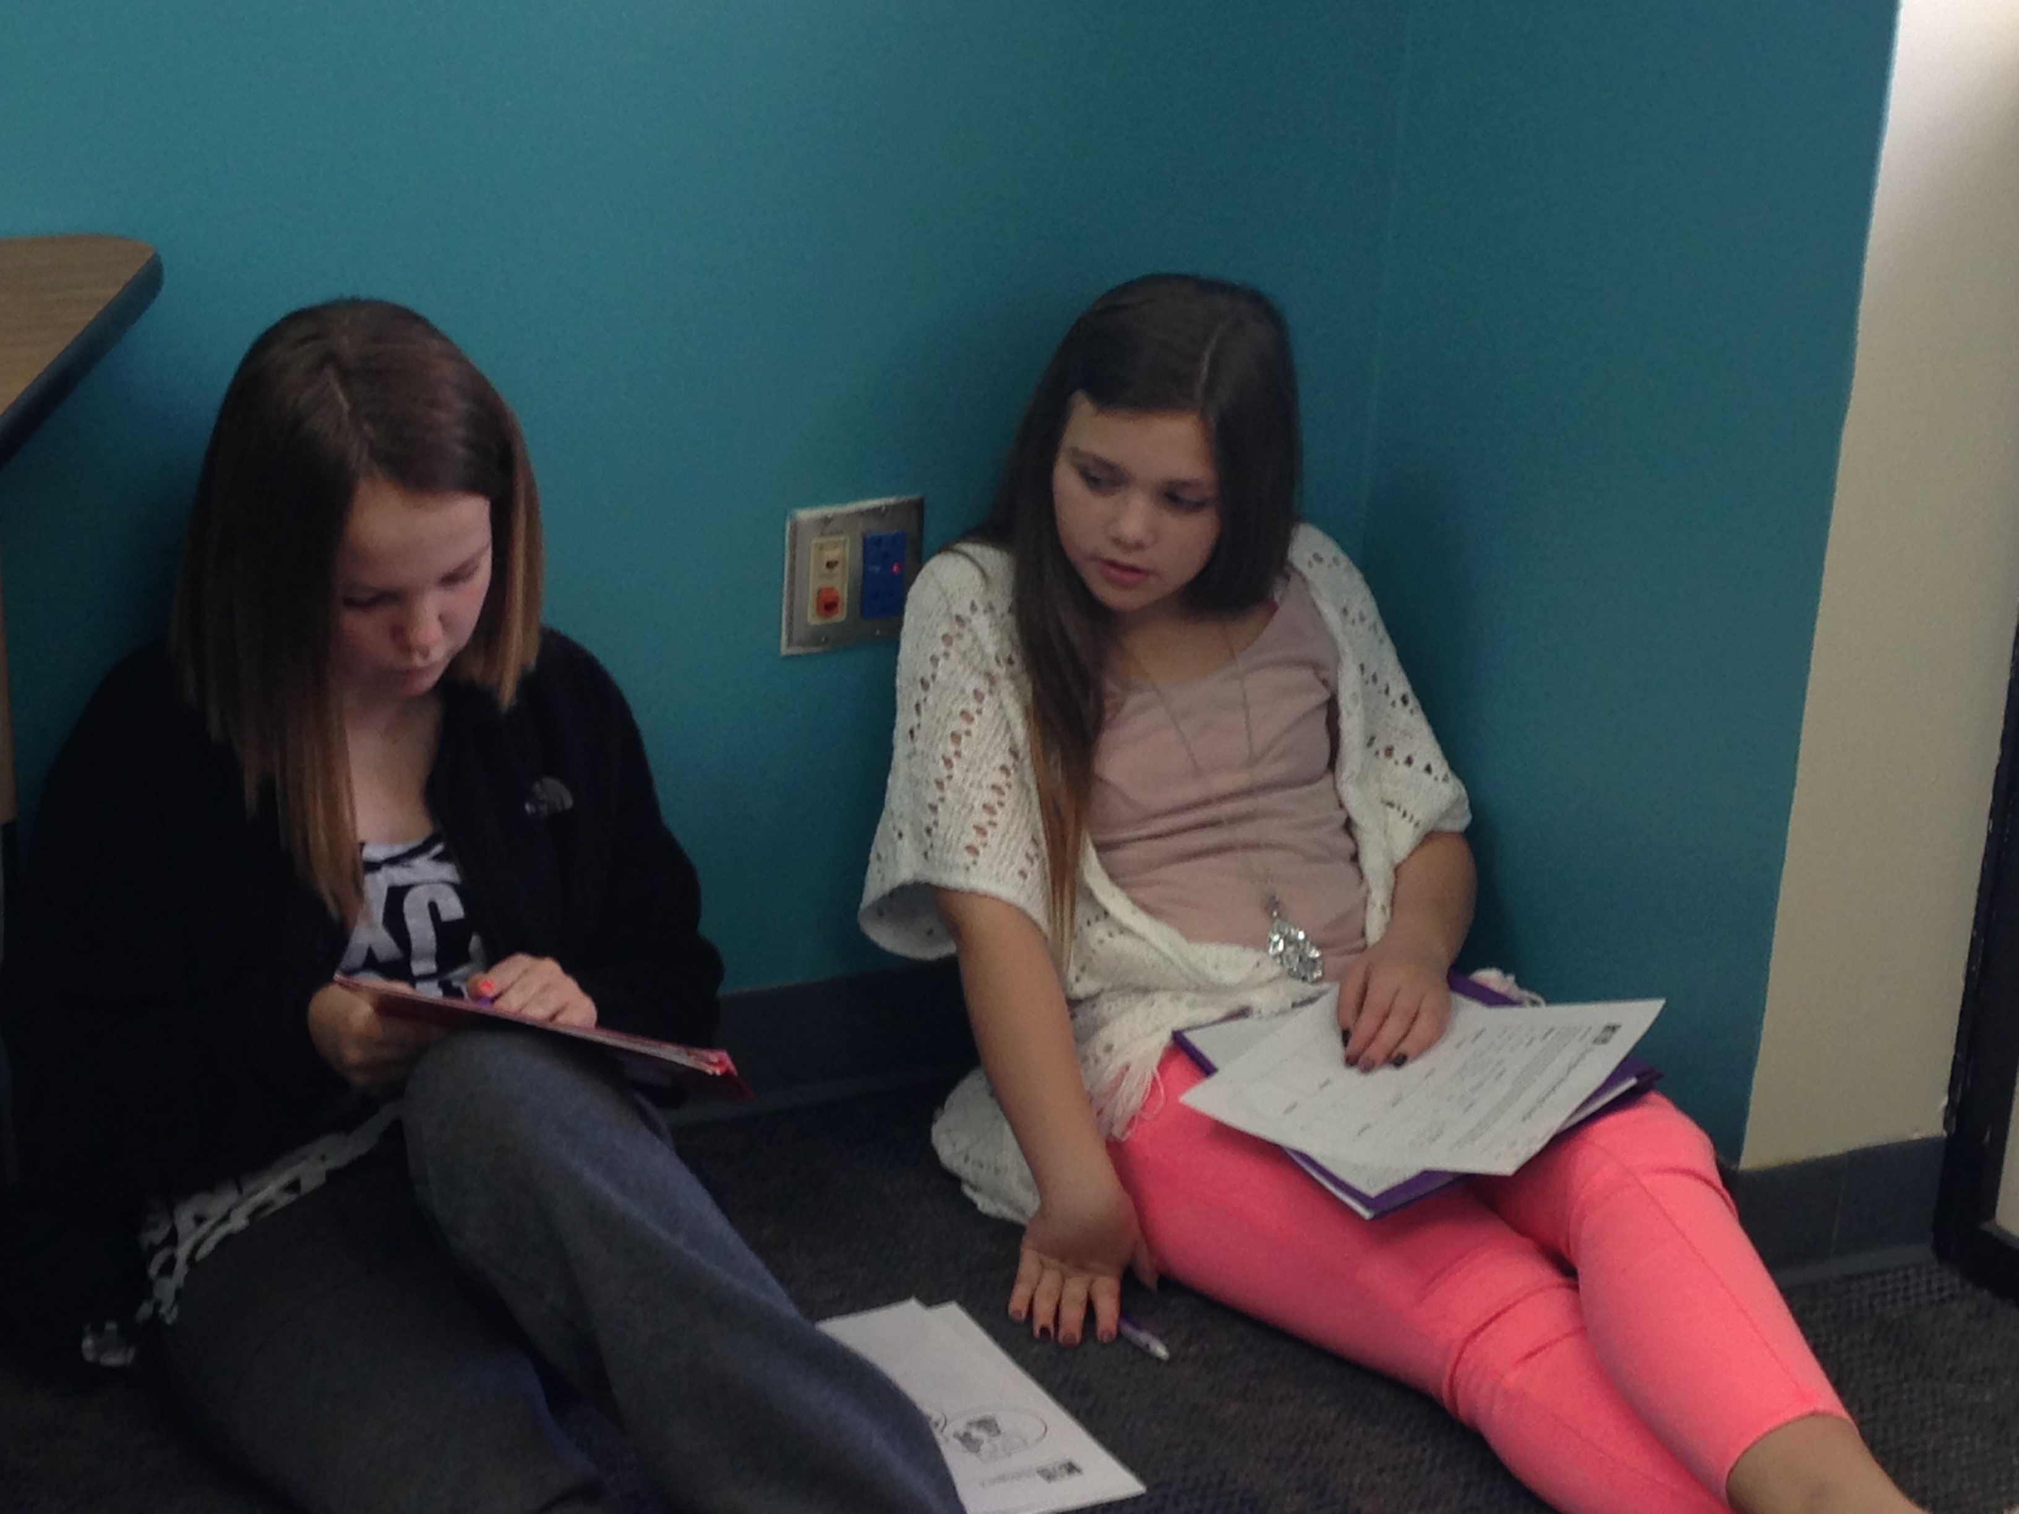
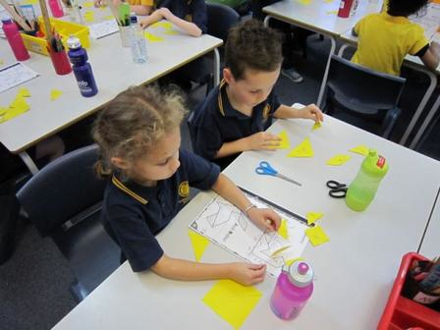
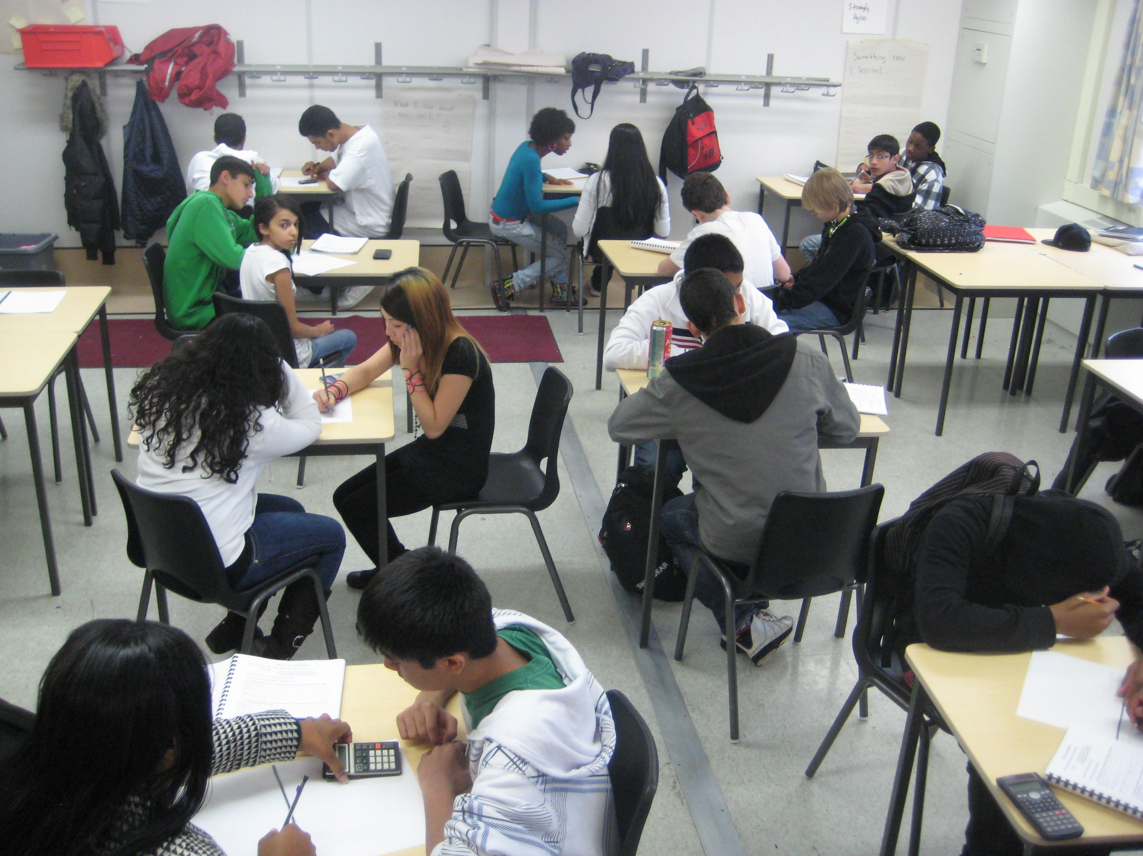
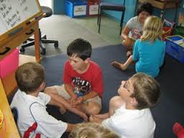
Setting Up the Physical Environment
Notes:
Talking points: Earlier in the day, we discussed that the physical environment must support collaborative learning. More specifically, the Common Core standards as well as the ELD standards require that students engage in a variety of discussions: large group, small group, and partner. As teachers, we need to think about the way our physical environment either encourages or hinders students’ ability to engage in these types of conversations. We want to think about where in the classroom will students engage in these types of conversations, how we will transition in and out of each space or transform the same space to meet different needs (e.g., turning desks to face a partner or group). We also want to think about how much structure will be required to support students in maximizing their time in each space. Assigned seating is a commonly used strategy that minimizes the amount of time spent transitioning from one space to the next. What are some other effective strategies for maximizing student work time?

Slide 6
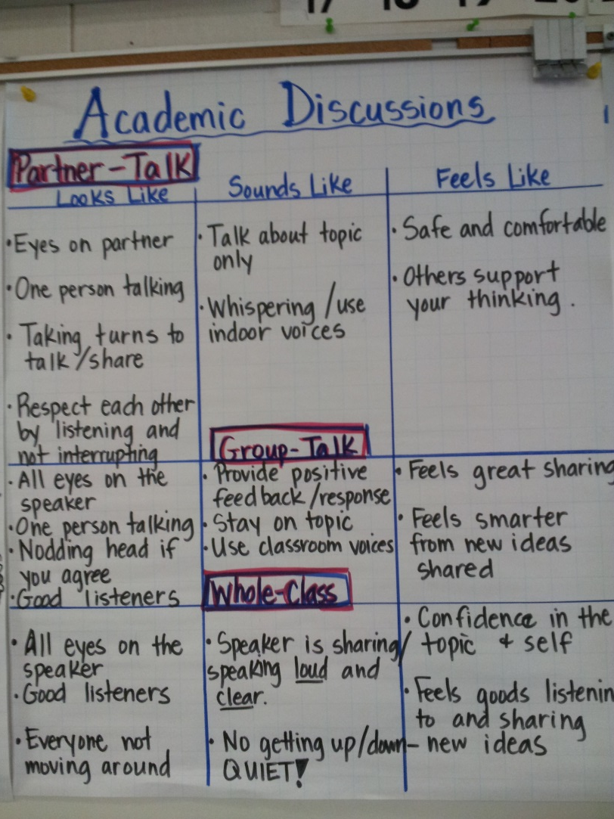
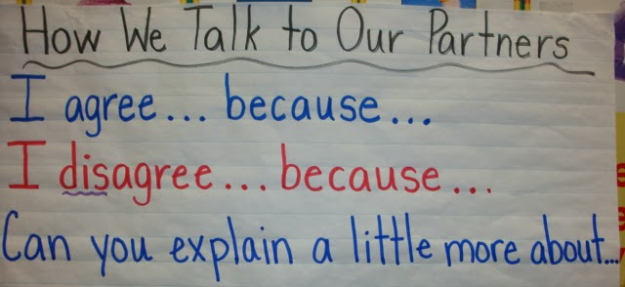
Expectations for Classroom Talk
Co-create anchor charts that might address the following:
Eye contact
Body language
Volume/Tone of voice
Language stems that promote respect
Notes:
Talking points: Co-creating charts, AS A CLASS, is an effective way of setting classroom expectations. Here you see pictures of some classroom anchor charts around the basics of academic conversations. These are expectations that apply to all classroom talk regardless of size of group or specific discussion protocol. Some of the basics include: eye contact, face your partner, speak audibly. You may also use this opportunity to introduce stems or frames for basic conversation skills, such as sharing ideas, agreeing, disagreeing, requesting clarification, inviting participation of others, etc. How many skills you introduce will be grade-level dependent. For example, in the beginning of kindergarten we are excited if students exhibit turn taking and clearly state their own idea. In sixth grade, we would expect students to request clarification and stick with one idea for an extended time elaborating and clarifying throughout the conversation.

Slide 7
Implementing Collaborative Structures: (Think), Turn and Talk
What it is, why we use it
Establish partnerships
Model
Practice with student-friendly topics
Debrief
Create anchor chart for protocol
Offer multiple opportunities for practice/debrief over time
Notes:
Talking points: In Core Ready materials partner work is often referred to as turn and talk. Many of you are probably familiar with Think, Pair, Share. I recommend calling it Think, Pair, Share or Think, Turn, and Talk because it is easy to forget the think time that is so critical to the success of the discussion. When introducing a new discussion protocol, it is important to address each of these areas in order to set your students up for success. For (Think) Turn and Talk, these areas might be addressed like this.
What it is, why we use it – partner discussion will be our most commonly used form of discussion because talking with partners means EVERYBODY gets a chance to talk and process their ideas, we also can get nervous when sharing our ideas with larger groups and we get comfortable working with our partner regularly
Establish partnerships – We can increase the success of this protocol through strategic partnering. This can mean heterogeneous or homogeneous pairs based on ability in content area, pairs of students with the same primary language, pairs based on interest, etc. Having assigned partners allows you to scaffold in the moment depending on tasks. For example, I could have eyeball partners and elbow partners (or A/B partners) predetermined. One is a heterogeneous pairing and one is homogeneous by ability. If I think my struggling students will need additional scaffolding for a task I ask them to work with their elbow partner (higher achieving peer), If I want each pairing to struggle through something at their level, they can work with they eyeball partner. I would seat students accordingly when planning my physical environment. Some teachers, especially at older grades prefer to have students choose their own partners in order to promote agency. I personally have concerns about this strategy because I have seen many classrooms in which the same student never gets chosen and must be assigned a partner by the teacher. It also removes the ability of the teacher to take advantage of strategic partnering. If you choose to use this strategy, just be sure you have addressed those two issues in some other way. You also want to be sure you have a procedure in place for what to do if your partner is absent. You know it’s going to happen so you might as well have a plan in place so it doesn’t take away from the student work-time.
Model – Modeling of this protocol can take many forms. The teacher can model with a student; two students can model for the rest of the class in a fish bowl; you can take the class to visit an older class using the protocol.
Practice with student-friendly topics – In order to provide students a chance to be meta-cognitive about the structure of the protocol, they can practice with a topic that is comfortable and engaging. Even though the topic is student-friendly, the task should require the same type of conversation you expect students to engage in. For example, “With a partner, design a robot that can do your three least-favorite household chores.” will elicit more complex conversation than “Tell your partner your three least-favorite household chores.”
Debrief – SUPER IMPORTANT!!! The debrief can be general, such as “what worked/didn’t work” or focused on a particular area, such as “how did we do with staying on topic?”. Younger children especially will need to debrief their product before process. This may mean sharing the content of your conversation with another partnership, having additional think time around the process, and then sharing that as a large group.
Chart – You may not need a chart for this protocol since it is relatively simple and you will use it so often, but more complex protocols (jigsaw, or numbered heads together) or those that are less frequently used will benefit from an anchor chart for students to refer to during the protocol.
Multiple opportunities – Once your students seem to have a protocol mastered, it is easy to forget that they’ll need opportunities to practice and debrief over time. But don’t worry, they have ways of letting you know when they need them.
This process for introducing discussion protocols can be used for any new protocol for partner talk, small group or whole class. And is included in your handouts.

Slide 8
Increasing Depth of Conversations
Typical conversation by un-coached students:
Student A: OK, why did the author write this?
Student B: To teach us about courage.
Student A: Yeah, the guy was brave.
Student B: OK, what do we do now?
Increasing depth of conversations allows you to use academic conversations to push students’ thinking in all curricular areas.
Notes:
Talking points: Constructive Conversation Skills Poster and Depth of Knowledge/Blooms
Conversations will build from level one moving through the depths of knowledge.

Slide 9
Increasing Depth of Conversations with Conversation Skills
Another way to increase the depth of academic conversations is to teach students to facilitate conversations in teacher-like ways.
Academic Conversations,
Jeff Zwiers and Marie Crawford
Stenhouse (2011)
Notes:
This is the Constructive Conversation Skills Poster. It is a tool for helping teach students to facilitate their own conversations is teacher-like ways. Each conversation skill should be explicitly taught including some ways the skill might sound in conversation. Read the passage from Jeff Zwiers BOOK TITLE explaining each of the skills. Think time (2 minute plan) how would you teach this in your classroom? Now you will have 5 minutes to come up with the steps you would take in your classroom to teach one of these skills.
Note to presenter: Be sure modeling the skills, practicing with student-friendly content, and developing an anchor chart are among strategies discussed as a group.

Slide 10
(Think), Turn and Talk Debrief
How did the 2 minute think time affect the conversation you had?
How did you manage your time in the conversation?
How did the (think) turn and talk help you build up your ideas about academic conversation?
Notes:
How did the 2 minute think time affect the conversation you had?
How did you manage your time in the conversation?
How did the turn and talk help you build up your ideas about academic conversation?

Slide 11
Increasing Depth of Conversations with Prompts
One way to increase depth of conversation is through clear and engaging prompts that require complex thinking.
From Core Ready “Journey to Meaning” Grade 3
Now, open your research folder and look at your notes. Read all of your notes to yourself first. Then, turn and talk to your partner, sharing with him or her some notes that seem to go together. Let your partner know if you agree with what he or she has found. Ask yourselves and each other, “Does it sound like those notes go together?”
Provide your students with some sentence starters for this partner talk:
I agree that your notes about ______________ go together.”
I disagree because your notes about _____________ and _____________ don’t seem to fit together.”
Notes:
Talking points: Here is an example of a prompt from Core Ready (page 54/55 of Journey to Meaning 3-5). It is given after students have read an article on the topic.
What makes this prompt clear and engaging?
Where does this fall on DOK?
Luckily, Core Ready provides us with many clear and engaging prompts that require complex thinking. Not all of them are listed as turn and talks or small group discussions. This doesn’t mean that you cannot decide to have students work with partners or groups to address the prompts. It is your decision as the teacher what will most greatly benefit your students. You will use these supplemental materials as you see that they will best support your implementation of the curriculum maps.

Slide 12
Reflection Tool
Physical Environment There is an established space for Large group discussion Small group discussion Partner discussion Transition procedures are well rehearsed There are structures that maximize learning time, such as Assigned seating Procedure for absent partners | Expectations for Classroom Talk Anchor Charts and student behavior reflect: Eye contact Volume/Tone of voice Body language Basics skills are addressed with sentence stems or language frames (sharing ideas, agreeing, disagreeing, promoting participation from others, etc.) | Collaborative Structures Discussion protocols are in place, such as: (Think) Turn and Talk Numbered Heads Together Jigsaw Huddle Put your 2 cents in Pass the mic
Increasing Depth of Conversation Prompts reflect complexity of thought (See Webb’s DOK) Students facilitate conversations in teacher-like ways (See Zwiers’ Constructive Conversation Skills on back)
Level 1
Recall
Recall fact, or information
Level 2
Skill/Concept
Use information, conceptual knowledge, procedures
Two or more steps
Level 4
Extended Thinking
Requires an investigation
Time to process multiple conditions of the problem or task
Level 3
Strategic Thinking
Recall procedure
Requires reasoning or developing a plan
More than one possible answer
Notes:
This is a tool we have developed to help you reflect on your classroom regarding academic conversations. The front has each of the four components that build academic conversations. Webb’s DOK level descriptors are here under Increasing depth of conversation and on the back is the Constructive Conversation Skills Poster from Zwiers. We hope this will assist you in planning your launch unit as well as throughout the year as you reflect on the effectiveness of the conversations students are having.

Slide 13
(Think), Turn and Talk
What is one improvement you will make in the first trimester to build academic conversations in your classroom?
Focus Conversation Skill: Clarify
Notes:
We are all at different places in our journey toward frequent and deep academic conversation in our classroom. Looking at graphic “Building Academic Conversations” think about where your classroom is with regards to academic conversation. What would the next logical step be to move the conversations in your classroom? 2 minutes to think first. Now you have 3 minutes to discuss with partner. As you discuss with your partner, practice the conversation skill of clarifying. You may use the starters from your poster if you find them helpful.

Slide 14
Jeff Zwiers
Academic Conversations
http://www.jeffzwiers.org/
Stanford MOOC - Kenji Hakuta
Massive Open Online Course
Notes:
Free resources to grow our knowledge and understanding

