Slide 1

Math CCSS Sessions
December 2014
Using A Genre Approach to Help Students Explain Their Thinking

Slide 2
Francis Christie describes language as “the hidden curriculum”.
Discussion – What are the implications for math instruction?
Notes:
Discuss with partner.

Slide 3
SMP 1 – Make sense of problems
“(Students) analyze givens, constraints, relationships, and goals….they can explain correspondences between equations, verbal descriptions, tables, and graphs….they can understand the approaches of others to solving complex problems and identify correspondences between different approaches.”
Notes:
This SMP also talks about perseverance, but we will live in explanation today.

Slide 4
Why Teach Language of Math?
“The main pedagogical aims of this research are to….provide (students) with a wider range of linguistic resources, enabling them to make appropriate language choices that they can (use to) comprehend and construct meaning within oral and written texts.”
Notes:
This is from Appendix C of the ELD Standards where there is discussion of discipline specific language instruction.
Last time we focused on comprehending/understanding text (deconstructing word problems); today we will focus on constructing meaning (explaining) either orally or in written text.

Slide 5
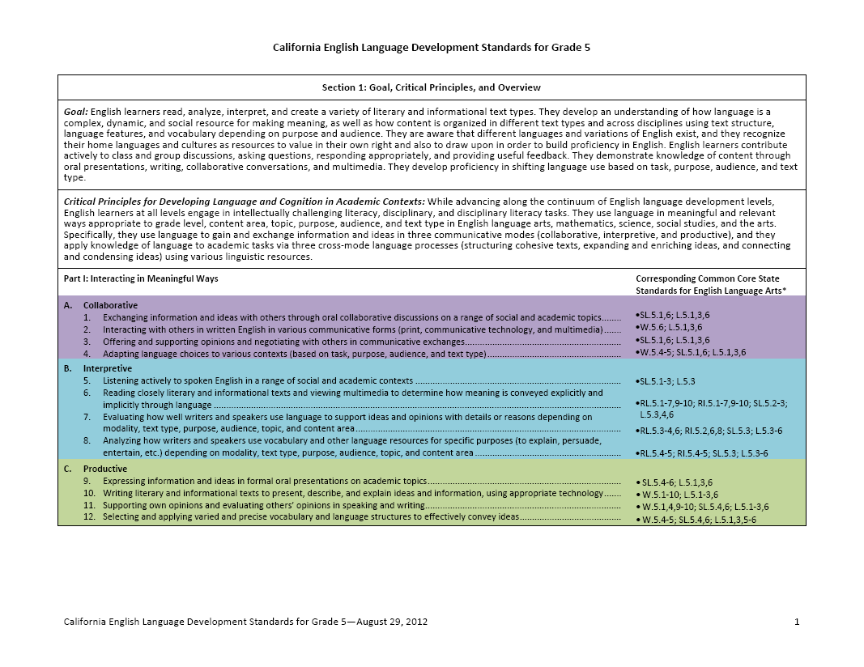
The California ELD Standards
Part I: Interacting in Meaningful Ways
Part II: Learning About How English Works
II A. 1 Structuring Cohesive Texts: Apply understanding of how text types are organized to comprehending and composing texts.
I A. 2 Collaborative: Interacting with others in written English in various communicative forms.
Notes:
Note where the focus was last time (Academic Conversations) in comprehending word problems. Today we move to producing language to explain thinking in Math. We are using the same “genre study” approach to now focus on the language we are asking students to produce.

Slide 6
Math Explanations as a Genre
“Show and explain your mathematical thinking.”
A genre is a category of texts that shares a particular social purpose, structure, and set of language features.
Explaining your thinking can be more than one genre.
Notes:
If you were here last time, you heard Vanessa say that the purpose of the genre dictates the structure and language features that are most effective. In order to support my students in understanding or producing a particular genre, I can explicitly teach them the structure and language features that are effective and appropriate in that genre.
Like any good language teacher, I set out to find what structure and language features are found in math explanations. After many hours analyzing different samples of math explanations, I had an aha moment; math explanations is not a genre. Different types of problems have different purposes and, therefore, require different types of responses.

Slide 7
Some Possible Purposes (Genres) for Explaining Math Thinking
Argument – Ramon says… Do you agree or disagree? Why or why not?
Explanation - How can you use a multiplication fact to find a division fact?
Procedural Recount – Explain how you solved the problem.
** Procedural AND Conceptual Thinking
Notes:
Argument structure allows you to take a position and defend that position with reasons and evidence.
Explanation allows you to explain a phenomenon or idea.
Procedural recount allows you to explain your approach or reasoning to solving a specific problem.

Slide 8
Procedural Recount
Explain How You Solved The Problem
What is the purpose of a procedural recount? In other words, why do we ask students to read or write them?
Jot down your ideas in order to be prepared for an academic conversation.

Slide 9
Procedural Recount
Explain How You Solved The Problem
Academic Conversation
Share your ideas with your partner.
Create a new statement of purpose based on both your ideas.
Be prepared to share your purpose in the event that you are called upon.
The purpose for having students produce procedural recounts is …
Having students produce a procedural recount serves to …

Slide 10
Procedural Recount as a Genre
“Explain how you solved the problem.”
A genre is a category of texts that shares particular social purpose, structure, and set of language features.

Slide 11
Procedural Recounts as a Genre:
Using Inquiry to Identify Structure and Language Features
Review the samples of procedural recounts provided.
What do you notice about their structure and language features?
 | STRUCTURE |  |  | Language Features (vocab, verb tenses, POV, etc.)
 | Beginning | Middle | End
Sample 1
Sample 2
Sample 3
Notes:
This should look familiar if you were here last time. This is the same way you analyzed word problems. Under structure, look for what kind of content is included in each part of the explanation. Under language features, look closely at patterns in vocabulary used, verb tenses or forms, point of view, etc. This activity I encourage you to do with your partner.

Slide 12
Procedural Recounts as a Genre
Academic Conversation
How can I use a procedural recount to demonstrate conceptual understanding?
$$Procedural Recount≠Procedural Math$$

Slide 13
Procedural Recount as a Genre--
Mapping the Text Structure
Structure | My Explanation of How I Solved the Problem
Goal and Strategy
Steps I took
Result

Slide 14
Mr. Brown sells flowers. He sold 417 red roses and 232 yellow roses. Which flowers did he sell more of? Explain how you solved the problem.

Slide 15
Evidence of Conceptual Understanding
Revisit you and your partner’s explanation of how you solved the problem.
Find places where you demonstrate conceptual understanding.
Which language features allowed you to demonstrate conceptual understanding?

Slide 16
What teaching moves will you use in your classroom to support your students in explaining their mathematical thinking?
What can you bring to our next session to celebrate your students’ progress?

