Slide 1
Guided Reading for K-2 & Struggling Readers in 3-6
August 2015
Jeannette Schroeder

Slide 2
Guided Reading for K-2 & Struggling Readers in 3-6
Session Outcomes:
1. Deepen our understanding of why and how we should monitor the progress of beginning readers using running records
2. How to administer, score, and analyze running record assessments
3. How to use cueing systems to teach guided reading groups
4. Plan for teaching and record keeping systems
Notes:
Jeannette

Slide 3
Reading is a highly complex process. Readers must build a system of strategic actions for processing texts that begins with early reading behaviors and becomes a network of strategic activities for reading increasingly difficult texts.
The construction of systems “in the head” is unique for each student. Marie Clay (1991) described readers’ paths to proficient reading as, “different paths to common outcomes.” Your role is to notice each student’s precise literacy behaviors and provide appropriate teaching that supports students in developing their systems of strategic actions.
Notes:
Kae

Slide 4
Why and how should we monitor the progress of beginning readers?
Notes:
ad Page 1 from start to stop and be ready to discuss with your partner the question above. Chart: Using standard procedures, observe precisely what kids are doing, discover what reading behaviors they now should be taught, train using on-task activities

Slide 5
Running Records
First Step- Select something that is known to the student for him or her to read orally. (If it is too familiar, the reading may not reveal much information about the child’s thinking.) This may be: a guided reading book, a poem, a dictated piece of student writing, some of the student’s published personal writing
Second Step- Ask the student to read the selected piece aloud. Record the student’s reading in one of these ways: Record the correct reading and miscues on a blank sheet of paper as the student reads OR make a copy of the text and mark the miscues on it as the student reads.
Third Step- Tabulate the miscues. Use symbols to indicate what the student is doing. Some usual convention follows. (Fountas & Pinnell)

Slide 7
Things to Remember About
Running Records
Running Records are not timed (if a student is struggling too much with a text, stop the record)
Do NOT teach during a running record. (Do NOT correct errors)
If a student does not attempt to say the word (allow a few seconds to pass) then prompt them by saying, “Try it”. Give them the word if they do not try it. (Mark T for told)
If a student attempts to sound out a word, but the attempt goes on for 2 or 3 seconds or does not seem productive, then tell them the word and mark T for told along with the sounds that were attempted.
No penalty for trying, self correcting, or rereading (but still mark these behaviors)

Slide 8
Video of a Running Record

Slide 9
Administering
Running Record
Notes:
Kae
Ways to build your classroom library-
Open Court Books can now join your library- leveled and read aloud
Garage/Yard Sales
Scholastic book points
Ebay- book bundles
Friends of the Library Sales- Libraries once a year sell books that people donate
Scholastic Warehouse Sale

Slide 10
Scoring the Running Record
Tally the errors and self corrects
Circle the cueing systems the student used in errors and self corrects?
Meaning: Using context/picture to make meaning
Structure: Making sense of grammar
Visual: Using actual print/ word parts on page
Notes:
Kae
Ways to build your classroom library-
Open Court Books can now join your library- leveled and read aloud
Garage/Yard Sales
Scholastic book points
Ebay- book bundles
Friends of the Library Sales- Libraries once a year sell books that people donate
Scholastic Warehouse Sale

Slide 11
Scoring the Running Record
What is the error rate of this student?
(Total words / Total errors= Error rate)
Ex. 100/ 9= 11.1 or 11 rounded to the nearest
whole number. The ratio is expressed 1:11
This means that for each error made, the student read approximately 11 words correctly.

Slide 12
Scoring the Running Record
What is the accuracy rate of this student?
(Total words read- total errors/ total words
read X 100= accuracy rate)
Ex.100-9/ 100 X 100= 91% Accuracy.
You can use the accuracy rate to determine whether the text read is:
Independent Easy enough for independent reading 95%-100%
Instructional Instructional level for use in guided reading 90%-94%
Frustration Too difficult and will frustrate the reader 89%-below

Slide 13
Analyze the Running Record
What does the accuracy rate tell us about the students reading level?
What cueing system(s) is/are the student using?
Around what skill or strategy does this student need instruction?
Notes:
Kae
Ways to build your classroom library-
Open Court Books can now join your library- leveled and read aloud
Garage/Yard Sales
Scholastic book points
Ebay- book bundles
Friends of the Library Sales- Libraries once a year sell books that people donate
Scholastic Warehouse Sale

Slide 14
Administering
Running Record
Notes:
Kae
Ways to build your classroom library-
Open Court Books can now join your library- leveled and read aloud
Garage/Yard Sales
Scholastic book points
Ebay- book bundles
Friends of the Library Sales- Libraries once a year sell books that people donate
Scholastic Warehouse Sale

Slide 15
Scoring the Running Record
Tally the errors and self corrects
Circle the cueing systems the student used in errors and self corrects?
Meaning: Using context/picture to make meaning
Structure: Making sense of grammar
Visual: Using actual print/ word parts on page
Notes:
Kae
Ways to build your classroom library-
Open Court Books can now join your library- leveled and read aloud
Garage/Yard Sales
Scholastic book points
Ebay- book bundles
Friends of the Library Sales- Libraries once a year sell books that people donate
Scholastic Warehouse Sale

Slide 16
Scoring the Running Record
What is the error rate of this student?
(Total words / Total errors= Error rate)
Ex. 100/ 9= 11.1 or 11 rounded to the nearest
whole number. The ratio is expressed 1:11
This means that for each error made, the student read approximately 11 words correctly.

Slide 17
Scoring the Running Record
What is the accuracy rate of this student?
(Total words read- total errors/ total words
read X 100= accuracy rate)
Ex. 100-9/ 100 X 100= 91% Accuracy.
You can use the accuracy rate to determine whether the text read is:
Independent Easy enough for independent reading 95%-100%
Instructional Instructional level for use in guided reading 90%-94%
Frustration Too difficult and will frustrate the reader 89%-below

Slide 18
Analyze the Running Record
What does the accuracy rate tell us about the students reading level?
What cueing systems is the student using?
Around what skill or strategy does this student need instruction?
Notes:
Kae
Ways to build your classroom library-
Open Court Books can now join your library- leveled and read aloud
Garage/Yard Sales
Scholastic book points
Ebay- book bundles
Friends of the Library Sales- Libraries once a year sell books that people donate
Scholastic Warehouse Sale

Slide 19
Analyze the Running Record
What does the accuracy rate tell us about the students reading level?
What cueing system(s) is/are the student using?
Around what skill or strategy does this student need instruction?
Notes:
Kae
Ways to build your classroom library-
Open Court Books can now join your library- leveled and read aloud
Garage/Yard Sales
Scholastic book points
Ebay- book bundles
Friends of the Library Sales- Libraries once a year sell books that people donate
Scholastic Warehouse Sale

Slide 20
Administering
Running Record
Notes:
Kae
Ways to build your classroom library-
Open Court Books can now join your library- leveled and read aloud
Garage/Yard Sales
Scholastic book points
Ebay- book bundles
Friends of the Library Sales- Libraries once a year sell books that people donate
Scholastic Warehouse Sale

Slide 21
Scoring the Running Record
Tally the errors and self corrects
Circle the cueing systems the student used in errors and self corrects?
Meaning: Using context/picture to make meaning
Structure: Making sense of grammar
Visual: Using actual print/ word parts on page
Notes:
Kae
Ways to build your classroom library-
Open Court Books can now join your library- leveled and read aloud
Garage/Yard Sales
Scholastic book points
Ebay- book bundles
Friends of the Library Sales- Libraries once a year sell books that people donate
Scholastic Warehouse Sale

Slide 22
Scoring the Running Record
What is the error rate of this student?
(Total words / Total errors= Error rate)
Ex. 100/ 9= 11.1 or 11 rounded to the nearest
whole number. The ratio is expressed 1:11
This means that for each error made, the student read approximately 11 words correctly.

Slide 23
Scoring the Running Record
What is the accuracy rate of this student?
(Total words read- total errors/ total words
read X 100= accuracy rate)
Ex. 100-9/ 100 X 100= 91% Accuracy.
You can use the accuracy rate to determine whether the text read is:
Independent Easy enough for independent reading 95%-100%
Instructional Instructional level for use in guided reading 90%-94%
Frustration Too difficult and will frustrate the reader 89%-below

Slide 24
Analyze the Running Record
What does the accuracy rate tell us about the students reading level?
What cueing systems is the student using?
Around what skill or strategy does this student need instruction?
Notes:
Kae
Ways to build your classroom library-
Open Court Books can now join your library- leveled and read aloud
Garage/Yard Sales
Scholastic book points
Ebay- book bundles
Friends of the Library Sales- Libraries once a year sell books that people donate
Scholastic Warehouse Sale

Slide 25
Analyze the Running Record
What does the accuracy rate tell us about the students reading level?
What cueing system(s) is/are the student using?
Around what skill or strategy does this student need instruction?
Notes:
Kae
Ways to build your classroom library-
Open Court Books can now join your library- leveled and read aloud
Garage/Yard Sales
Scholastic book points
Ebay- book bundles
Friends of the Library Sales- Libraries once a year sell books that people donate
Scholastic Warehouse Sale

Slide 26
Guided Reading Groups
Teacher pulls students at same reading levels to designated learning area.
Teacher begins lesson by having students do some kind of word work (i.e. letter sound review.
Teacher does vocabulary work (to help with problems that might occur while students read the text) This is done one student at a time to help stagger the reading of the text selected and avoid choral reading.
Students read softly and with teacher occasionally. They become more aware of their own reading process and may learn more than one strategy during one to one with teacher.
Purpose- To differentiate instruction based on individual needs, and develop an effective system for students to read increasingly challenging text.
Format- Small temporary need based groups (e.g. reading instructional level based on benchmark test, word work, comprehension strategy).
Notes:
Kae

Slide 27
What will Guided Reading look like in my classroom?
What do I need to do to make it happen?

Slide 28
Things to Consider:
Environment
Record Keeping System
Student Tools
Plan for Teaching

Slide 29
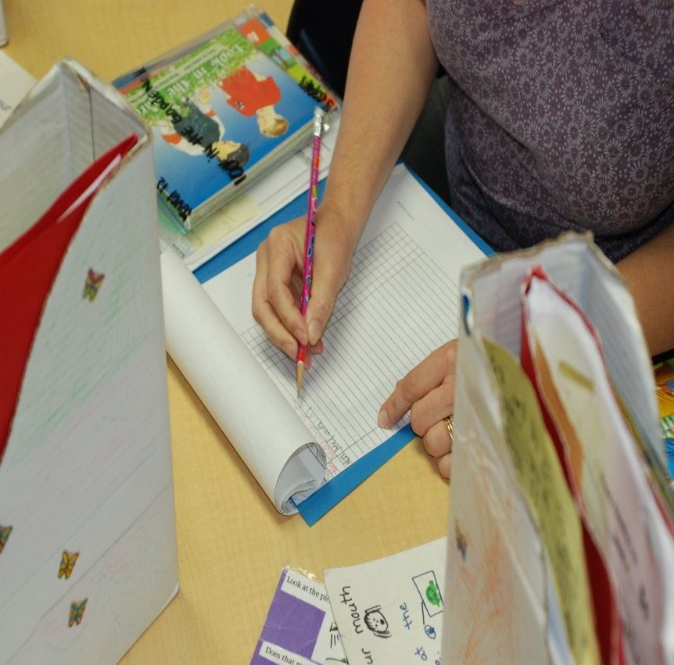
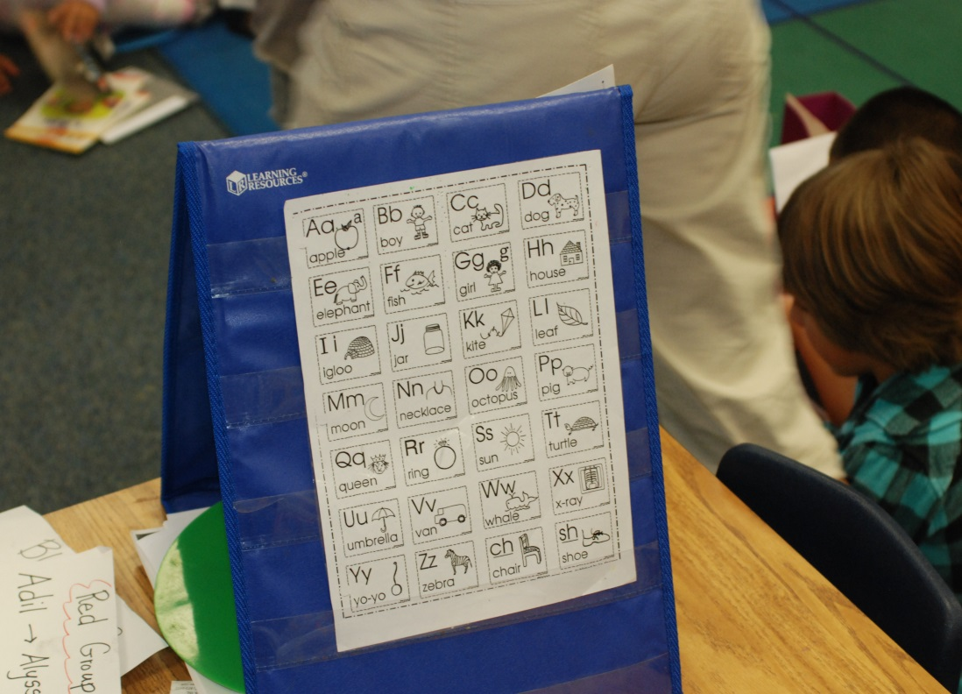

Slide 30
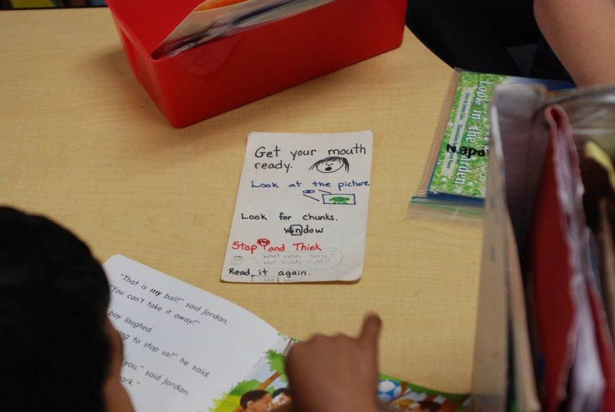
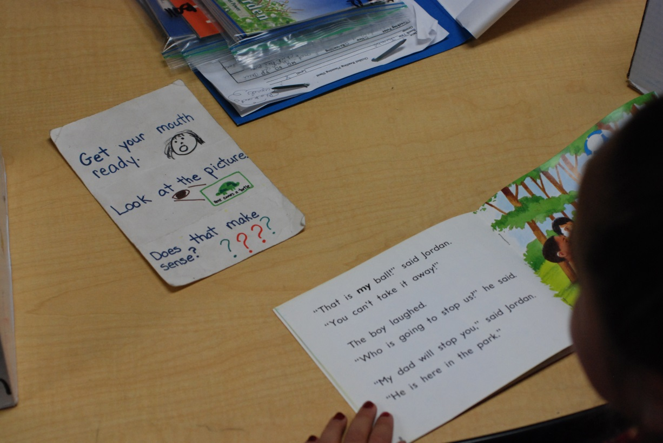

Slide 31
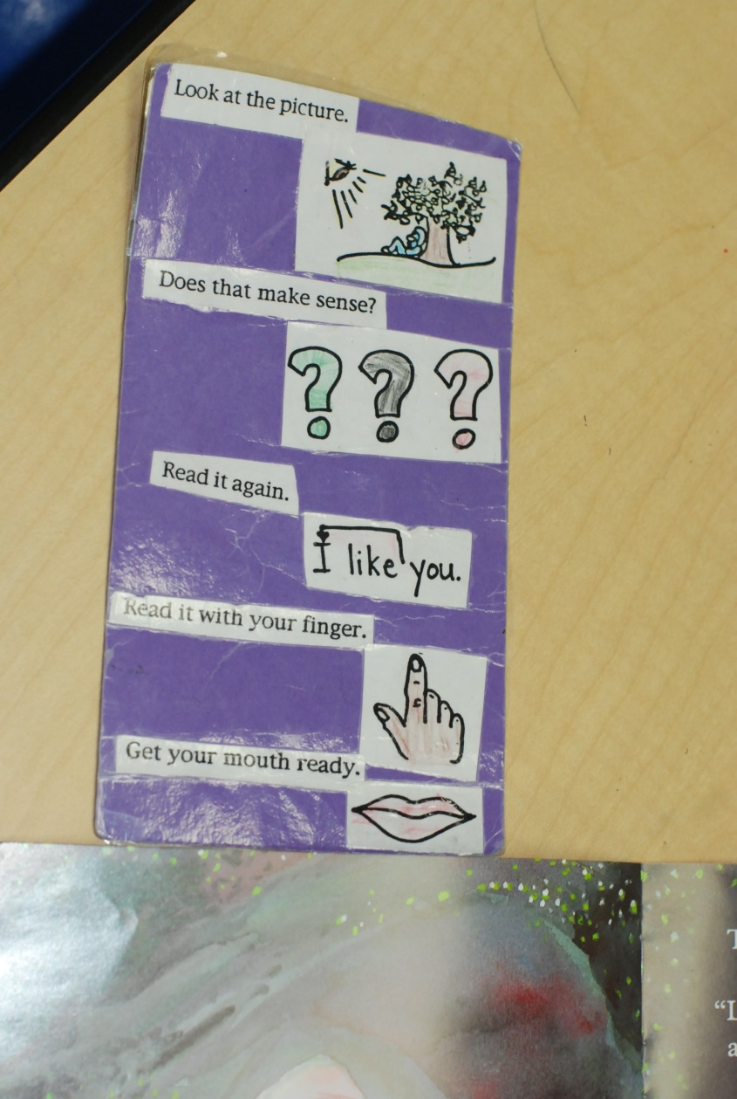
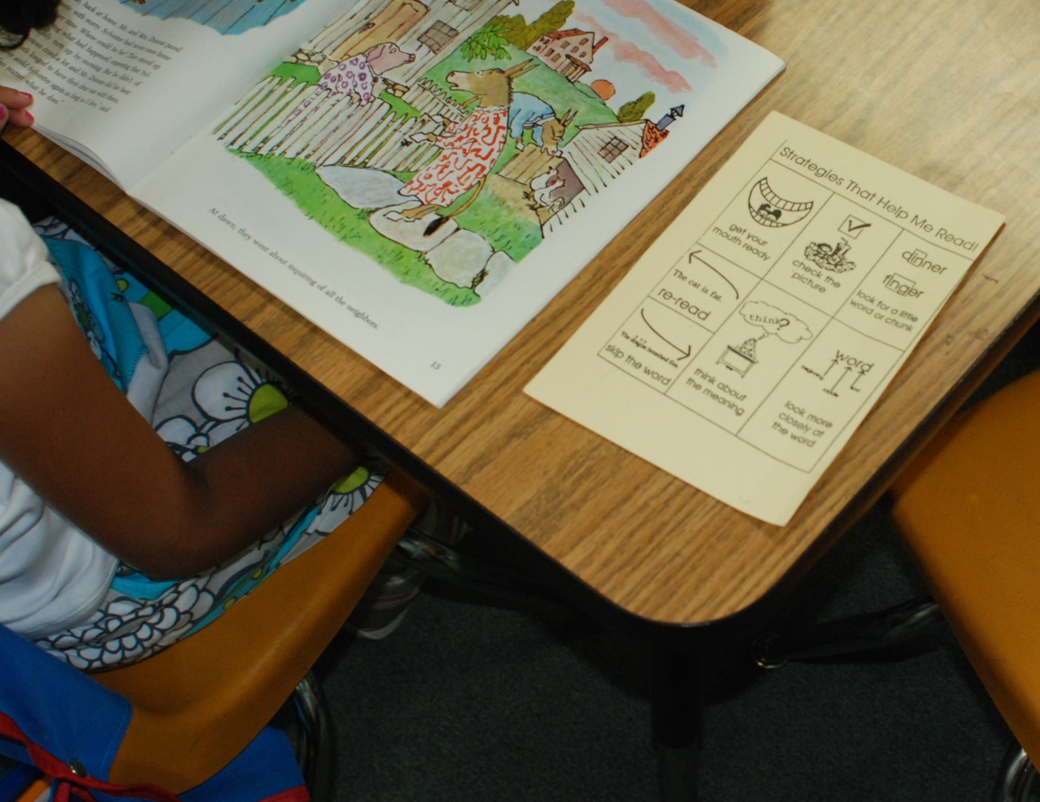

Slide 32
Why and how should we monitor the progress of beginning readers?

Slide 33
TIME TO PLAN

Slide 34
Q & A
Evaluations

