Slide 1
ELA PL LEADERSHIP January 13, 14, 15, 2015

Slide 2
CORE READY by Pam Allyn
K-2 and 3-6 Breakouts
Lesson Structure Focus
Please sit in grade level table groups
Notes:
Handout check:
Zweirs stems, to choose one

Slide 3
Survey Choice Ranked #2
Core Ready Big Picture:
We will examine the components of Core Ready including the opportunities for academic conversation.

Slide 4
Survey Choice Ranked #3
Core Ready Rubrics:
We will unpack the Core Ready Rubrics against the standards and plan for their practical use including Speaking and Listening rubrics for assessing academic conversation.

Slide 5
Survey Choice Ranked #1
Core Ready Lesson Structure:
We will take a close look at the lesson
structure, purpose, delivery, and academic conversation opportunities.
Participants will also design daily and weekly schedules.
Notes:
Time, patience, piano to guitar
3 years in San Juan – 2nd year focusing on delivering the mini-lesson

Slide 6
Plan for our session time addressing
Structure, Delivery, AC, Scheduling:
1. Handout, Info, Reading
2. Collaborative table discussion
3. Record and share out understandings
4. Repeat
Notes:
Permission to learn as going along
GENRE STUDY
Especially in Reading lessons – not basic comprehension strategy

Slide 7
Protocols for
Collaborative table discussion
See “Building Ideas: Knowledge & Solutions”
2. Optional - choose from Create and Clarify Zweirs stems
Notes:
Permission to learn as going along
GENRE STUDY
Especially in Reading lessons – not basic comprehension strategy

Slide 8
Leadership Opportunities
Consider…
What protocol(s) might you take back?
Or tweak and take back?

Slide 9
PURPOSE
Review CCSS descriptors
Notes:
why do we teach this way: purpose of instructional shift

Slide 10
STRUCTURE
Study Literacy Block Graphic
whole, small, whole
Notes:
1-3 days for a lesson
Read ahead in gray, think about what needed to be front-loaded
2 ways to look at the whole small whole 1) block sheet 2) zoom in to architecture with stems

Slide 11
DELIVERY
Compare and Contrast
Study lesson delivery as illustrated in example from Lucy Calkins’ The Art of Teaching Reading
Notes:
Compare and contrast Judi’s sheet
TONE – writers to writers innovators, learning, supporting
Teachers as facilitators, sage on stage guide on the side
Framework for LOVE, JOY

Slide 12
ACADEMIC CONVERSATION
OPPORTUNITIES
Where are they in a lesson?
Notes:
3 places = try, independent, share

Slide 13
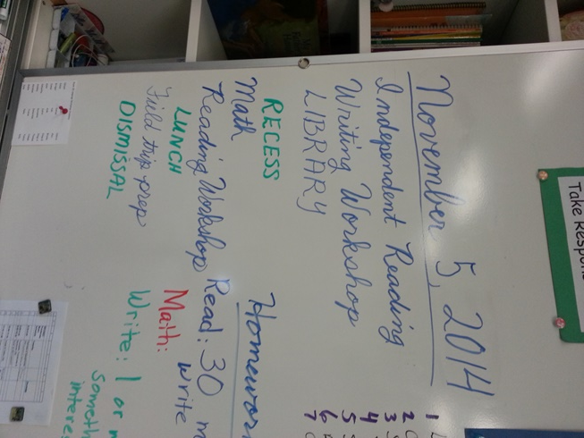
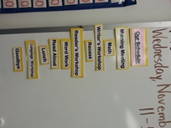
SCHEDULING – DAILY & WEEKLY
Note: Wednesday is this school’s early out day, so afternoon read aloud and science or social studies or PE are not listed.
Notes:
Check framework for “daily”
Photos to drop in
“Out of scope”
Don’t take whole group through it them through what they already know, small group when needed

Slide 14
Leadership Opportunities
What protocol(s) might you take back?
Or tweak and take back?

Slide 15
NEXT TIME
Put your idea/need on a post-it
If necessary, I will send a new survey

