Slide 1
Digital Library Resources

Slide 2
Purposes of the Digital Library
Provide teachers with resources to build their formative assessment practice to support student growth and success.
Provide teachers opportunities to engage in collegial conversations regarding teaching and learning.

Slide 3
Digital Library
Features of Resources

Slide 4
Vetted Resources
All resources in the Digital Library are reviewed by educators using a set of Quality Criteria developed by experts in English language arts/literacy and mathematics; the formative assessment process; instruction for diverse learners including English language learners, students with disabilities, and students with gifts/talents; educational technology; and adult learning.

Slide 5
Thumbnail Preview
When educators enter the library, they see resources in thumbnail view.
Some of these resources have been highly rated by the educators reviewing them and have a green check mark of distinction.

Slide 6
Thumbnail Preview (cont.)
The thumbnail preview provides educators with images of the resources to better understand their form and format.
Educators can also see summaries of the resources, the content addressed, the grade level for which the resources are targeted, and the media formats that are used.

Slide 7
Thumbnail Preview (cont.)

Slide 8
Resource Card
Teachers can use filter, sort, or search features to find the resources they need.
Once educators select a resource, they access the resource card, which includes information provided by the contributor, such as:
The specific formative strategies the resource emphasizes and the research that supports these strategies
The standard or standards the resource addresses
The supporting evidence for the effectiveness of the resource

Slide 9
Resource Card (cont.)

Slide 10
Rating Resources
Educators can rate resources and share their experiences using them with other Digital Library users.

Slide 11
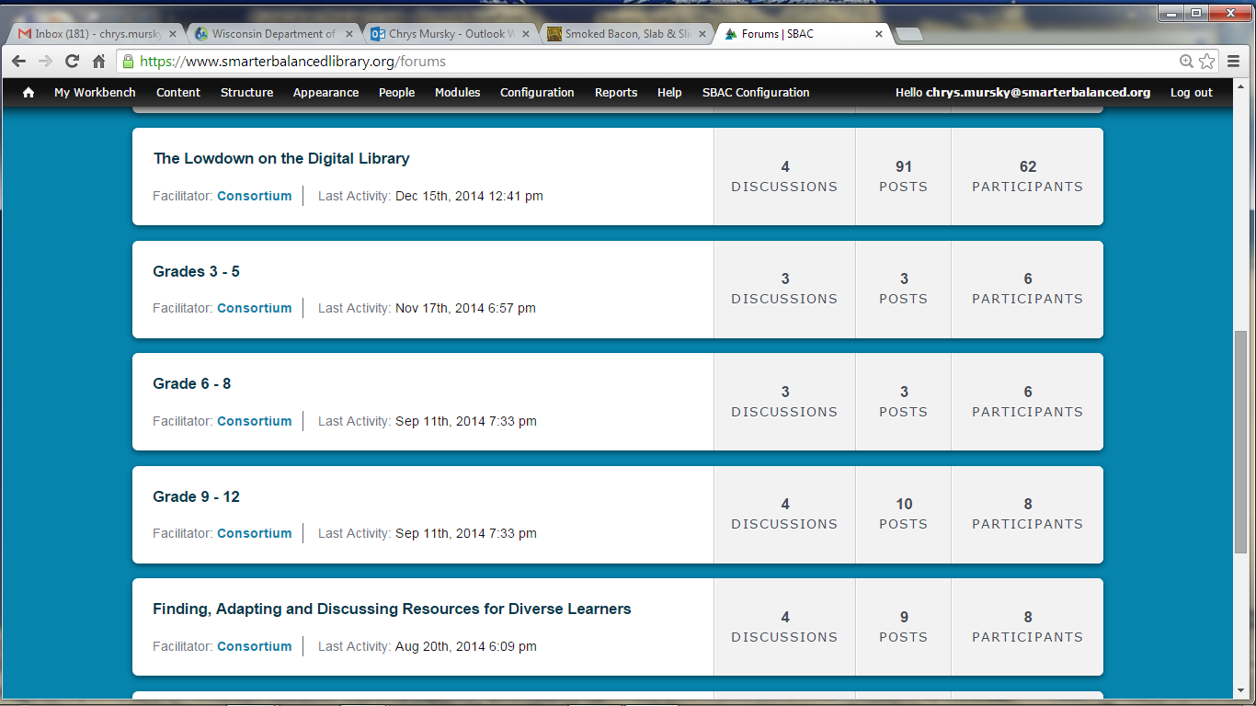
Forums
Educators can also collaborate and share their knowledge with other educators by participating in forums.

Slide 12
Digital Library
Sample Resources

Slide 13
Sample Resource #1: Understanding the Individual Student Assessment Accessibility Profile (ISAAP)
Some of the modules in the Digital Library help teachers use the Smarter Balanced assessment system more effectively.
The ISAAP module describes an optional resource that can help educators plan which of the available tools, supports, and accommodations will best meet the needs of each of their students for both the summative and interim assessments.

Slide 14
Sample Resource #1: ISAAP Module
View the module by clicking on the following link:
Individual Student Assessment Accessibility Profile (ISAAP) Module

Slide 15
Sample Resource #2: Pythagorean Theorem: Act On Evidence
Interactive instructional mathematics modules in the Digital Library support teachers in implementing the Common Core State Standards for Mathematics (CCSM).
This grade eight resource shows how a teacher acts on a student misconception related to the Pythagorean Theorem and irrational numbers. The teacher identifies the misconception based on evidence collected from student posters, as well as from student conversations. The teacher engages students in a mini-lesson to extend their understanding of irrational numbers as possible measures of length.

Slide 16
Sample Resource #2: Pythagorean Theorem: Act On Evidence
View the module by clicking on the following link:
Pythagorean Theorem: Act On Evidence Module

Slide 17
Sample Resource #3: Characters, Settings, and Major Events: Clarify Intended Learning
Interactive ELA instructional modules in the Digital Library support teachers in implementing the Common Core State Standards (CCSS) for English language arts/literacy.
This kindergarten module focuses on clarifying the intended learning. It demonstrates how teachers can use student-friendly language and familiar texts to clarify the student learning goal.
Students listen to a read-aloud of the folktale The Little Red Hen. They are prompted to identify characters, settings, and major events using the text to support their responses.

Slide 18
Sample Resource #3: Characters, Settings, and Major Events: Clarify Intended Learning
View the module by clicking on the following link:
Characters, Settings, and Major Events: Clarify Intended Learning Module

