Slide 1
Tools for Success: Application of UDL and Accommodations to Support ALL Students in the CCSS
Presented By:
Linda Mangum, Courtney Coffin, Melissa Ferrante
SCUSD Inclusive Practices Coaches

Slide 2
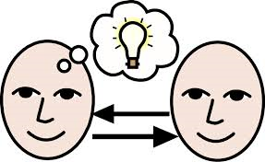
Share one strategy you are using to facilitate
Academic Conversations
to reach ALL learners.
Notes:
Introduce yourself. Discuss question, then ask for a few responses. Share partner’s response.

Slide 3
Necessary Skills
Fine motor/writing skills
Comprehension, reasoning, and processing
Reading skills
Basic math skills
Organization, executive functioning skills
Behaviors that support learning, i.e. attention skills, on-task skills
Speaking and Listening
Notes:
Do we all agree that these are all skills that students need to succeed and meet the standards…
Are these the skills we want all students to have mastered to be Career and College ready?
PLACEMENT???

Slide 4
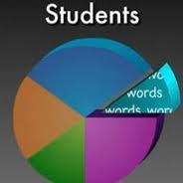
California’s Learning Population
http://www.youtube.com/watch?v=7odhYT8yzUM
Notes:
Stop after 1:47 after Einstein quote WOW!
Discussion format?

Slide 5
But what about those students who need more???
Accommodations:
A change in what or how something is being presented or represented
Does not alter or change the outcome or expectation
Does not require an IEP
Grading is the same
Looks a lot like UDL…
Notes:
Discuss I Have a Student Who…. Handout
Point out Core Ready Binders Pam Allyn (sentence starters, meet needs of diverse learners and EL)
Its just good teaching… cannot be used interchangeably with the word MODIFICATION
GIVE ONE< GET ONE: examples of accommodations….. This will clarify understanding.

Slide 6
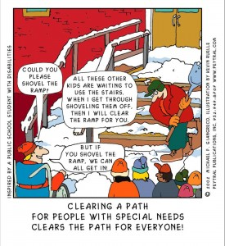
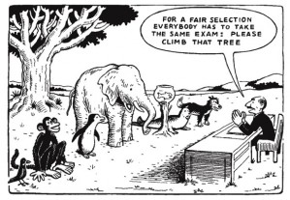
Universal Design for Learning Benefits Everyone!
Notes:
Respond to a comic/quote……

Slide 7
What is UDL?
UDL gives all individuals equal opportunities to learn.
UDL provides a blueprint for creating instructional goals, methods, materials, and assessments.
It’s not a single, one-size-fits-all solution, but rather flexible approaches that can be customized and adjusted for individual needs.
Notes:
Handout for One Size Fits All
Discussed BEM
NEED TO LOOK AT THE LESSON BEFORE HAND
Need to know your students (accomm checklist or other tools)
Need to understand UDL and accomm on IEP

Slide 8
Why is UDL Necessary?
Individuals bring a huge variety of skills, needs, and interests to learning.
Neuroscience reveals that these differences are as varied and unique as our DNA or fingerprints.
Notes:
12-22% of students have some sort of cognitive, behavioral, or emotional difference. These are students with AND without IEPs

Slide 9
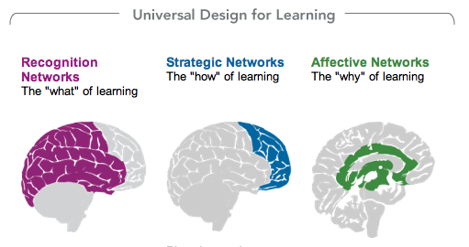
How we gather facts and categorize what we see, hear, and read. Identifying letters, words, or an author's style are recognition tasks.
Planning and performing tasks. How we organize and express our ideas. Writing an essay or solving a math problem are strategic tasks.
How learners get engaged and stay motivated. How they are challenged, excited, or interested. These are affective dimensions.
Notes:
Introduce the WHEELS, UDL handout

Slide 10
Using a curriculum that is rooted in the 3 UDL principles:
Teachers Provide: | Students Have:
Flexible ways of presenting lesson content. (WHAT) | Options for how they learn.
Flexible methods of expression and assessment. (HOW) | Choices for how they demonstrate their knowledge and learning.
Flexible options for student engagement. (WHY) | Choices which will engage student interest.
Notes:
Providing thoughtful choices based on student need and differences. Set the parameters.
Wheels

Slide 11
UDL is for ALL Students
UDL is a framework to support the variability of learners that exist in all classrooms.
This includes gifted students, disengaged students, students with disabilities, students who are English learners, and even the mythical average student.
Notes:
Todd Rose Learner Variability 10:13 minutes TED TALK
NOTE TAKING PAGE!!

Slide 12
Academic Conversation About Todd Rose Video
At your tables, use the stems provided to have an academic conversation about the video.
Make sure you address all three questions:
Implications of “myth of the average learner”
What is variability and why is it important?
Why is the “myth of the average” harmful to our educational system
Be prepared to share 1-2 insights from your table
Notes:
TAPIN
3 Step discussion: think to yourself as you watch the video, discuss at your tables with an AC, report out to the group (N)
Im going to give you 5 minutes to discuss the video in an academic conversation format (T, A)
Use the stems provided to guide your conversation. Use wall and table stems for reference. (I)
Make sure you address all three questions (I)
Be prepared after 5 minutes to share insights from your group (select a spokesperson or volunteer answers) (I, P)
Is everyone clear on the instructions? Recap from 1-2 audience members (I)
Explicitly discuss:
3 step discussion
TAPIN
Use of anchor charts and teaching/mastering one set of stems at a time.
Need for both near and far point charts for reference

Slide 13
Keep all these Things in Mind…
Mythical Average Student
Notes:
Keep all these things in mind…
All levels: Gate, EL, sped, the mythical average

Slide 14
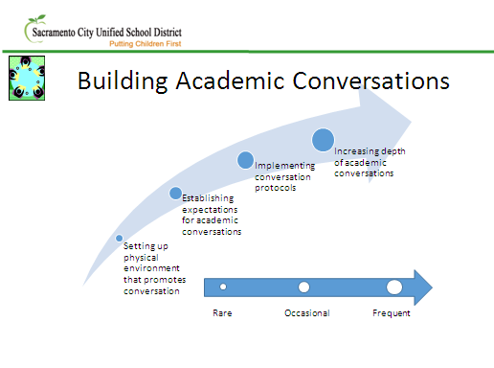
Notes:
Activity: Big sticky
Poster for each area
Groups of 2-4, brainstorm supports in each area.

Slide 16
Building Academic Conversations
Physical Environment:
Strategic use of heterogeneous and homogeneous groupings (see establishing expectations page)
Use of engaging group selections
Color cards
Clock appts
“Meet me at…”
Visible Sentence Frames
Wall charts
Personal task cards, table charts
“Literacy bath”: Provide environment and walls free of clutter with intentional placement of wall décor, stems, supports , etc to increase accessibility for students
Strategic placement of furniture and groupings
Transition protocols (explicitly taught and practiced)
Protocols in place for when students are absent or other surprise factors
Notes:
Compilation of ideas from participants throughout the week……

Slide 18
Building Academic Conversations
Establishing Expectations for AC
Visuals for conversations skills, anchor charts
Explicitly teach conversation skills: eye contact, body posture, tone, etc
Explicitly teach how to have a back and forth conversation where content builds and is not a string of isolated ideas
Modeling and role play
Video demonstrations
“Fishbowl” observations
Debrief and feedback opportunities
Strategic partners and groupings
Sentence frames and starters (explicitly taught, practiced and modeled)
Video students and use for critique
Notes:
Compilation of ideas from participants throughout the week……

Slide 20
Building Academic Conversations
Implementing Conversation Protocols
Color code the 4 quadrants; develop consistent colors across the grade levels
“Re-voicing” and validating common language with more academic language
Focus on student-selected stems;
Student created charts and cards for AC
Actively teach and practice specific stems for mastery before moving on to others
Create a “sentence stem” wall of mastered frames that the class can own.
Cross-grade Peer Buddies
Incentives and reinforcement for using AC stems correctly
Practice with comfortable, known material and topics
Conversation protocols (implemented and taught one at a time)
The Huddle
2 Cents
1, 3, 6 (https://www.teachingchannel.org/videos/1-3-6-protocol )
Pencil Activity: all pencils go in center of table and only the person who picks up their pencil may speak. Students continue around the table until all have picked up their pencil and added to the conversation (similar to 2 cents)
Fishbowl
Use of whiteboards (for reluctant speakers) show vs tell
EEKK (eye to eye, knee to knee)
Notes:
Compilation of ideas from participants throughout the week……

Slide 22
Building Academic Conversations
Increasing Depth of AC
Continue evaluating skills and supports, reassess groupings
Visuals for conversations skills
Modeling, role play, and video demonstrations
“Fishbowl” observations
Asking text specific questions
Play devil’s advocate
Teach language to respectfully disagree
Provide text/materials that allow opportunity for depth and multiple perspectives
Provide topics that are interesting and engaging to students to practice with
Create opportunities and environments that promote a growth mindset
Less direct instruction, more student-led conversations
Use AC for formative assessments
Notes:
Compilation of ideas from participants throughout the week……

Slide 23
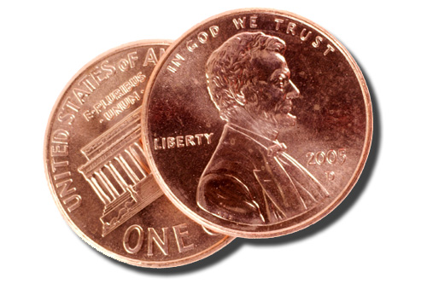
Give your TWO CENTS…
Notes:
In your table groups, give your “two cents” about how to infuse new strategies and supports to your academic conversations.

Slide 24
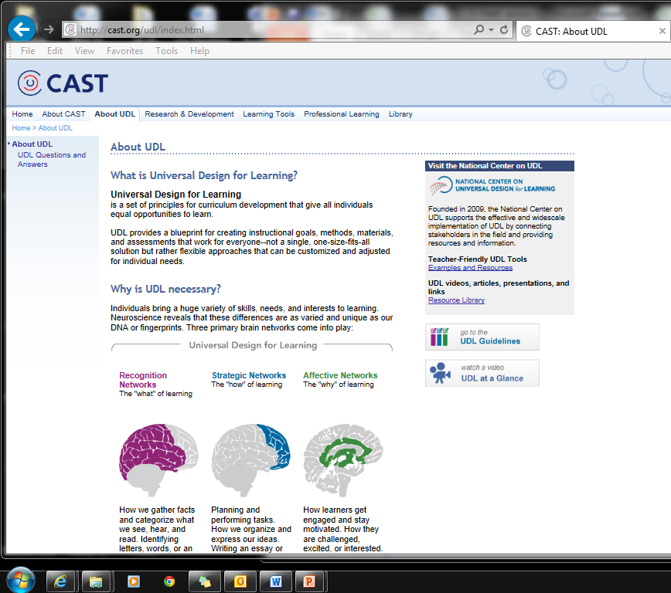
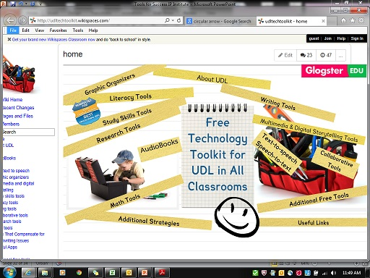
http://cast.org/index.html
http://udltechtoolkit.wikispaces.com/
Notes:
Also discuss

Slide 25
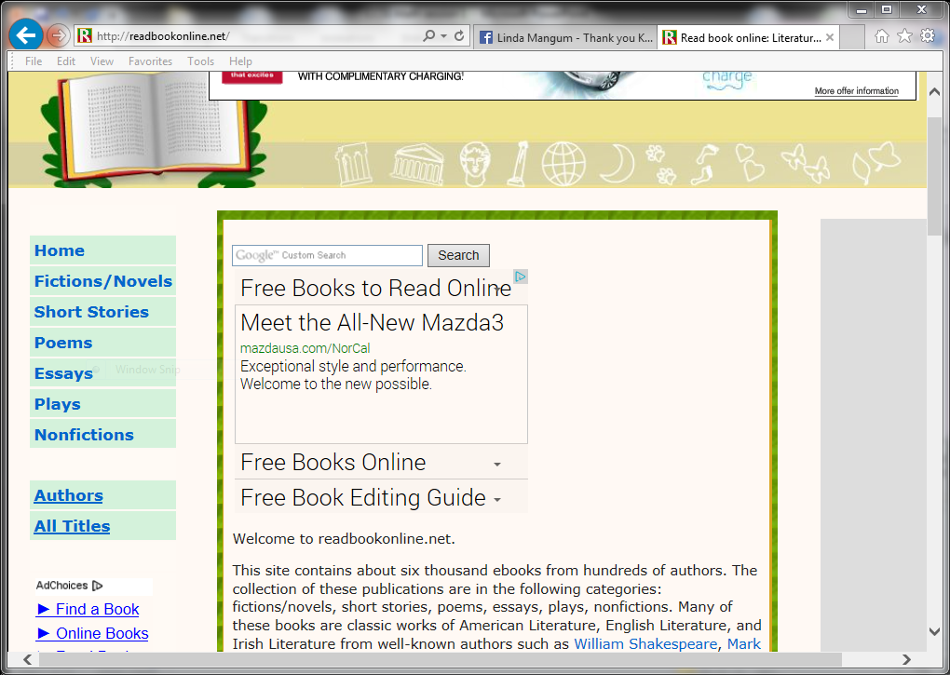
Multiple Means of Representation, Expression and Engagement
www.bookshare.org
www.readbookonline.net
Notes:
Bookshare, readbookonline.org, sparknotes,

Slide 26
Multiple Means of Representation, Expression and Engagement
www.newsela.com
Online source for expository text in multiple lexile levels
www.sparknotes.com

Slide 27
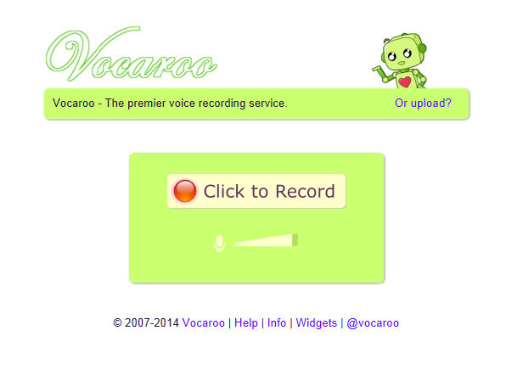
Multiple Means of Expression and Representation
Voice recording that can be emailed and shared. www.vacaroo.com
Text-to-speech technology
Notes:
TO……
Use it within your class or use it as a planning tool.

Slide 28
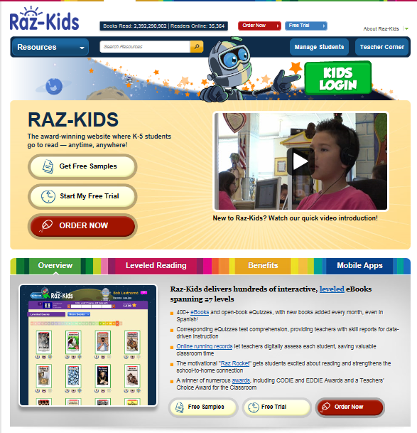
Multiple Means of Representation, Expression and Engagement
www.raz-kids.com
Online source for elementary Scholastic books in multiple lexile levels with a comprehension component
www.mobymax.com
CCSS based interactive learning system

Slide 29
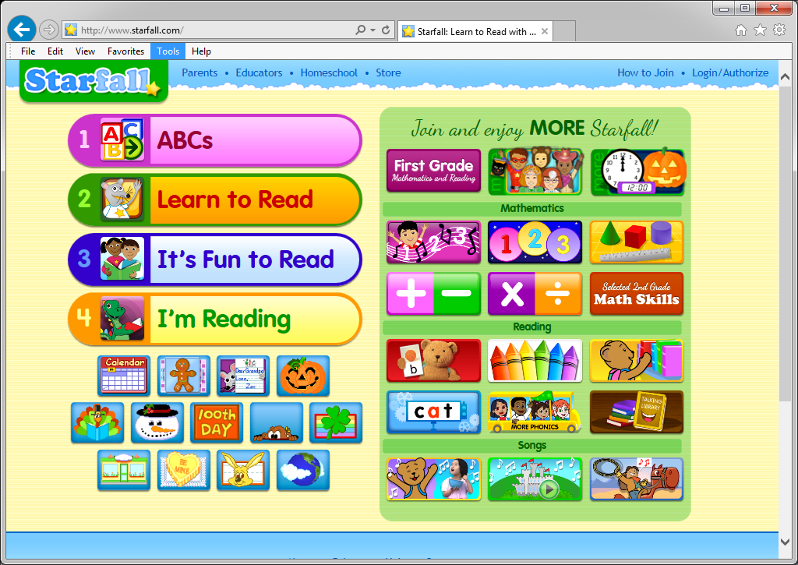
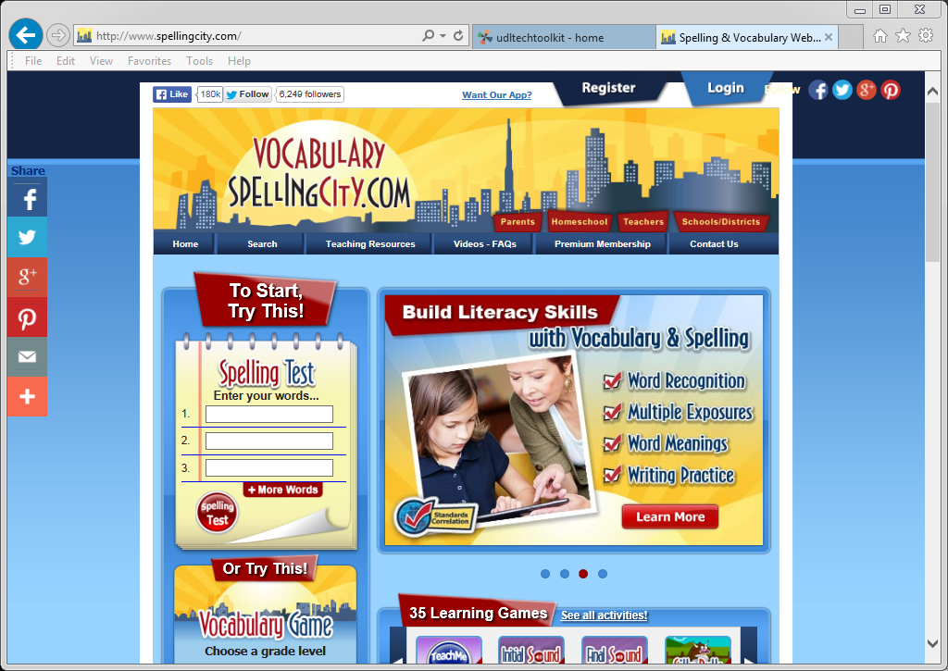
Multiple Means of Representation, Expression and Engagement
www.starfall.com
www.spellingcity.com

Slide 30
Thank you for attending. Please fill out feedback sheet before leaving.
“SCUSD Inclusive Practices”
articles, resources and videos related
to teaching.

Slide 31
References:
UNIVERSAL DESIGN FOR LEARNING:
http://cast.org//
http://www.udlcenter.org/
Hall, Tracey, Meyer, Ann, and Rose, David. Universal Design for Learning in the Classroom. New York, New York: Guillford Press, 2012
http://www.youtube.com/watch?v=7odhYT8yzUM
http://www.youtube.com/watch?v=8WClnVjCEVM
ACCOMMODATIONS
http://www.cehd.umn.edu/nceo/TopicAreas/Accommodations/Accomtopic.htm
http://www.ncld.org/students-disabilities/accommodations-education/accommodations-include-iep-504-students-ld
https://www.teachervision.com/special-education/printable/5596.html

