Slide 1


Moving Beyond Right and Wrong:
Using Contrastive Analysis to Teach Language
CCSS ELA – ELD Breakout
March 12
S

Slide 2
PURPOSE and OUTCOMES
Discuss rule-based language learning
Learn one strategy, contrastive analysis, for making the rules of language, contexts, genres, etc. explicit

Slide 3

Language and culture
Language is the road map of culture. It tells you where its people came from and where they are going.
-Rita Mae Brown

Slide 4
The Framework
Ch. 1 Introduction
Ch. 2 Key Considerations
Ch. 3 Grades TK-1
Ch. 4 Grades 2-3
Ch. 5 Grades 4-5
Ch. 6 Grades 6-8
Ch. 7 Grades 9-12
Ch. 8 Assessment
Ch. 9 Access and Equity
Ch.10 Learning in the 21st Century
Ch. 11 PL, Leadership, and Program Support
Ch. 12 Guidance for Instructional Materials
Notes:
Grade level teacher can dig in. More extensive discussion on read-alouds.
Disciplinary literacy.
Overview where five themes (circles on turtle) are discussed more specifically for span and grade level

Slide 5

Read the excerpts from Chapter Nine of the CA ELA/ELD Framework
Be prepared to discuss with a partner:
How does this reading challenge or affirm
your thinking about language
your experiences with teaching and learning language?

Slide 6

Jamila Lyiscott
Poet and Educator
TED Talk
Notes:
Grade level teacher can dig in. More extensive discussion on read-alouds.
Disciplinary literacy.
Overview where five themes (circles on turtle) are discussed more specifically for span and grade level

Slide 7


Slide 8
TED Talk
In your table group, discuss:
What was Jamila Lyiscot’s purpose in creating this performance?
What are some of the language choices she made and why?

Slide 9
An approach to language that is based on making choices according to context (or topic, audience, and purpose) can be universally helpful in the classroom, for example:
What type of language should I use to write this note to my advocacy teacher?
What type of language should I use to compose this poem?
Which transition words should I use I use to connect my ideas in this biography? In my personal essay?

Slide 10
Integrated & Designated ELD:
Working in Tandem
Both/And
Integrated ELD: All teachers with ELs in their classrooms use the CA ELD Standards in tandem with the CA CCSS for ELA/Literacy and other content standards.
Designated ELD: Teachers use the CA ELD Standards as the focal standards in ways that build into and from content instruction.
Notes:
I’ve been hearing interesting things like We’ve decide to do integrated ELD– but it’s not a choice
ANY teacher with an EL in their classroom- is=using the ELD standards
A specific time during the day where we are taking alser-like focus of the ELs using the ELD standards as the focal standards. It is NOT isolated language instruction- it MUST build into and from what is happening the rest of the day. Chapter two describes this piece. Explained in depth in 2 ans each grade level chapters and multiple vignettes Don’t just tell us what it is, we want to see what it looks like.
Figures : complex because this stuff is really complex..
The relationship between integrated ELD, where the CA ELD Standards are used during content instruction, and designated ELD, where the CA ELD Standards are used as the focal standards, is a close one. Designated ELD builds into and from content instruction.
Use the CA ELD Standards as a lens or guide for:
Routinely examining texts and tasks
Identifying opportunities for highlighting and discussing language
Observing students’ language use
Adjusting instruction
Understanding EL students’ language learning needs
Addressing the language students need to develop for success in school tasks
Identifying opportunities for delving deeper into language
Continuously linking language learning to content knowledge

Slide 11
Contrastive Analysis Compares Two or More Things
Thing A Thing B
Noticing patterns and rules in text examples Noticing same and contrasting/comparing

Slide 12
Contrastive Analysis Compares Two or More Things
Primary Language (foreign) English
English Primary Language (foreign)
English Dialect (AAVE, Chicano English) Standard English
Standard English English Dialect (AAVE, Chicano English)
Everyday English Academic English
Personal memoir Informational report
Etc.
Noticing patterns and rules in text examples Noticing same and contrasting/comparing

Slide 13
Designated ELD Lesson
SPANISH ENGLISH
When I was little, I was falling a lot.
When he was in night school, my dad was doing homework every night
In the fourth grade, we were writing all the time.
Before she moved, my grandmother was hugging me every time she saw me.
RULE:
When I was little, I fell a lot.
When he was in night school, my dad did homework every night.

Slide 14
Designated ELD Lesson
HMONG ENGLISH
I have many brother and sister.
My uncle has two car.
All the student got into trouble.
I did three page of math.
RULE:
I have many brothers and sisters.
My uncle has two cars.

Slide 15
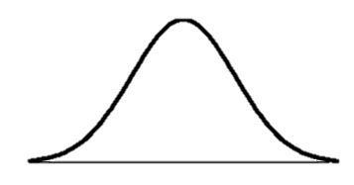
Personal Narratives
Climax
Rising Action
Falling Action
Exposition
Resolution
Story Arc
1st Person Point of View
Figurative Language
Mood/Tone

Slide 16
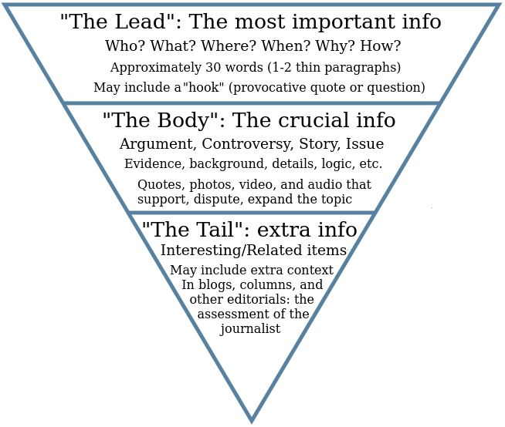
Most common speaker tags, i.e. use these whenever possible:
Said
Asked
“Objective” modifiers only, e.g. blue, retired, four, etc.

Slide 17

Using Rules to Teach Genres
Create an account of a video you’ll watch that is written according to your designated genre.
Share your account with another.
How is it similar?
How is it different?
Can your partner guess some of the rule of your genre?

Slide 18
Integrated ELD Lesson
Personal narrative News story

Slide 19
Think-Table Group-Share
Review your handouts and notes from this session and ponder this question:
How might you teach differently as a result of this breakout?
Is there anything form this breakout that you might be able to share wit others?
Be ready to share.

