Slide 1


Academic Conversations in the Common Core Classroom
Elementary
ELA Leadership Institute
Session 2
January 2015

Slide 2
PURPOSE and OUTCOMES
Review basic principles and dimensions of Academic Conversations
Learn several strategies for teaching students to facilitate conversations in teacher-like ways
Read about a strategy for creating engaging prompts.

Slide 3
Creating an understanding of the role of academic conversations in 21st century learning
“To build a foundation for college and career readiness, students must have ample opportunities to take part in a variety of rich, structured conversations—as part of a whole class, in small groups, and with a partner. Being productive members of these conversations requires that students contribute accurate, relevant information; respond to and develop what others have said; make comparisons and contrasts; and analyze and synthesize a multitude of ideas in various domains.” Notes on Speaking and Listening, CCSS Anchor Standards

Slide 4
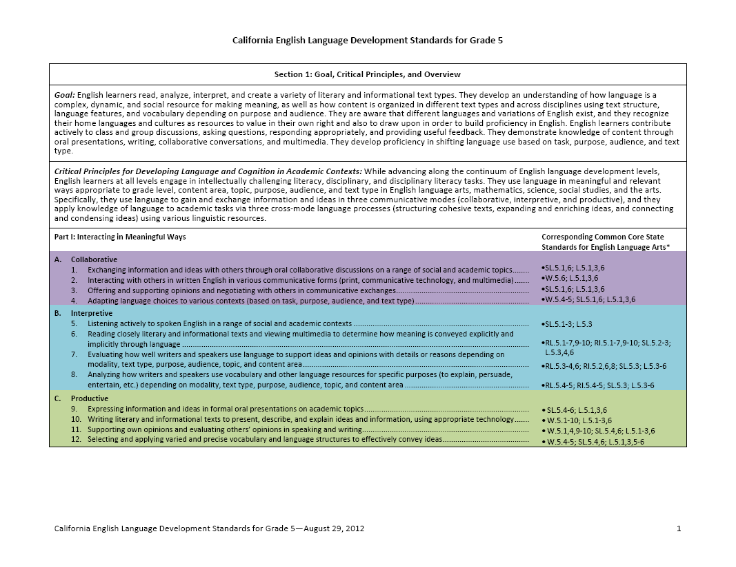
The New California ELD Standards
Part I: Interacting in Meaningful Ways
Part II: Learning About How English Works
Collaborative: Exchanging information and ideas with others through collaborative conversations. Offering and supporting opinions and negotiating with others.
Interpretive: Evaluating how well writers and speakers use language to support ideas and
opinions with details or reasons.

Slide 5
Building Academic Conversations
Establishing expectations for academic conversations
Implementing conversation protocols
Increasing depth of academic conversations
Setting up physical environment that promotes conversation
Rare Occasional Frequent

Slide 6
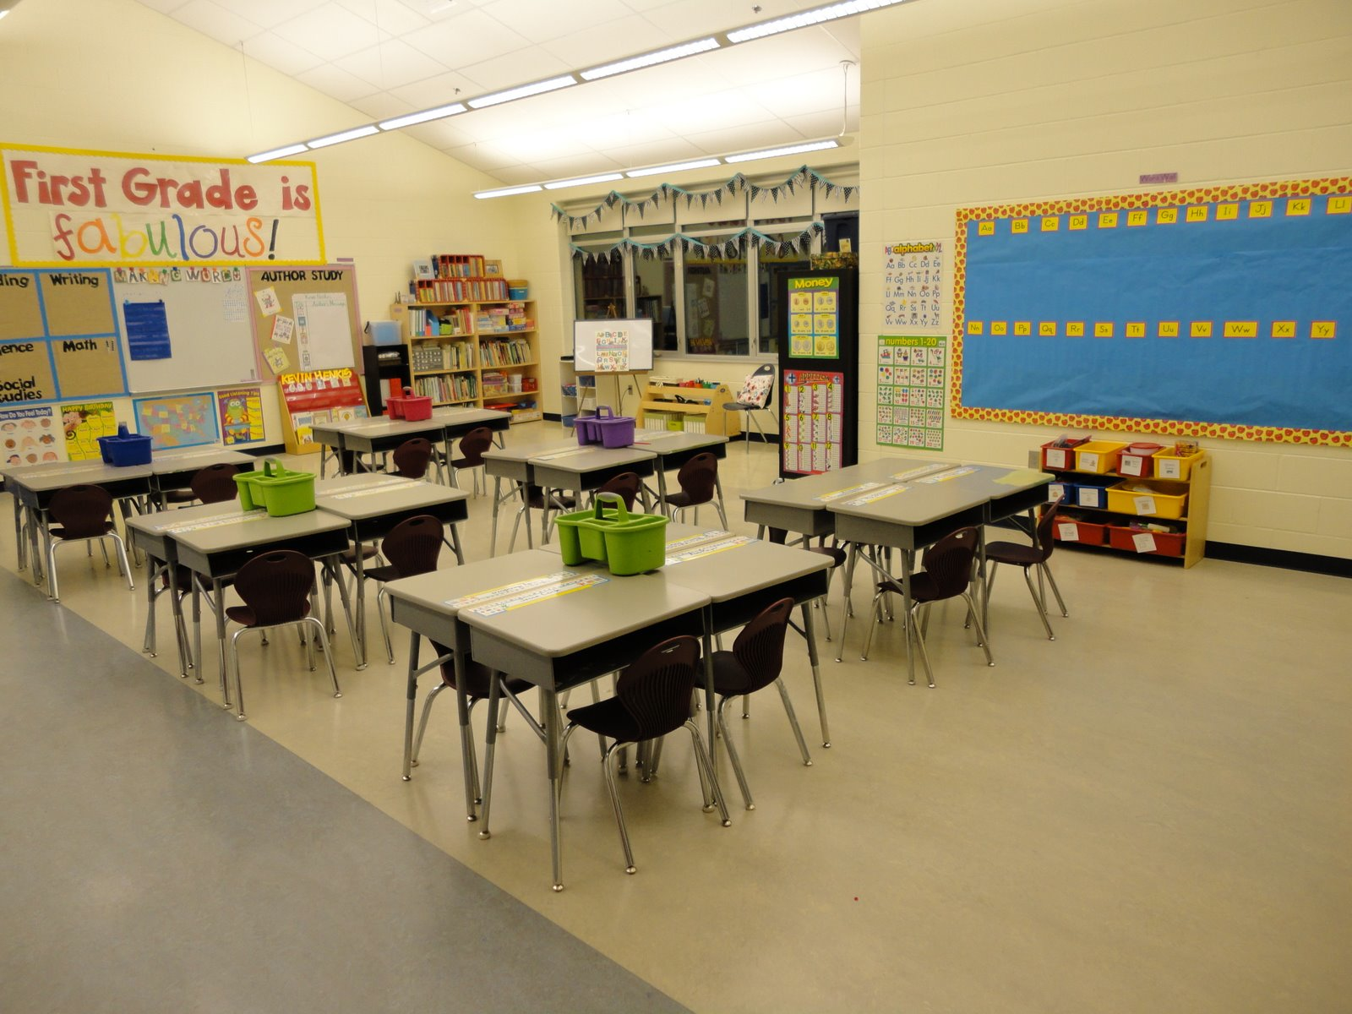
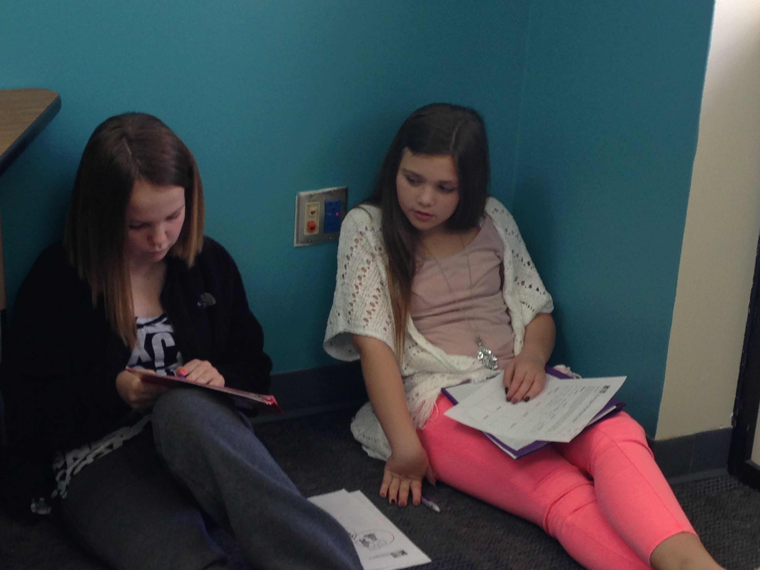
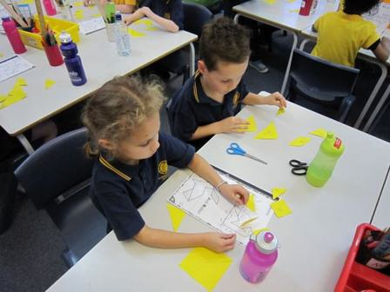
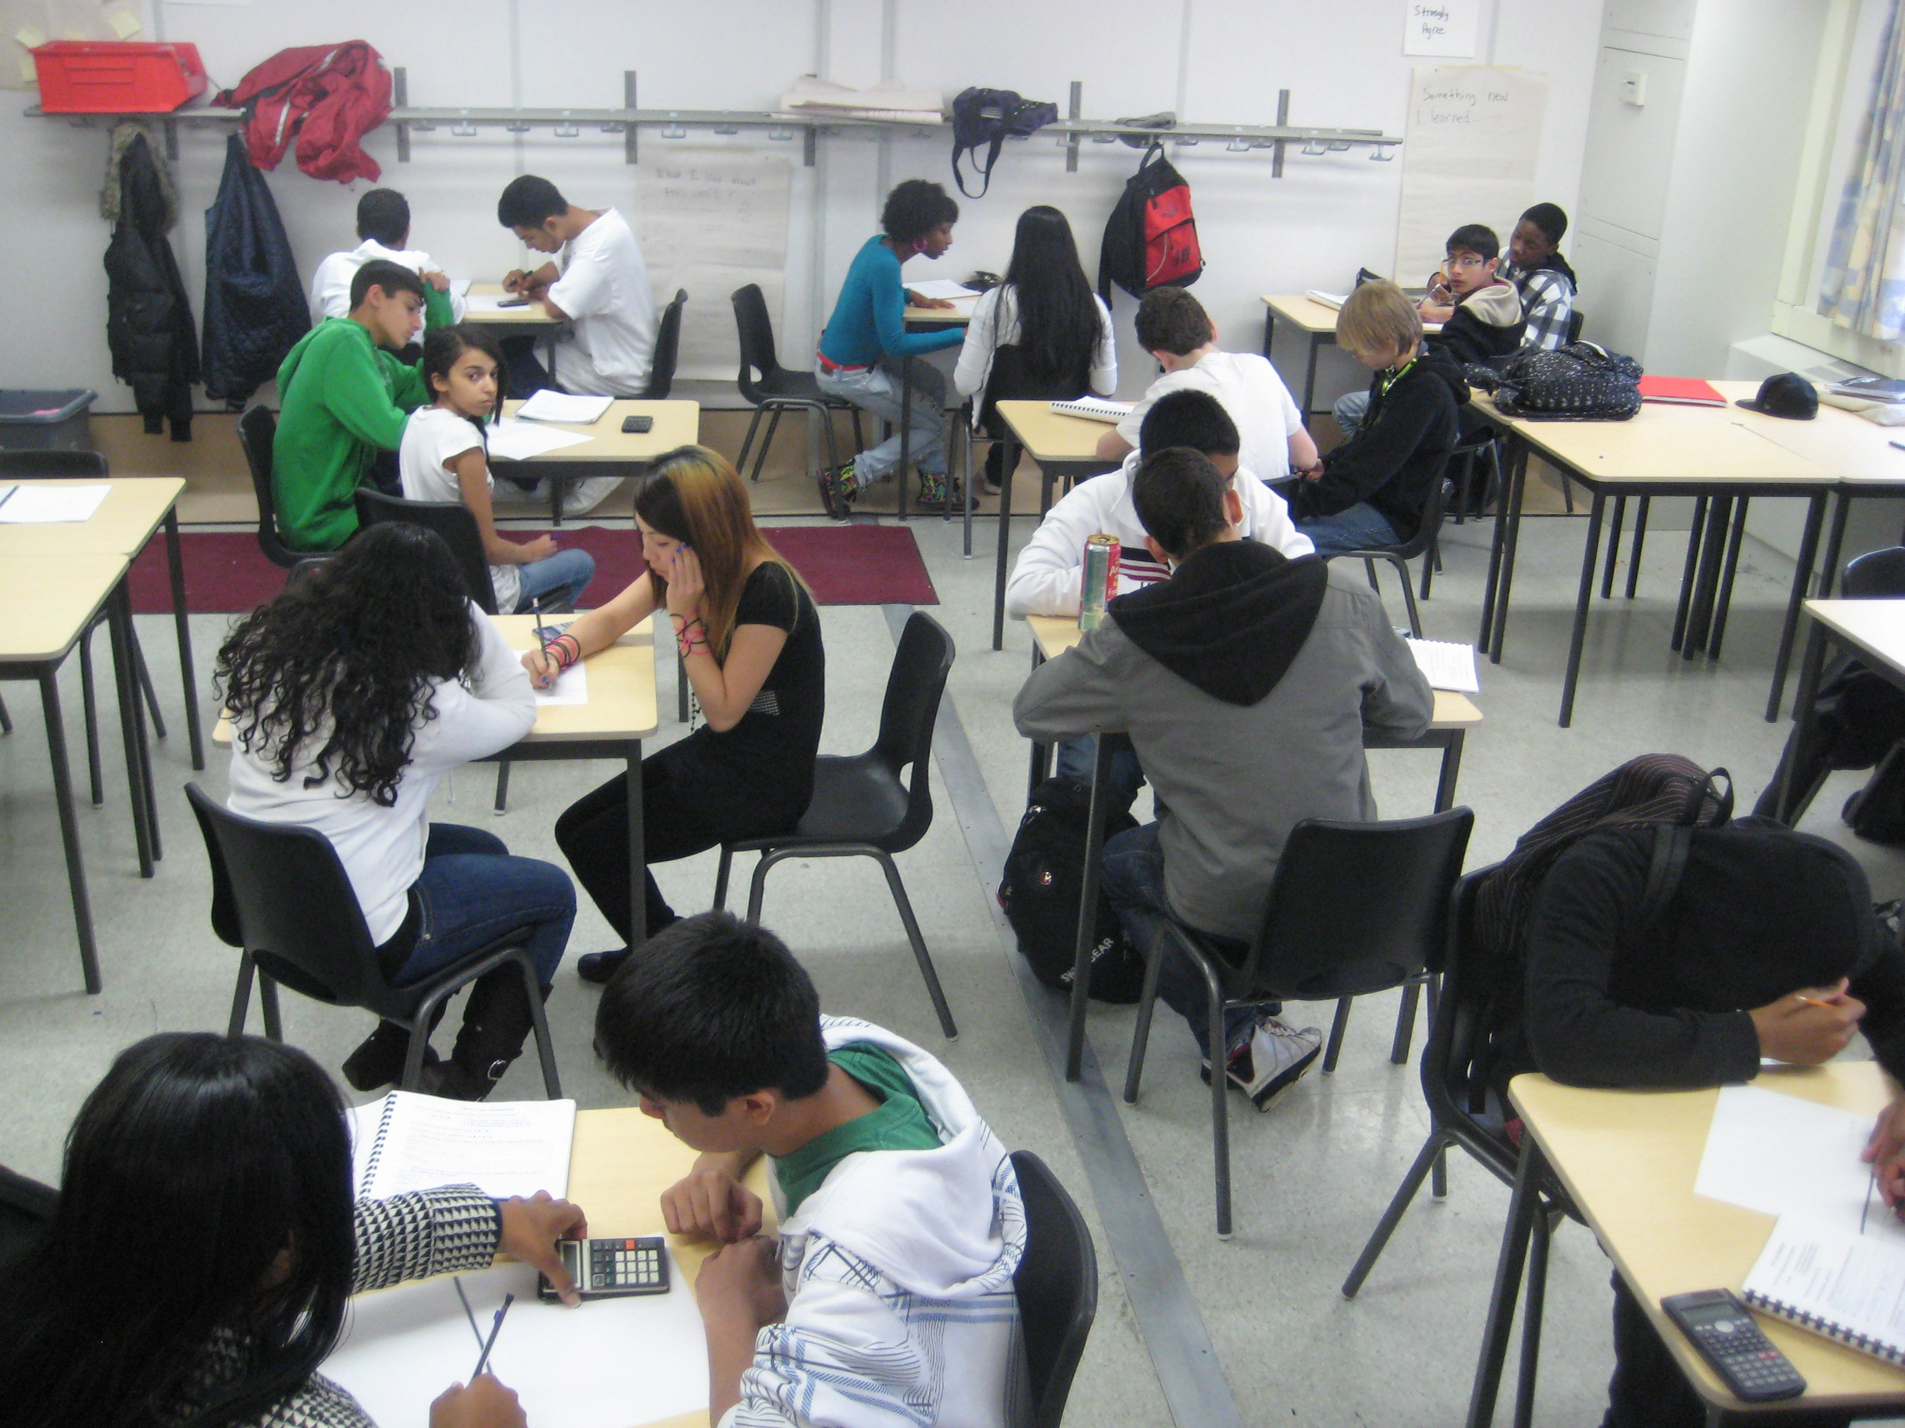
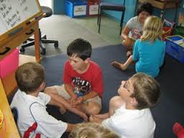
Setting Up the Physical Environment

Slide 7
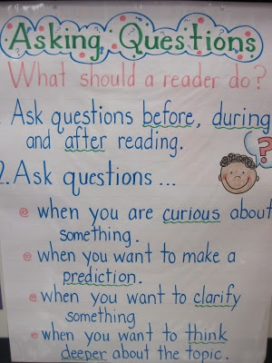
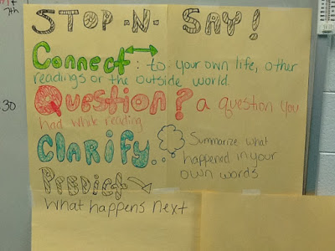
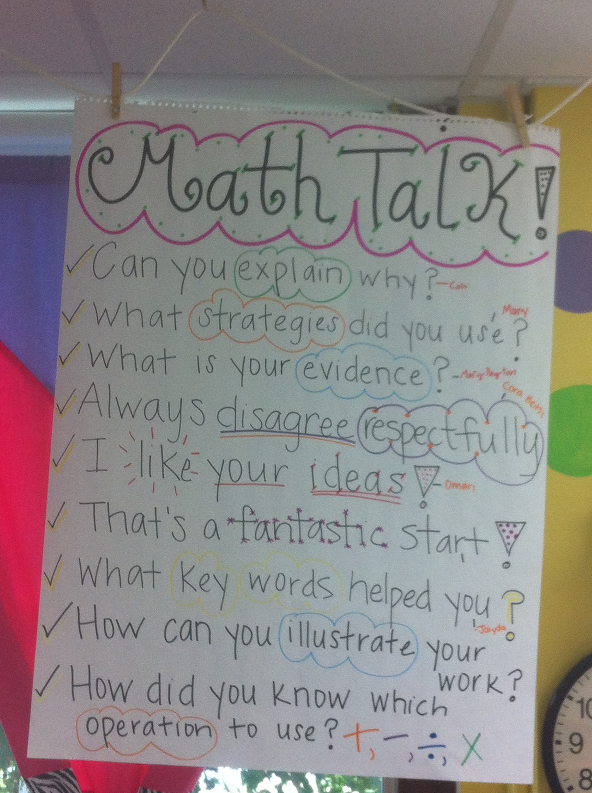
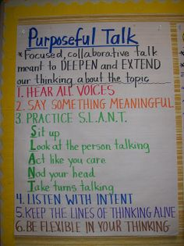
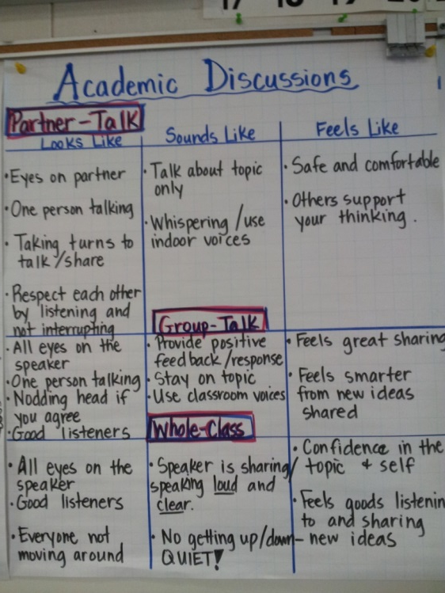
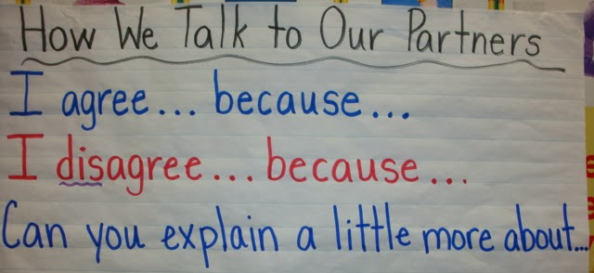
Establishing Expectations for Academic Conversations

Slide 8
Building Academic Conversations
Establishing expectations for academic conversations
Implementing conversation protocols
Increasing depth of academic conversations
Setting up physical environment that promotes conversation
Teaching students to facilitate conversations in teacher-like ways
Creating clear and engaging prompts
Rare Occasional Frequent

Slide 9
Increasing Depth of Conversations
Depth of Knowledge/Levels of Complexity
Recall/Reproduction – Recall a fact, information, or procedure; process information on a low level
Skill/Concept – Use information or conceptual knowledge, two or more steps
Strategic Thinking – Requires reasoning, developing a plan or a sequence of steps, more than one reasonable approach
Extended Thinking – Requires connections and extensions, high cognitive demands and complex reasoning, creation
(

Slide 10
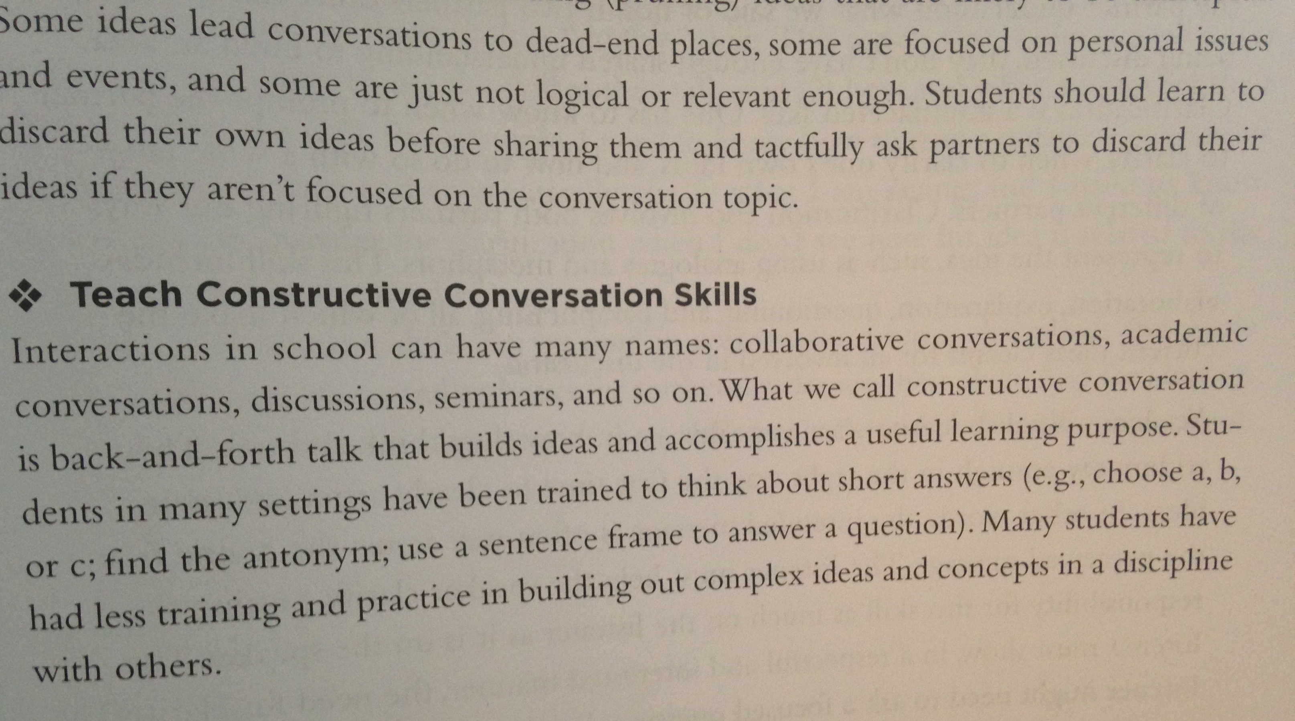
Increasing Depth of Conversations
Teach students to facilitate conversations in teacher-like ways
Briefly review the book excerpt and poster on constructive conversation skills to refresh our memory of the facilitation skills that teachers use.

Slide 11

Increasing Depth of Conversations
Three strategies: jigsaw reading
Form a triad
Assign each member a reading task:
  A (pp 9-10) Ways to model academic conversations
  B (pp 11-12) Using content observers
  C (pp 13-14) Using rubrics with students
Read and annotate to include your interpretations of the reading that you’d like to share
Every member shares their content, interpretation, and the implications for practice for teachers

Slide 12
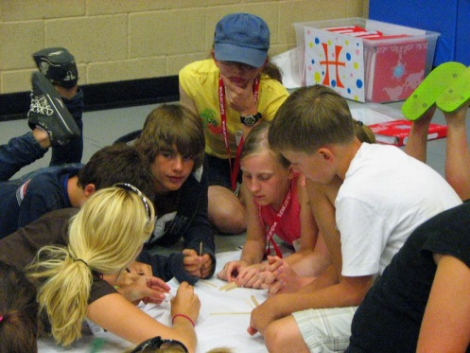
Increasing Depth of Conversations with Clear and Engaging Prompts
One way to increase depth of conversation is through clear and engaging prompts that require complex thinking and “real world” applications.
Read the excerpt entitled “Clear and Engaging Purposes for Conversations
Briefly discuss its content with your group.
Next, choose a K-5 Reading Standard for Informational Text and try creating a conversation prompt that would address the standards AND a “real world” application.
Be prepared to share your thought process and prompt.

Slide 13
Think-School Team-Share
Review your handouts and notes from this session and ponder this question:
What is one action you can take immediately to improve the quality or quantity of academic conversations in your classroom? Be prepared to discuss why you chose this action and how you will undertake it.

